Slide 1


UNIT 18
What's your
phone number?
Lesson 3

Slide 2

1. Listen and repeat
re'peat | Can you re'peat that?
en'joy | She en'joys the party.
in'vite | They in'vite me to go for a picnic.
com'plete | We have to com'plete the sentences.
Can you re'peat that?
They in'vite me to go for a picnic.
She en'joys the party.
We have to com'plete the sentences.

Slide 3

2. Listen and circle. Then say the sentences aloud.
1. I ___________ my English lesson.
a. enjoy b. invite
2. I want to ___________ some friends to my party.
a. begin b. invite
3. They ___________ playing badminton.
a. repeat b. enjoy
4. Now ___________ the sentence with these words.
a. complete b. repeat

Slide 4
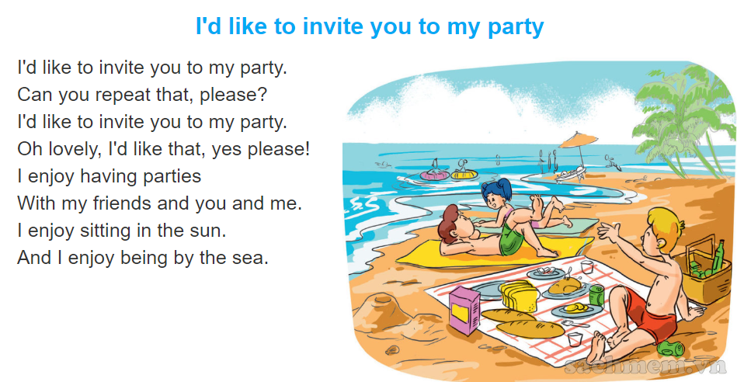

3. Let's chant.

Slide 5

4. Read and tick
At weekends, Tom often goes for a picnic with his family in the countryside. He wants to relax and enjoy the scenery. He likes playing sports and games, and he enjoys taking photographs with his mobile phone. He also likes cooking lunch for his family.
 | True | False
1. Tom often has picnics with his friends at the weekend.
2. He wants to relax and enjoy the scenery in the countryside.

Slide 6
4. Read and tick
At weekends, Tom often goes for a picnic with his family in the countryside. He wants to relax and enjoy the scenery. He likes playing sports and games, and he enjoys taking photographs with his mobile phone. He also likes cooking lunch for his family.
 | True | False
3. He dislikes playing sports and games.
4. He likes taking photographs with his mobile phone.
5. He loves cooking for his parents and sister.

Slide 7
5. Let's write.
On Sundays, I often _______________.
I want to __________________.
I like _____________________.
I enjoy ___________________.
I love ____________________.

Slide 8
6. Project
Ask four classmates for their phone numbers.
Then tell the class about them.
 | Name | Phone number
1
2
3
4

