Slide 1

Unit 17
What would you like to eat?
Lesson 2

Slide 2

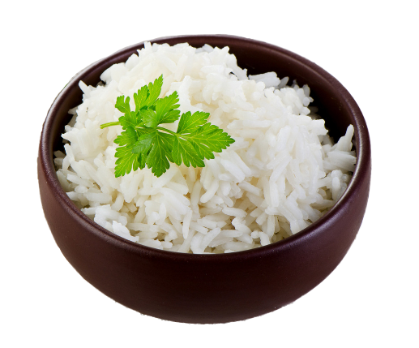
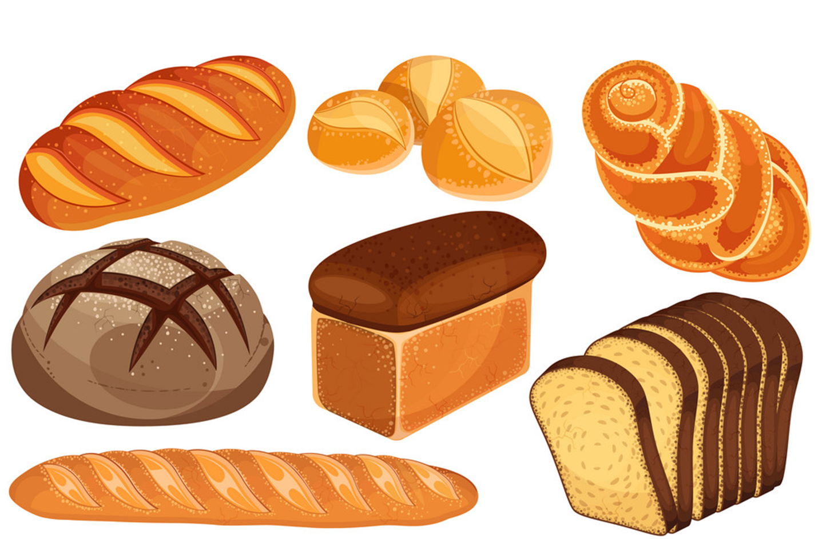
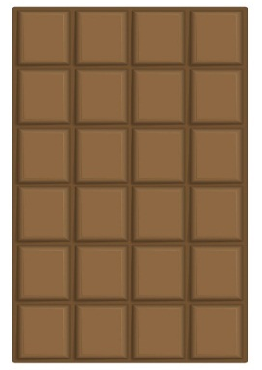
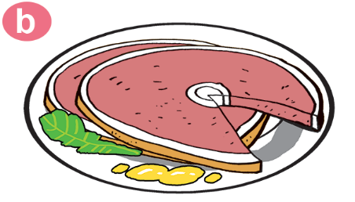
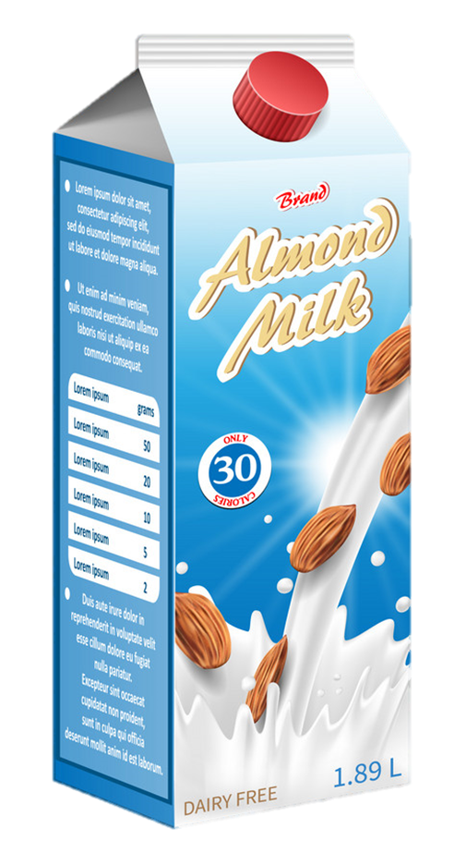


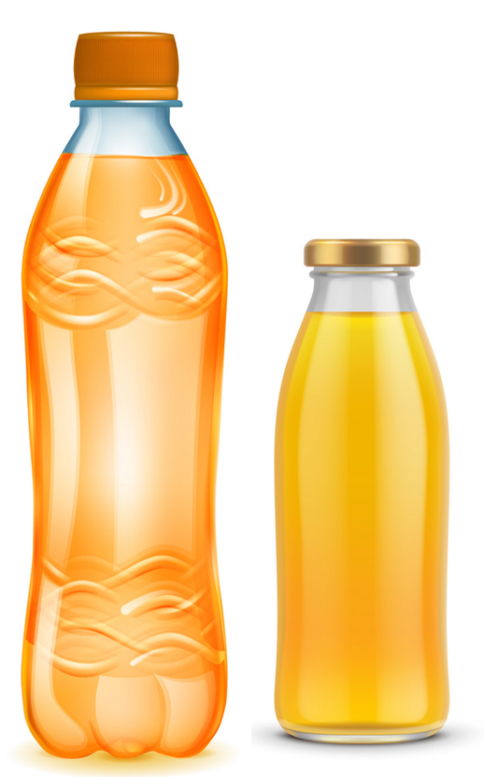
Vocabulary
Uncountable nouns
rice
bread
meat
chocolate
milk
water
juice
lemonade

Slide 3
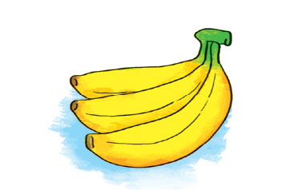

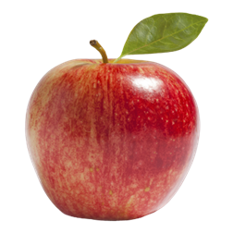
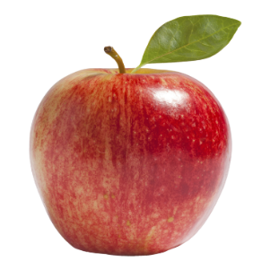
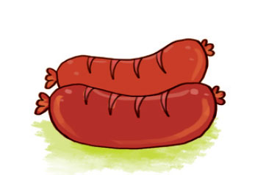
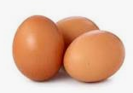
Countable nouns
Vocabulary
bananas
tomatoes
apples
eggs
sausages

Slide 4
GRAMMAR

Slide 5
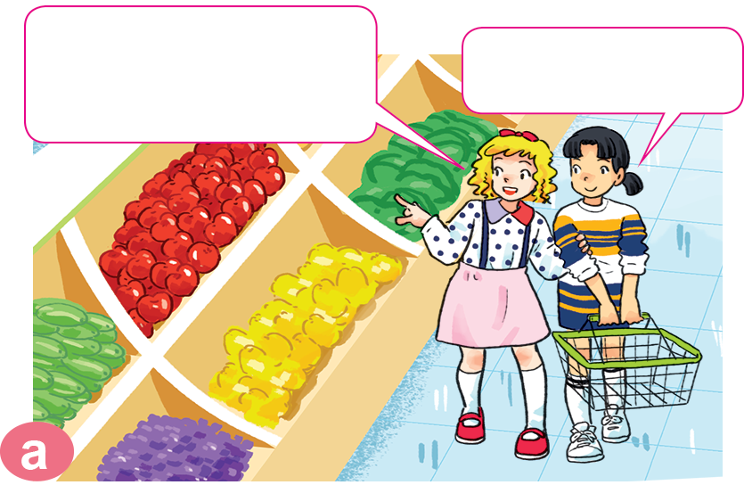
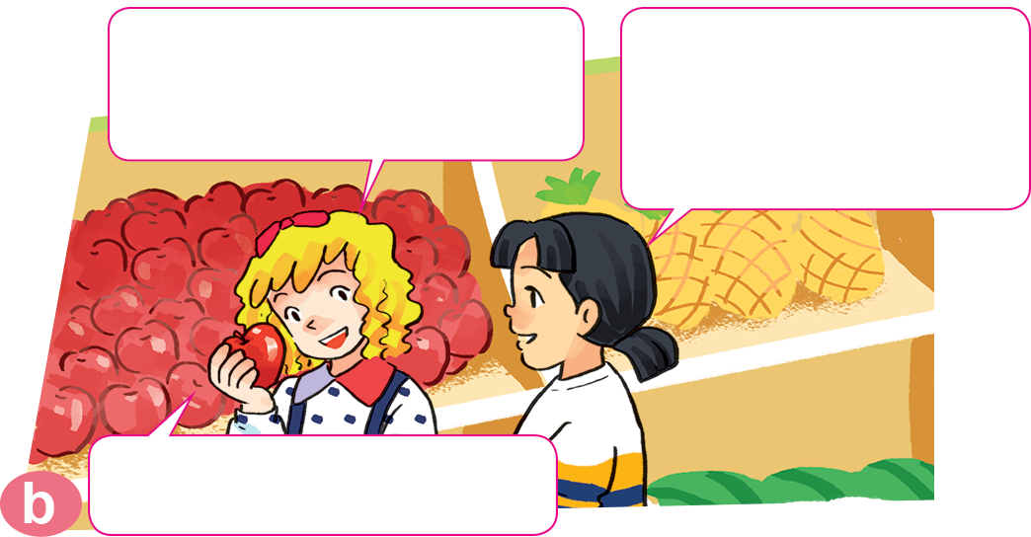

1. Look, listen and repeat.
The apples look very fresh.
I like apples.
How many apples do you eat every day?
Two. I'm thirsty. Where can we
get some drinks?
They're over there.

Slide 6
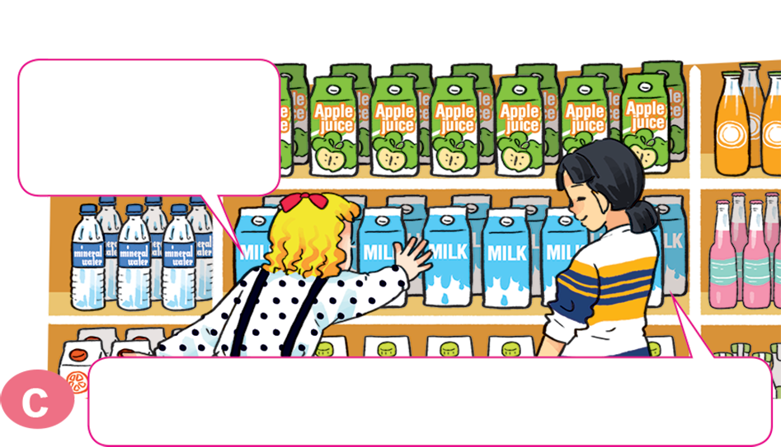
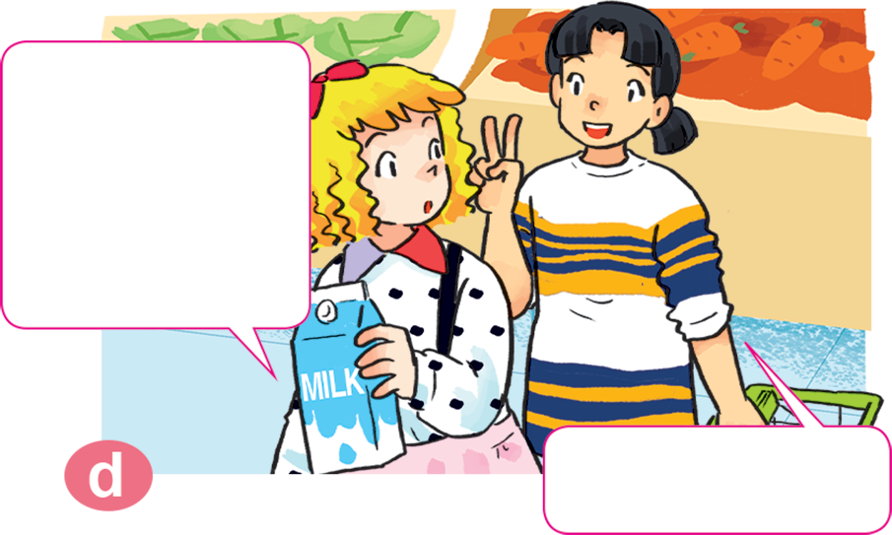
1. Look, listen and repeat.
How much milk do you drink every day?
Do you like milk, Mai?
Yes, I do. It's my favourite drink.
Two glasses.

Slide 7


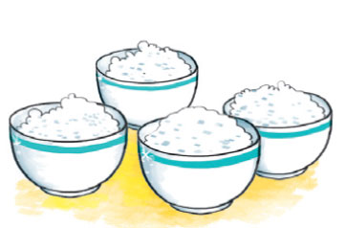
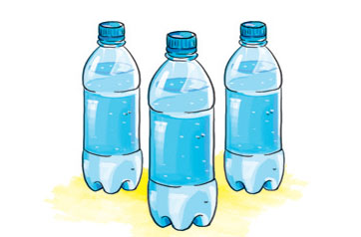
Structure:
How much/ How many _____ do you eat / drink every day?
I eat / drink _____.
How many + countable nouns
How much + uncountable nouns

Slide 8

2. Point and say.
How many _________ do you eat every day?
bananas
I eat _____________________.
three bananas

Slide 9
2. Point and say.
How many _________ do you eat every day?
sausages
I eat _____________________.
two sausages

Slide 10
2. Point and say.
How much _________ do you eat every day?
rice
I eat _____________________.
four bowls

Slide 11
2. Point and say.
How much _______ do you drink every day?
water
I eat _____________________.
three bottles

Slide 12
How many/much _______ do you eat/drink every day?
I eat ______________________.
bananas
water
sausages
rice
three bottles
three bananas
two sausages
four bowls
Ms.Phạm English

Slide 13

3. Let’s talk
How many/much ______ do you
eat/drink every day?
I eat/drink _______.

Slide 14
4. Listen and circle.
1. How many bananas does Tony eat every day?
a. One. b. Two. c. Three.
2. How much rice does Nam eat every day?
a. Two bowls. b. Three bowls. c. Four bowls.
3. How much water does Mai drink every day?
a. Three bottles. b. Four bottles. c. Five bottles.
4. How many sausages does Tom eat every day?
a. One. b. Two. c. Three.

Slide 15
5. Read and complete.
Mai: What do you usually have for breakfast?
Tom: Some bread with butter, sausages, eggs, chocolate and milk.
Mai: (1) _________ sausages and eggs do you have?
Tom: I usually have two sausages and one egg.
Mai: (2) _________ chocolate do you eat?
Tom: One or two bars.
Mai: And how much (3) ______ do you drink?
Tom: A big glass.
Mai: You (4) ___________ eat too many sausages
and chocolate bars.
Tom: Why not?
Mai: Because they're not very (5) _________!
shouldn't
Healthy
How many
milk
How much
How many
How much
milk
shouldn't
healthy

Slide 16


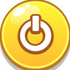


1
1
ant
2
mouse
3
elephant
4
dog
5
fish
6
iguana
7
hen
8
pet
9
Notes:
Ms Huyền Phạm - 0936.082.789 – YOUTUBE: MsPham. Facebook: Dạy và học cùng công nghệ.

Slide 17




Question
1
2
3
4
5
6
7
8
9
10
Time’s up
much
How many/much rice do you eat every day?
I eat three bowls.
Answer
Back
Notes:
Ms Huyền Phạm - 0936.082.789 – YOUTUBE: MsPham. Facebook: Dạy và học cùng công nghệ.

Slide 18
Question
1
2
3
4
5
6
7
8
9
10
Time’s up
many
How many/much bananas do you eat every day?
I eat two bananas.
Answer
Back
Notes:
Ms Huyền Phạm - 0936.082.789 – YOUTUBE: MsPham. Facebook: Dạy và học cùng công nghệ.

Slide 19
Question
1
2
3
4
5
6
7
8
9
10
Time’s up
many
How many/much sausages do you eat every day?
I eat a sausage.
Answer
Back
Notes:
Ms Huyền Phạm - 0936.082.789 – YOUTUBE: MsPham. Facebook: Dạy và học cùng công nghệ.

Slide 20
Question
1
2
3
4
5
6
7
8
9
10
Time’s up
much
How many/much chocolate do you eat a week?
I eat two bars.
Answer
Back
Notes:
Ms Huyền Phạm - 0936.082.789 – YOUTUBE: MsPham. Facebook: Dạy và học cùng công nghệ.

Slide 21
Question
1
2
3
4
5
6
7
8
9
10
Time’s up
much
How many/much water do you drink every day?
I drink two bottles.
Answer
Back
Notes:
Ms Huyền Phạm - 0936.082.789 – YOUTUBE: MsPham. Facebook: Dạy và học cùng công nghệ.

Slide 22
Question
1
2
3
4
5
6
7
8
9
10
Time’s up
much
How many/much milk do you drink every day?
I drink four cartons.
Answer
Back
Notes:
Ms Huyền Phạm - 0936.082.789 – YOUTUBE: MsPham. Facebook: Dạy và học cùng công nghệ.

Slide 23
Question
1
2
3
4
5
6
7
8
9
10
Time’s up
kilo
How much meat do you eat a week?
I eat a kilo/kilos.
Answer
Back
Notes:
Ms Huyền Phạm - 0936.082.789 – YOUTUBE: MsPham. Facebook: Dạy và học cùng công nghệ.

Slide 24
Question
1
2
3
4
5
6
7
8
9
10
Time’s up
does
How many eggs does/do your mother eat a week?
She eats five eggs.
Answer
Back
Notes:
Ms Huyền Phạm - 0936.082.789 – YOUTUBE: MsPham. Facebook: Dạy và học cùng công nghệ.

Slide 25
Question
1
2
3
4
5
6
7
8
9
10
Time’s up
glasses
How much lemonnade does your brother drink a day?
He drinks two glass/glasses.
Answer
Back
Notes:
Ms Huyền Phạm - 0936.082.789 – YOUTUBE: MsPham. Facebook: Dạy và học cùng công nghệ.

