Slide 1
Unit 15 – Lesson 2
What would you like to be in the future?

Slide 2
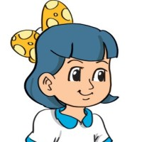

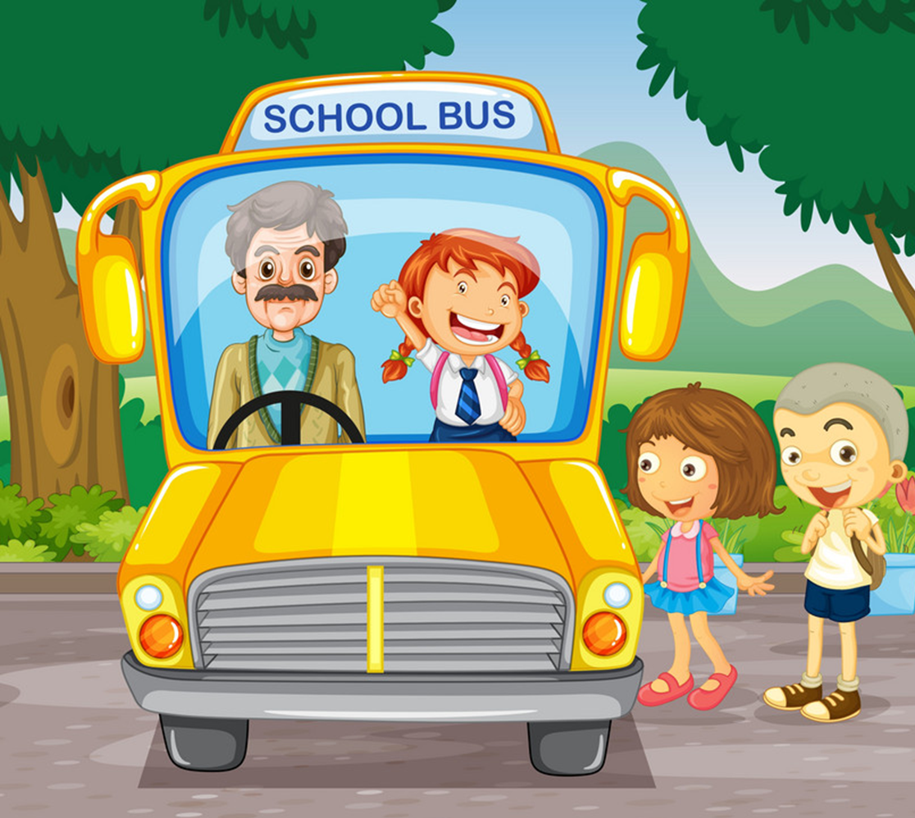
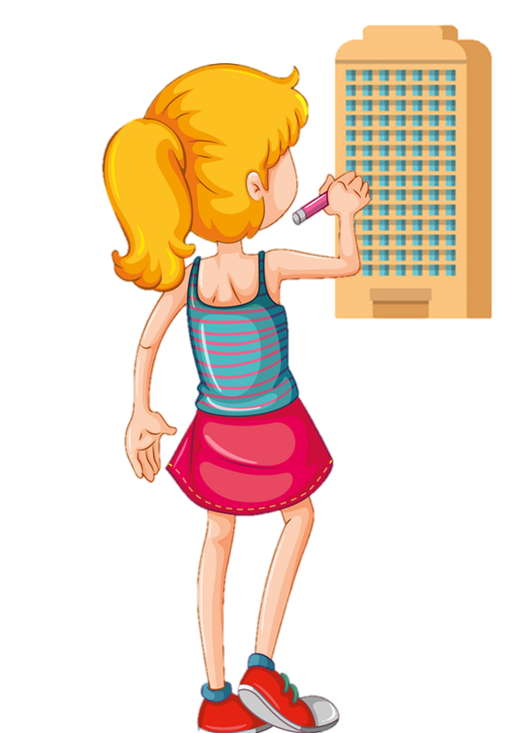
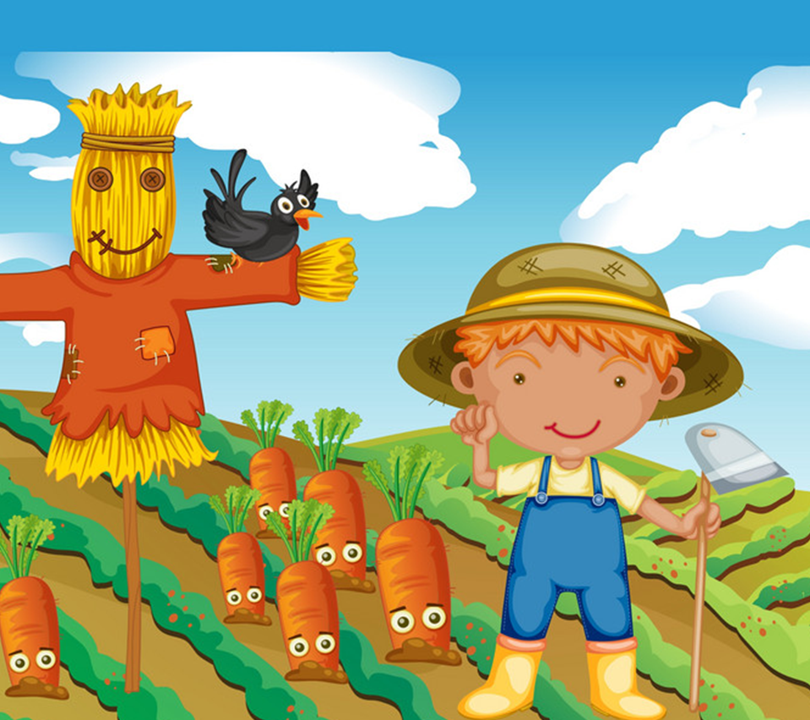
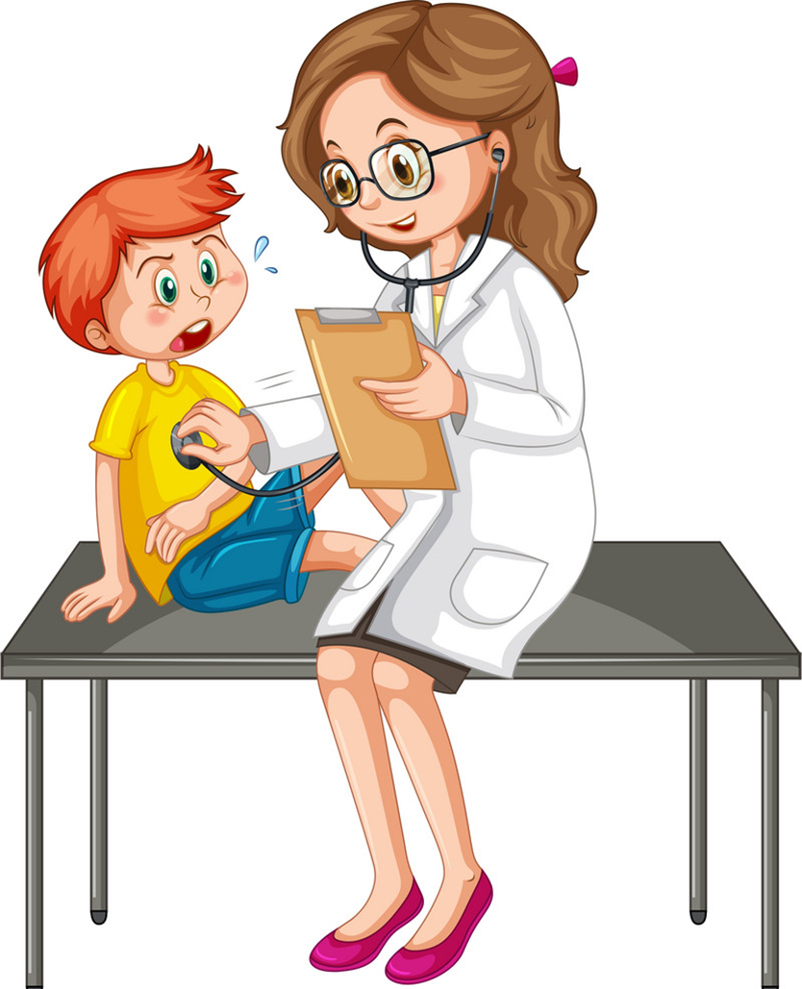

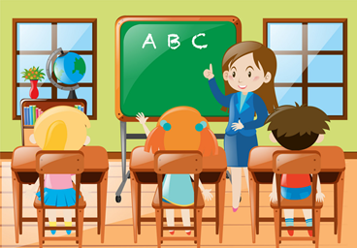



Review
What would you like to be in the future?
I’d like to be a/an __________.
driver
architect
farmer
doctor
writer
teacher
pilot
worker
nurse
Ms.Phạm English

Slide 3

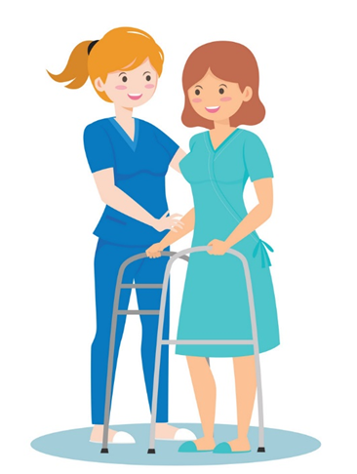

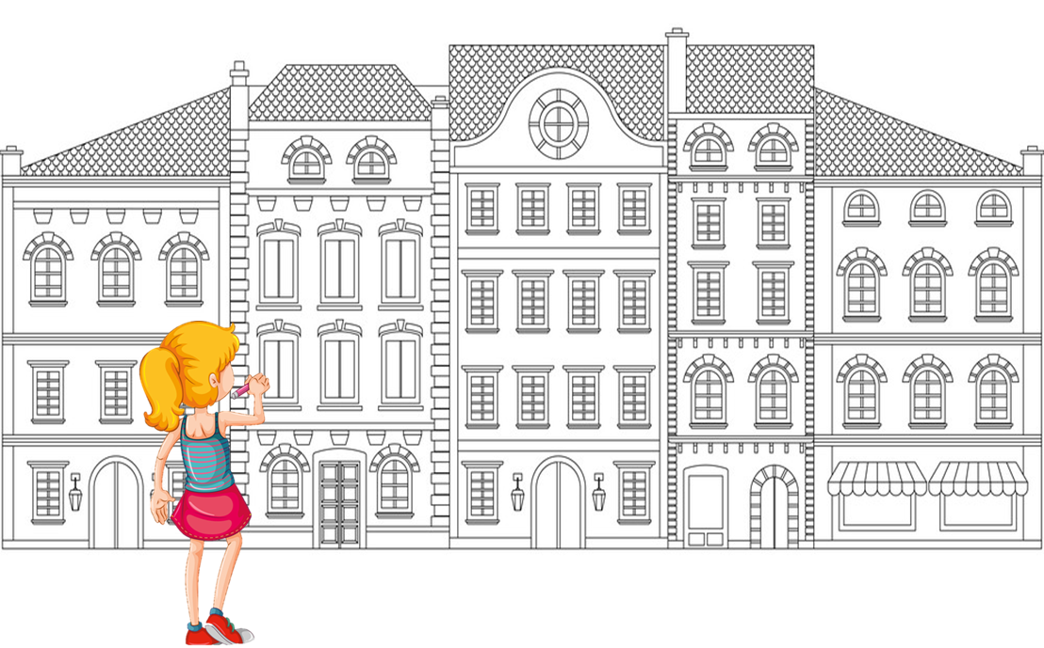
Vocabulary
look after patients
/lʊk ˈɑːftə ˈpeɪʃənts/
write stories for children /raɪt ˈstɔːriz fə ˈʧɪldrən/
fly a plane
/flaɪ ə pleɪn/
design buildings
/dɪˈzaɪn ˈbɪldɪŋz/

Slide 4
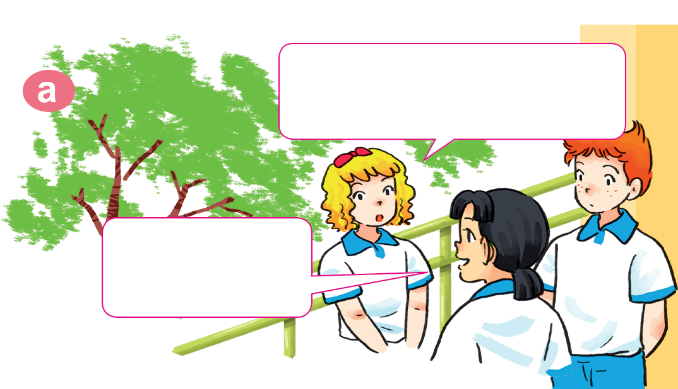
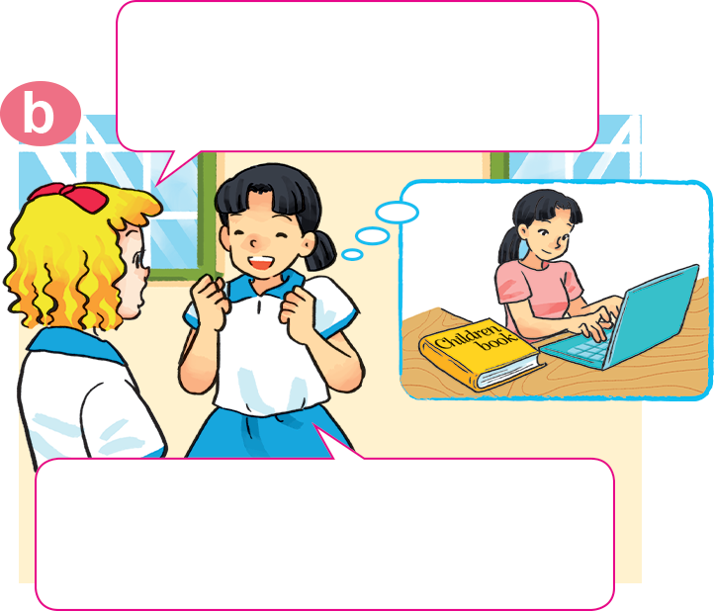

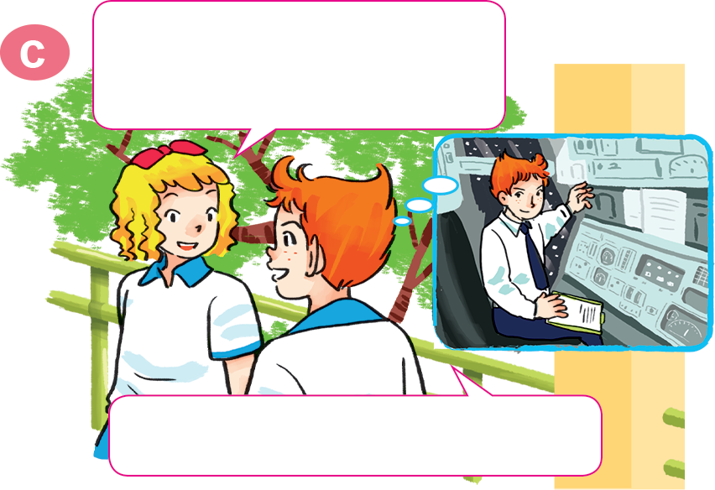
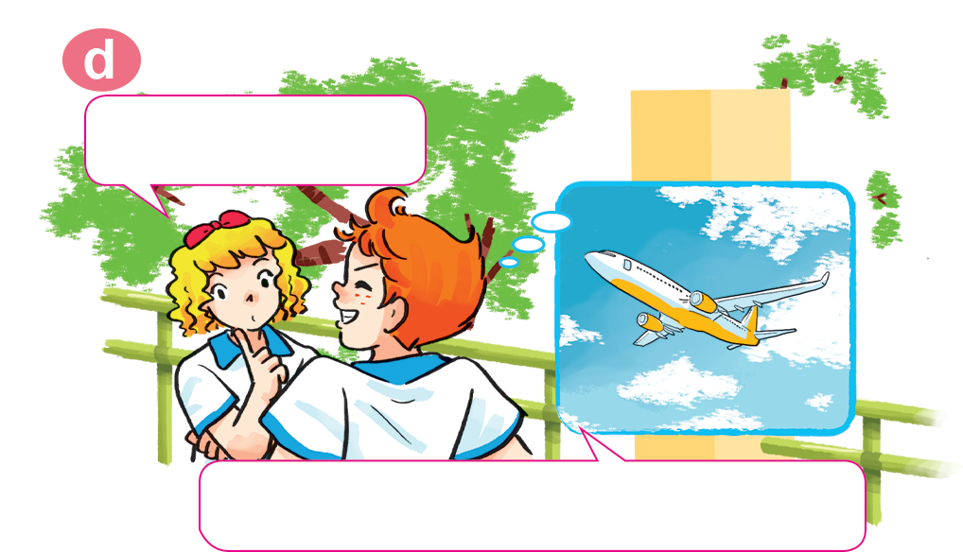
1. Look, listen and repeat
Why would you like to be a writer?
What would you like to be in the future, Mai?
I'd like to be a writer.
Because I'd like to write stories for children.
Would you like to be a writer too, Tony?
A pilot? Why?
No. I'd like to be a pilot.
Because I'd like to fly a plane.

Slide 5
Structure:
Why would you like to be _________?
Because I’d like to ___________.

Slide 6
2. Point and say
Why would you like to be _________?
Because I'd like to _____________.
a nurse
an architect
look after patients
design buildings
a writer
a pilot
write stories for children
fly a plane

Slide 7
4. Listen and circle a, b or c
1. Trung would like to be ___________.
a. an engineer b. an artist c. an architect
2. Mai would like to be ___________.
a. a nurse b. a teacher c. a singer
3. Tony would like to ___________.
a. drive a car b. fly a plane c. work in a factory
4. Tom would like to ___________.
a. grow vegetables b. look after flowers
c. work on a farm

Slide 8
5. Read and complete.
A: What would you like to be in the future?
B: I'd like to be a (1) __________.
A: Why?
B: Because I'd like to (2) __________ patients.
A: Where would you like to work?
B: In a (3) __________ in the countryside.
A: What would you like to (4) _____ in your free time?
B: I'd like to (5) __________ comic stories.
nurse
look after
hospital
do
write

Slide 9




Slide 10


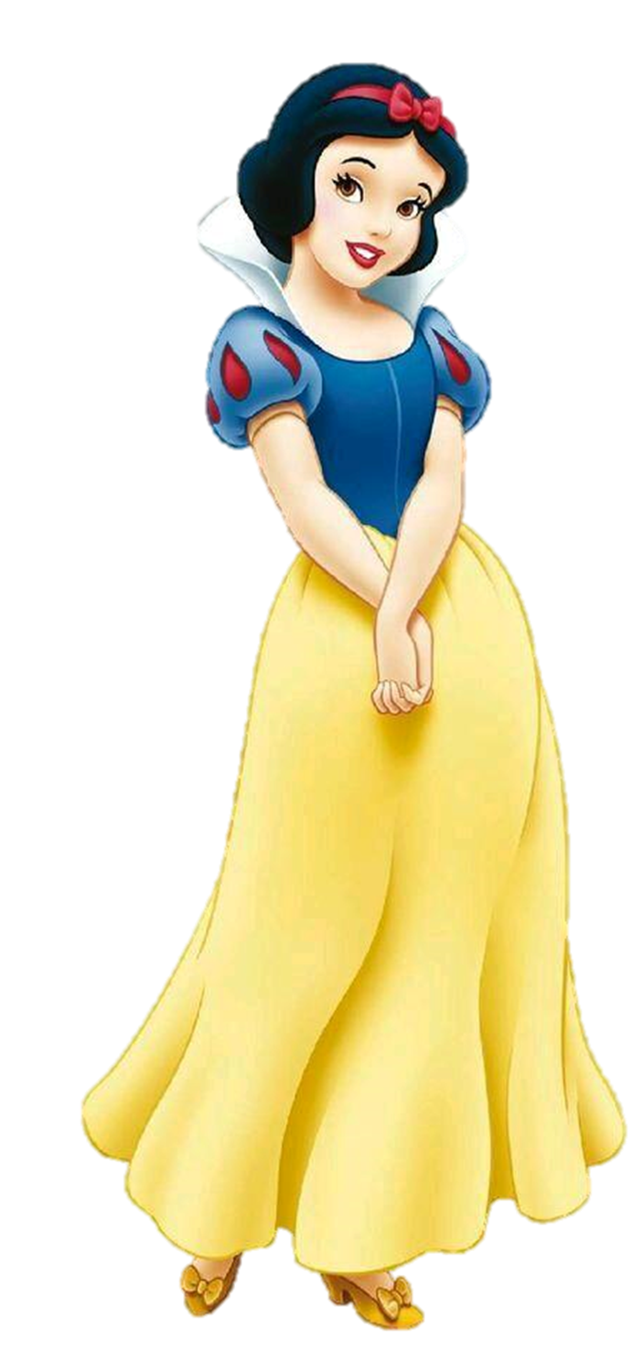
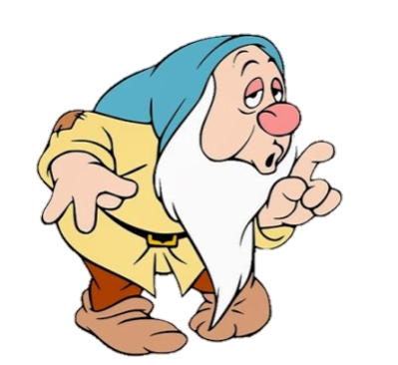
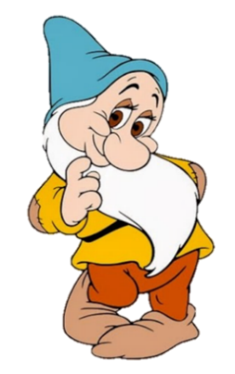
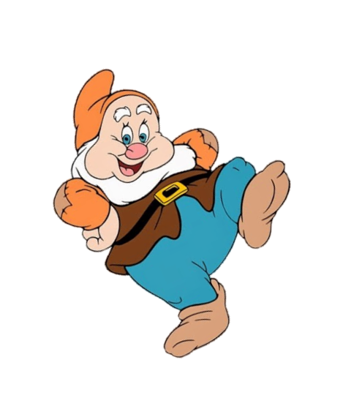
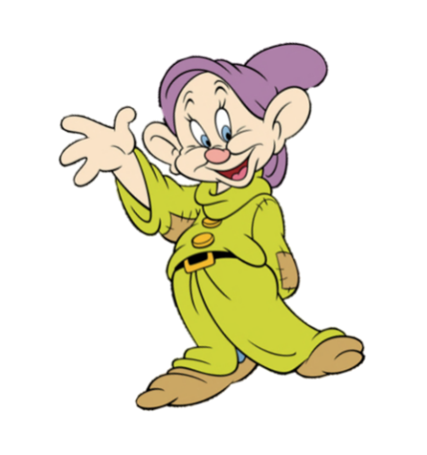
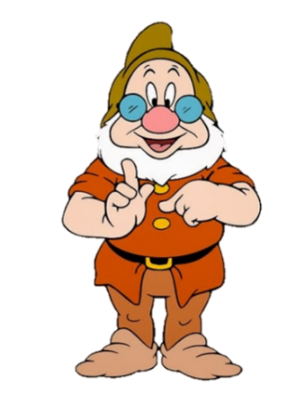
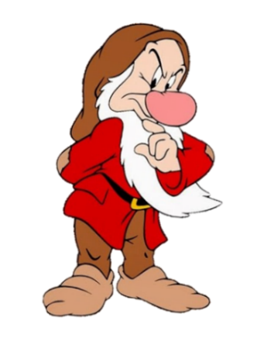
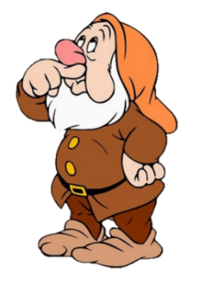

A: What would you like to be in the future?
B: I'd like to be a __________.
nurse
look after patients

Slide 11
A: Why would you like to be a nurse?
B: Because I'd like to __________ patients.
look
look after

Slide 12
A: Where would you like
to work?
B: In a __________.
farm
hospital

Slide 13
A: What would you like to _____ in your free time?
B: I'd like to write comic stories.
go
do

Slide 14

Mai would like
to be a nurse.
True
False

Slide 15
Tom would like to work on a school.
True
False

Slide 16
Phong would like to fly a plane. .
True
False

Slide 17
Trung would like to be an architect.
True
False

Slide 18
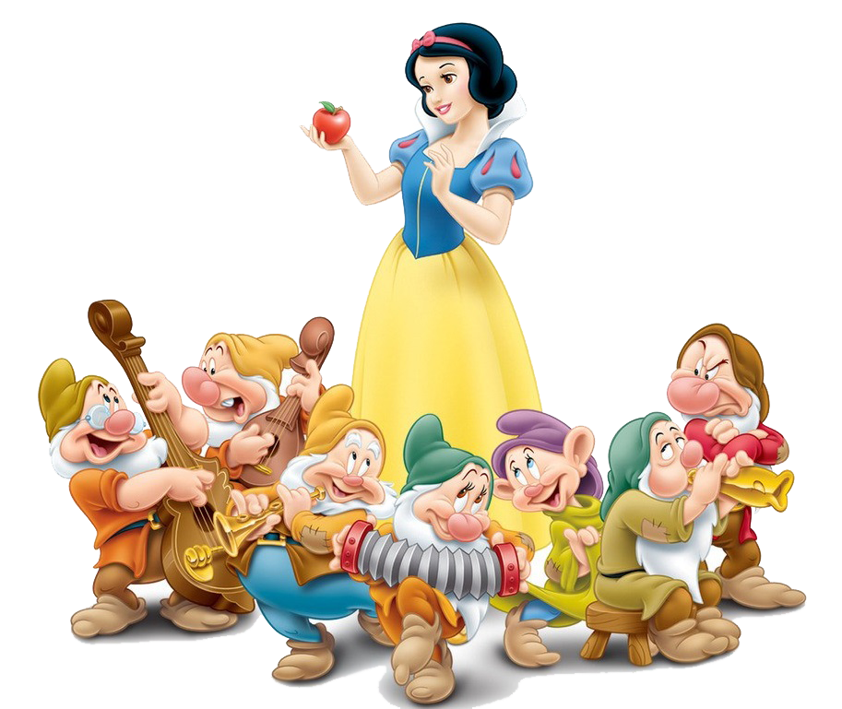
Good job!

