Slide 1
Unit 17 – Lesson 2
HOW MUCH IS THE T-SHIRT

Slide 2
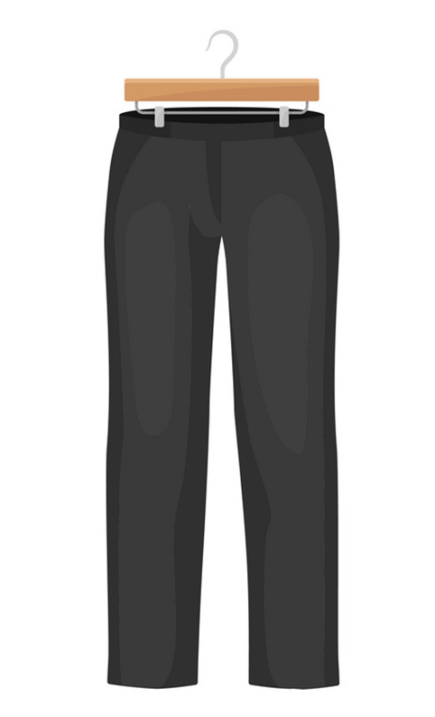
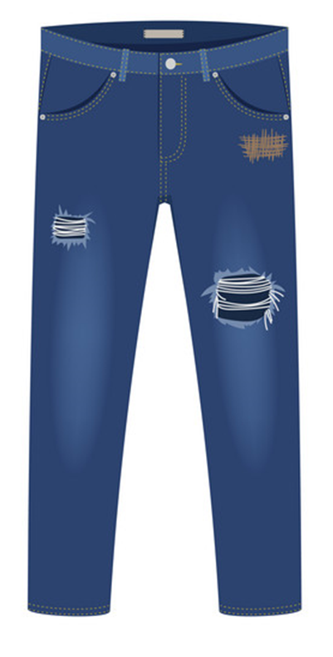
Vocabulary
jeans
trousers
/dʒiːnz/
/ˈtraʊzərz/

Slide 3
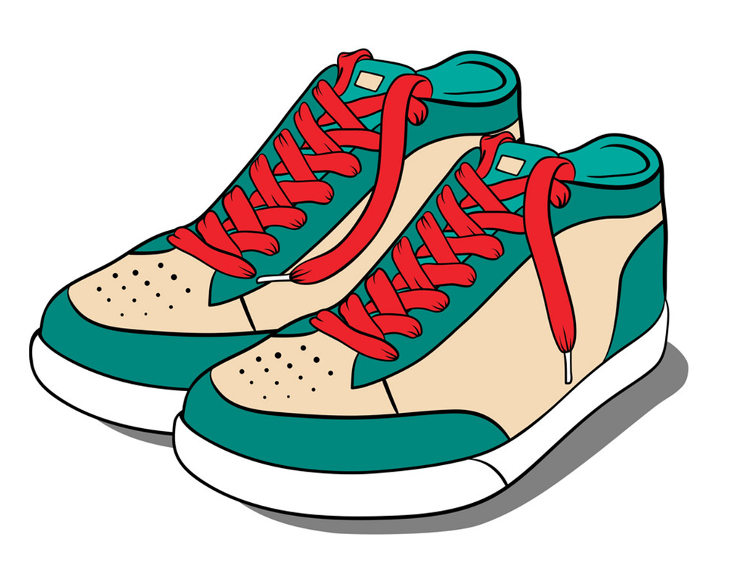
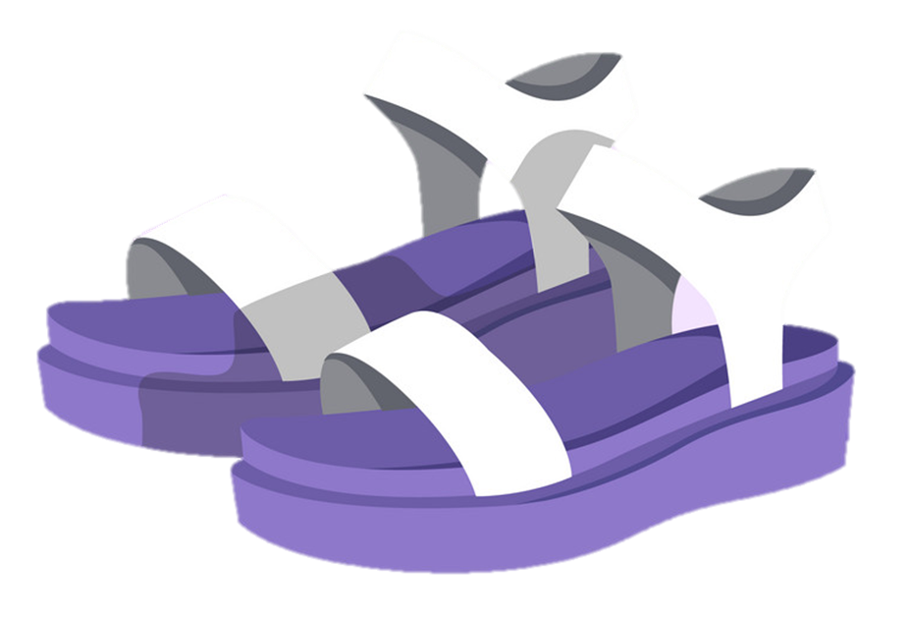
Vocabulary
sandals
shoes
/ˈsændl/
/ʃuː/

Slide 4
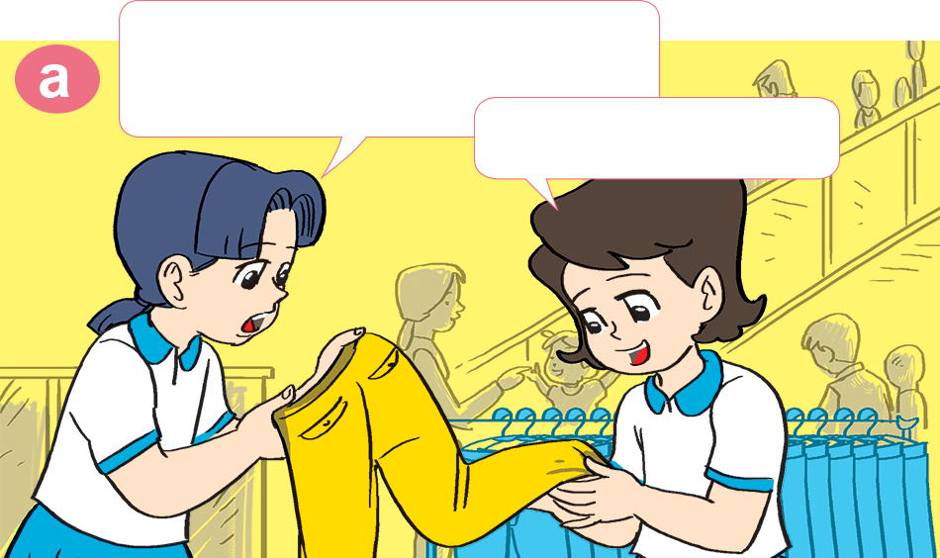
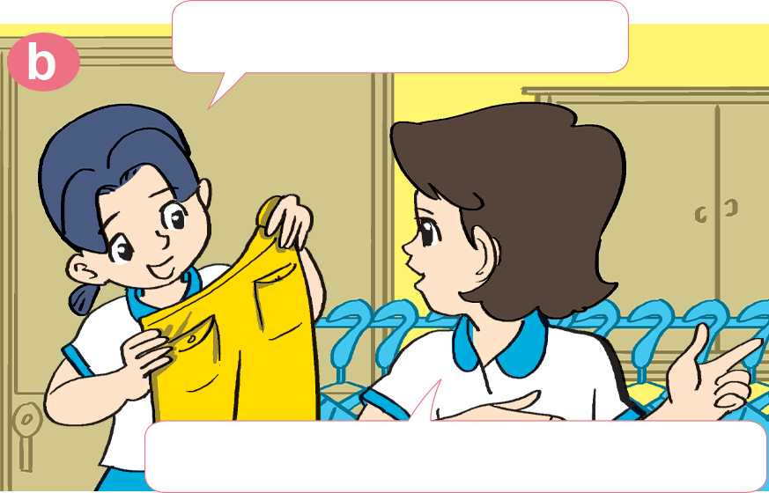

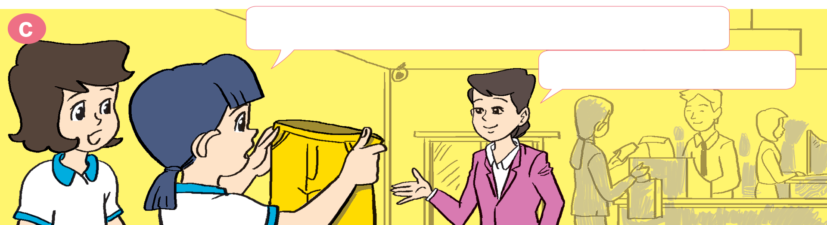
1. Look, listen and repeat
These yellow trousers are very nice.
How much are they?
Yes, they are.
Let's ask the sales assistant.
Excuse me. How much are these trousers?
They're 99,000 dong.

Slide 5


B. Structure:
Hỏi và trả lời giá tiền (đồ vật số nhiều)
How much are the ___?
They’re _______.
(They are)
How much = Bao nhiêu tiền

Slide 6
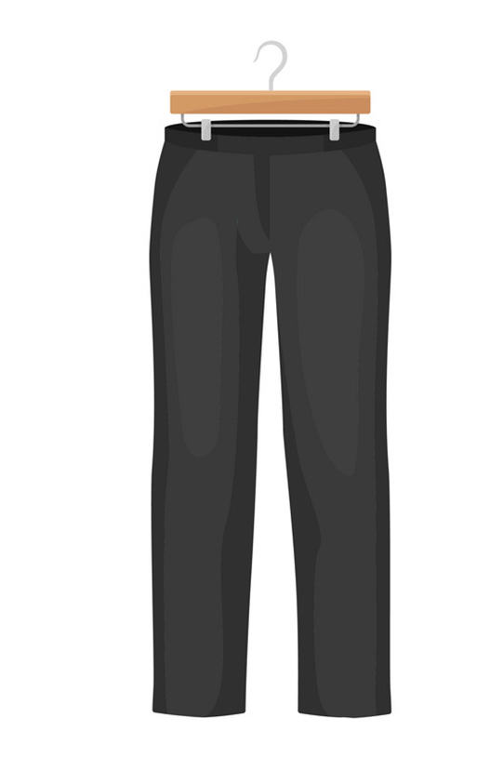
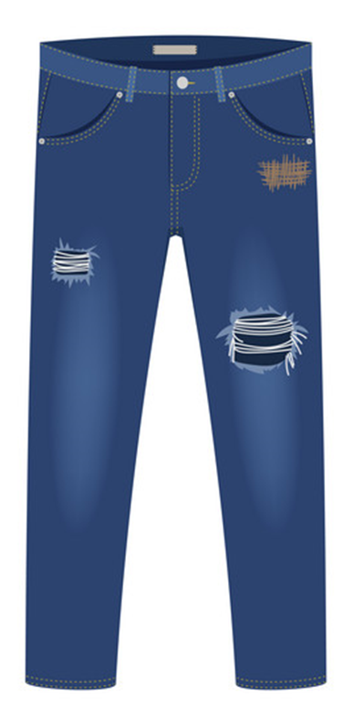

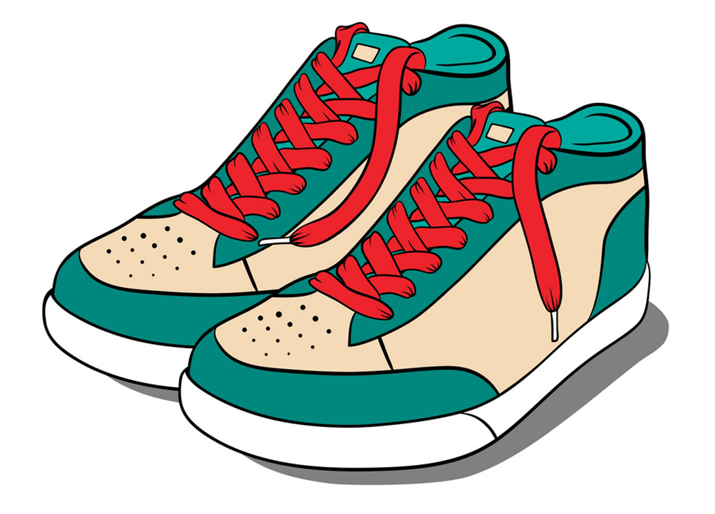
3. Let's talk
How much are the _____?
They’re ___________.
99.000 DONG
85.000 DONG
63.000 DONG
74.000 DONG
trousers
jeans
sandals
shoes

Slide 7
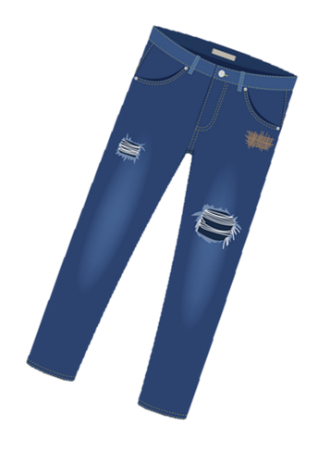
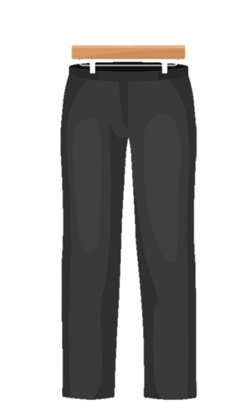
4. Listen and write the prices.
1
2
90.0000
dong
73.0000
dong
3
4
80.0000
dong
95.0000
dong

Slide 8
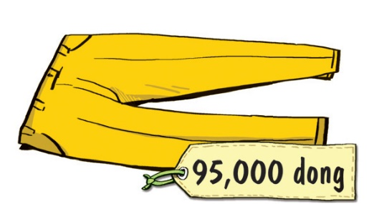
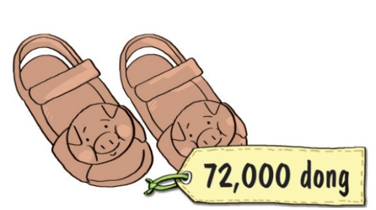
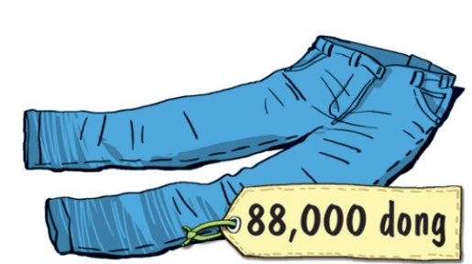
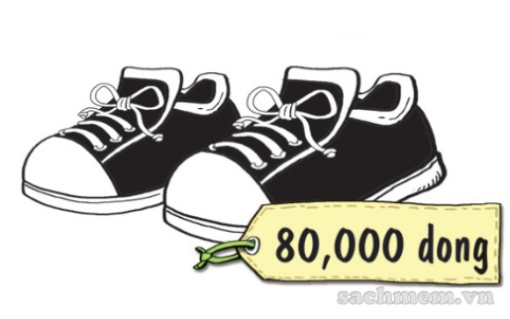
5. Look and write
The pair of yellow trousers = chiếc quần (số ít)
yellow trousers
The pair of ________________ is ________________________________.
The pair of _____________ is ___________
__________________________.
_______________________________________________________________________.
__________________________________________________________________.
ninety-five thousand dong
brown sandals
seventy-two
thousand dong
The pair of blue jeans is eighty-eight thousand dong
The pair of black and white shoes is eighty thousand dong

Slide 9
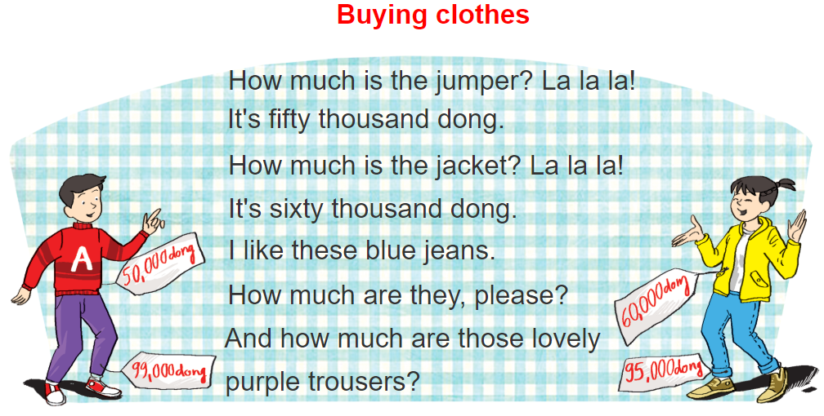

6. Let's sing

