Slide 1
Unit 16
LET'S GO TO
THE BOOKSHOP
Lesson 1

Slide 2
VOCABULARY

Slide 3
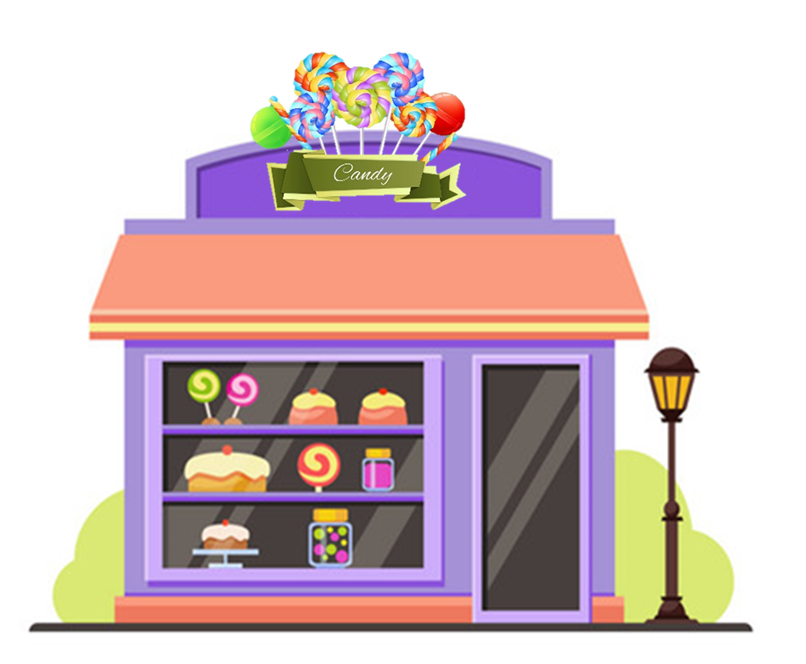
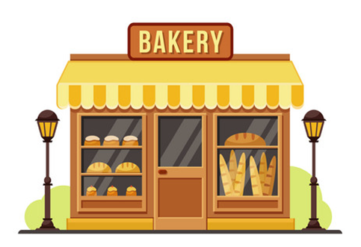



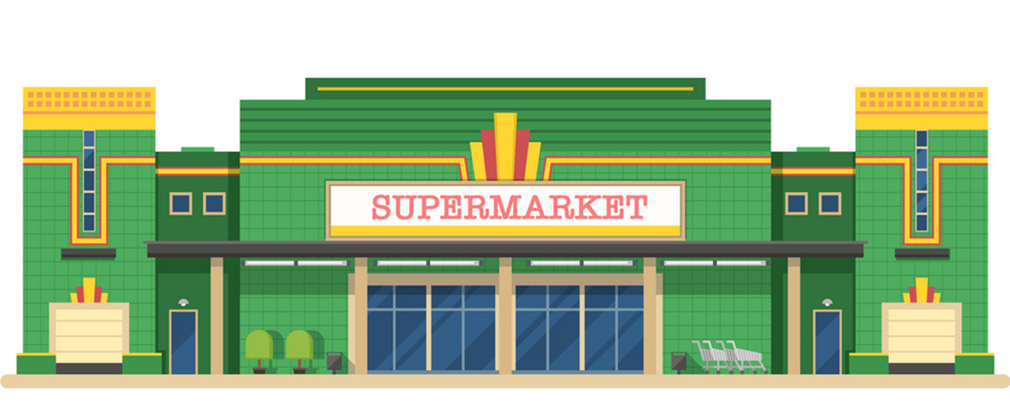


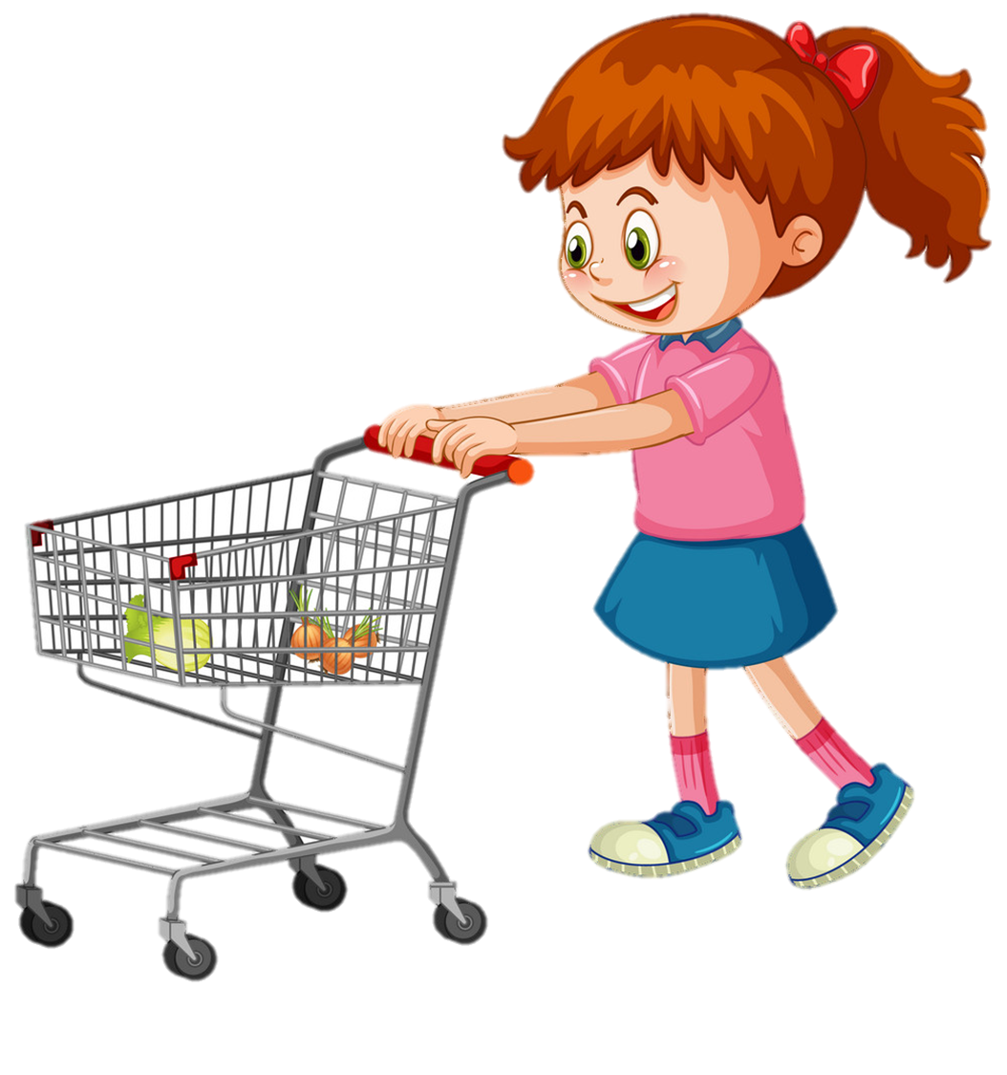
Vocabulary
1
2
3
sweet shop
bakery
bookshop
4
5
pharmacy
supermarket

Slide 4
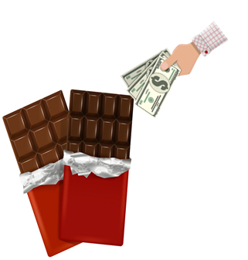


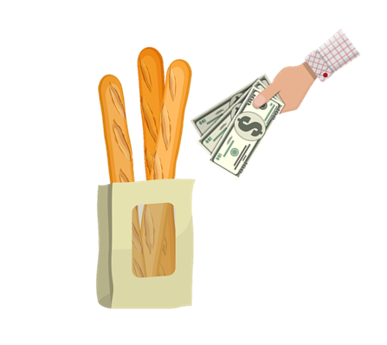

Vocabulary
1
2
3
buy some chocolate
buy some medicine
buy some books
4
5
buy some bread
buy some food

Slide 5
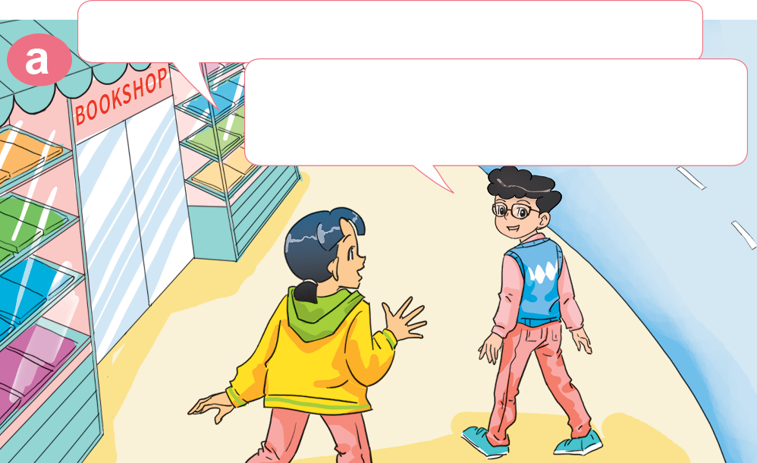
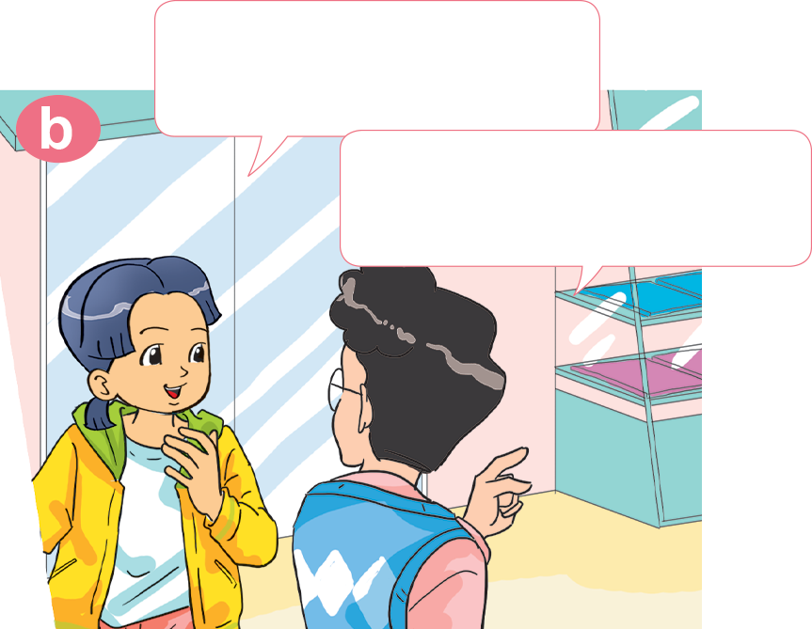

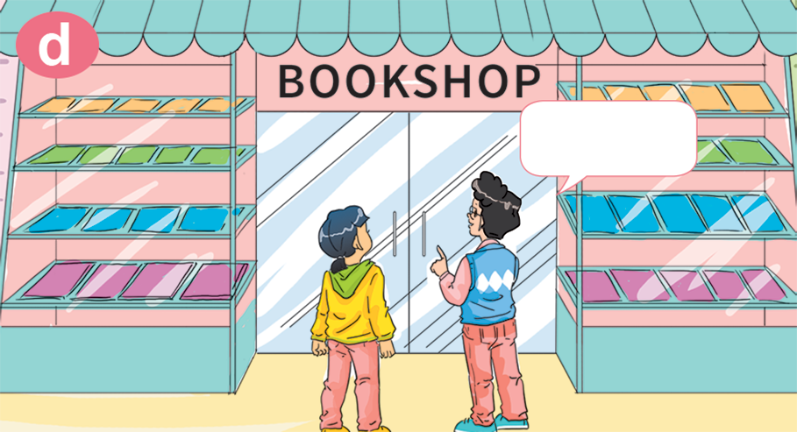
1. Look, listen and repeat.
Oh! I want to buy some books, too.
Hi, Phong. Where are you going?
I'm going to the bookshop. I want to buy some books.
OK. Let's go to the bookshop together.
Good idea! Where's the bookshop?
Here!

Slide 6




B. Structures:
Rủ ai đó cùng đi đâu:
Let’s go to the ______.
I want to ___________.
Great idea!
Sorry. I’m busy.

Slide 7
Let’s go to the ______.
I want to ___________.
Great idea!
Sorry. I’m busy.
sweet shop
bakery
sweet shop
buy some chocolate
buy some bread
buy some chocolate
pharmacy
supermarket
buy some medicine
buy some food

Slide 8




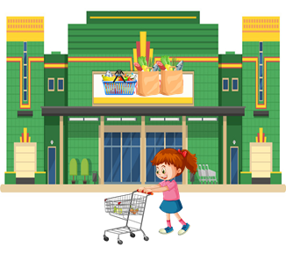
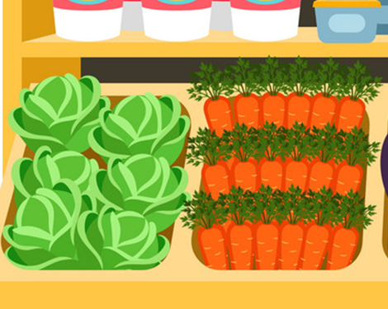
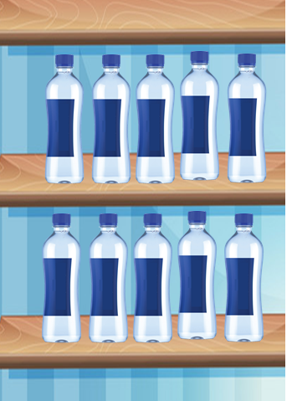
3. Listen and tick.
1. Where do Phong and Linda go?
2. What do they want?
a
b
a
b
3. Where do Mai and Tony go?
4. What do they want?
a
b
a
b

Slide 9
4. Look and write
to the bookshop
to the bakery
Let's go ________________. I want to ________________.
Let's go________________. I want to ________________.
buy some books
buy some cakes
to the sweet shop
to the pharmacy
Let's go ________________. I want to ________________.
Let's go ________________.
I want to __________________.
buy some sweets
buy some medicine

Slide 10
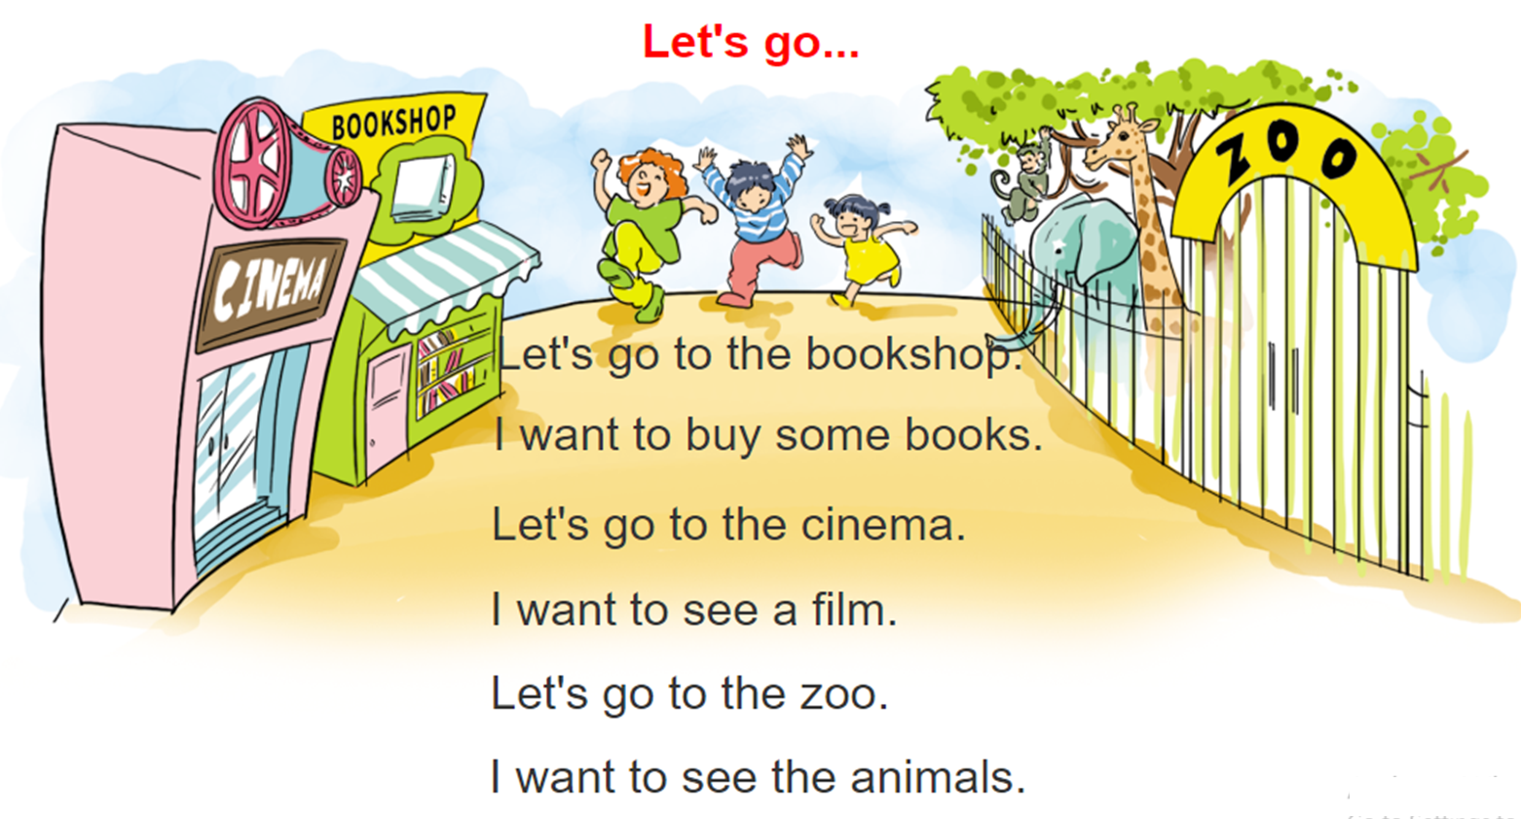

5. Let's sing.

Slide 11
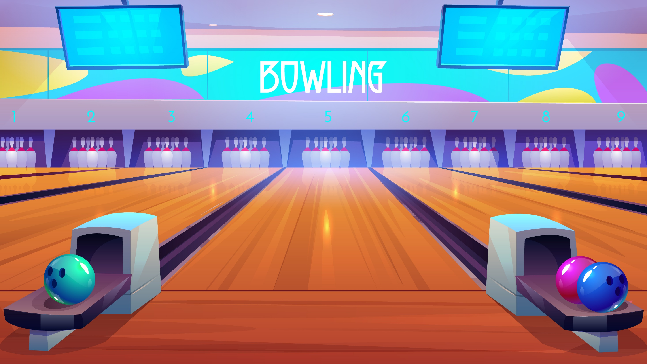



Notes:
Ms Huyền Phạm - 0936.082.789 – YOUTUBE: MsPham. Facebook: Dạy và học cùng công nghệ.

Slide 12
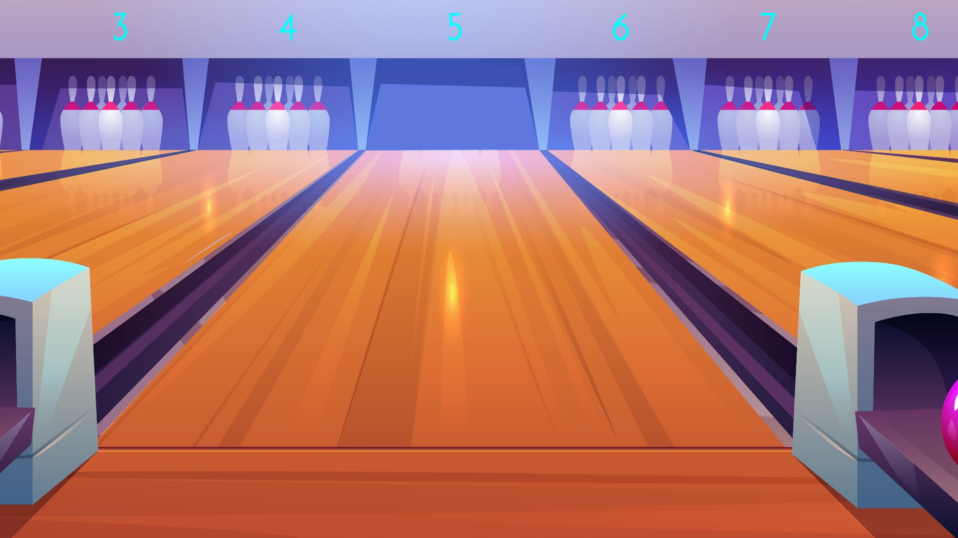



buy some food
buy some books
Let’s go to the bookshop.
I want to ______.
buy some chocolate
Next
Notes:
Ms Huyền Phạm - 0936.082.789 – YOUTUBE: MsPham. Facebook: Dạy và học cùng công nghệ.

Slide 13
buy some food
buy some medicine
Let’s go to the supermarket.
I want to ______.
buy some books
Next
Notes:
Ms Huyền Phạm - 0936.082.789 – YOUTUBE: MsPham. Facebook: Dạy và học cùng công nghệ.

Slide 14
buy some pens
buy some bread
Let’s go to the bakery. I want to ______.
buy some books
Next
Notes:
Ms Huyền Phạm - 0936.082.789 – YOUTUBE: MsPham. Facebook: Dạy và học cùng công nghệ.

Slide 15
buy some medicine
buy some vegetables
Let’s go to the sweetshop.
I want to ______.
buy some chocolate
Next
Notes:
Ms Huyền Phạm - 0936.082.789 – YOUTUBE: MsPham. Facebook: Dạy và học cùng công nghệ.

Slide 16
buy some medicine
buy some food
Let’s go to the pharmacy.
I want to ______.
buy some bread
Notes:
Ms Huyền Phạm - 0936.082.789 – YOUTUBE: MsPham. Facebook: Dạy và học cùng công nghệ.

Slide 17
b. am like
Great idea.
Sorry. I’m busy.
Let’s go to the bakery. I want to buy some bread.
Next
Notes:
Ms Huyền Phạm - 0936.082.789 – YOUTUBE: MsPham. Facebook: Dạy và học cùng công nghệ.

Slide 18
b. am like
Great idea.
Sorry. I’m busy.
Let’s go to the pharmacy.
I want to buy some medicine.
Next
Notes:
Ms Huyền Phạm - 0936.082.789 – YOUTUBE: MsPham. Facebook: Dạy và học cùng công nghệ.

Slide 19
Let’s go to the bookshop.
Let’s go to the supermaket.
________
I want to buy some food.
Let’s go to the pharmacy.
Next
Notes:
Ms Huyền Phạm - 0936.082.789 – YOUTUBE: MsPham. Facebook: Dạy và học cùng công nghệ.

Slide 20

TIME’S UP
Notes:
Ms Huyền Phạm - 0936.082.789 – YOUTUBE: MsPham. Facebook: Dạy và học cùng công nghệ.

