Slide 1

Unit 15
When is
Children's Day?
Lesson 2

Slide 2
VOCABULARY

Slide 3
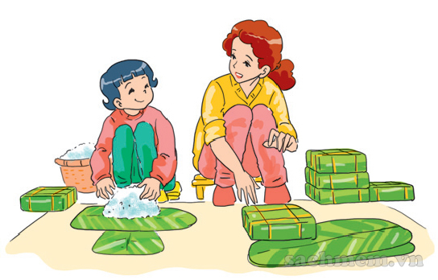

2. Point and say
make banh chung
/meɪk banh chung/

Slide 4
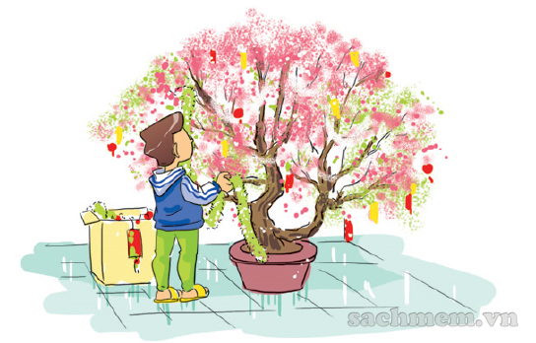
2. Point and say
decorate the house
/ˈdɛkəˌreɪt ðə haʊs/

Slide 5
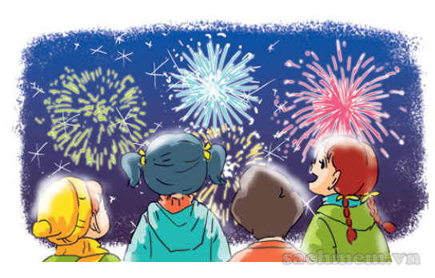
2. Point and say
watch firework displays
/wɑʧ ˈfaɪrˌwɜrk dɪˈspleɪz/

Slide 6
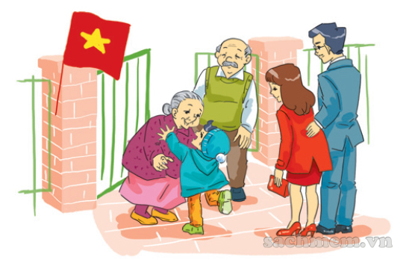
2. Point and say
visit grandparents
/ˈvɪzət ˈgrændˌpɛrənts/

Slide 7
Vocabulary
decorate the house
make banh chung
watch firework displays
visit grandparents
/meɪk banh chung/
/ˈdɛkəˌreɪt ðə haʊs/
/wɑʧ ˈfaɪrˌwɜrk dɪˈspleɪz/
/ˈvɪzət ˈgrændˌpɛrənts/

Slide 8
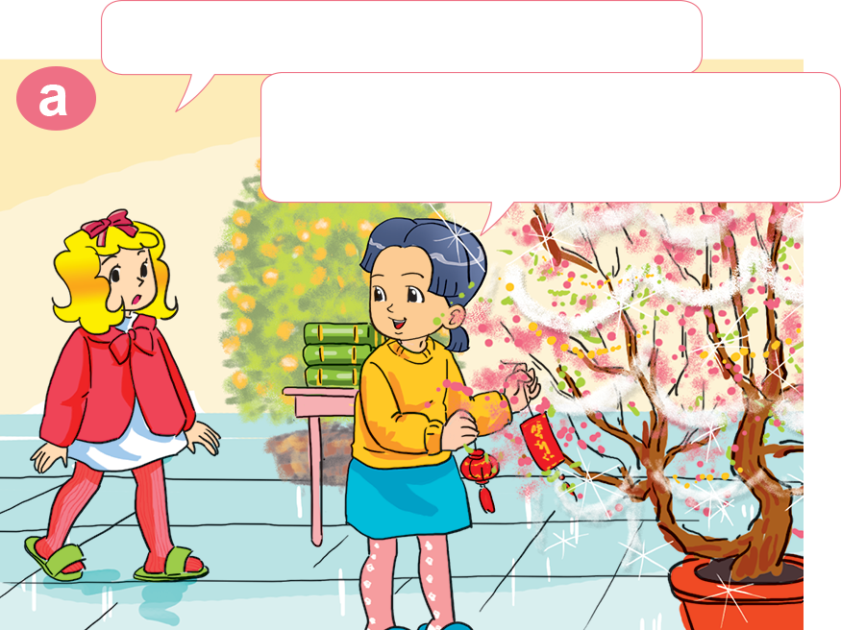
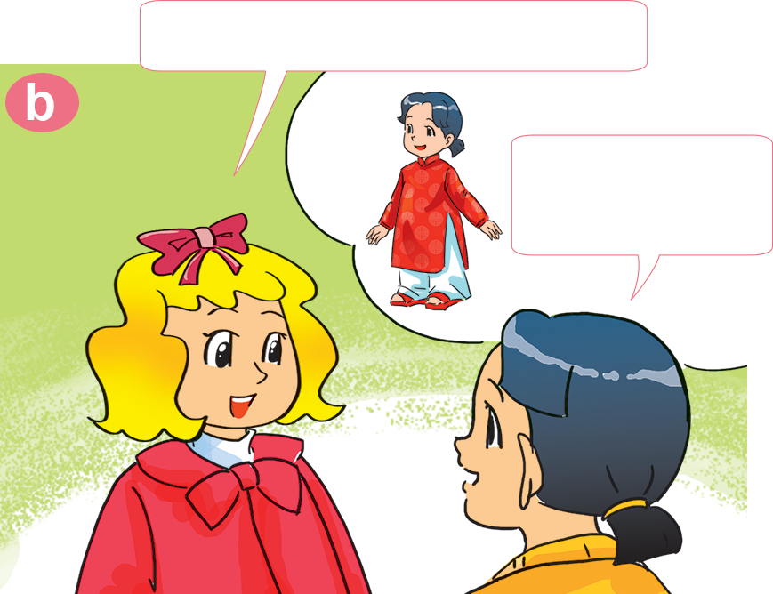

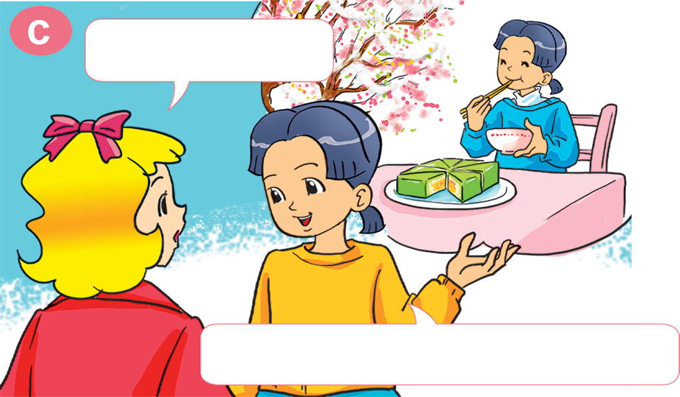
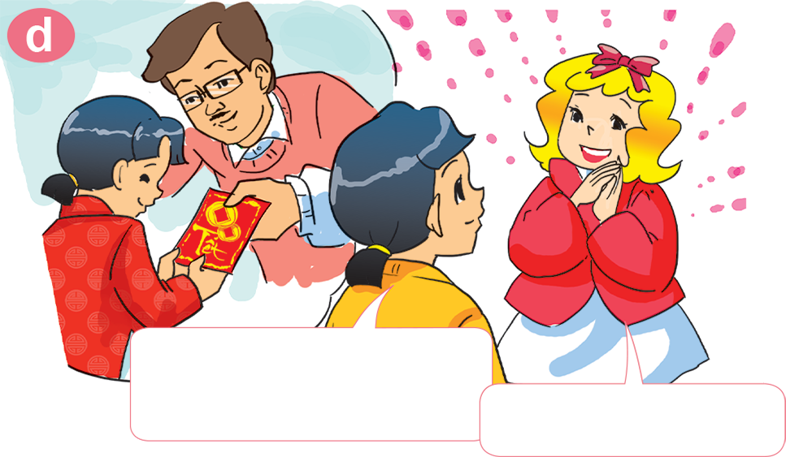
1. Look, listen and repeat
What are you doing, Mai?
What do you do at Tet?
I'm decorating my house. It's Tet soon.
I wear nice clothes.
What else?
I get lucky money from my parents.
I eat a lot of banh chung.
Oh, I like Tet!

Slide 9
What do you do
at Tet?
I _________________.
visit grandparents
make banh chung
decorate the house
watch firework displays

Slide 10
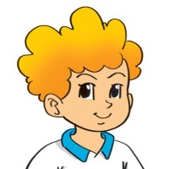
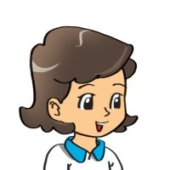
3. Let’s talk
When is___________?
It's on___________.
What do you do at/on___________
I ___________.

Slide 11
4. Listen and circle
What do they do at Tet?
1. Phong ___________.
a. buys flowers b. decorates the house
2. His parents ___________.
a. go shopping b. make banh chung
3. His sister ___________.
a. wears new clothes b. gets lucky money
4. Phong and his sister ___________.
a. watch firework displays b. visit teachers

Slide 12
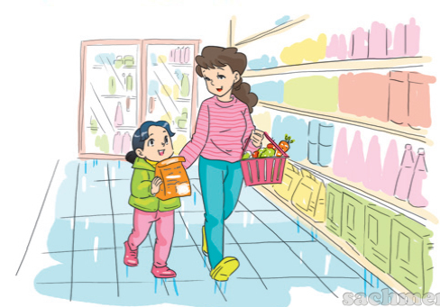
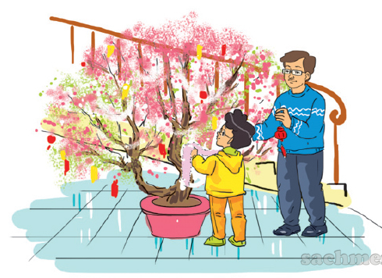
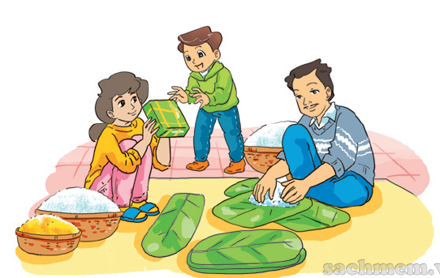
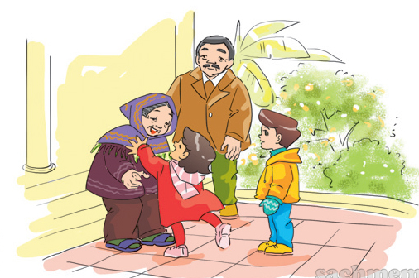
5. Look and write
go shopping
1. Mai and her mother ________________.
2. Phong and his father ___________________.
decorate their house
make banh chung
3. Nam and his family ___________________.
visit their grandparents
4. Hoa and her brother _____________________.

Slide 13




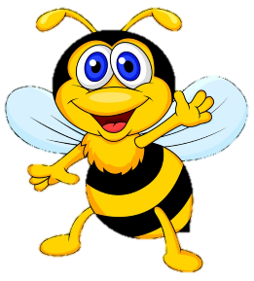






Ms Huyền Phạm
0936.082.789
Ms Huyền Phạm
0936.082.789
Ms Huyền Phạm
0936.082.789
Ms Huyền Phạm - 0936.082.789 – YOUTUBE: MsPham. Facebook: Dạy và học cùng công nghệ.
Ms Huyền Phạm
0936.082.789
Notes:
Ms Huyền Phạm - 0936.082.789 – YOUTUBE: MsPham. Facebook: Dạy và học cùng công nghệ.

Slide 14
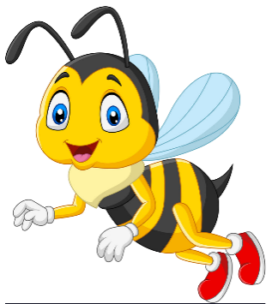





What do you do at Tet?
I _______ the house.
Next
do
decorate
make
visit
Notes:
Ms Huyền Phạm - 0936.082.789 – YOUTUBE: MsPham. Facebook: Dạy và học cùng công nghệ.

Slide 15
What do you do at Tet?
I _____ my grandparents.
Next
decorate
go
visit
do
Notes:
Ms Huyền Phạm - 0936.082.789 – YOUTUBE: MsPham. Facebook: Dạy và học cùng công nghệ.

Slide 16
What do you do at Tet?
I _____ Banh Chung
Next
make
do
decorate
visit
Notes:
Ms Huyền Phạm - 0936.082.789 – YOUTUBE: MsPham. Facebook: Dạy và học cùng công nghệ.

Slide 17
What do you do at Tet?
I go _________.
Next
shopping
to school
swimming
to the farm
Notes:
Ms Huyền Phạm - 0936.082.789 – YOUTUBE: MsPham. Facebook: Dạy và học cùng công nghệ.

Slide 18
What do you do at Tet?
I _____ firework displays.
Next
visit
make
do
watch
Notes:
Ms Huyền Phạm - 0936.082.789 – YOUTUBE: MsPham. Facebook: Dạy và học cùng công nghệ.

Slide 19
What _____you do at Tet?
I go shopping.
Next
are
does
do
like
Notes:
Ms Huyền Phạm - 0936.082.789 – YOUTUBE: MsPham. Facebook: Dạy và học cùng công nghệ.

Slide 20
______________
I get luckey money.
Next
What do you do at Tet?
What do you do at Christmas?
What do you do at Teacher’s Day?
What do you do?
Notes:
Ms Huyền Phạm - 0936.082.789 – YOUTUBE: MsPham. Facebook: Dạy và học cùng công nghệ.

Slide 21
______ do you do at Tet?
I visit my teachers.
Next
Where
How
when
what
Notes:
Ms Huyền Phạm - 0936.082.789 – YOUTUBE: MsPham. Facebook: Dạy và học cùng công nghệ.

Slide 22
What do you do at Tet?
I get _________.
Next
good mark
lucky money
books
Banh Chung
Notes:
Ms Huyền Phạm - 0936.082.789 – YOUTUBE: MsPham. Facebook: Dạy và học cùng công nghệ.

Slide 23
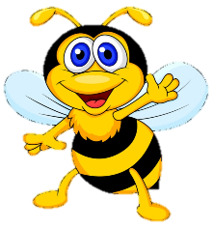







Notes:
Ms Huyền Phạm - 0936.082.789 – YOUTUBE: MsPham. Facebook: Dạy và học cùng công nghệ.

