Slide 1


Unit 14
What does he look like?
Lesson 3

Slide 2
REVIEW

Slide 3
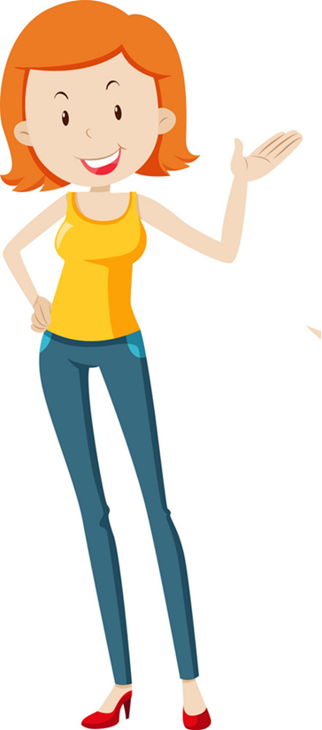
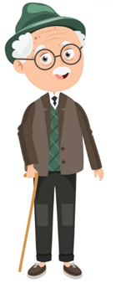
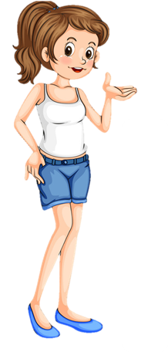
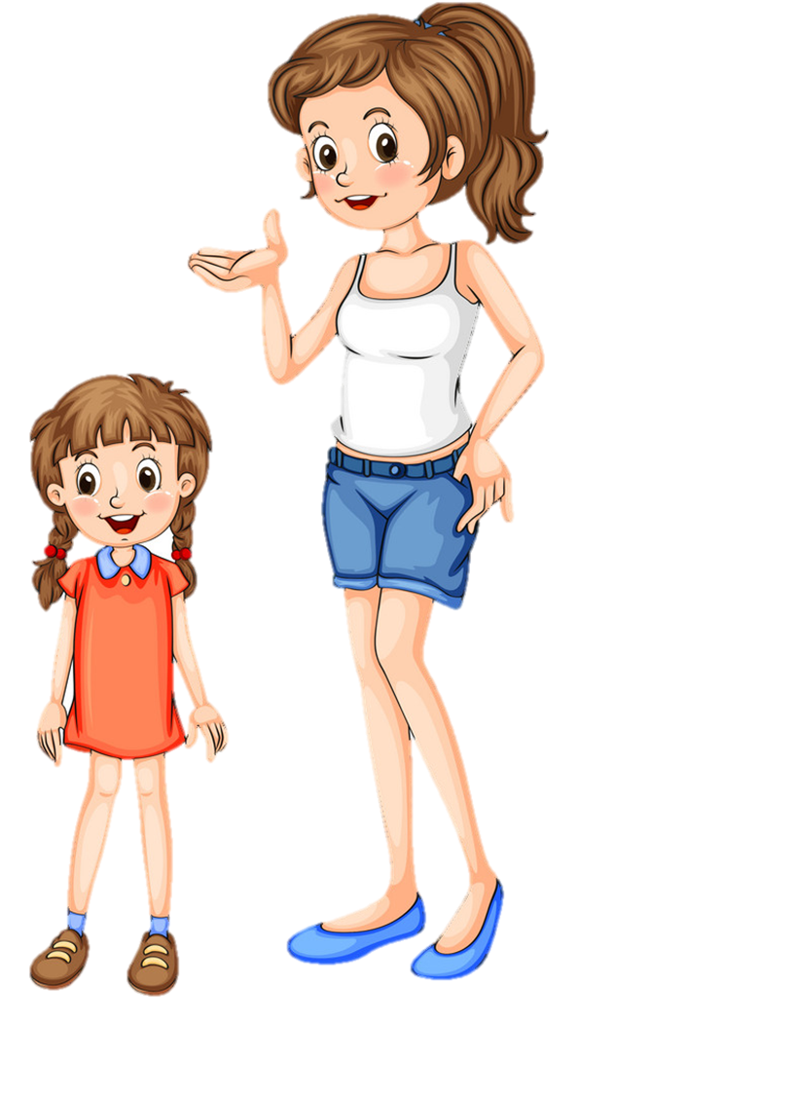
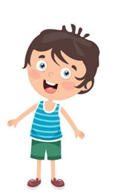
What does she / he look like?
She / He ____________.
old
slim
tall
short
young

Slide 4
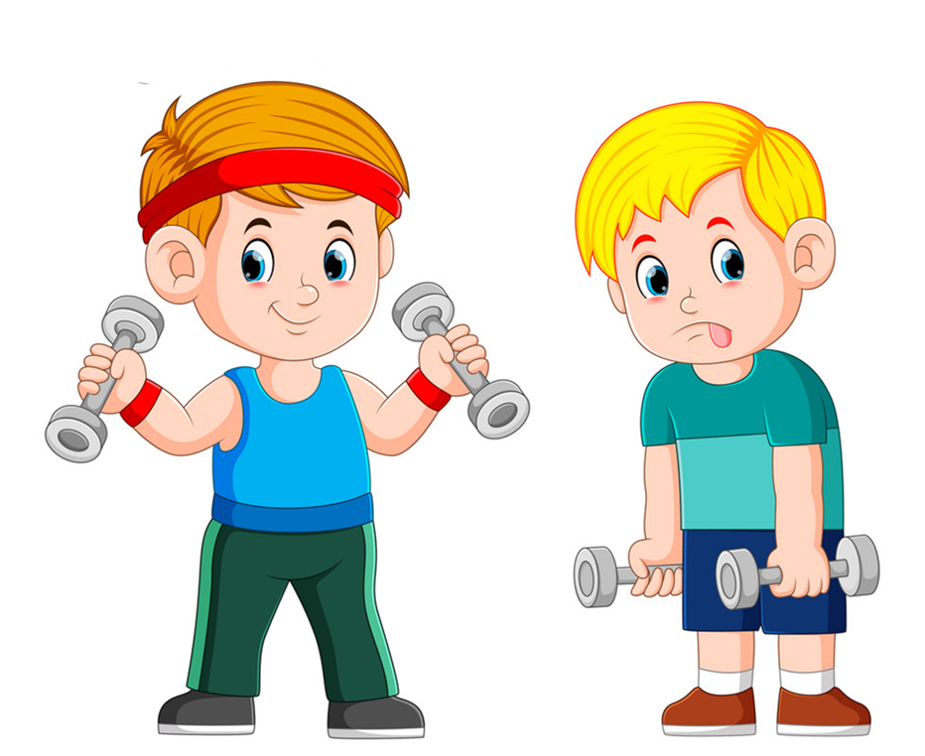
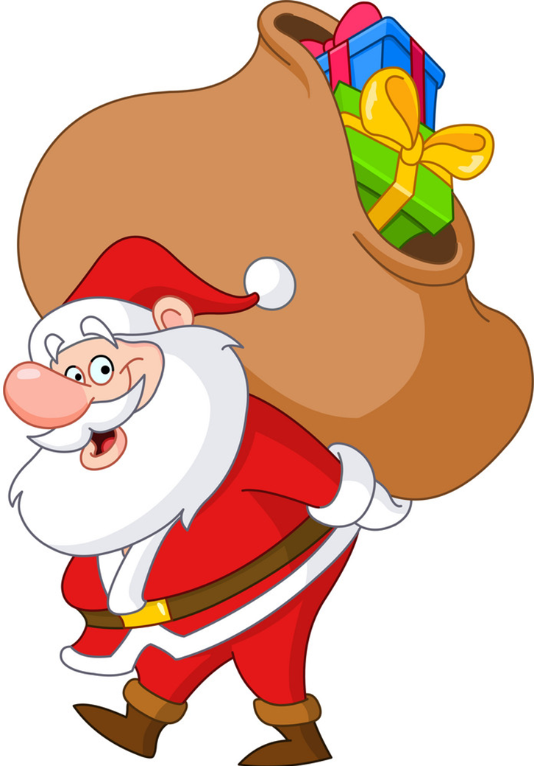
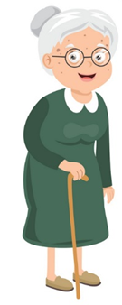
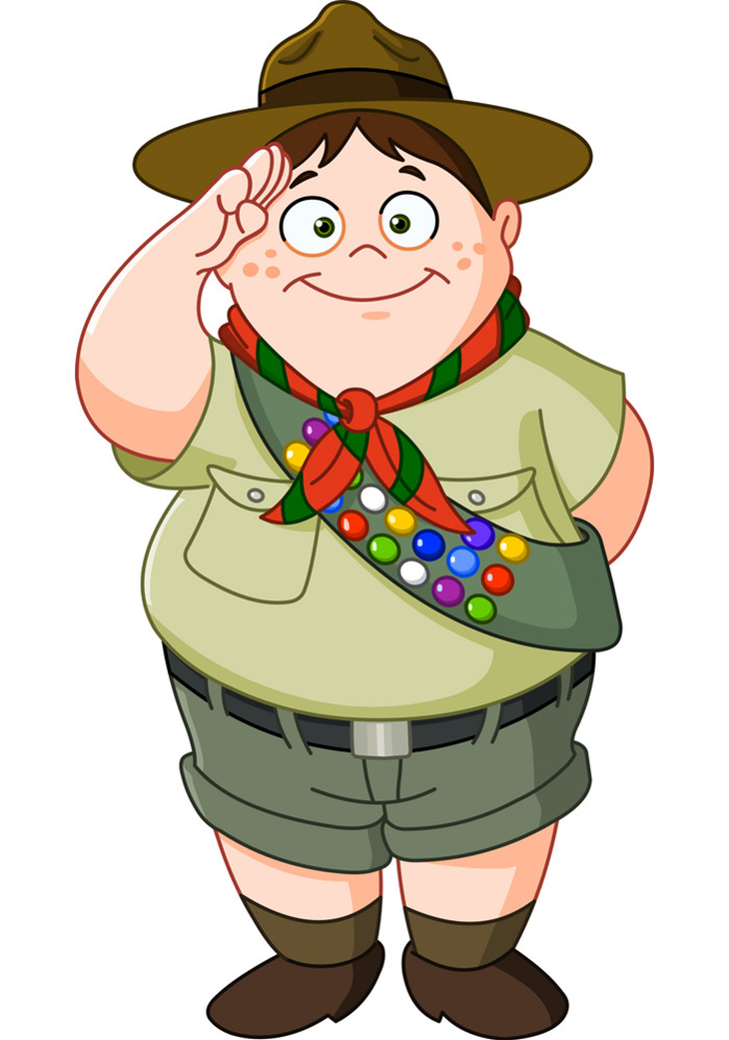
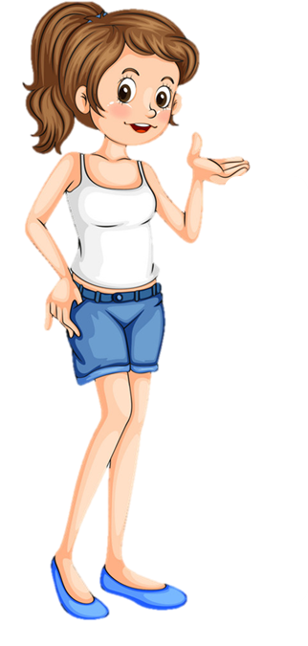
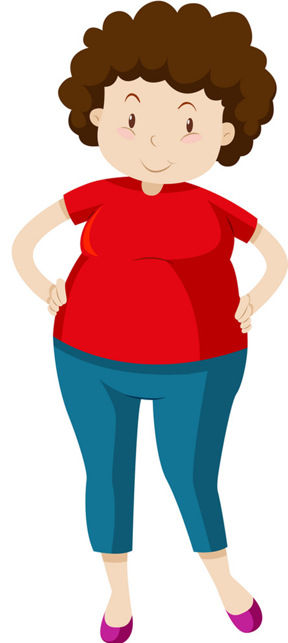
Who's ________er?
_______ is _____er than ______.
younger
stronger
older
bigger
taller
shorter

Slide 5
PHONICS

Slide 6

1. Listen and repeat.
th /ð/ | this | This is my mother.
 | that | That is my father.
th /θ/ | thin | The book is thin.
 | thick | The dictionary is thick.

Slide 7
2. Listen and circle.
1. My brother is ___________.
a. thin b. there
2. My sister is ___________.
a. There b. three
3. ___________ books are on the table.
a. Their b. The
4. Their books are ___________.
a. Thin b. thick

Slide 8
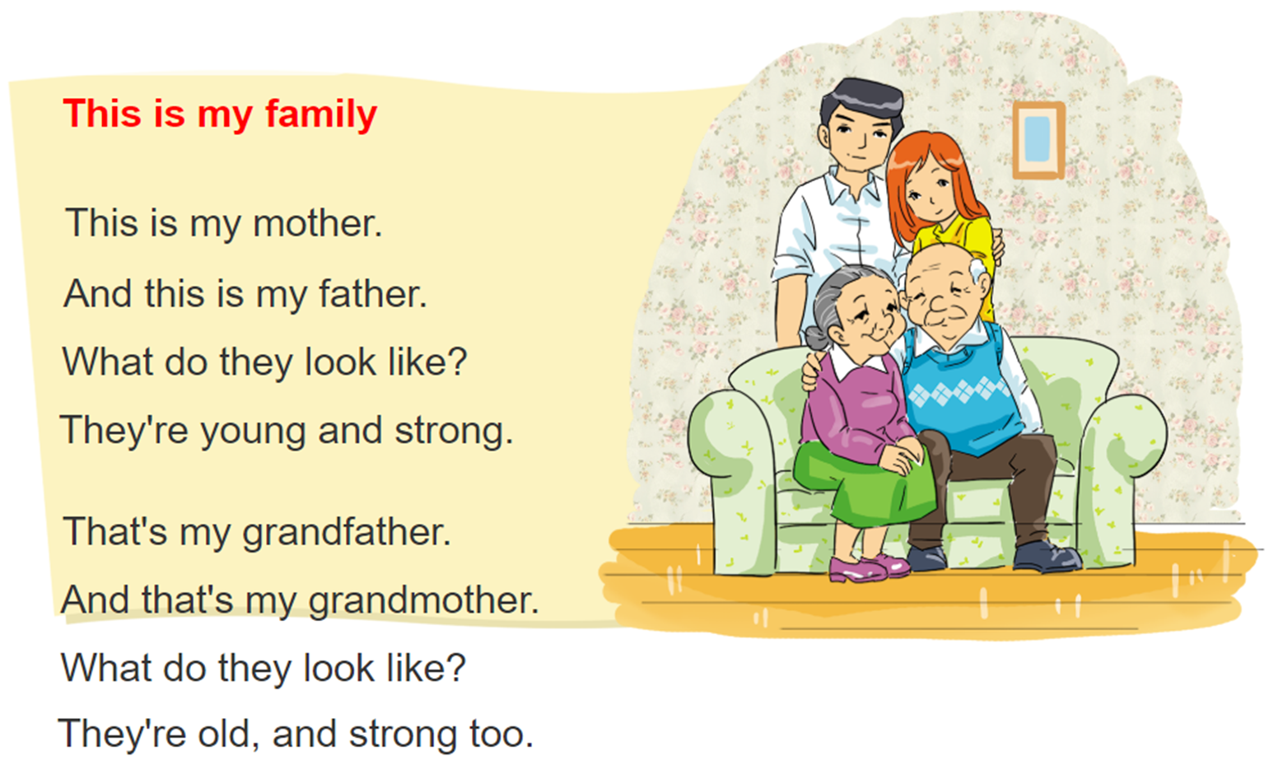

3. Let's chant

Slide 9
4. Read and write
Dear Jane,
My name's Marie. I'm nine years old and I live in Can Tho. There are four people in my family: my father, my mother, my brother and me. My father's 34 years old. He's a teacher, and he's tall and slim. My mother's 31 years old. She's a doctor. I think she's very beautiful! My brother and I are pupils at Hoa Sen Primary School. I'm older than my brother but he's taller than me.
Best wishes, Marie.
1. What does Marie's father do?
2. What does her father look like?
3. What does her mother look like?
4. Who is younger, Marie or her brother?
5. Who is shorter, Marie or her brother?
______________________.
______________________. ______________________. ______________________. ______________________.
He is a teacher
He is tall and slim
Her mother is beautiful
Her brother is younger
Marie is shorter

Slide 10
5. Write
Dear,
My name's ____________. I'm ________ years old.
There are ____________ people in my family.
My father's ____________.
My mother's ____________.
Best wishes,
________________

Slide 11
6. Project
Bring a photo of your family.
Describe your family members to the class.

