Slide 1


UNIT 13 – LESSON 2

Slide 2
VOCABULARY

Slide 3


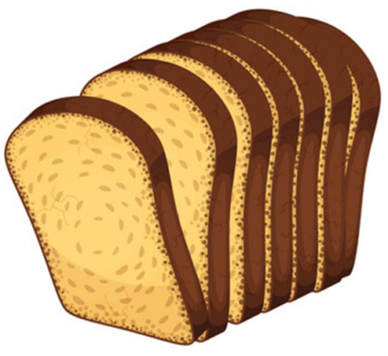
Vocabulary
bread
/bred/

Slide 4
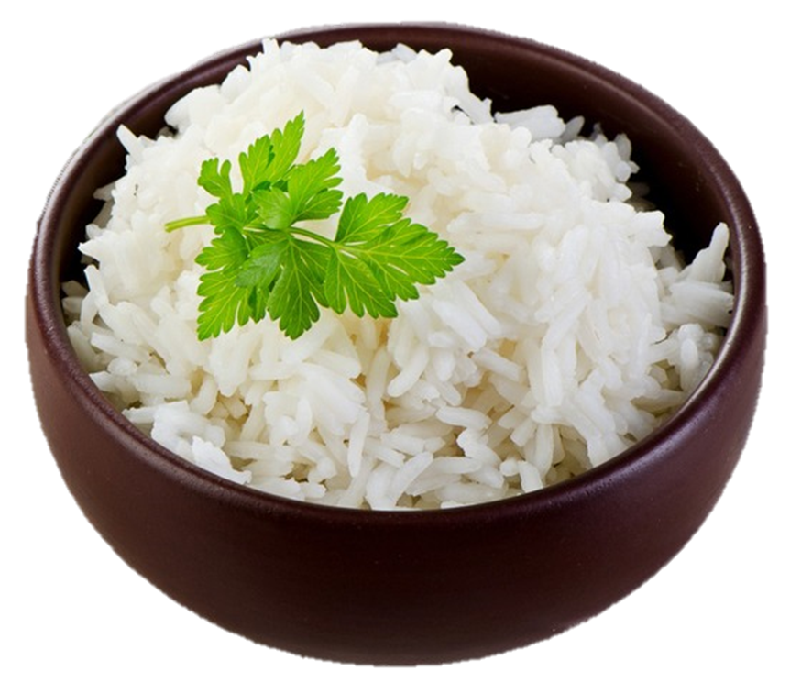
Vocabulary
rice
/raɪs/

Slide 5
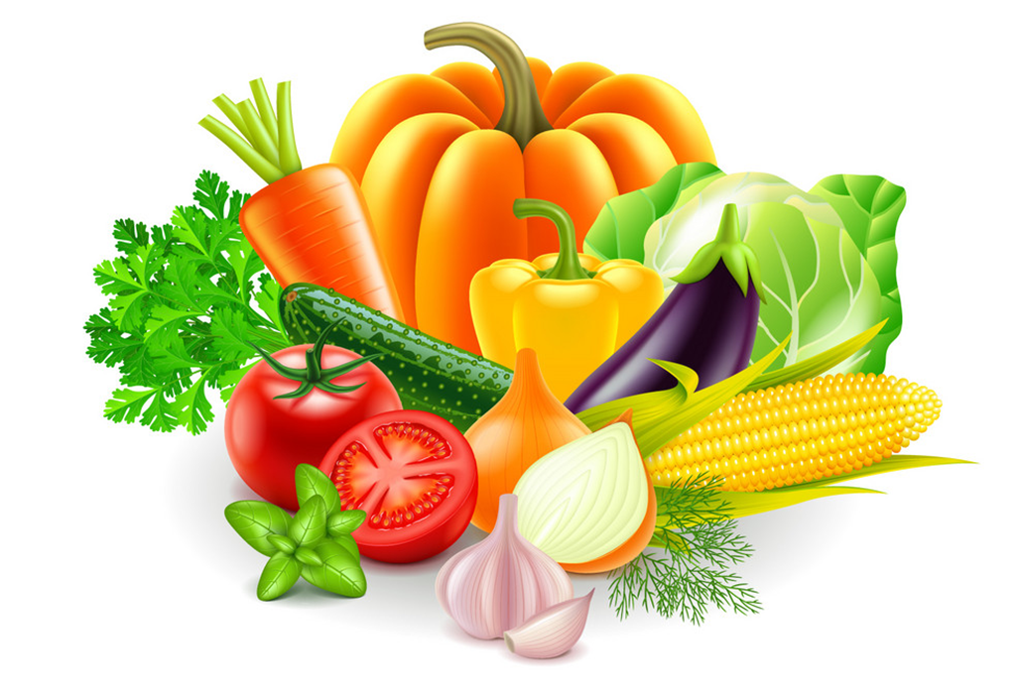
Vocabulary
vegetables
/ˈvedʒtəblz/

Slide 6


Vocabulary
lemonade
/leməˈneɪd/

Slide 7
Vocabulary
Lemonade
vegetables
Rice
Bread

Slide 8
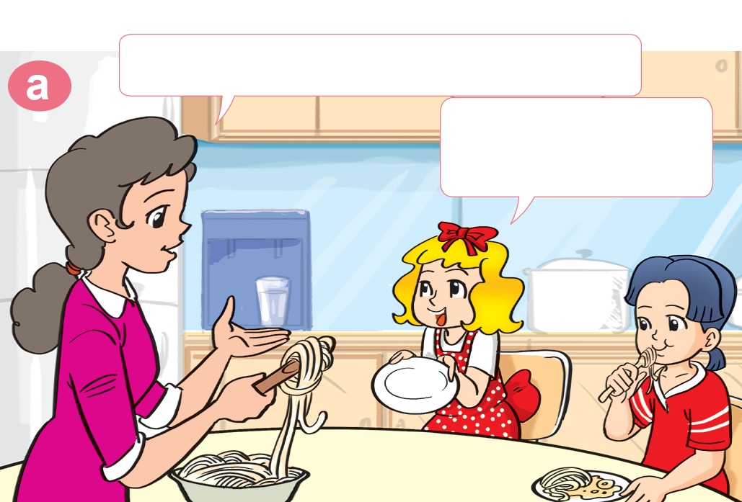
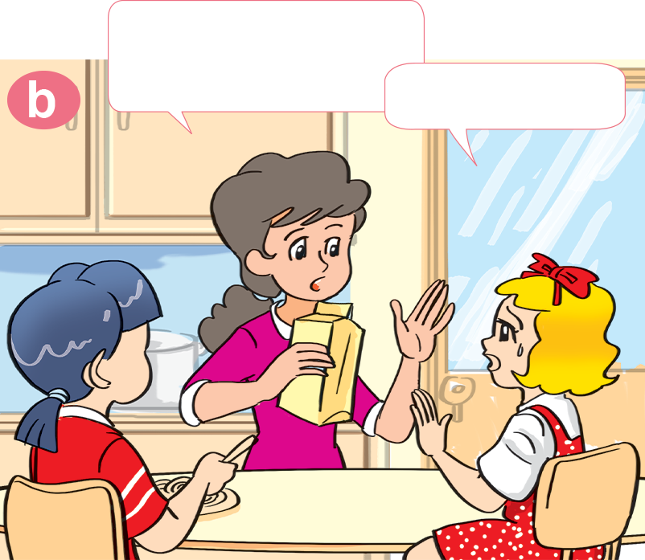

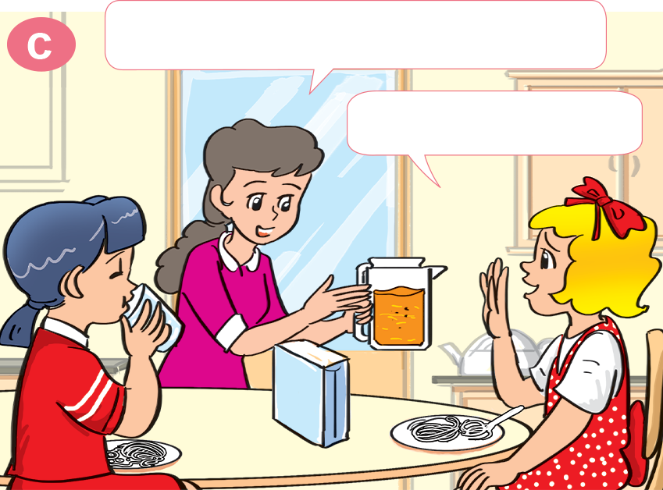
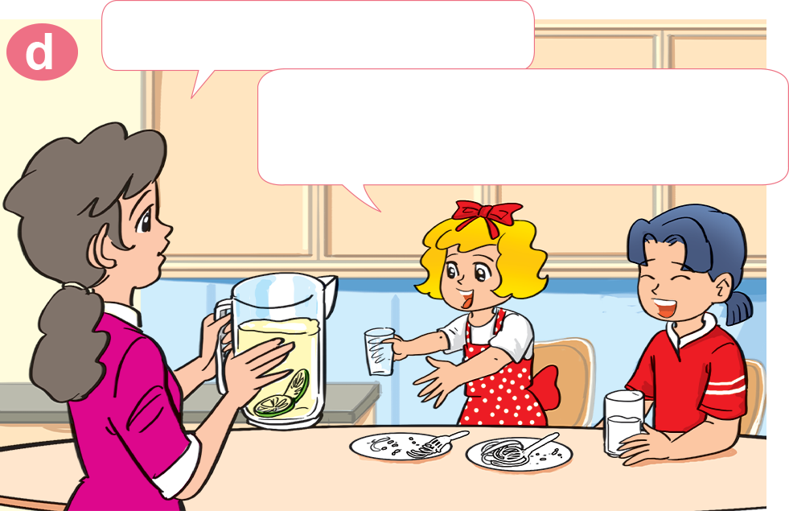

1. Look, listen and repeat
Would you like some milk?
Would you like some noodles?
No, thanks.
Yes, please. I love noodles.
What about orange juice?
How about lemonade?
Lemonade! Yes, please!
That's my favourite drink.
No, thank you.

Slide 9


B. Structures:
Mời ai ăn / uống gì:
Would you like some___?
Yes, please.
No, thank you.

Slide 10
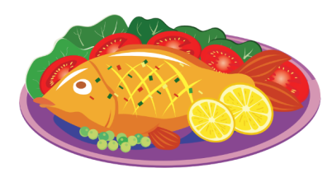
Yes, please.
Would you like some ________?
No, thank you.
fish
Lemonade
Rice
Bread
vegetables

Slide 11
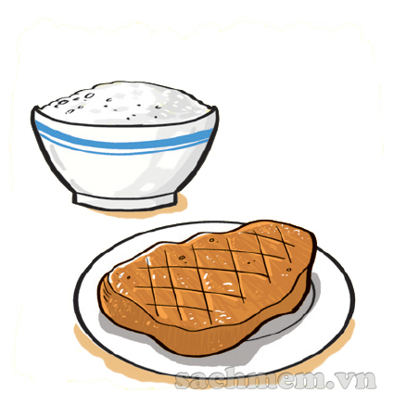
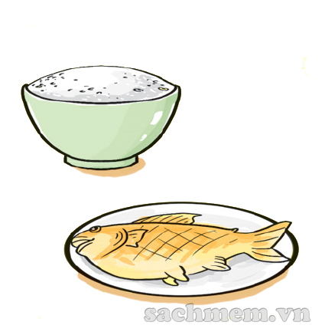
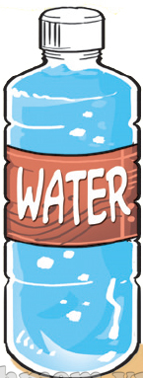
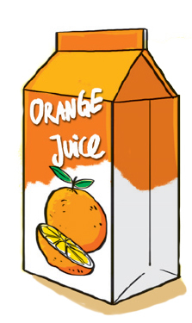
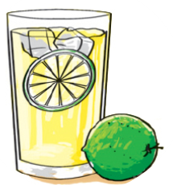
3. Listen and number
a
3
b
1
c
2
d
4
1
2
3
4

Slide 12

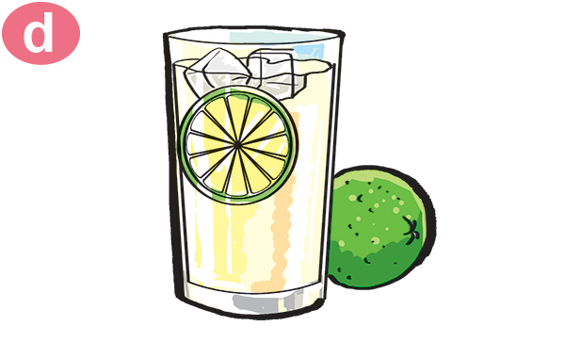

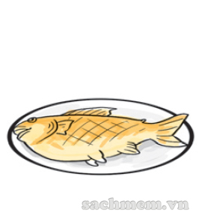


4. Look and write.
Orange juice
Milk
Lemonade
Water
Chicken
Fish
Rice
Bread

Slide 13
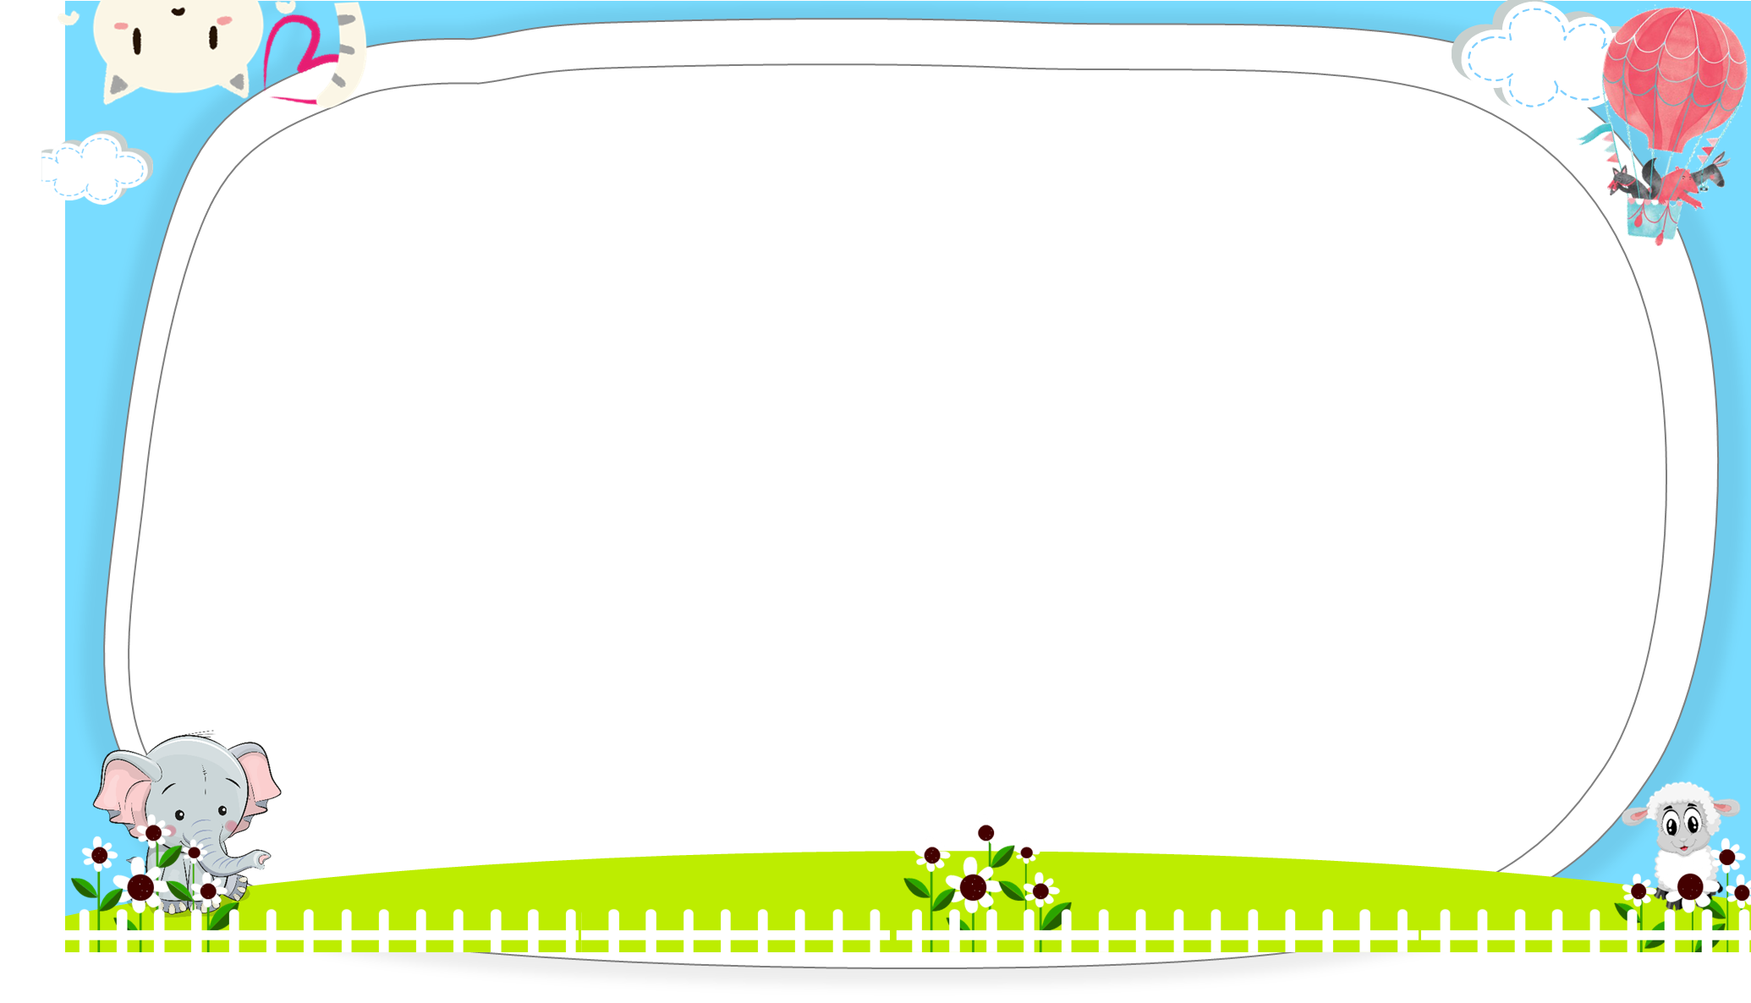




AND
GAME
PLAY

Slide 14



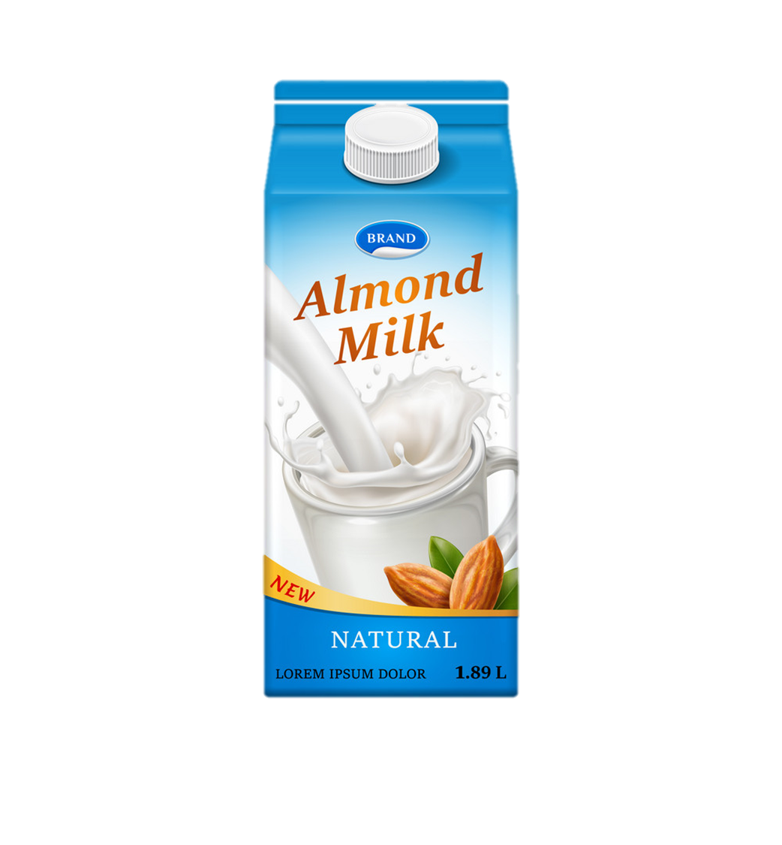
No
Yes
Would you like some milk?
____, please.
Next

Slide 15
please
Thank you
Would you like some lemonade?
Yes, _________.
Next

Slide 16
please
Thank you
Would you like some vegetable?
No, _________.
Next

Slide 17
please
Thank you
Would you like some rice?
No, _________.
Next

Slide 18
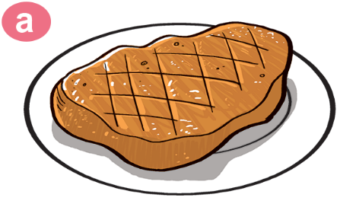
some
a
Would you like _____ beef?
No, thank you.
Next

Slide 19
please
Thank you
Would you like some bread?
Yes, _________.
Next

Slide 20

No
Yes
Would you like some orange juice?
_____, please.
Next

Slide 21


Would
What
______ you like some chicken?
Yes,please.
Next

Slide 22
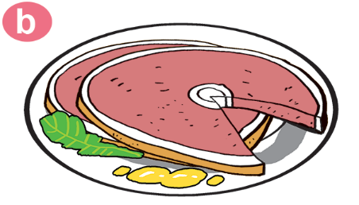
favourite
like
Would you ____ some pork?
No, thank you.
Next

Slide 23

Next

