Slide 1
Unit 12 – Lesson 3
What does
your father do?

Slide 2

1. Listen and repeat
ie /i:/ | field | My grandpa works in a field.
 | piece | I want a piece of chocolate.
ea /i:/ | teacher | My mother is a teacher.
 | reading | She's reading a book now.

Slide 3
2. Listen and circle. Then say sentences with the circled words.
a. field b. piece
a. teaching b. reading

Slide 4

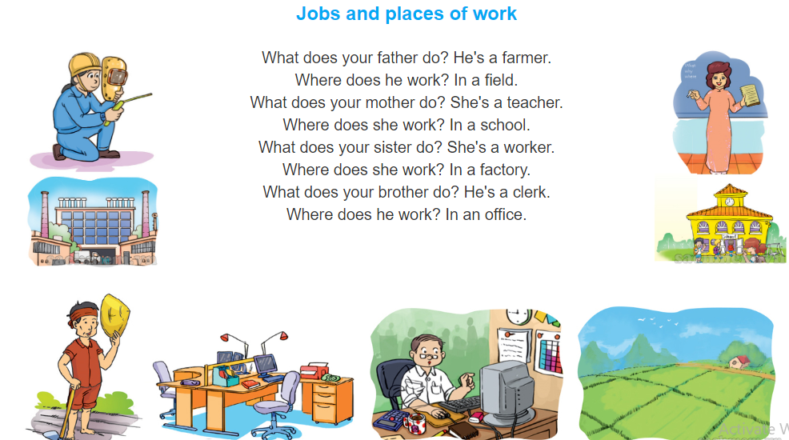
3. Let’s chant

Slide 5
4. Read and complete.
Report
This is the report of my interview with Phong. His father is a teacher. He works in Le Hong Phong Primary School. His mother is a nurse. She works in Thanh Nhan Hospital. Phong has a brother but he doesn't have a sister. His brother is a worker in a car factory. And as you know, Phong is a pupil in Class 4A. Thank you for reading.
 | Job | Place of work
Father
Mother
Brother
teacher
Le Hong Phong Primary School
nurse
Thanh Nhan Hospital
worker
car factory

Slide 6
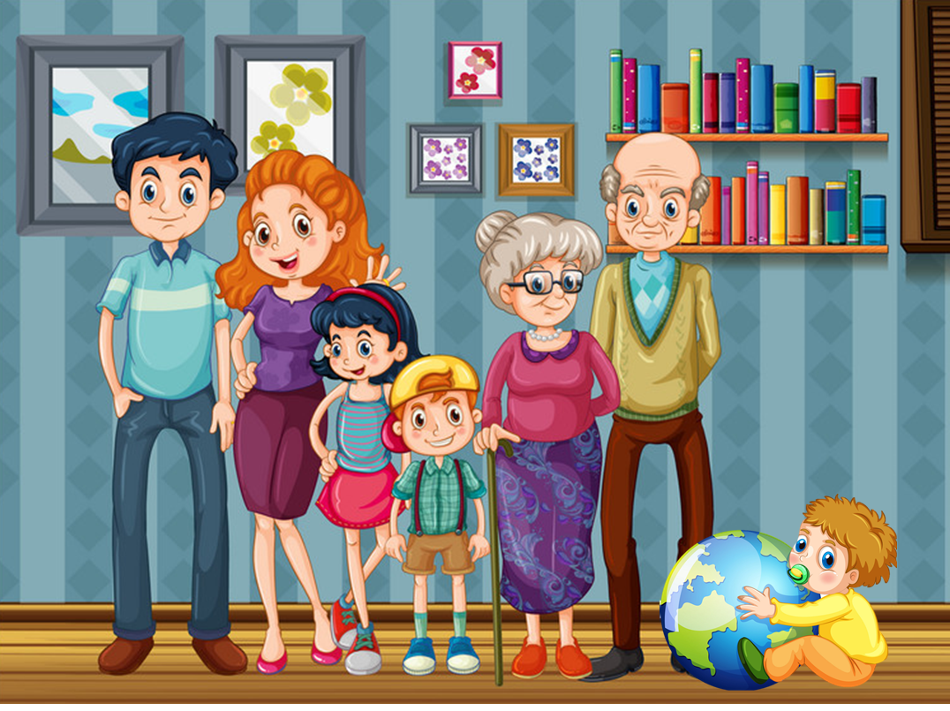
5. Write about the jobs of your family members and where they work.
There are _____ people in my family.
My father is a/an _______. He works _______________.
My mother is a/an _______. She works _______________.
My brother is a/an _______. He works/study __________.
My sister is a/an _______. She works/study ____________.
And I am a/an _______. I work/study _______________.

Slide 7
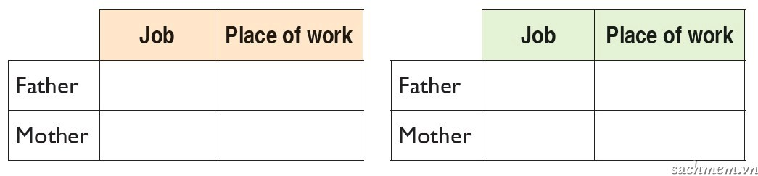
6. Project
lnterview two classmates about their parents' jobs.
Tell the class about them.
1. lnterviewee's name: ______
2. lnterviewee's name: ______

Slide 8








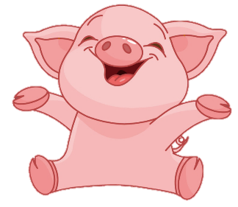
Luật chơi:
Các đội lần lượt chọn các số từ 1-10.
Trả lời đúng được cộng, trả lời sai bị trừ số điểm đã mở.
Ngôi sao xanh được +200 điểm khi trả lời đúng, trả lời sai không bị trừ điểm
Ngôi sao đen bị -200 điểm khi trả lời sai, trả lời đúng không bị trừ điểm.
Lucky number
PLAY
Notes:
Ms Huyền Phạm - 0936.082.789 – YOUTUBE: MsPham. Facebook: Dạy và học cùng công nghệ.

Slide 9


2
100
200
4
1
100
-200
3
100
7
5
6
+200
200
8
100
100
9
10
200
Notes:
Ms Huyền Phạm - 0936.082.789 – YOUTUBE: MsPham. Facebook: Dạy và học cùng công nghệ.

Slide 10



Her father is a worker.
He works in a _____.
Back
a. hospital
b. factory
c. school
Notes:
Ms Huyền Phạm - 0936.082.789 – YOUTUBE: MsPham. Facebook: Dạy và học cùng công nghệ.

Slide 11
Her sister is a teacher. She _____ in a primary school.
Back
a. teaches
b. work
c. teach
Notes:
Ms Huyền Phạm - 0936.082.789 – YOUTUBE: MsPham. Facebook: Dạy và học cùng công nghệ.

Slide 12
What does your _____ do?
Back
a. grandparents
b. parents
c. mother
Notes:
Ms Huyền Phạm - 0936.082.789 – YOUTUBE: MsPham. Facebook: Dạy và học cùng công nghệ.

Slide 13
Where does _____ work?
Back
a. they
b. you
c. he
Notes:
Ms Huyền Phạm - 0936.082.789 – YOUTUBE: MsPham. Facebook: Dạy và học cùng công nghệ.

Slide 14
Peter's sister works in an _____.
Back
a. factory
b. office
c. hospital
Notes:
Ms Huyền Phạm - 0936.082.789 – YOUTUBE: MsPham. Facebook: Dạy và học cùng công nghệ.

Slide 15
A: What does your father do, Mai?
B: He's a __________. He teaches English in a ____school in the city.
Back
a. worker
b. teacher
c. nurse
Notes:
Ms Huyền Phạm - 0936.082.789 – YOUTUBE: MsPham. Facebook: Dạy và học cùng công nghệ.

Slide 16
A: What does she ____?
B: She’s a nurse.
Back
a. teach
b. work
c. do
Notes:
Ms Huyền Phạm - 0936.082.789 – YOUTUBE: MsPham. Facebook: Dạy và học cùng công nghệ.

Slide 17
A: ________ does she work?
B: In a small hospital.
Back
a. Where
b. How
c. What
Notes:
Ms Huyền Phạm - 0936.082.789 – YOUTUBE: MsPham. Facebook: Dạy và học cùng công nghệ.

Slide 18
A doctor works ____ a hospital.
Back
a. at
b. in
c. on
Notes:
Ms Huyền Phạm - 0936.082.789 – YOUTUBE: MsPham. Facebook: Dạy và học cùng công nghệ.

Slide 19
I’m a pupil _______ Nguyen Trai Primary School.
Back
a. in
b.at
c. on
Notes:
Ms Huyền Phạm - 0936.082.789 – YOUTUBE: MsPham. Facebook: Dạy và học cùng công nghệ.

