Slide 1

Unit 5: Sports and hobbies
P.E. Lesson 4.1
Page 77

Slide 2





Review
Can you play ________?
- Yes, I can. / No I can’t.

Slide 3
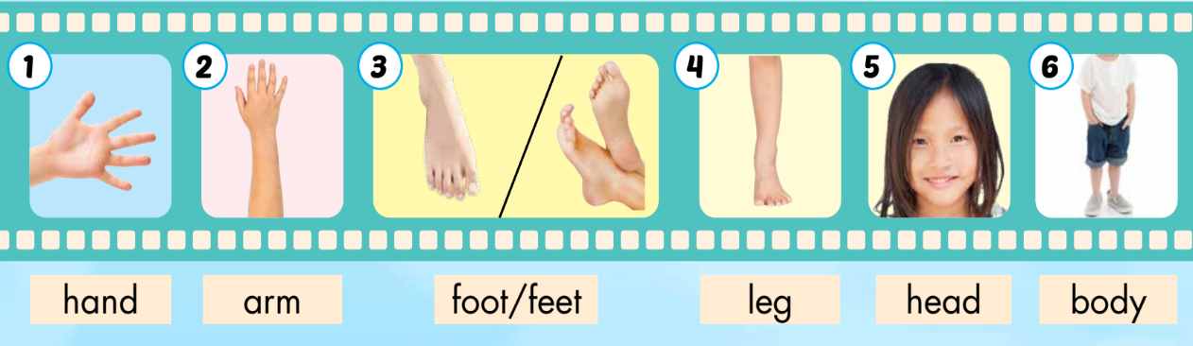

New words
Body parts
hand
arm
foot/feet
leg
head
body
/hænd/
bàn tay
/ɑːrm/
cánh tay
/fʊt/ /fiːt/
đôi bàn chân
/leɡ/
chân
/hed/
đầu
/ˈbɑːdi/
cơ thể
Click on each word to hear the sound.

Slide 4
Touch your ____.

Slide 5
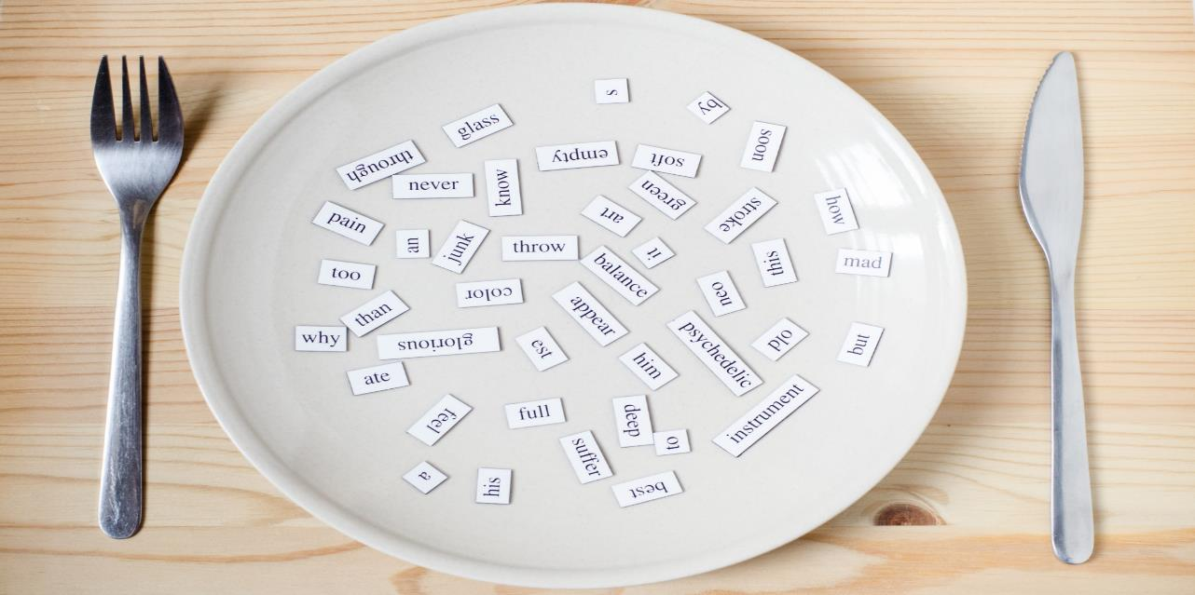
Structures
I use my legs and feet in soccer.
I can kick the ball in soccer.
I can't kick the ball in basketball.

Slide 6

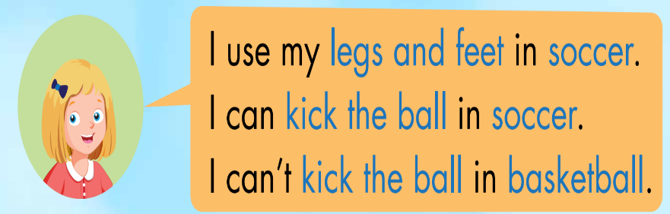
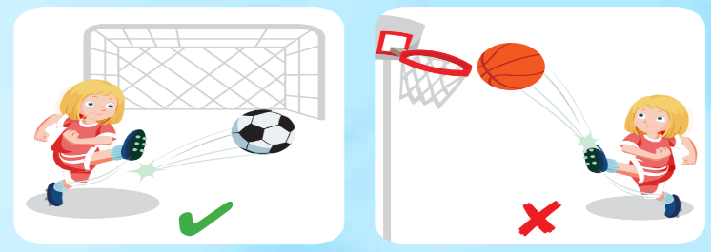

Slide 7
Make sentences:
head
arms
hands
feet
legs
basketball
I use my ______ in ______.
tennis
badminton
volleyball
soccer

Slide 8
Make sentences:
kick the ball
catch the ball
throw
the ball
basketball
I can ______ in ______.
I can’t _____ in ______.
tennis
badminton
volleyball
soccer

Slide 9

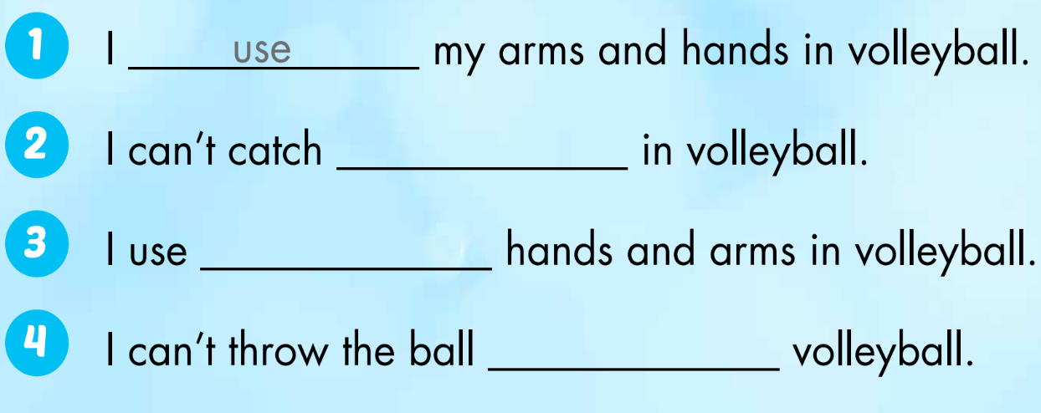
the ball
my
in

Slide 10

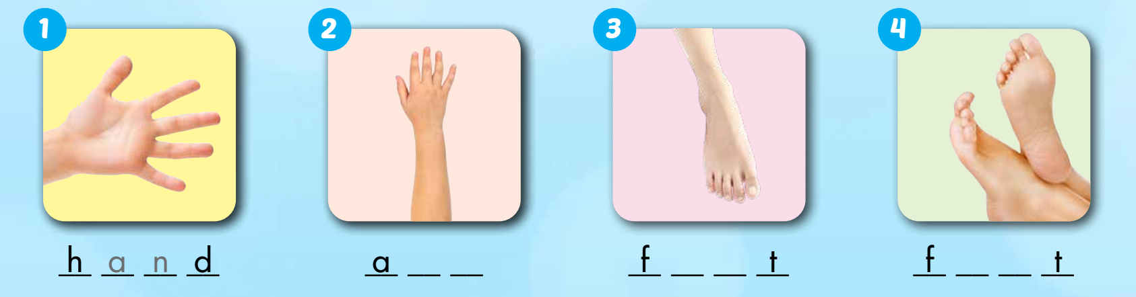
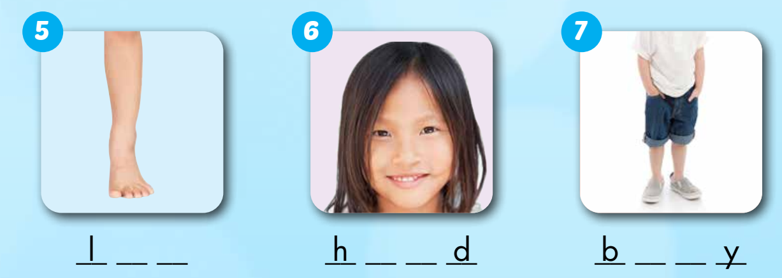
WB, page 54.
r m
o o
e e
e g
e a
o d

Slide 11

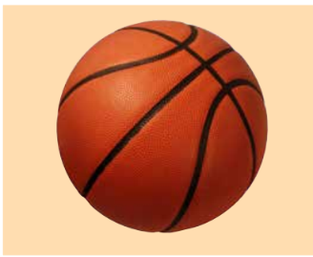
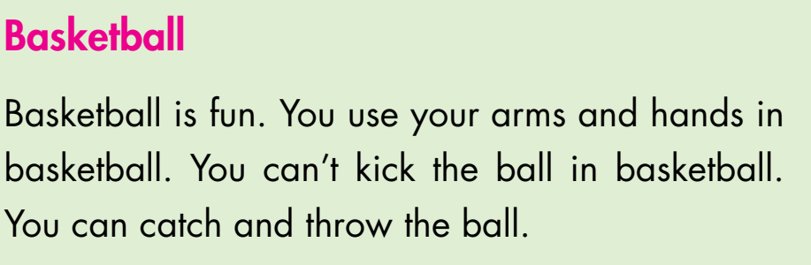
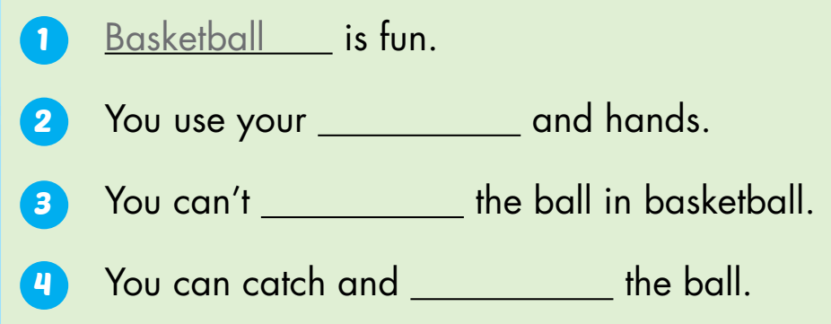
Extra Practice
WB, page 54.
arms
kick
throw

Slide 12
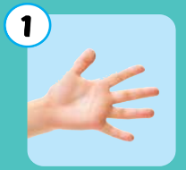
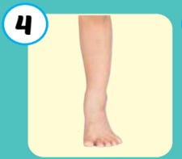
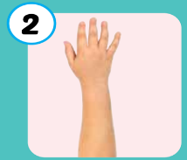

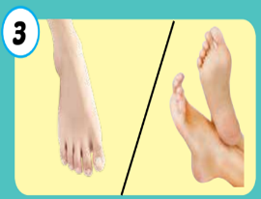
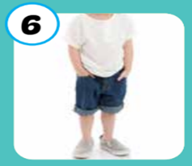
6
1
SPIN
5
2
4
3
Notes:
GV dùng vòng quay để HS chọn số ngẫu nhiên. Khi chọn vào ô số nào thì sẽ làm câu cho số đó

Slide 13

Write about yourself
_______ ____ is fun. I use my ___and ___in ____.
I can’t ___the ball in ____. I can ___ and ___ the ball.

Slide 14
Today’s lesson
Vocabularies
hand
arm
foot/feet
leg, head
body
Structures/ Sentence patterns
I use my legs and feet in soccer.
I can kick the ball in soccer.
I can't kick the ball in basketball.

