Slide 1

Unit 5: Sports and hobbies
Lesson 3.3
Page 76

Slide 2
WARM UP

Slide 3
BROKEN WORDS
BROKEN WORDS

Slide 4

ska
go
ing
gh
te
rd
boa
set
Click on the piece.

Slide 5
BROKEN WORDS
go skateboarding

Slide 6
ly
swi
ing
mm
go
rd
wa
set

Slide 7
BROKEN WORDS
go swimming

Slide 8
go
re
ing
th
wa
si
tch
TV

Slide 9
BROKEN WORDS
watch TV

Slide 10
ty
wh
ou
u
go
rd
w
t

Slide 11
BROKEN WORDS
Go out

Slide 12

It’s time to learn …

Slide 13
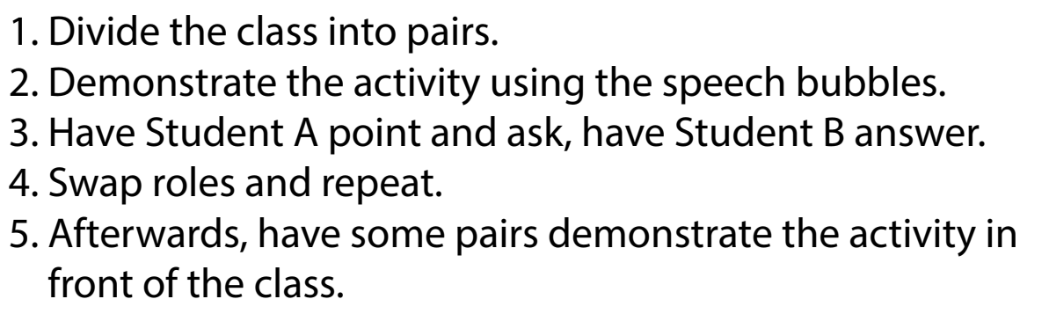

Slide 14

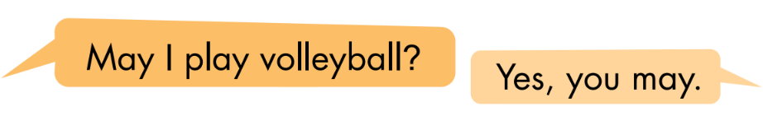
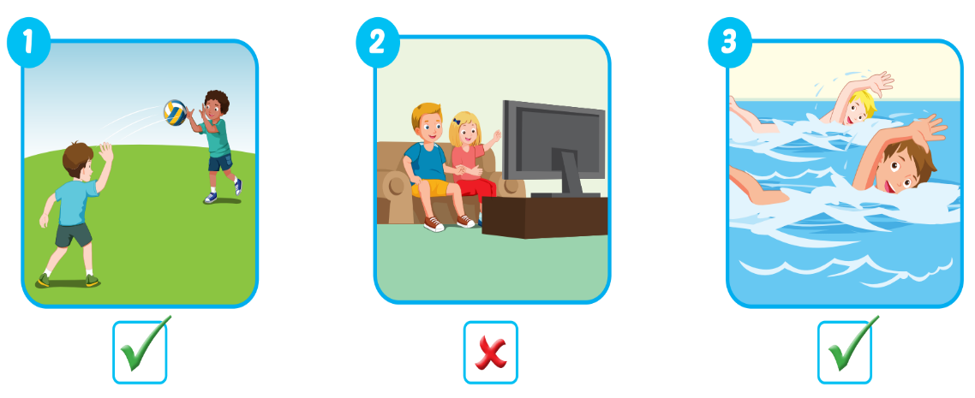
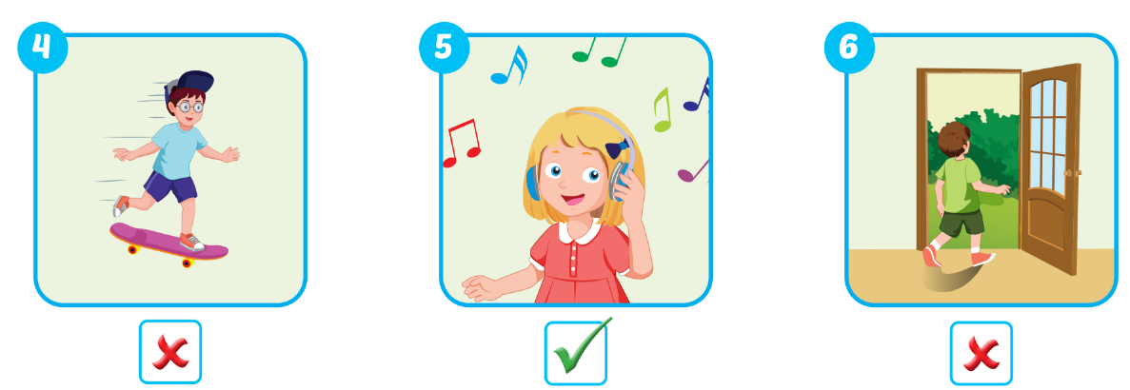

Slide 15

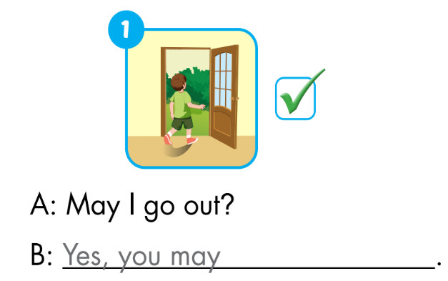
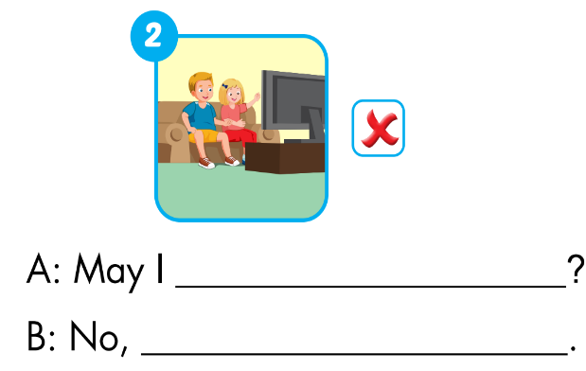
Extra Practice
WB, page 53.
watch TV
you may not

Slide 16
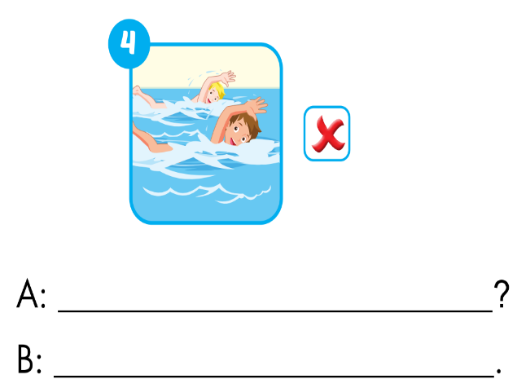
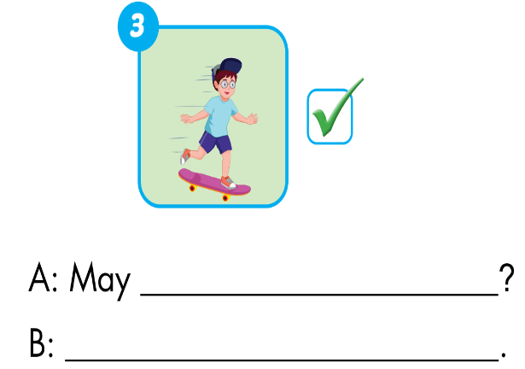
Extra Practice
WB, page 53.
I go skateboarding
May I go swimming?
Yes, you may.
No, you may not

Slide 17

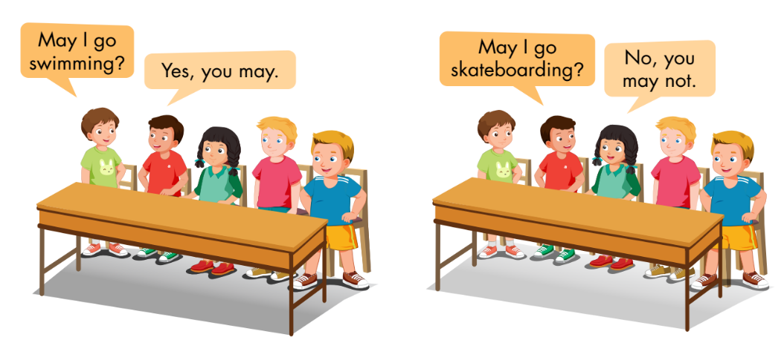

Slide 18

1. Divide the class into two teams. 2. Show a flashcard to the class and say "yes" or "no." 3. Have Team A ask the question and Team B answer. 4. Swap roles and repeat.

Slide 19
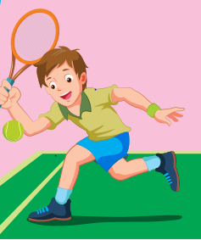

Team A:
May I play tennis?
No, you may not.
Team B:

Slide 20


Slide 21

✓

Slide 22
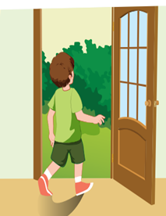

Slide 23
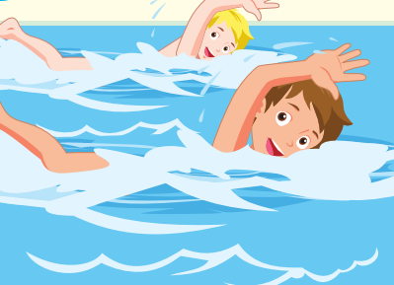
✓

Slide 24
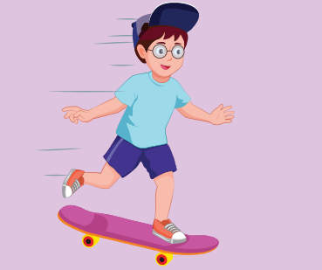
✓

Slide 25
Today’s lesson
Vocabularies
watch TV
go skateboarding
go out
go swimming
Structures/ Sentence patterns
May I watch TV?
- Yes, you may./No, you may not.

