Slide 1
Unit 14 – Lesson 2
What does
your father do?

Slide 2
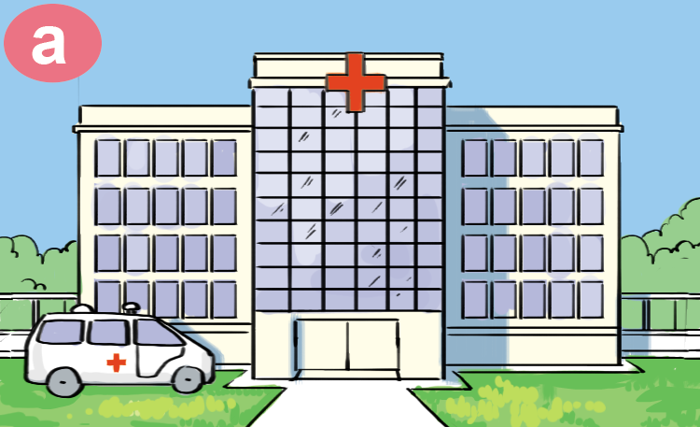
hospital
/ˈhɒspɪtl/

Slide 3
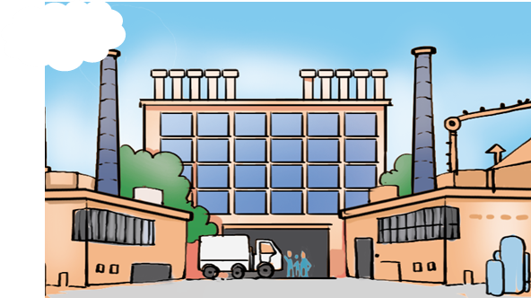
factory
/ˈfæktəri/

Slide 4
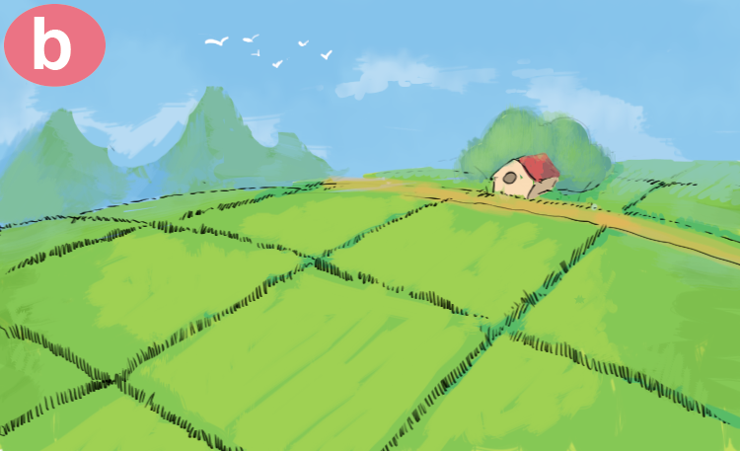
field
/fiːld/

Slide 5
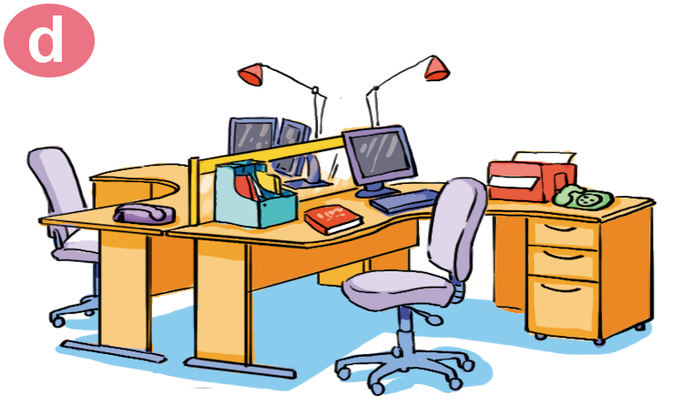
office
/ˈɒfɪs/

Slide 6

clerk
/klɜːrk/

Slide 7
Vocabulary
clerk
office
field
factory
hospital

Slide 8
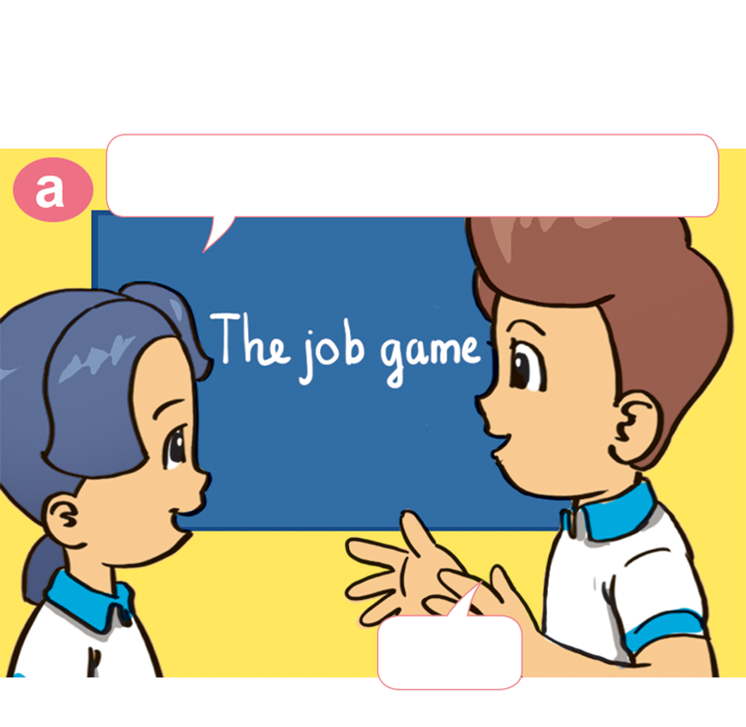
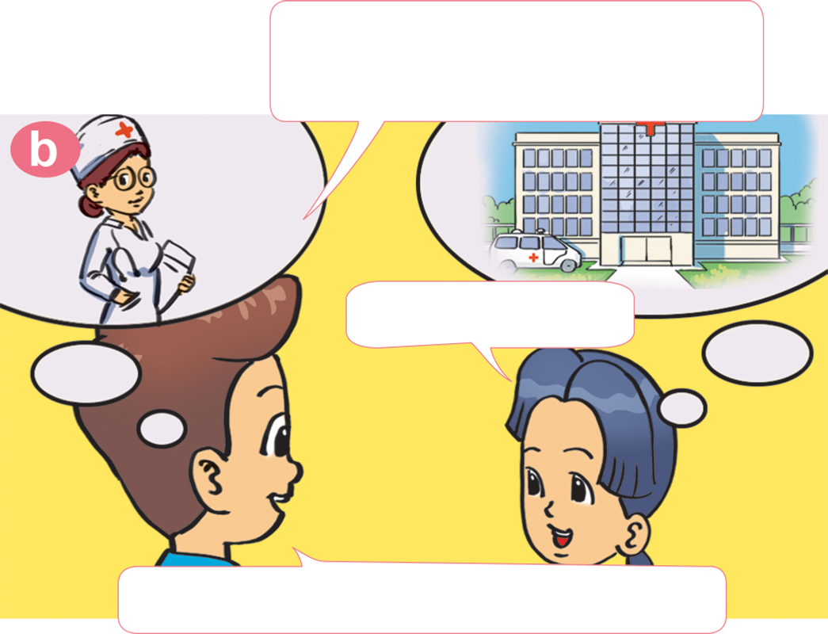
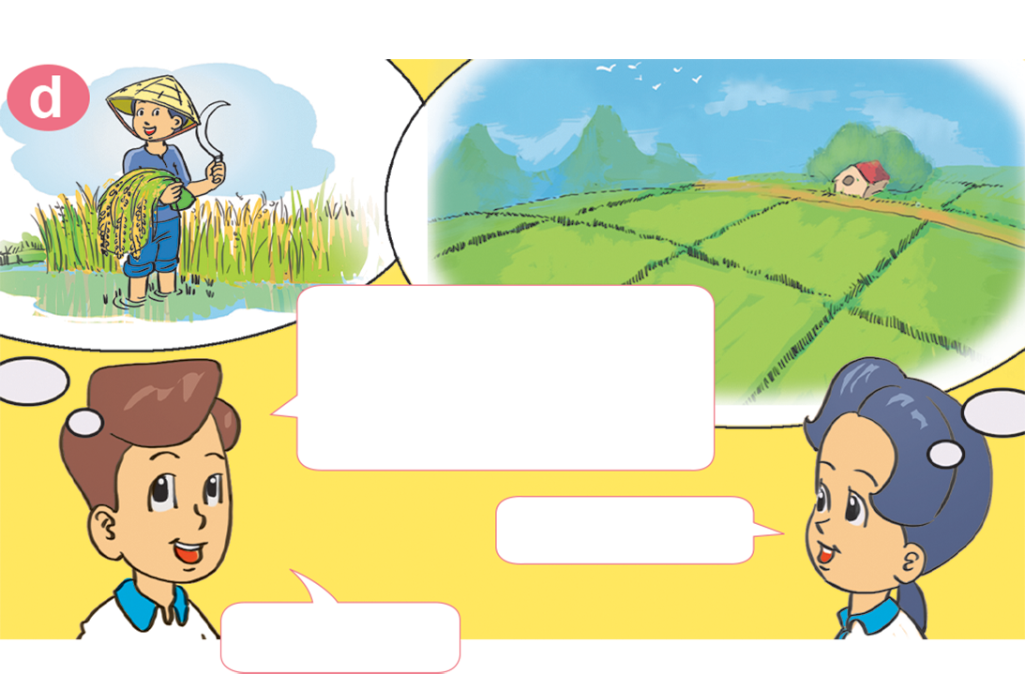
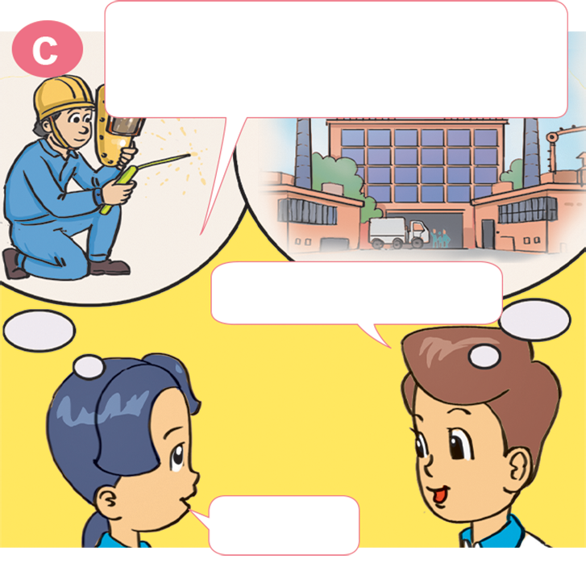
1. Look, listen and repeat
She's a doctor.
Where does she work?
Let's play a game of jobs.
ln a hospital.
OK
Well done! Now it's your turn.
He's a worker.
Where does he work?
She's a farmer.
Where does she
work?
ln a factory
ln a field.
Great.
Correct!

Slide 9
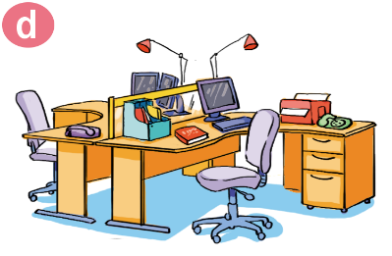


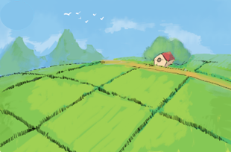
2. Point and say
Where does a/an ______ work?
A/an ____ works in a / an _____.
a clerk
a teacher
office
school
a doctor
a worker
a farmer
hospital
factory
field

Slide 10

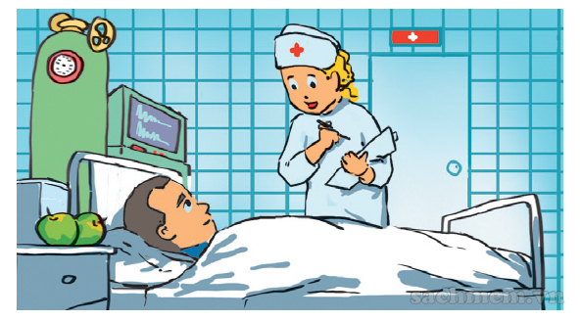
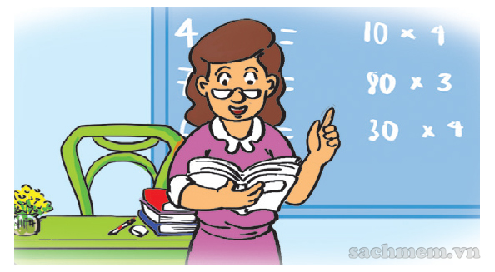
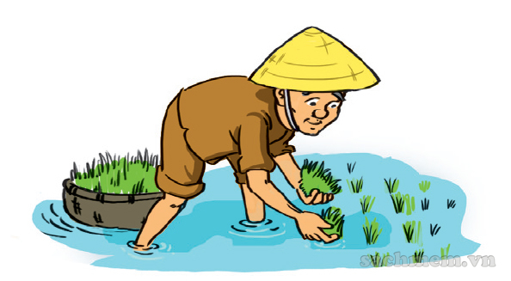
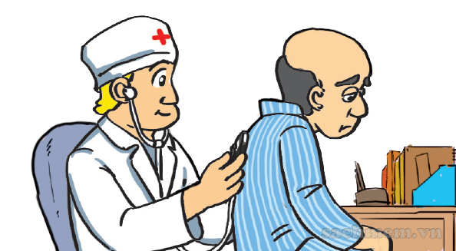
3. Listen and tick.
a
b
2
4
c
d
1
3

Slide 11
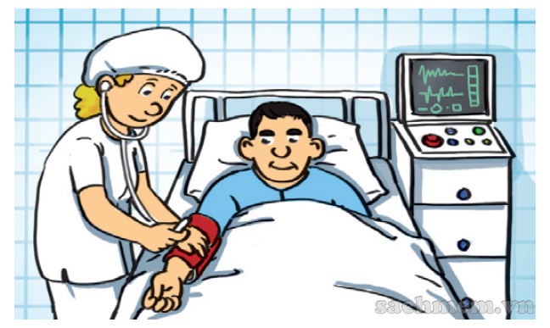
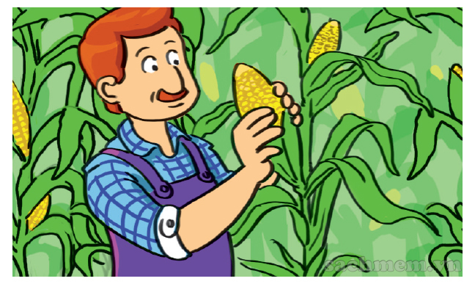
5. Look and write.
This is Ann's mother.
She is ____________________.
She works ________________.
This is Ann's father.
He is ___________________.
He works _________________.
a doctor
/ a nurse
a farmer
in a hospital
in a field

Slide 12



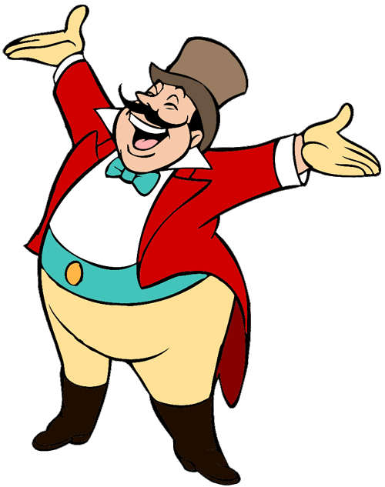
START

Slide 13

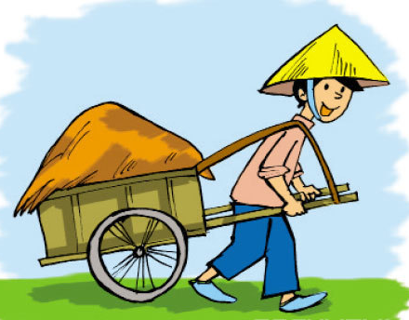



My father is a farmer. He works in _____.
a factory
a field
a school

Slide 14

I'm a pupil. I study _______.
in a school
in a hospital
in a field
Next

Slide 15

My brother is a factory worker. He works________.
in a company
in a factory
in a school

Slide 16
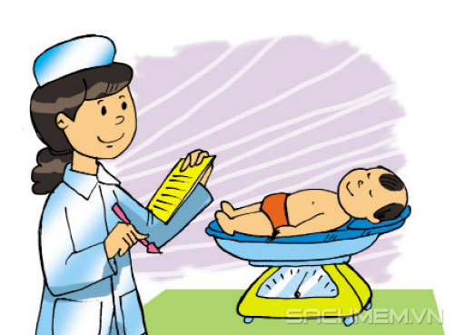
My mother is a nurse. She works _______.
in a hospital
in a school
in a field
Next

Slide 17
My brother is a factory worker. ____ works in a factory.
He is
He
He’s

Slide 18
My mother is a nurse. She _______ in a hospital.
is
work
works

Slide 19
_____ works in the field.
A teacher
A doctor
A farmer

Slide 20
A doctor works ____ a hospital.
in
on
up
Next

Slide 21
What does your grandfather do?
A. She's a doctor.
B. He's a doctor.
C. He works in a hospital.

Slide 22
Where does your brother work?
A. She works in a hospital.
B. He work in a hospital.
C. He works in a hospital.

Slide 23
Where does your father work?
A. He works on the farm.
B. She works on the farm.
C. He is a farmer.
Next

Slide 24
Where does your mother work?
A.She is a nurse.
B.She is a doctor.
C. She works in a hospital.

Slide 25



GOOD JOB!
Ms Huyền Phạm
0936.082.789

