Slide 1

Unit 5: Sports and hobbies
Lesson 2.3
Page 72

Slide 2
Vocabulary Review

Slide 3


Choose a number and fill in the blank.
c_tching
thr_w_ng
1
2
a
o
i
k_c_ing
_itting
3
i k
4
h
Click here to show answers.
1
2
3
4
Click on each word to hear the sound.

Slide 4

It’s time to learn …

Slide 5

Phonics
/θ/

Slide 6

/θ/
throwing
three
Click on each word to hear the sound.

Slide 7


/ θ /, / θ /, / θ /,
/ θ /, / θ /, / θ /,
throwing, three,
/ θ /, / θ /, / θ /
Click to follow the lyrics.
Notes:
GV click lần 1 để follow lyric 1
Gv click lần 2 để follow lyric 2

Slide 8

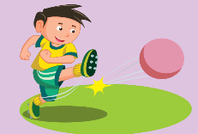
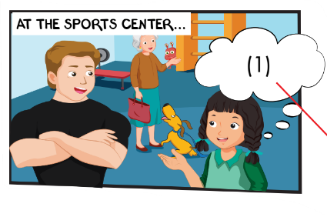
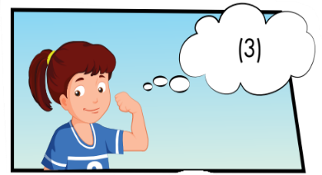
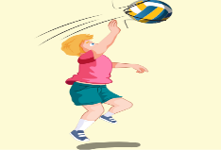
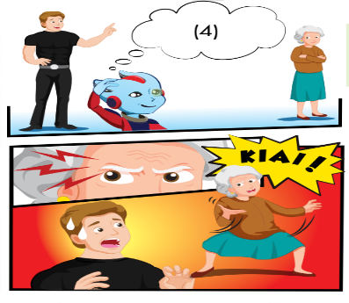
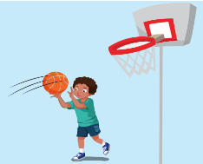
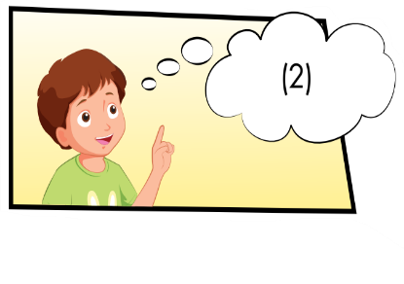
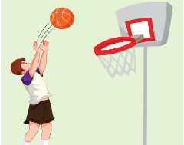
Who can you see?
What actions can you see?
How does the man feel?

Slide 9
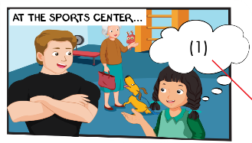
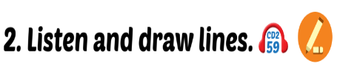
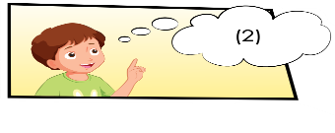
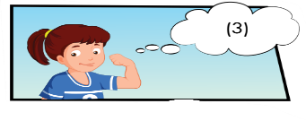
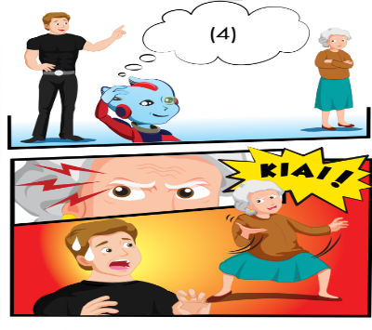
kicking, soccer
hitting balls, volleyball
catching, basketball
throwing, basketball

Slide 10
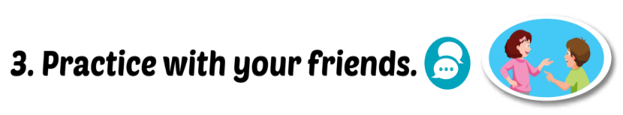
James: What are you good at, Mai? Mai: I’m good at James: Good. You can play with the team.
1
kicking.
soccer
James: What are you good at, Tom? Tom: I’m good at James: OK. for you.
2
catching.
Basketball

Slide 11
James: What about you, Lucy? Lucy: I’m good at .See? James: Lucy, the team.
3
hitting balls
volleyball
James: Alfie, what are you good at? Alfie: I’m good at balls. James: Good. team. OK, Grandma? What are you good at? Grandma: I’m good at doing this! Kiai! Children: Wow!
throwing
Basketball
4
Click on the number to hear the sound

Slide 12
Extra Structure:
Yes, I am
Are you good at _____?
No, I’m not

Slide 13

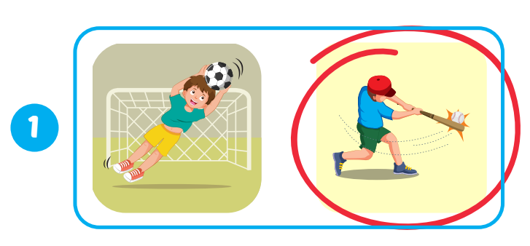
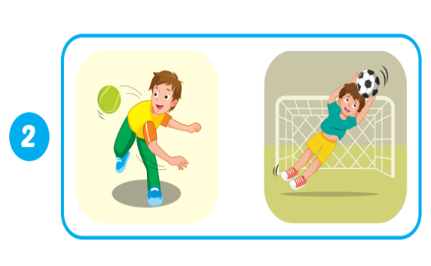
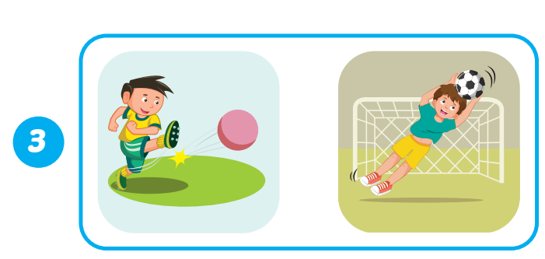
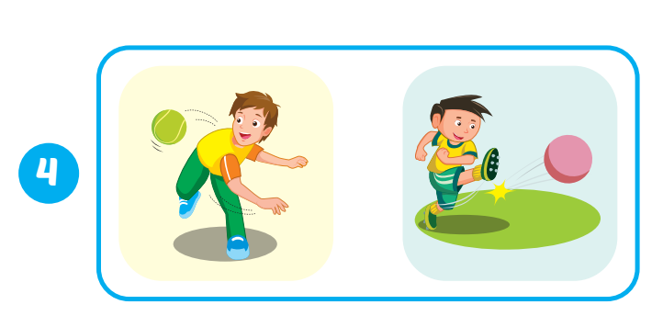
WB, page 51.

Slide 14

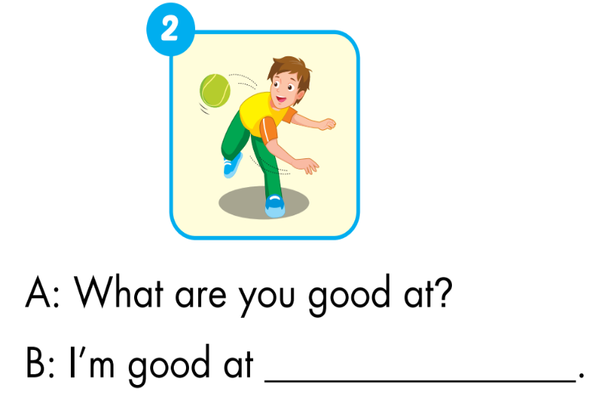
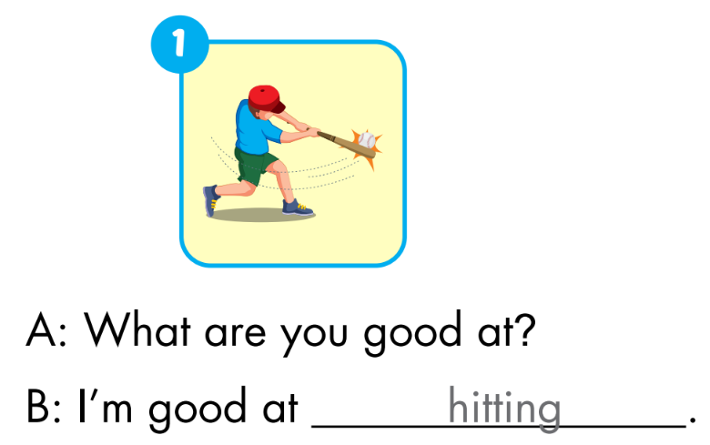
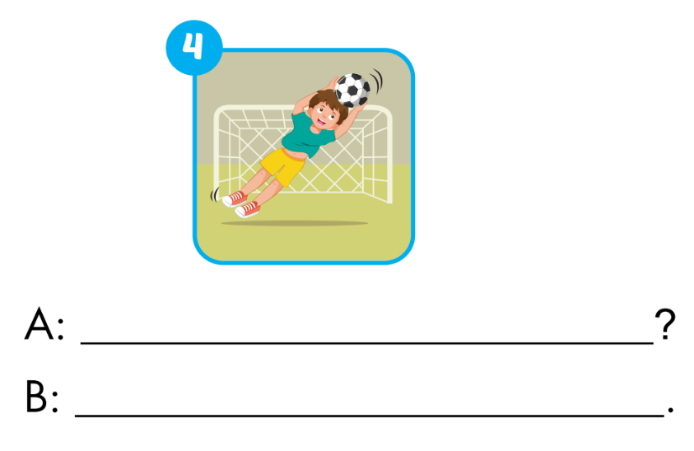
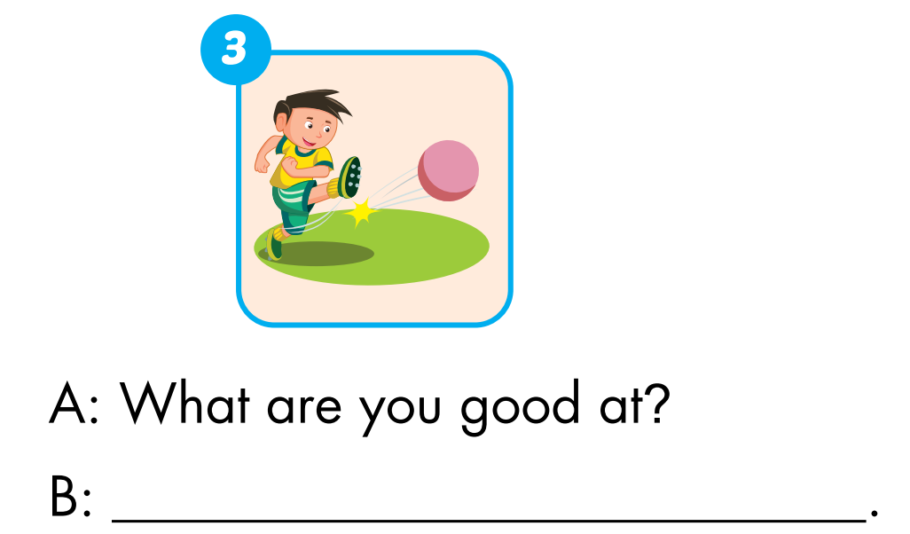
WB, page 51
throwing
What are you good at
I'm good at kicking.
I'm good at catching

Slide 15
Today’s lesson
Phonics
/θ/
Structures/ Sentence patterns
What are you good at?
- I’m good at…

