Slide 1
Project
BLACK BEANS
Người thực hiện: GV Thạch Lan Hương
Lớp: MGB C2

Slide 2
Thu hoạch
Hạt đỗ đen

Slide 3
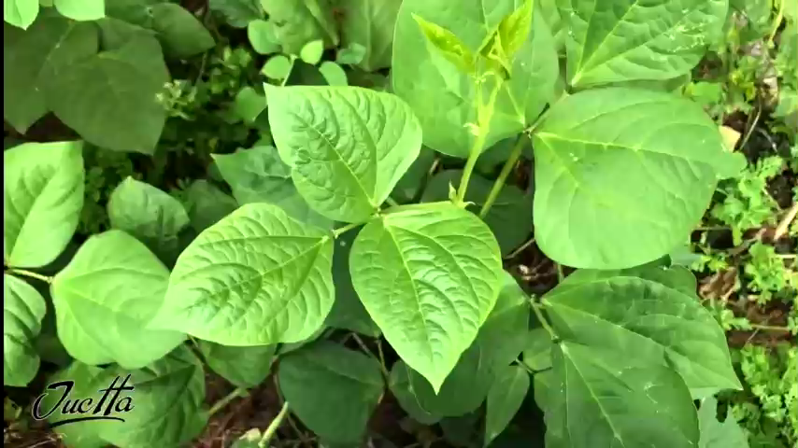
Contents of this template
This is a slide structure based on a Multi-Purpose presentation
You can delete this slide when you’re done editing the presentation
Fonts | To view this template correctly in PowerPoint, download and install the fonts we used
Used and alternative resources | An assortment of graphic resources that are suitable for use in this presentation
Thanks slide | You must keep it so that proper credits for our design are given
Colors | All the colors used in this presentation
Infographic resources | These can be used in the template, and their size and color can be edited
Customizable icons | They are sorted by theme so you can use them in all kinds of presentations
For more info:
SLIDESGO | SLIDESGO SCHOOL | FAQS
You can visit our sister projects:
FREEPIK | FLATICON | STORYSET | WEPIK | VIDFY

Slide 4
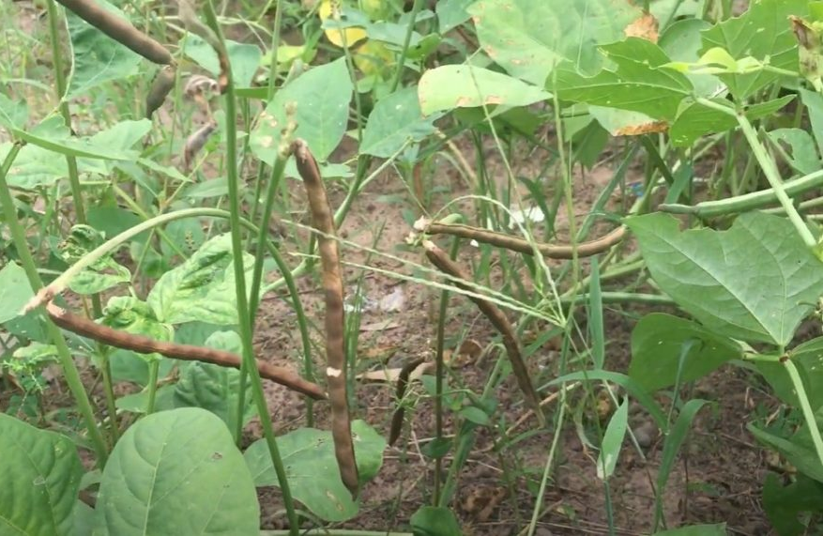
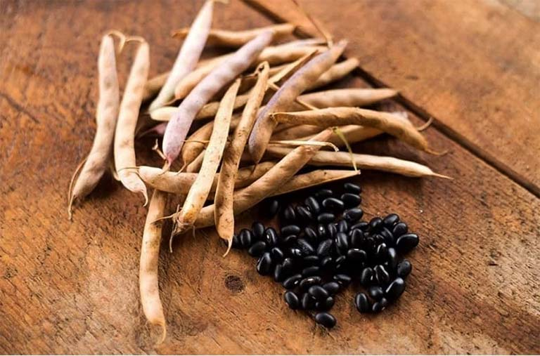
QUAN SÁT
Cây đỗ đen
Quả và hạt đỗ đen

Slide 5
Những món ăn được chế biến từ đỗ đen

Slide 6

Kem đỗ đen

Slide 7
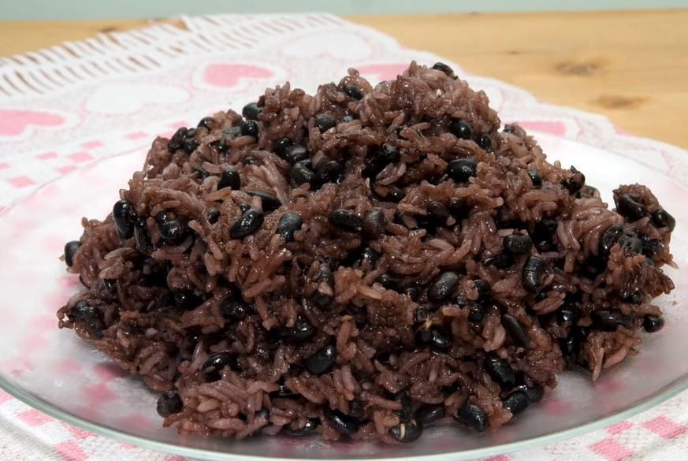
Xôi đỗ đen

Slide 8
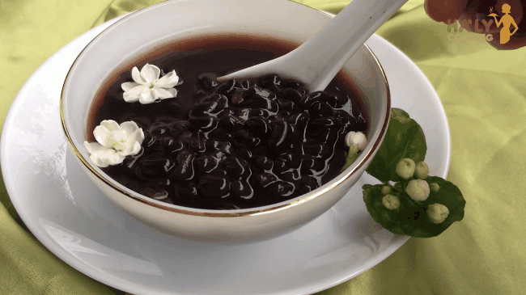
Chè đỗ đen

Slide 9
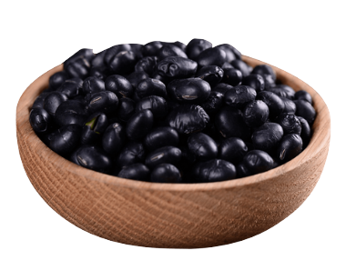
Về nhóm

