Slide 1

Unit 5: Getting Around
Lesson 1.1
Page 64

Slide 2

New words
stop, do not enter, turn left,
turn right, no parking.

Slide 3



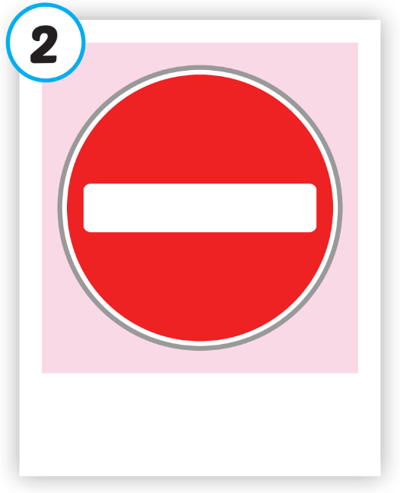
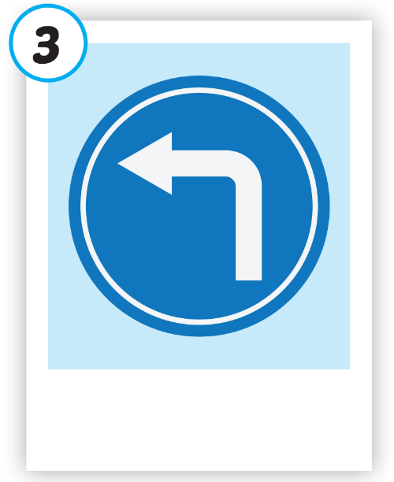
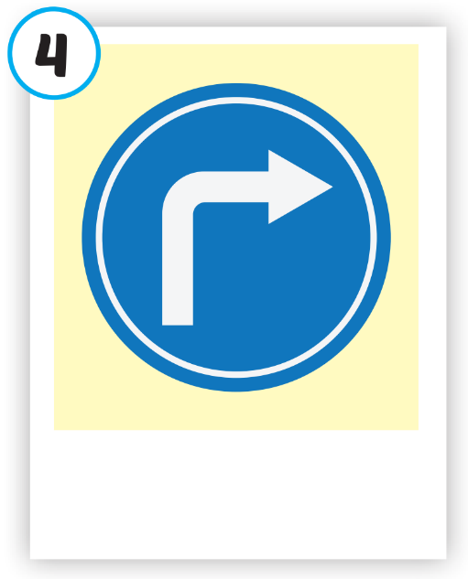
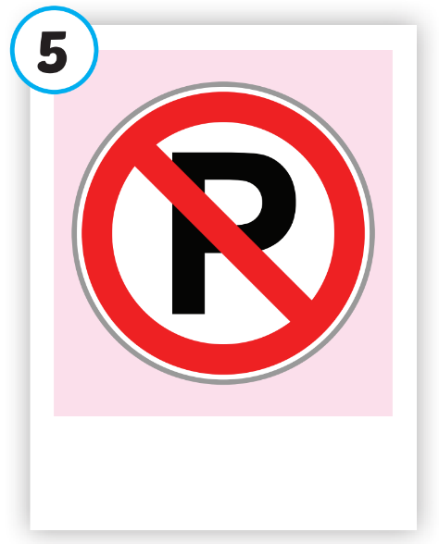





Click on each picture to hear the sound.
/stɑːp/
ngừng lại, dừng lại
/duː nɑːt ˈentər/
cấm vào
/tɜːrn left/
rẽ trái
/tɜːrn raɪt/
rẽ phải
/noʊ ˈpɑːrkɪŋ/
cấm đỗ xe

Slide 4
Structure
What does that sign mean?
It means "Stop".

Slide 5

Presentation

Slide 6


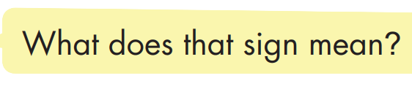
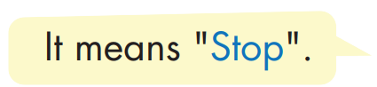

Structure

Slide 7


Slide 8

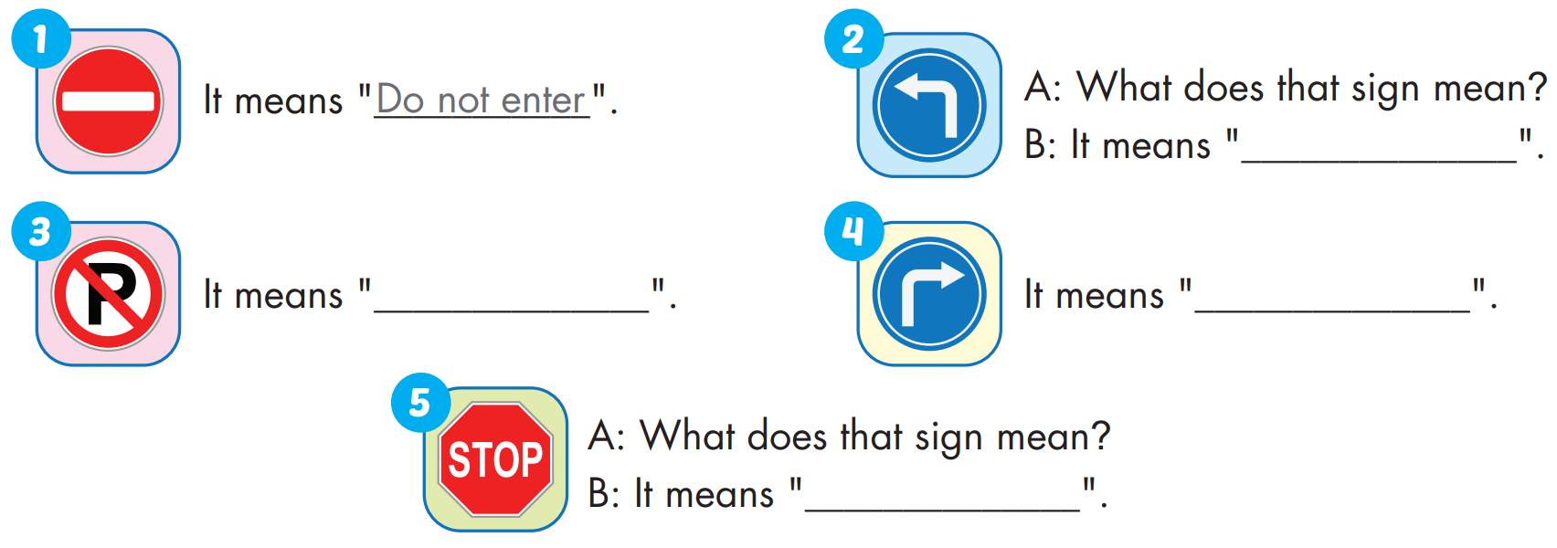
turn left
no parking
turn right
stop

Slide 9

CONSOLIDATION

Slide 10
Homework
Practice the vocabularies and structure; and make sentences using them.
Do the exercises in Tiếng Anh 4 i-Learn Smart Start WB (page 42).
Do the exercises in Tiếng Anh 4 i-Learn Smart Start Notebook (page 28).
Prepare the next lesson (page 65 SB).
Play the consolidation games in Tiếng Anh 4 i-Learn Smart Start DHA App on www.eduhome.com.vn

