Slide 1

Unit 5: Getting Around
Lesson 2.1
Page 67

Slide 2
Objectives
By the end of this lesson, students will be able to…
Vocabulary: Pronounce and use the words related to the topic properly: near, behind, next to, opposite, in front of.
Structure: Where's the park? - It's next to the library.

Slide 3

New words
near, behind, next to,
opposite, in front of

Slide 4

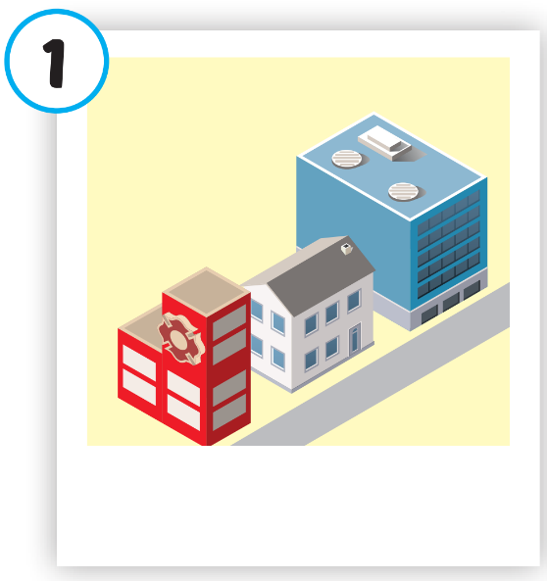
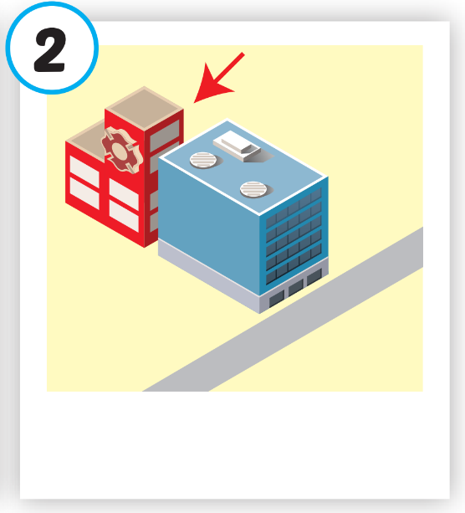
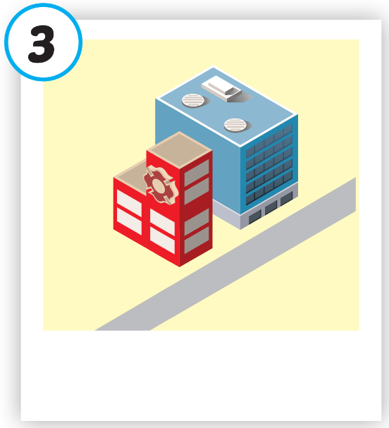
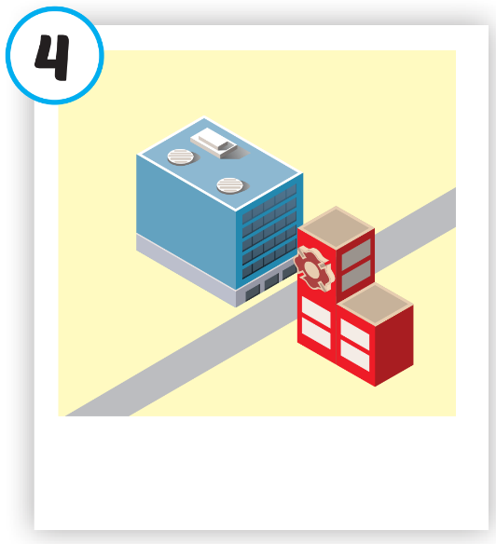
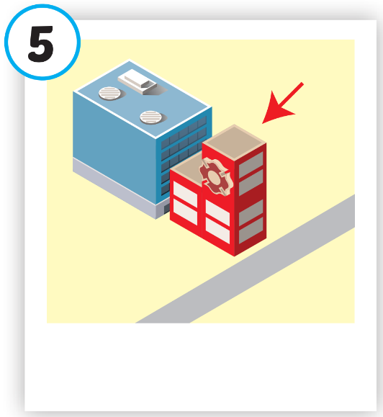





Click on each picture to hear the sound.
/nɪr/
gần
/bɪˈhaɪnd/
đằng sau
/nekst tə/
bên cạnh
/ˈɑːpəzɪt/
đối diện
/ɪn ˈfrʌnt əv/
phía trước
Notes:
Click vào hình A. 1. Listen and point. Repeat để cho cả audio full chạy

Slide 5
Structure
Where's the park?
It's next to the library.

Slide 6

Presentation

Slide 7
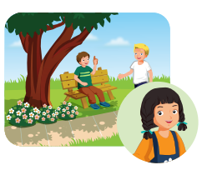

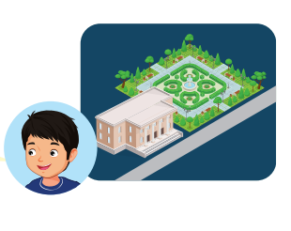

Structure

Slide 8

Practice

Slide 9


Slide 10
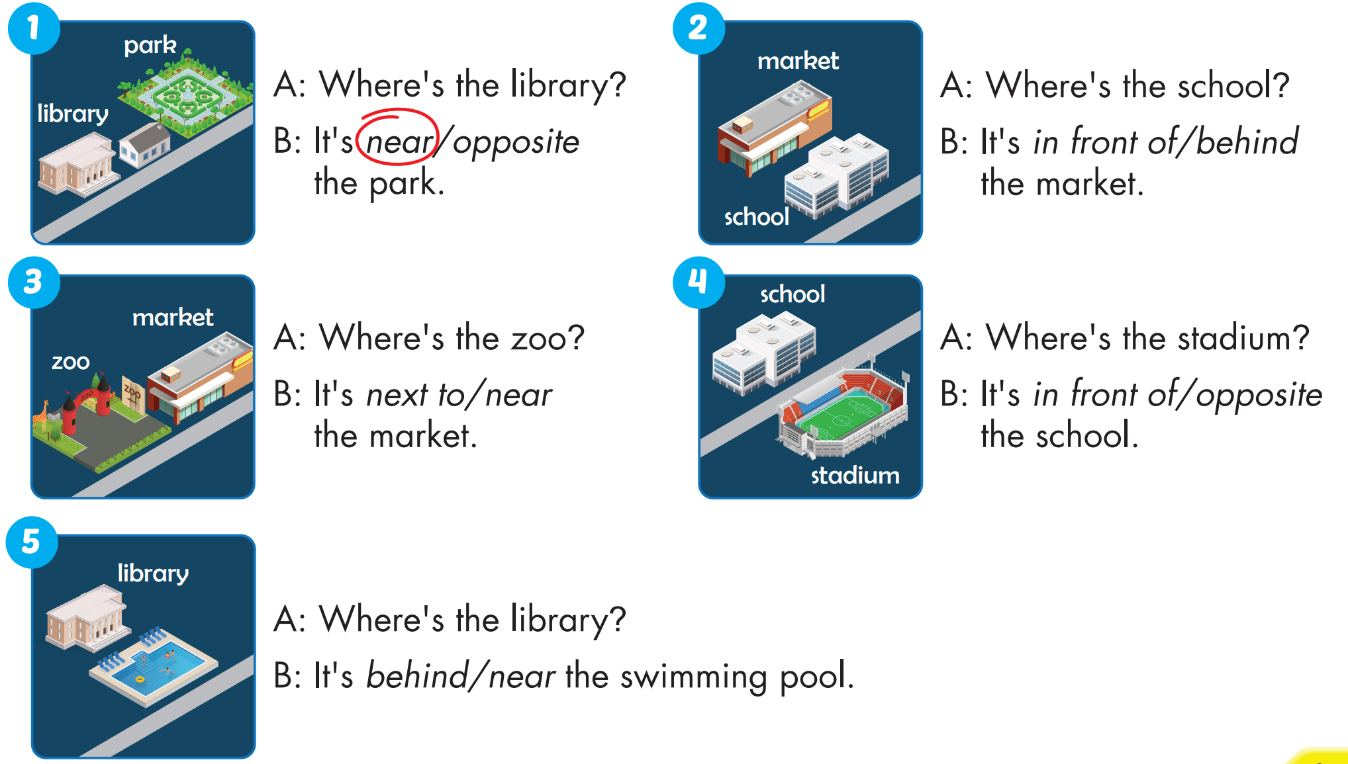


Slide 11

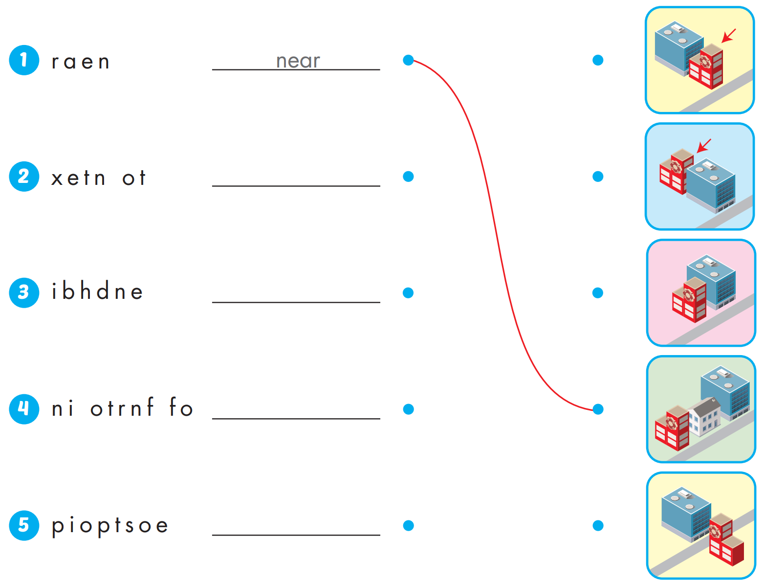
Extra Practice
WB, page 44
next to
behind
in front of
opposite

Slide 12

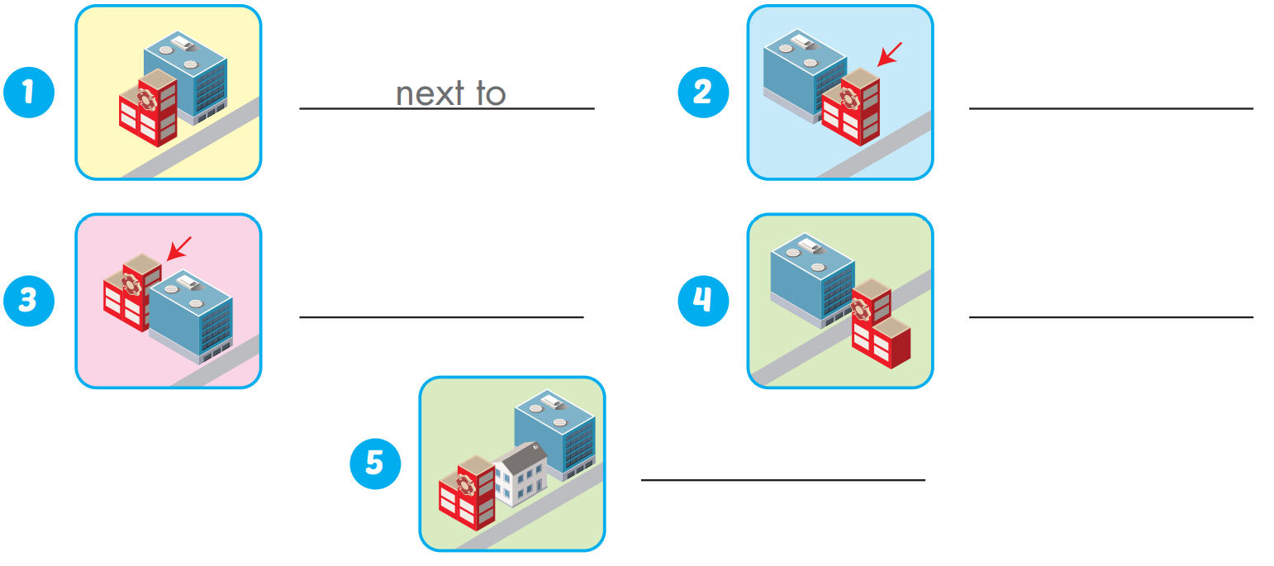
Extra Practice
WB, page 44
in front of
behind
opposite
near

Slide 13

WRAP-UP

Slide 14
Today’s lesson
Vocabularies
near, behind, next to, opposite, in front of.
Structures/ Sentence patterns
Where's the park?
- It's next to the library.

Slide 15
Homework
Practice the vocabularies and structure; and make sentences using them.
Do the exercises in Tiếng Anh 4 i-Learn Smart Start WB (page 44).
Do the exercises in Tiếng Anh 4 i-Learn Smart Start Notebook (page 29).
Prepare the next lesson (page 68 SB).
Play the consolidation games in Tiếng Anh 4 i-Learn Smart Start DHA App on www.eduhome.com.vn

Slide 16

Enjoy your day!

