Slide 1

Unit 5: Getting Around
Lesson 1.3
Page 66

Slide 2
Objectives
By the end of this lesson, students will be able to…
Vocabulary: Pronounce and use the words related to the topic properly: stop, do not enter, turn left, turn right, no parking.
Structure: What does that sign mean? - It means "Stop".
Phonics: Identify the /g/ sound and practice the conversations.

Slide 3

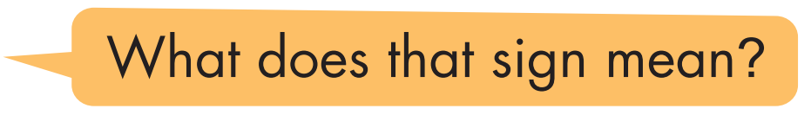
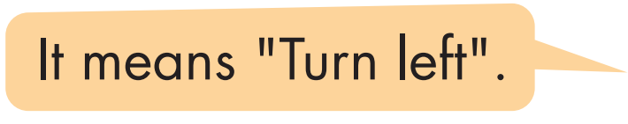
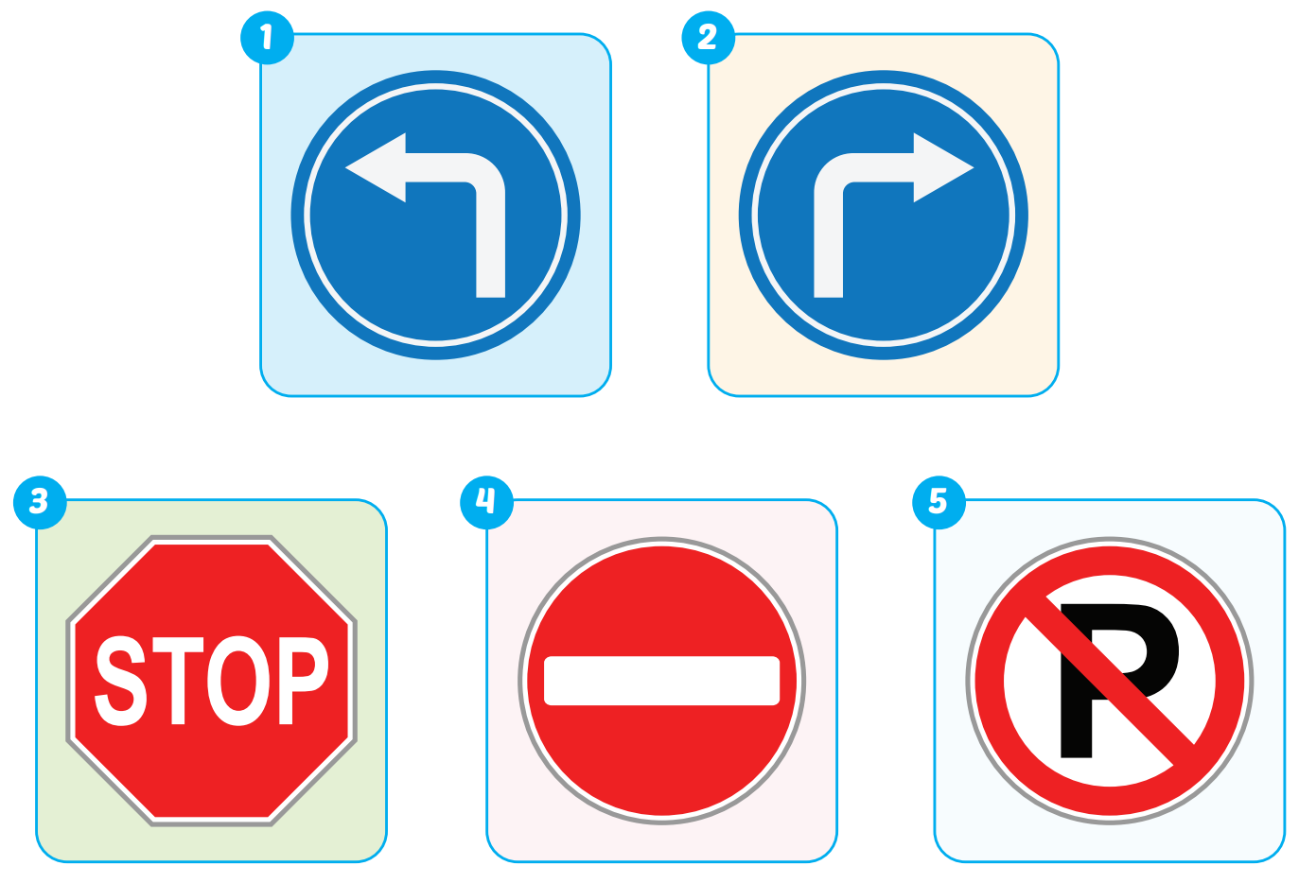

Slide 4

Production

Slide 5

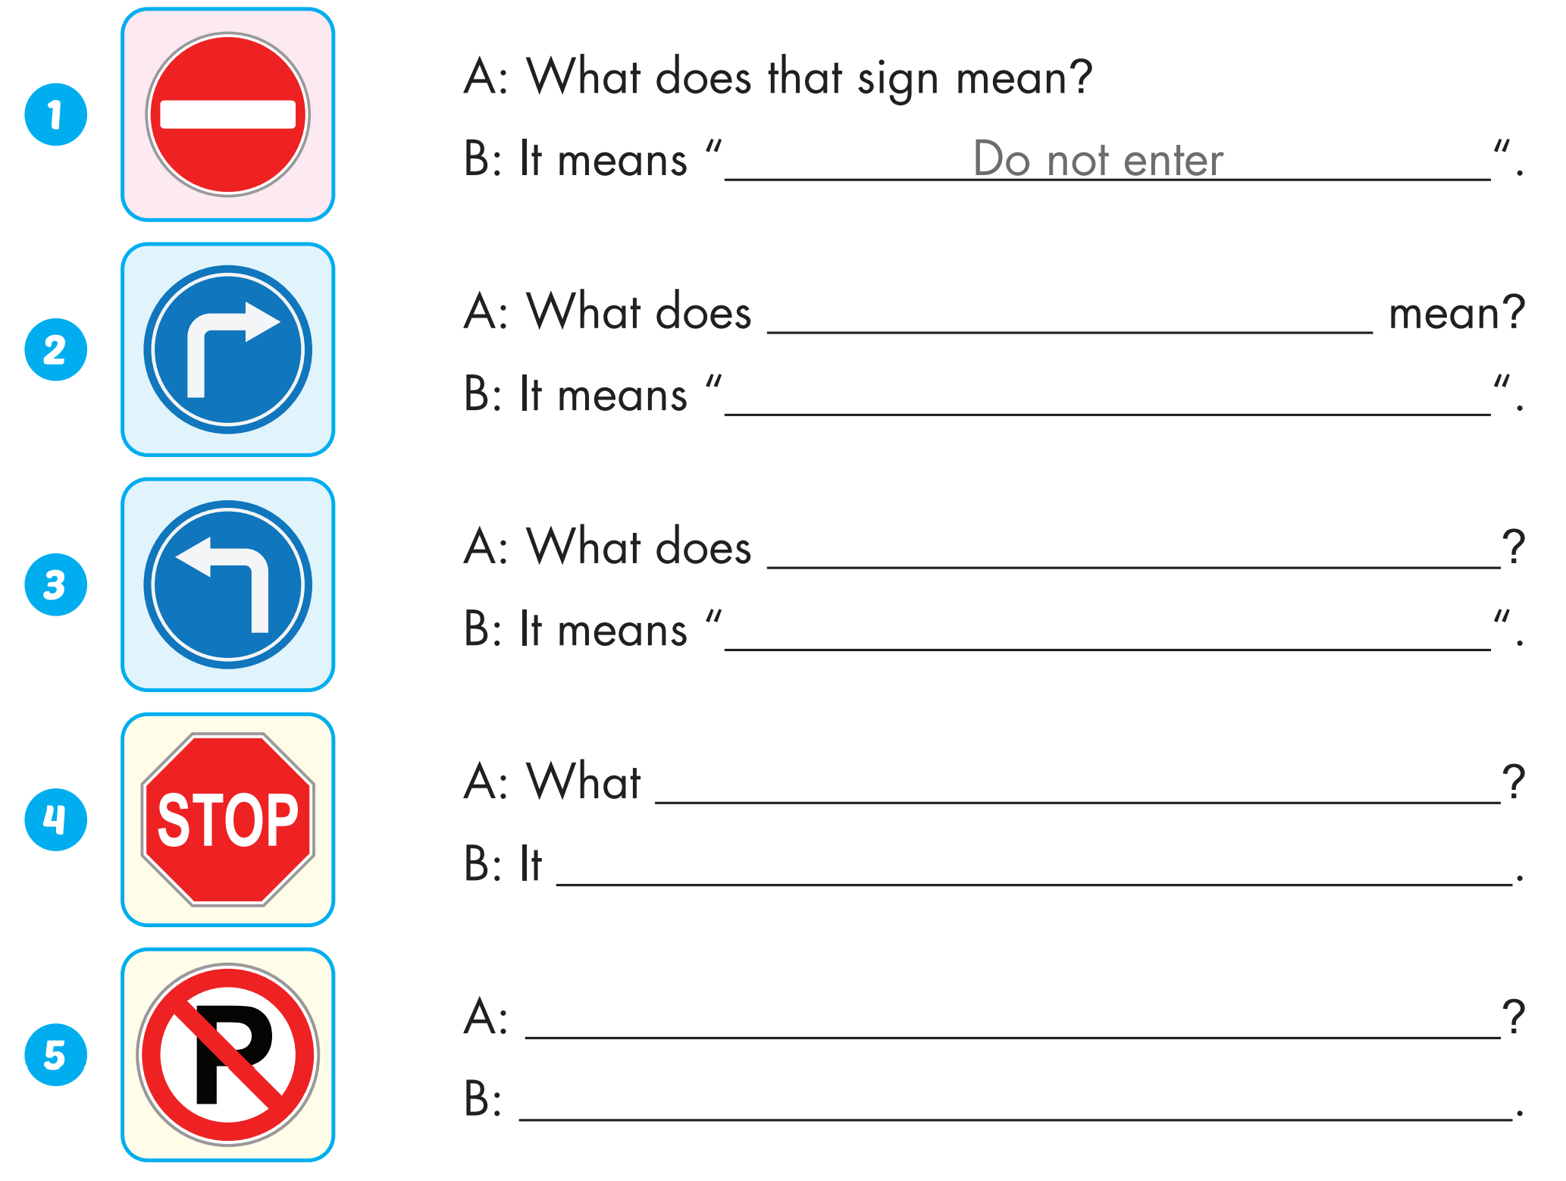
Extra Practice
WB, P. 43
that sign
turn right
that sign mean
turn left
does that sign mean
means "stop"
What does that sign mean
It means "no parking"

Slide 6
Today’s lesson
Vocabularies
stop, do not enter, turn left, turn right, no parking.
Structures/ Sentence patterns
What does that sign mean?
It means "Stop".
Phonics
Identify the /g/ sound and practice the conversations.

Slide 7
Homework
Practice the vocabularies and structure; and make sentences using them.
Do the exercises in Tiếng Anh 4 i-Learn Smart Start WB (page 43).
Prepare the next lesson (page 67 SB).
Play the consolidation games in Tiếng Anh 4 i-Learn Smart Start DHA App on www.eduhome.com.vn

