Slide 1

Click on the picture to hear the sound.

Slide 2












> Someone has deleted some words.
> Guess the deleted word within the time limit (12 seconds).

Slide 3



Y
Will you bring hamburgers?
Yes. I will.
CHECK
Notes:
3

Slide 4



Slide 5
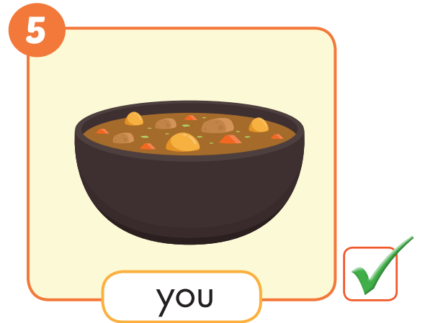
Will you bring ______?
curry
Yes. I will.

Slide 6
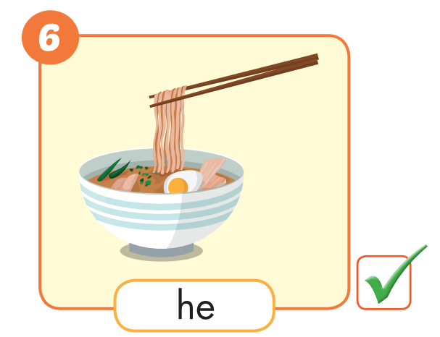
Will he bring _________?
noddle
Yes. He will.

Slide 7
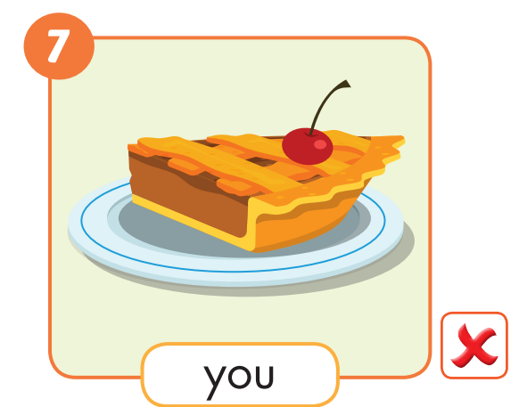
Will you bring _________?
pie
No. I won’t.

Slide 8
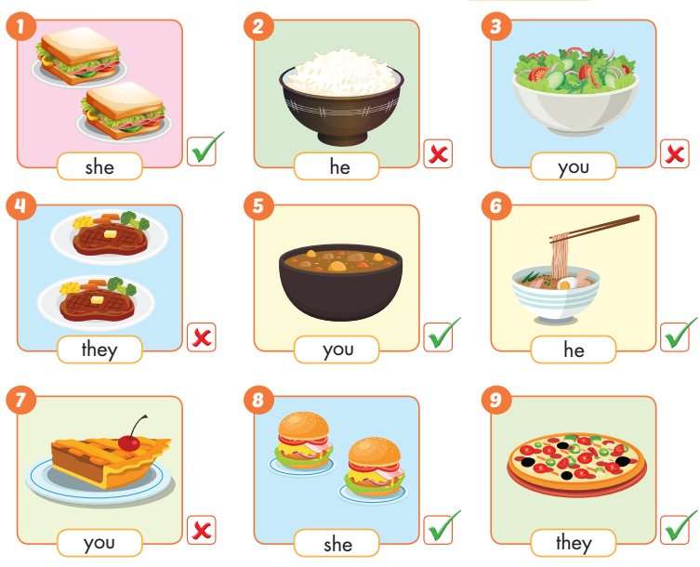


Speaking
Will you bring _____?
Yes. She will.
No. I won’t.

Slide 9





cereal
sushi
Hot pot
Fries/chips
spaghetti

Slide 10

WORD
Click on the right word

Slide 11

Lesson 3
Stay positive and have a nice day!

