Slide 1

Unit 6: FOOD AND DRINKS
Lesson 2.3
Page 83

Slide 2

Move to the next slide

Slide 3


WHERE IS THE COOKIE ?

Slide 4
Choose a cookie jar and read the word.
Click on the jar to find out if the cookie is hidden in it.

Slide 5


I’ll bring apples.
I’ll bring oranges.
I’ll bring soda.
I’ll bring sugar.
I’ll bring milk.

Slide 6

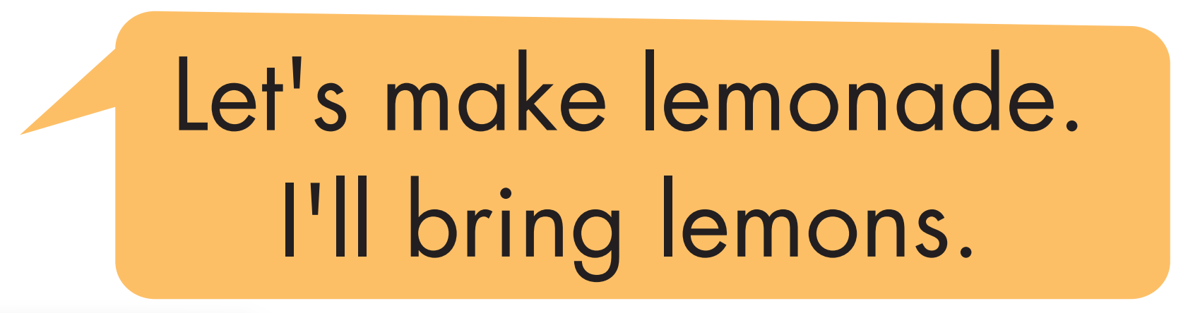


Slide 7
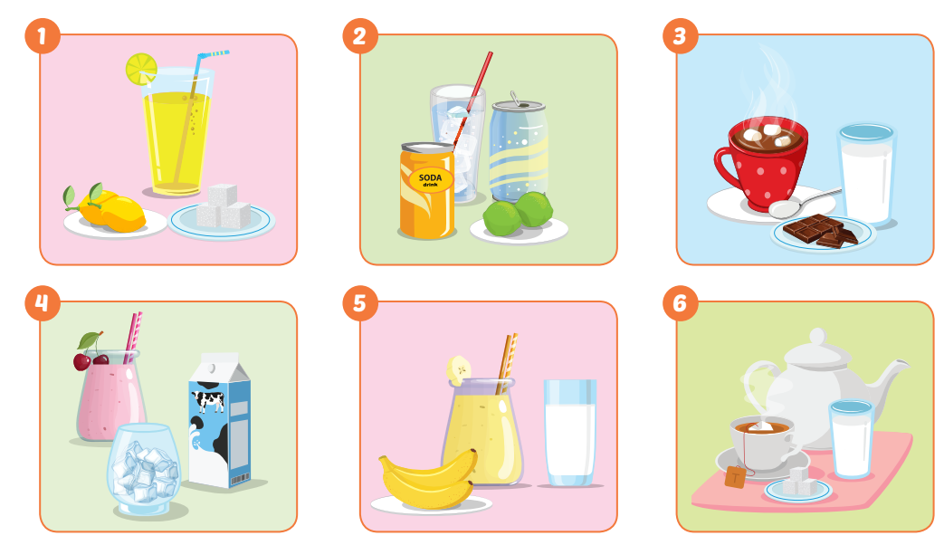

Slide 8


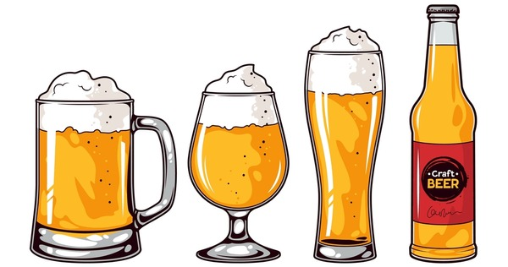
beer
coffee latte
milkshake

Slide 9
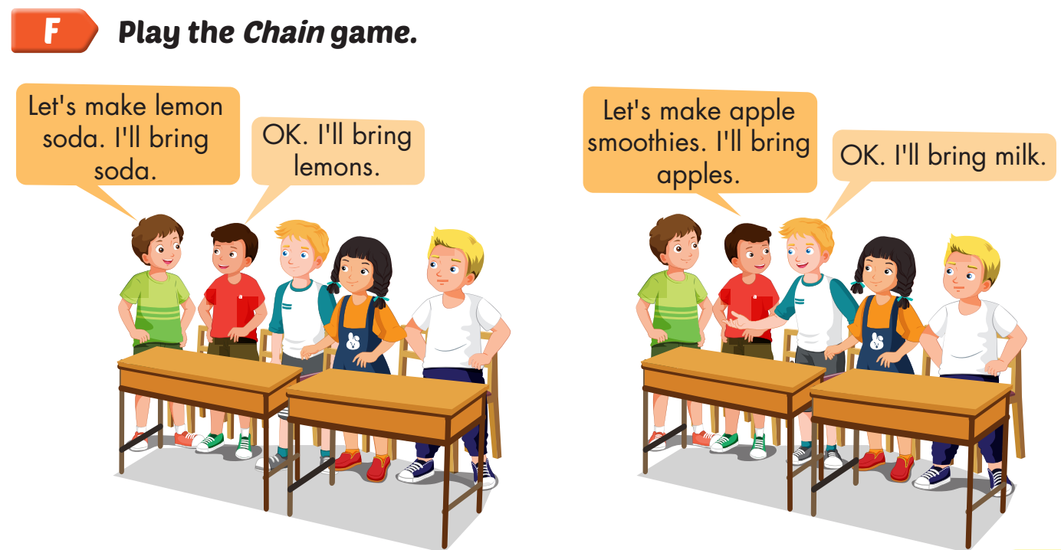

Slide 10
Today’s lesson
Vocabularies
soda, smoothie, tea, lemonade, juice, hot chocolate.
Structures/ Sentence patterns
Let's make smoothies.
OK. I'll bring milk.

Slide 11

Lesson 3
Stay positive and have a nice day!

