Slide 1

Unit 6: FOOD AND DRINKS
Lesson 1.3
Page 80

Slide 2


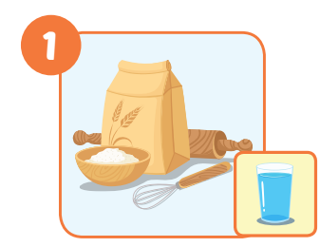


Click on the right word
some sugar
a little milk
a lot of flour

Slide 3
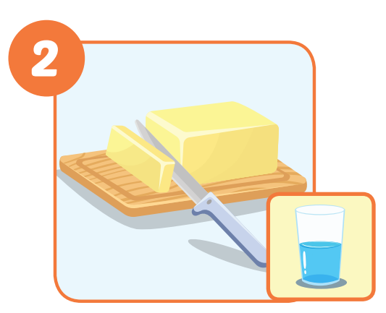
Click on the right word
a few chocolate chips
some butter
a little oil

Slide 4
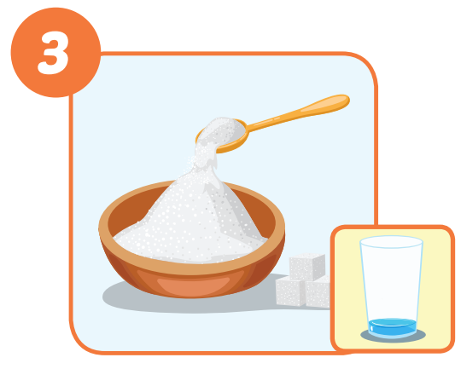
Click on the right word
some flour
a lot of milk
a little sugar

Slide 5
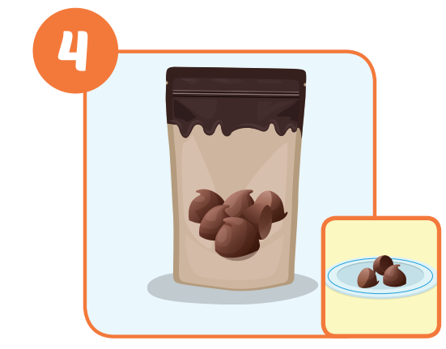
Click on the right word
a little oil
a few chocolate chips
a lot of milk

Slide 6
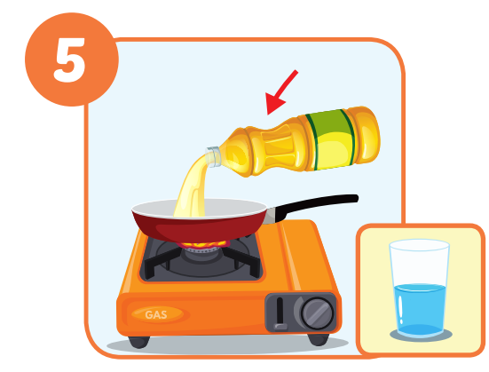
Click on the right word
a little oil
some oil
a lot of milk

Slide 7
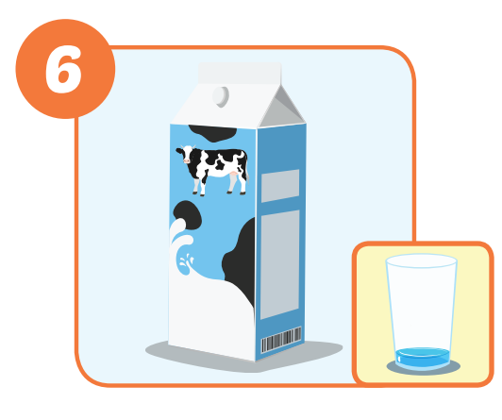
Click on the right word
a little milk
a little sugar
a lot of flour

Slide 8




Slide 9
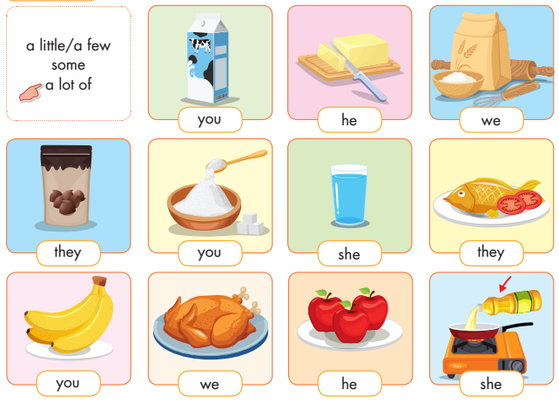

Slide 10
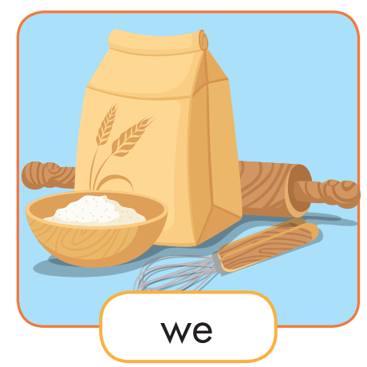
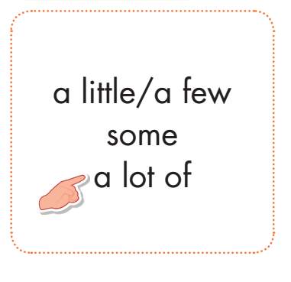
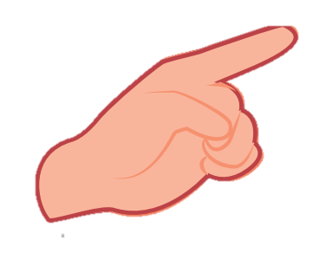
What do we need?
We need ___________.
some flour

Slide 11

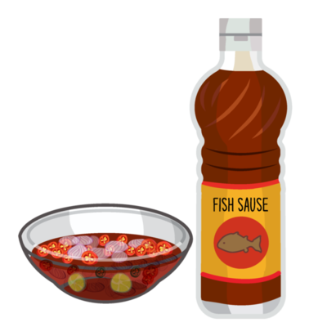
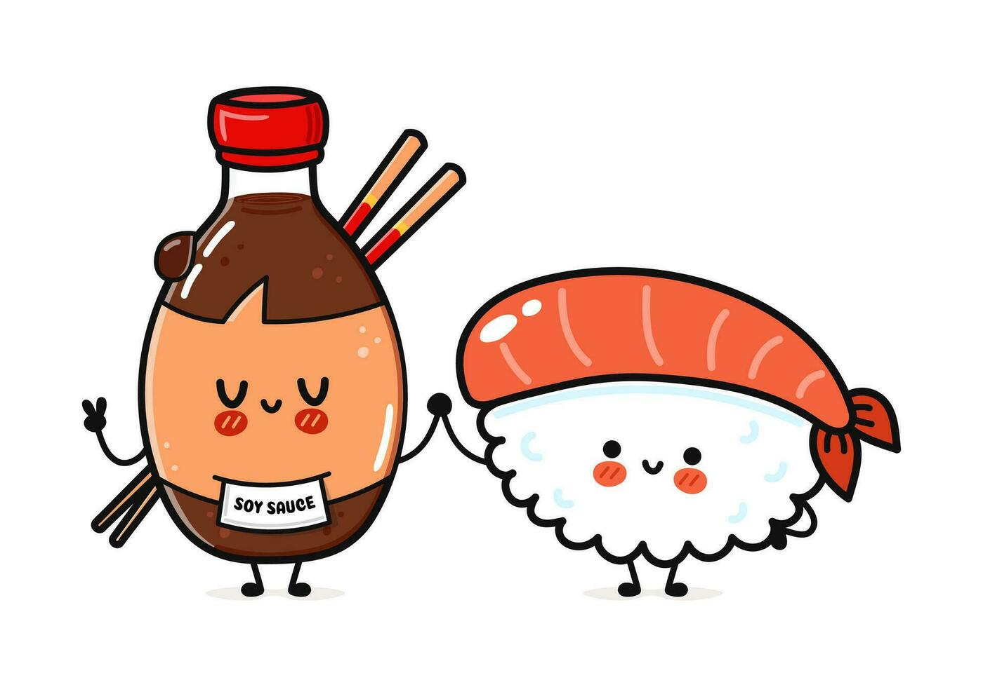
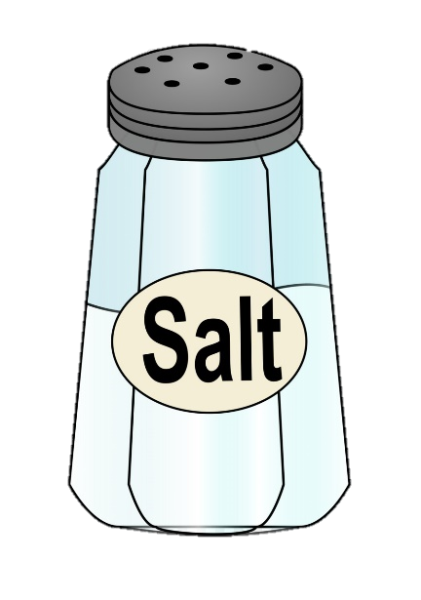
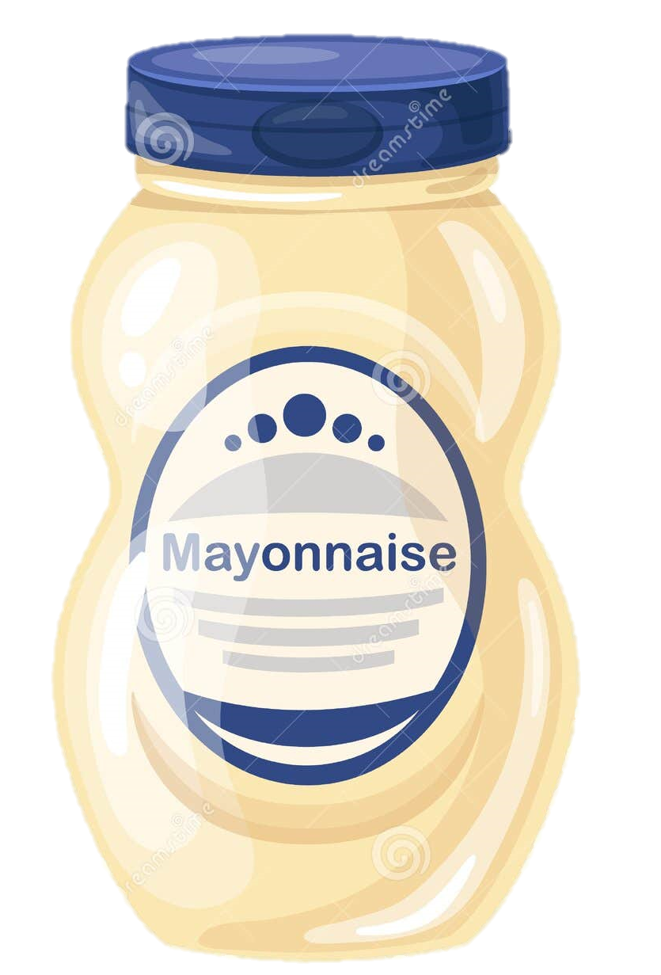
salt
tomato
ketchup
mayonnaise
fish sauce
soya sauce

Slide 12
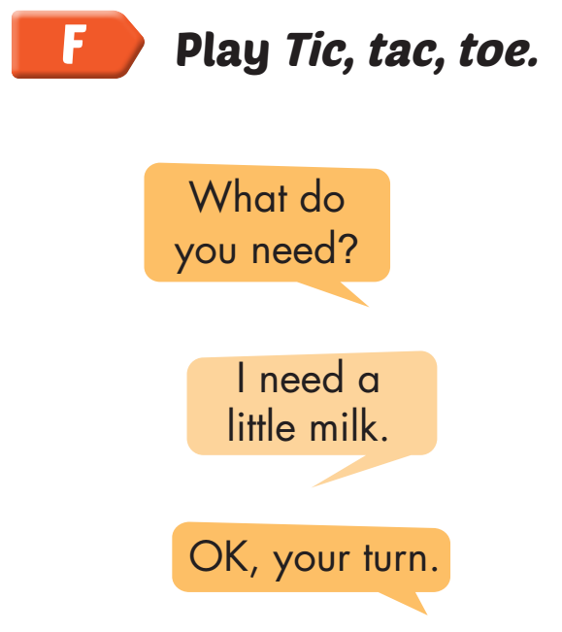
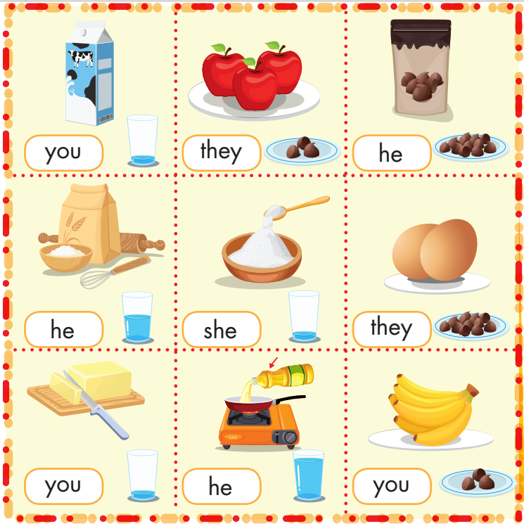

Slide 13
Today’s lesson
Vocabularies
sugar, butter, flour, chocolate chips, oil, milk.
Structures/ Sentence patterns
What do you need?
I need a lot of sugar.
What does she need?
She needs a little milk.

Slide 14

Enjoy your day!

