Slide 1

Unit 5: HEALTH
Review 1
Page 76

Slide 2
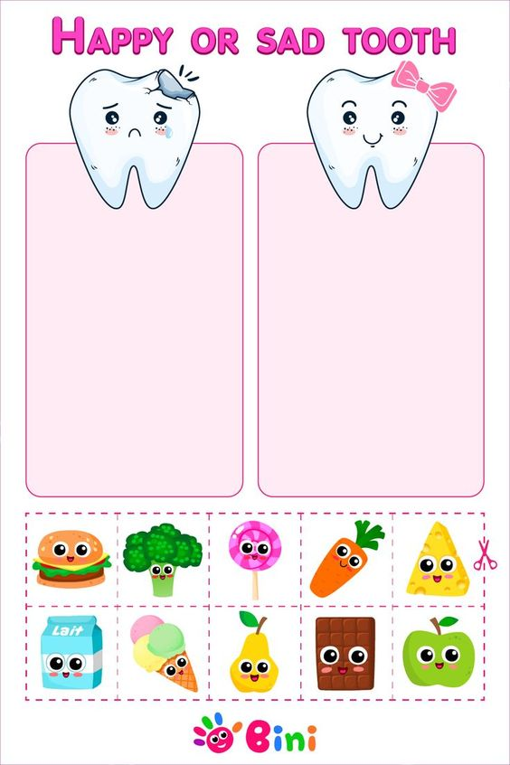
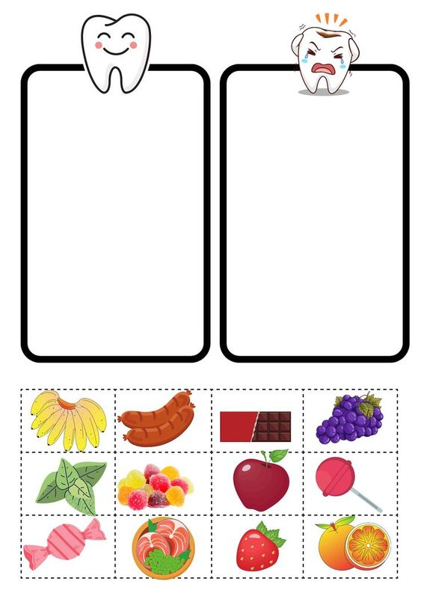

Slide 4
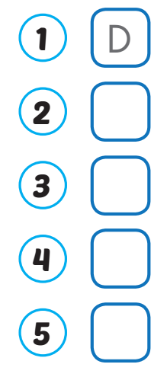
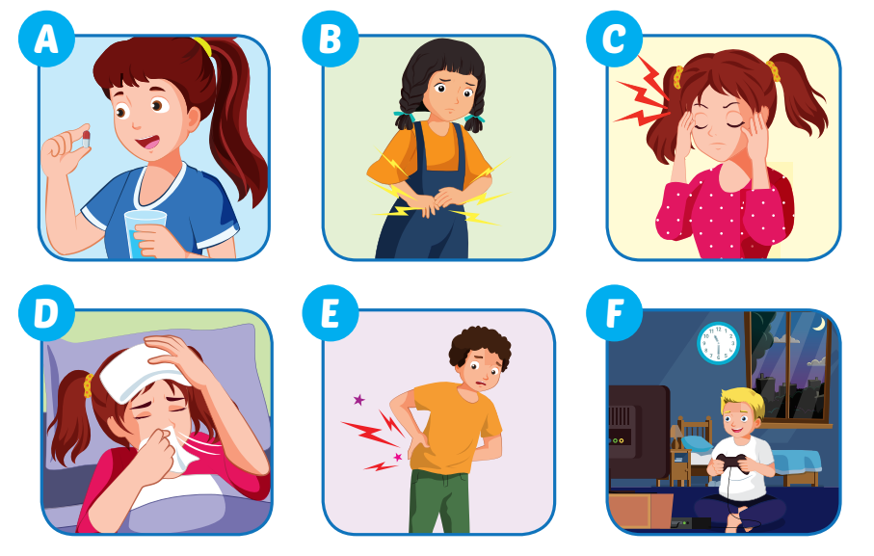
F
B
E
C

Slide 5
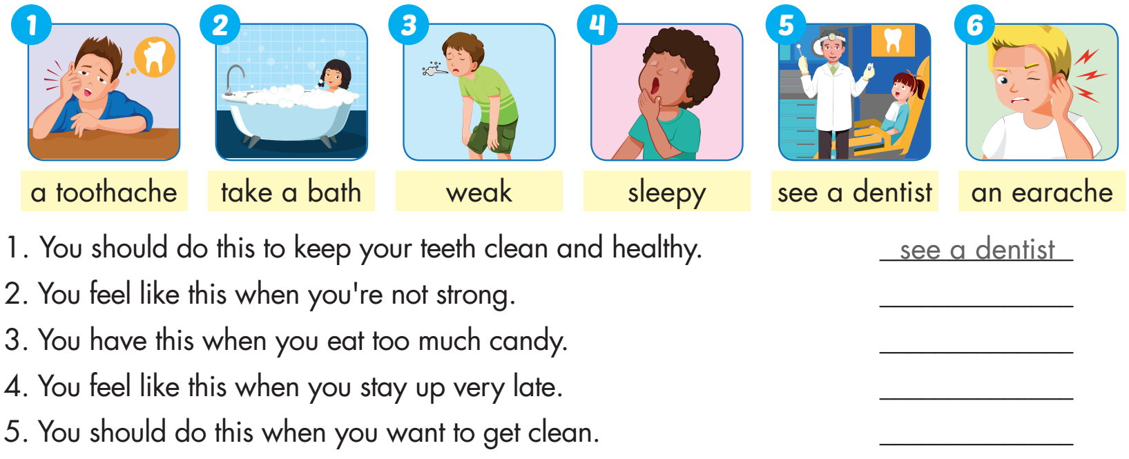
weak
a toothache
sleepy
take a bath

Slide 6

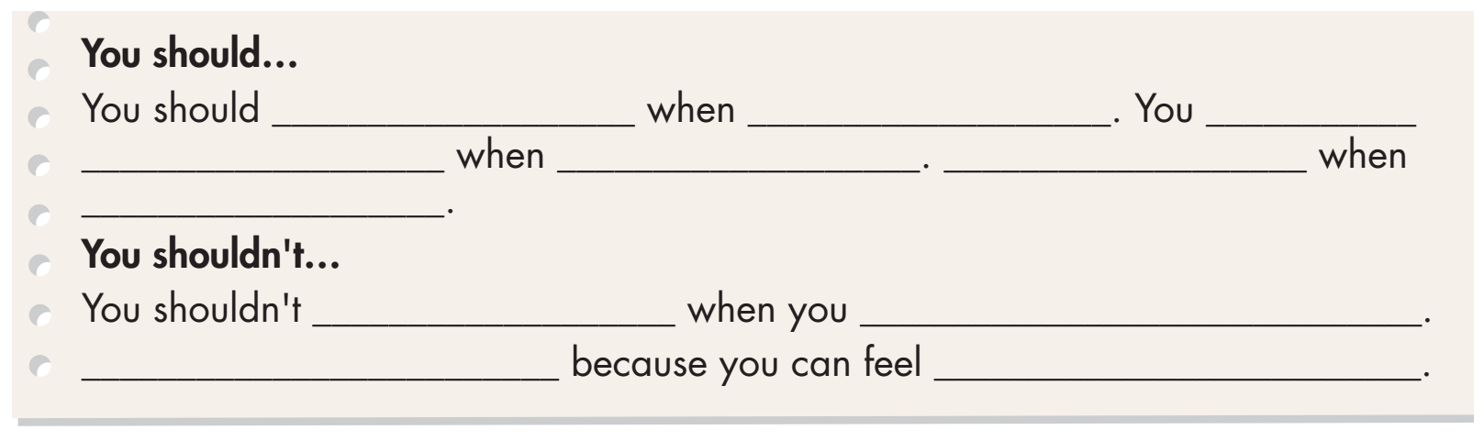
Examples:
see a dentist
you have a toothache
should
take some medicine
you are sick
You should get some rest
you feel terrible
stay up late
have school
You shouldn’t skip breakfast
weak

Slide 7
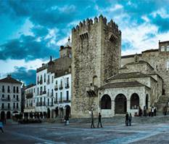
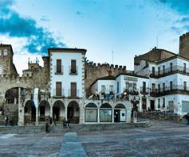
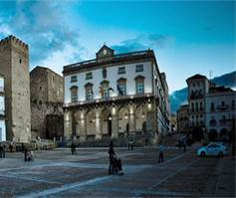

WHAT IS THIS PICTURE?
PHOTO PUZZLE

Slide 8

WHAT IS THIS PICTURE?
Turn around as many colored boxes as you can within the time limit (5 seconds) and say what it is in the picture.

Slide 9
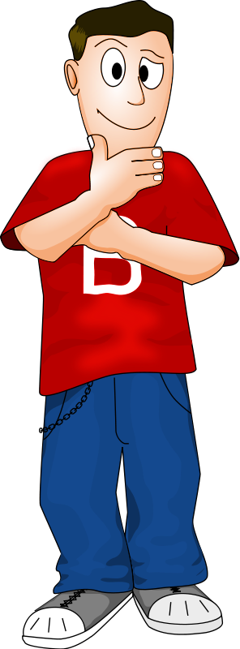
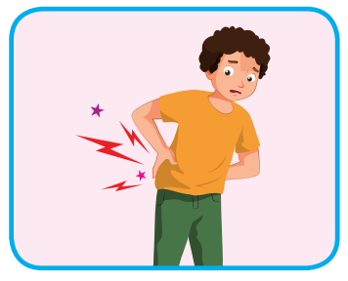
I feel sore.
T
I
M
E
I
S
U
P
CHECK
NEXT
Click on the colored boxes to turn them around

Slide 10
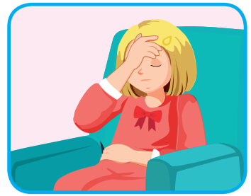
I feel stuffed up.
T
I
M
E
I
S
U
P
CHECK
NEXT
Click on the coloured boxes to turn them around

Slide 11
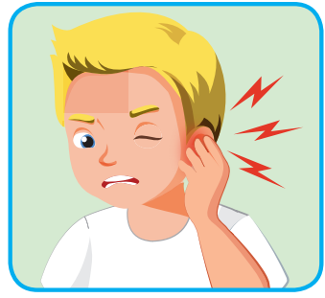
He has an earache.
T
I
M
E
I
S
U
P
CHECK
NEXT
Click on the colored boxes to turn them around

Slide 12
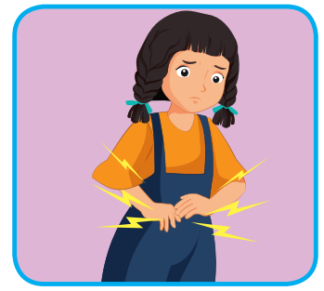
She has a stomachache.
What is it?
T
I
M
E
I
S
U
P
CHECK
NEXT
Click on the colored boxes to turn them around

Slide 13
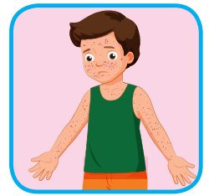
He has chickenpox.
T
I
M
E
I
S
U
P
CHECK
NEXT
Click on the colored boxes to turn them around

Slide 14
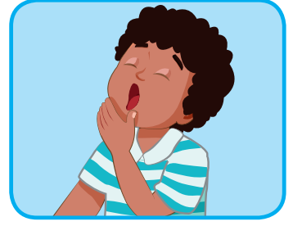
I feel sleepy.
T
I
M
E
I
S
U
P
CHECK
END
Click on the colored boxes to turn them around

Slide 15
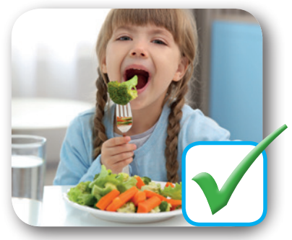
You should eat vegetables.
T
I
M
E
I
S
U
P
CHECK
END
Click on the colored boxes to turn them around

Slide 16
Today’s lesson
Vocabularies
Unit 5
Structures/ Sentence patterns
Unit 5

Slide 17

Lesson 3
Stay positive and have a nice day!

