Slide 1

Unit 5: HEALTH
CLIL - Lesson 3
Page 75

Slide 2
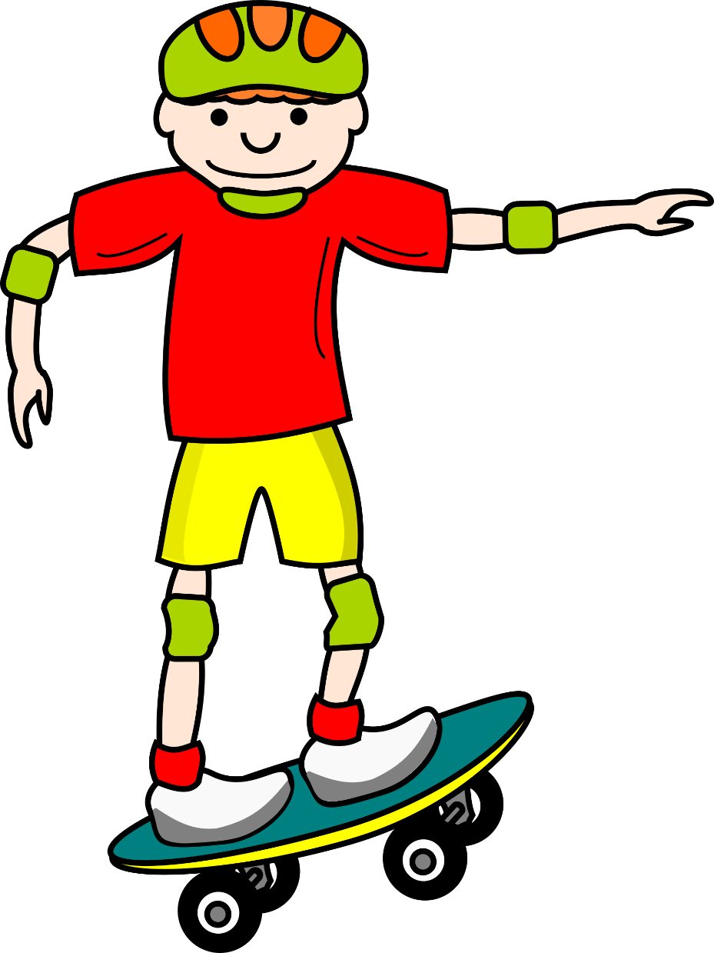
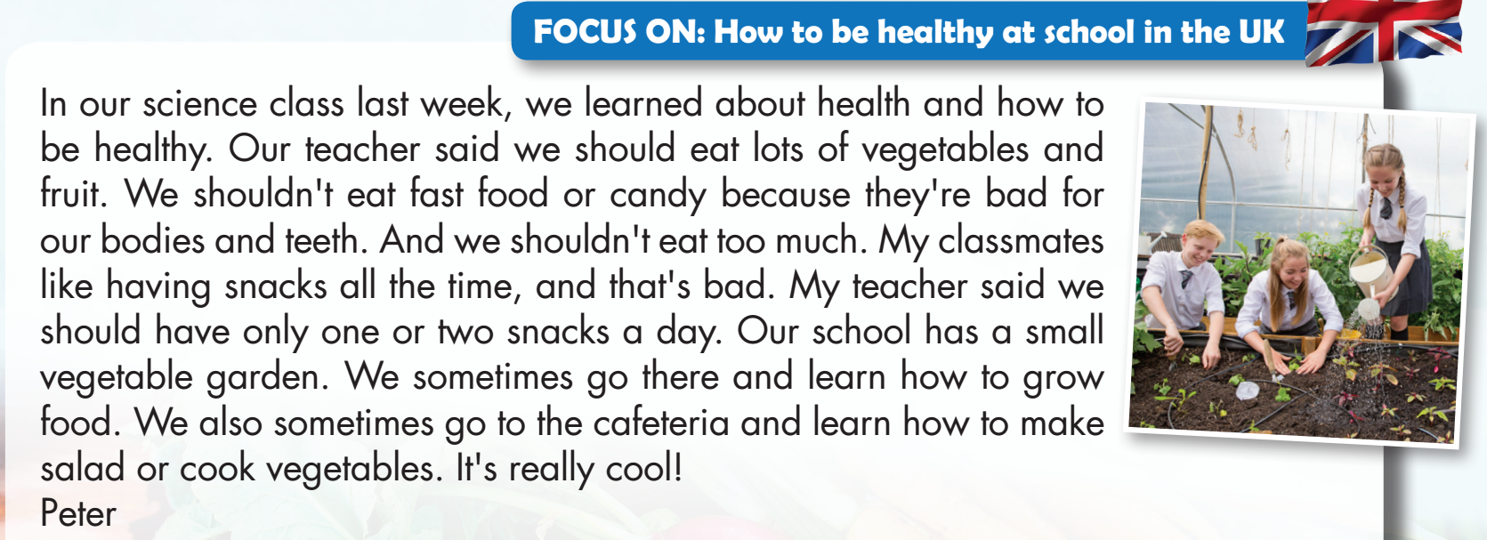
WHERE IS MY SKATEBOARD?
START

Slide 3
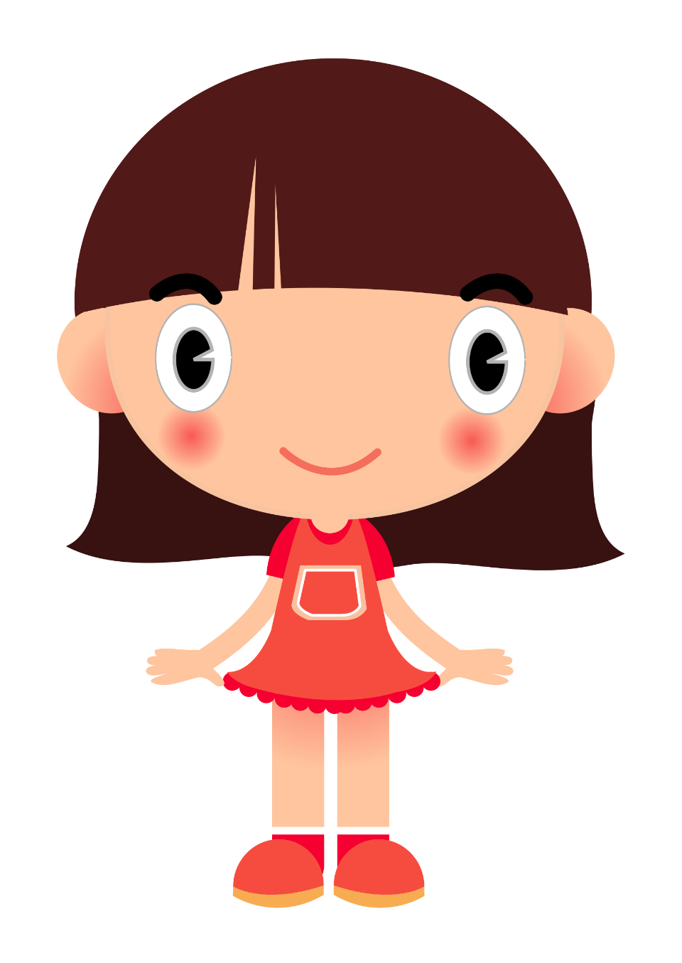

Peter learned about health and how to be healthy in his science class.
TRUE
FALSE

Slide 4
WHERE IS MY SKATEBOARD?
START

Slide 5
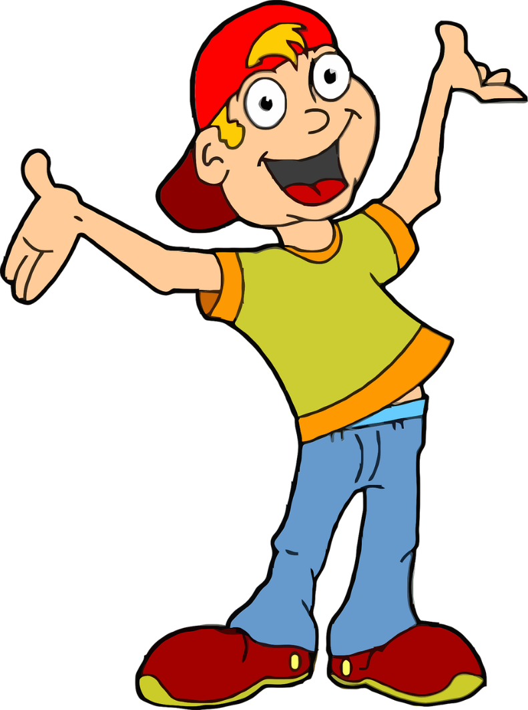
His teacher said we should eat lots of snacks.
TRUE
FALSE

Slide 6
WHERE IS MY SKATEBOARD?
START

Slide 7
We shouldn't eat fast food or candy.
TRUE
FALSE

Slide 8
WHERE IS MY SKATEBOARD?
START

Slide 9
Peter's classmates like having fast food all the time.
TRUE
FALSE

Slide 10
WHERE IS MY SKATEBOARD?
START

Slide 11
Peter sometimes goes to his school’s garden and learns how to grow food.
TRUE
FALSE

Slide 12
WHERE IS MY SKATEBOARD?
START

Slide 13

It’s time to learn …

Slide 14

WHAT COUNTRY IS IT?

Slide 15
LIST 5 THINGS ABOUT VIETNAM!
It’s a beautiful country in Asia.
Hanoi is the capital city.
Ho Chi Minh is in the south.
…………………..
…………………..

Slide 16
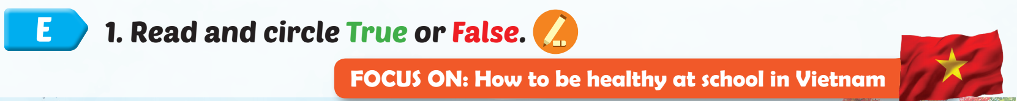
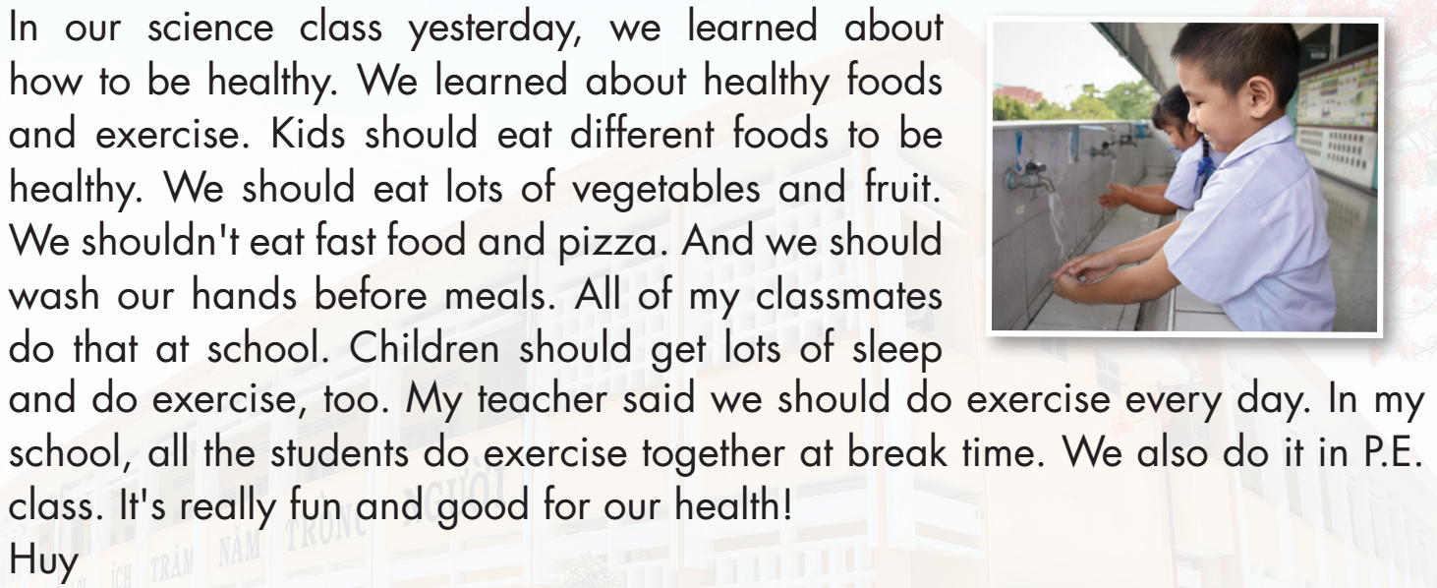

Slide 17
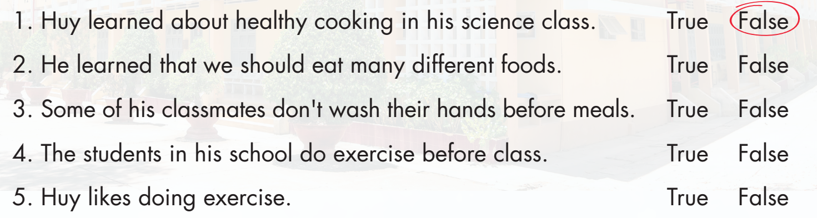
English
geography
P.E.

Slide 18
English
geography
P.E.

Slide 20
English
geography
P.E.

Slide 21
English
geography
P.E.

Slide 22
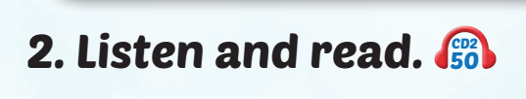


Slide 23
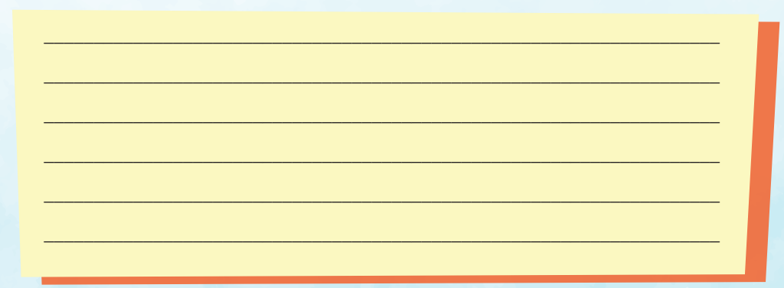
Examples: Last week, we learned about how to be healthy in science class. Our teacher said that we should eat lots of vegetables and fruit to be healthy. We should do exercise and play outside. We shouldn't eat fast food, and we should wash our hands before meals. We also need to brush our teeth twice a day and sleep early.

Slide 25
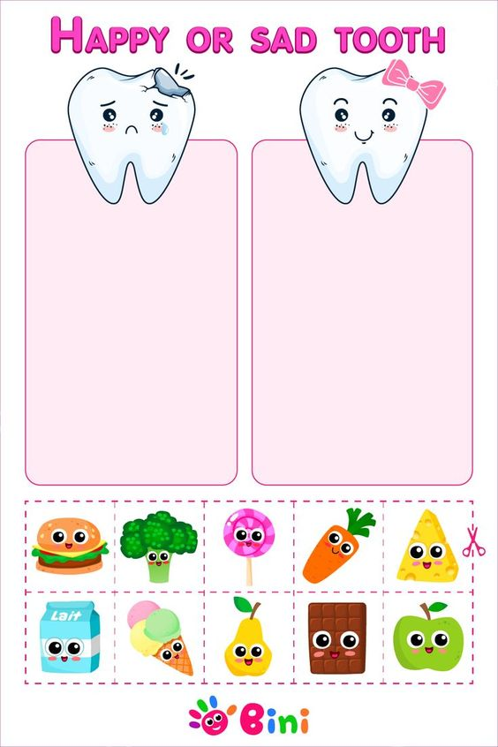
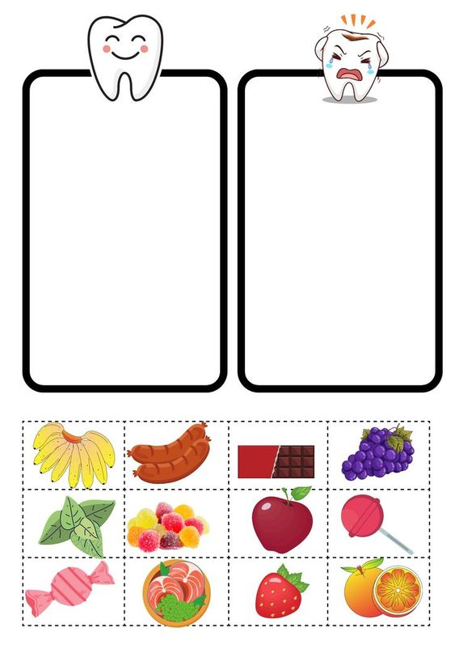

Slide 27
Today’s lesson
Vocabularies
do exercise, eat fast food, eat vegetables, wash your hands, play outside, eat too much
Structures/ Sentence patterns
What should I do to be healthy?
You should do exercise.
You shouldn't eat fast food.

