Slide 1


Unit 5: HEALTH
Lesson 2.2
Page 68

Slide 2
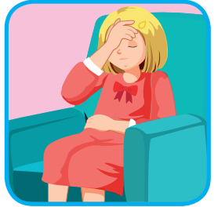
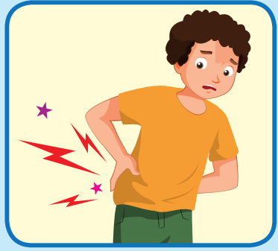
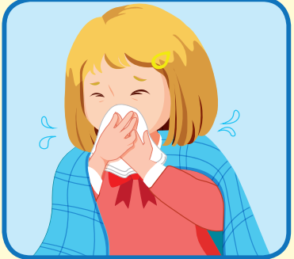

Listen and choose
A
B
C
I feel terrible.

Slide 3
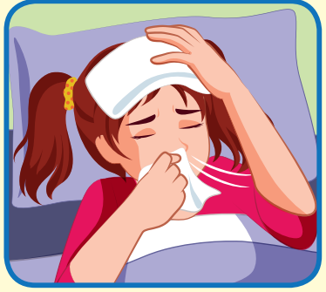
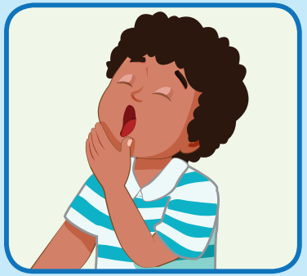
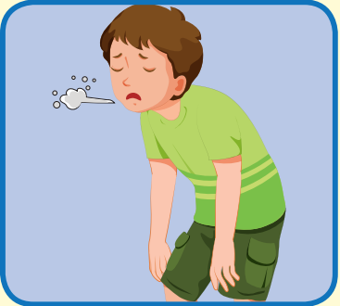
Listen and choose
A
B
C
I feel sleepy.

Slide 4
Listen and choose
A
B
C
I feel sick

Slide 5
Listen and choose
A
C
B
I feel sore.

Slide 6
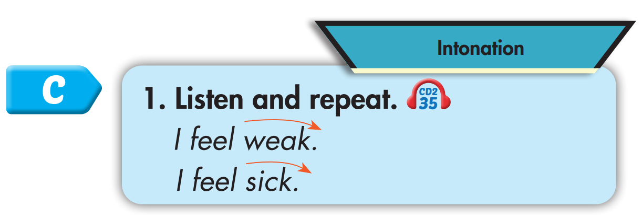
Click on C to hear the sound.

Slide 7

Practice

Slide 8
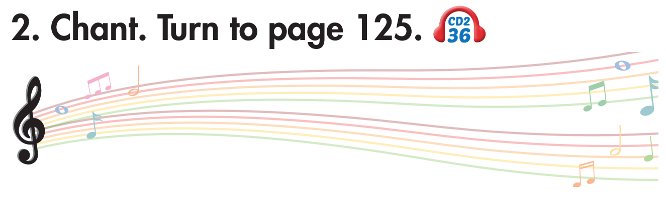
Click on 2 to hear the sound.

Slide 9
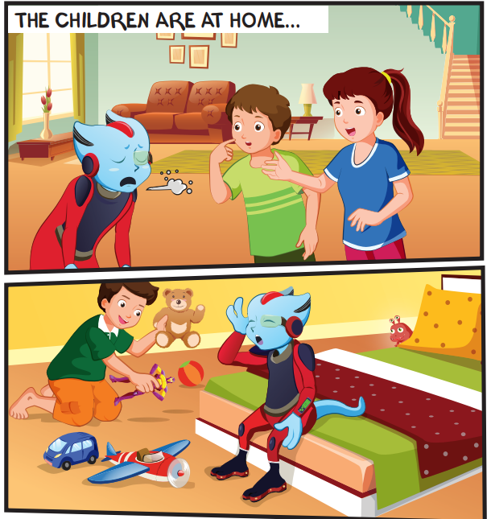
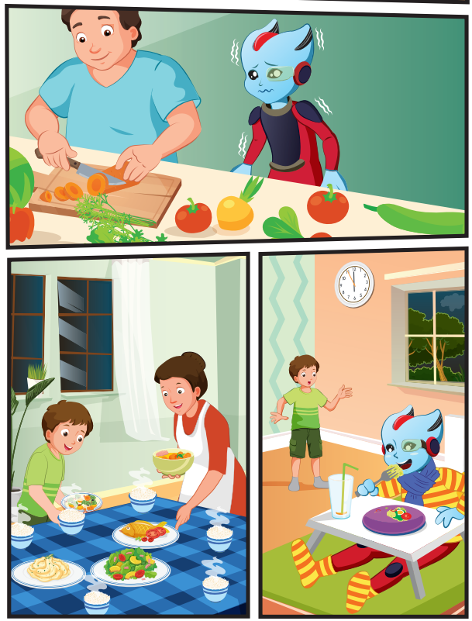
Who are they?
Alfie
Tom
Lucy
Ben
Mr. Brown
Mrs. Brown

Slide 10
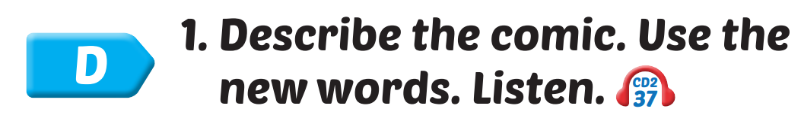
Click on D to hear the sound.

Slide 11

Practice

Slide 12
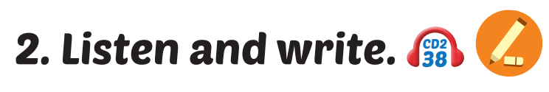
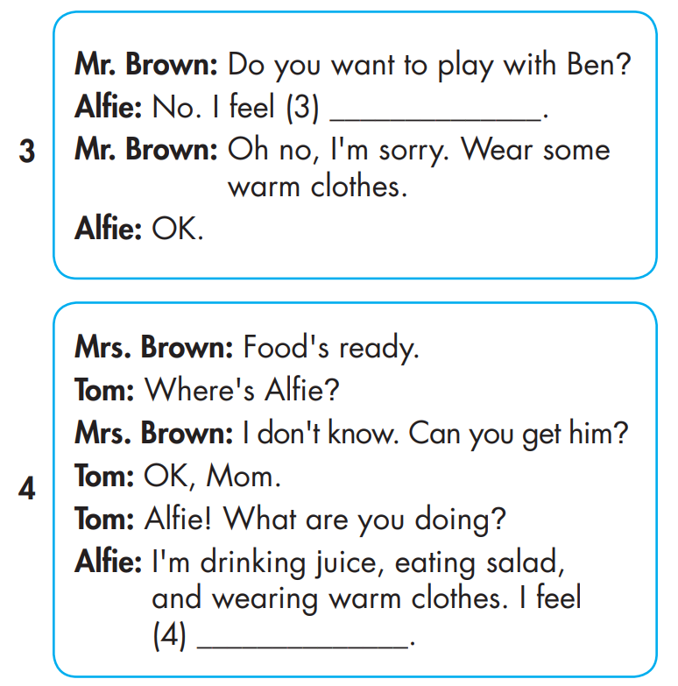
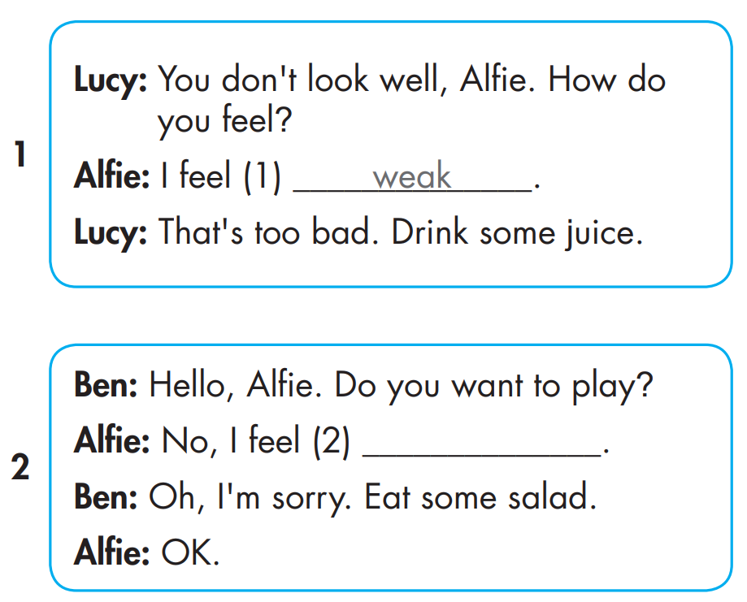
sick
Click on 2 to hear the sound.
terrible
sleepy

Slide 13
MAKE YOUR OWN STORY
4

Slide 14

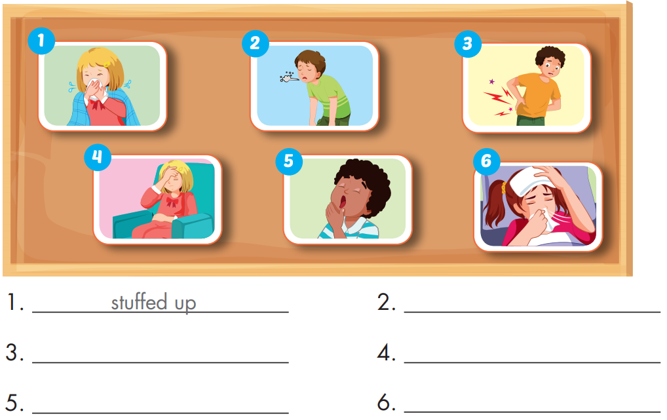
Extra Practice
WB, page 44
I feel stuffed up.
I feel weak.
I feel sore.
I feel terrible.
I feel sleepy.
I feel sick.

Slide 15


WHERE IS THE COOKIE ?

Slide 16
Chooses a cookie jar and reads the word.
Click on the jar to find out if the cookie is hidden in it.

Slide 17

I feel terrible
I feel sore
I feel sleepy
I feel sick
I feel weak

Slide 18
I feel terrible.
I feel sore.
I feel sleepy.
I feel sick.
I feel weak.

Slide 19
I feel terrible.
I feel sore.
I feel sleepy.
I feel sick.
I feel weak.

Slide 20
I feel terrible.
I feel sore.
I feel sleepy.
I feel sick.
I feel weak.

Slide 21
I feel terrible.
I feel sore.
I feel sleepy.
I feel sick.
I feel weak.

Slide 22
Today’s lesson
Pronunciation
Intonation
Structures/ Sentence patterns
How do you feel?
I feel weak.
That's too bad.

