Slide 1

Unit 5: HEALTH
Lesson 2.1
Page 67

Slide 2

Guess the HEALTH PROBLEMS

Slide 3

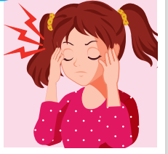
a pain you feel inside your head.
HEADACHE

Slide 4
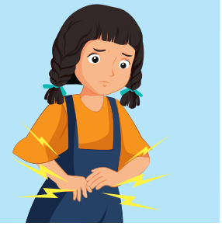
I ate too much and I had a terrible _____________.
STOMACHACHE

Slide 5
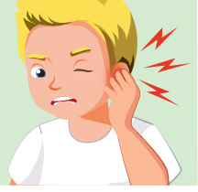
The pain inside part of your ear.
EARACHE

Slide 6
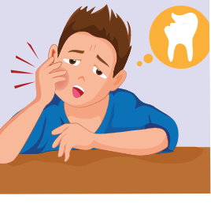
the pain caused by something being wrong with one of your teeth.
TOOTHACHE

Slide 7
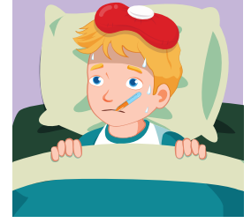
She's very hot and shivery, so I think she must have ______.
THE FLU

Slide 8
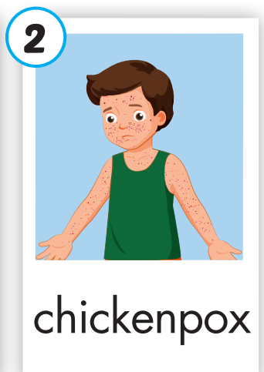
an infectious disease that causes a slight fever and red spots on the skin.
CHICKENPOX

Slide 9
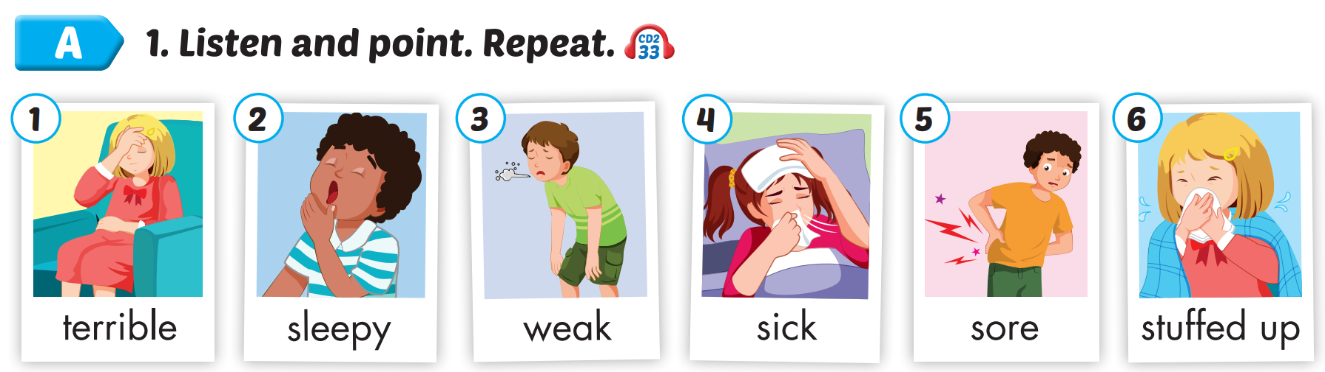
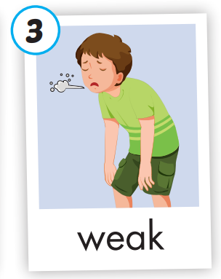
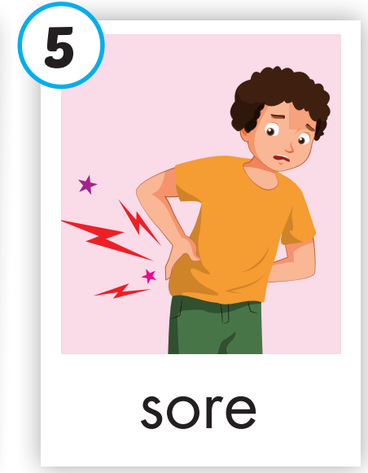
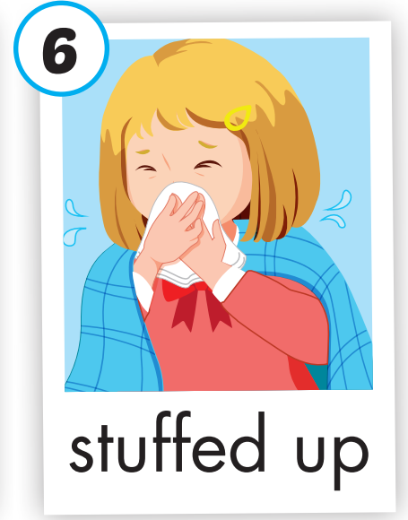
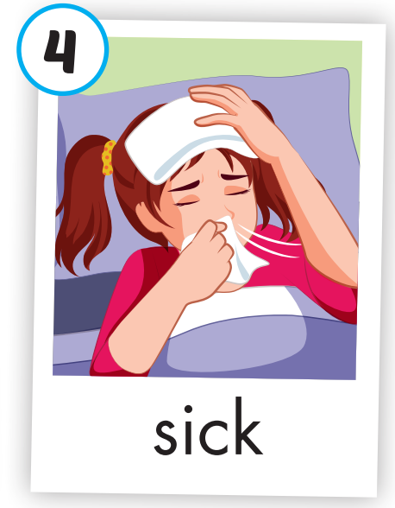

/ˈterəbl/
(adj)
tồi tệ
/ˈsliːpi/
(adj)
buồn ngủ
/wiːk/
(adj)
yếu
/sɪk/
(adj)
bệnh
/sɔːr/
(adj)
đau
/ˌstʌft ˈʌp/
(adj)
nghẹt mũi
Notes:
Click vào hình A. 1. Listen and point. Repeat để cho cả audio full chạy

Slide 10
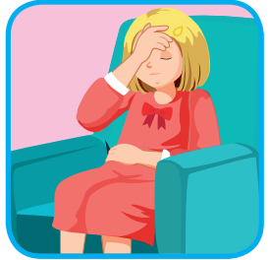
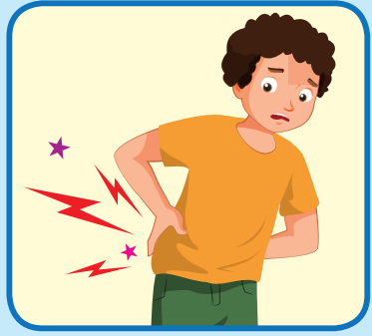
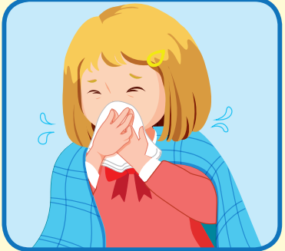

Read and choose
A
B
C
terrible

Slide 11
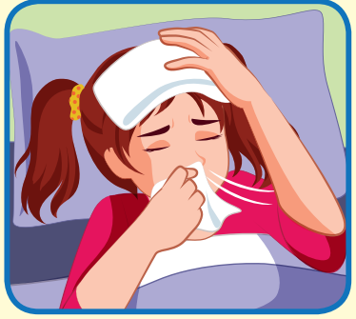
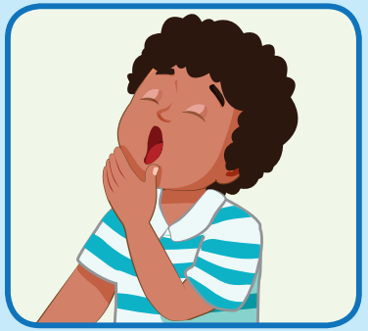
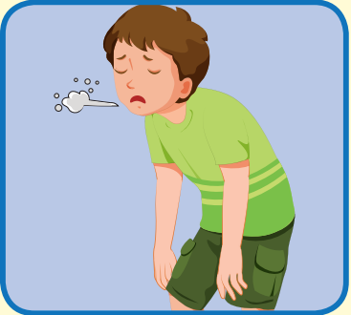
Read and choose
A
B
C
sick

Slide 12
Read and choose
A
B
C
sleepy

Slide 13
Read and choose
A
B
C
sore

Slide 14

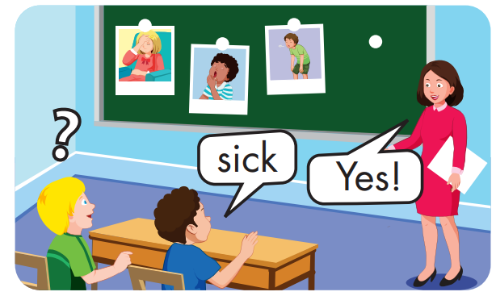

Slide 15
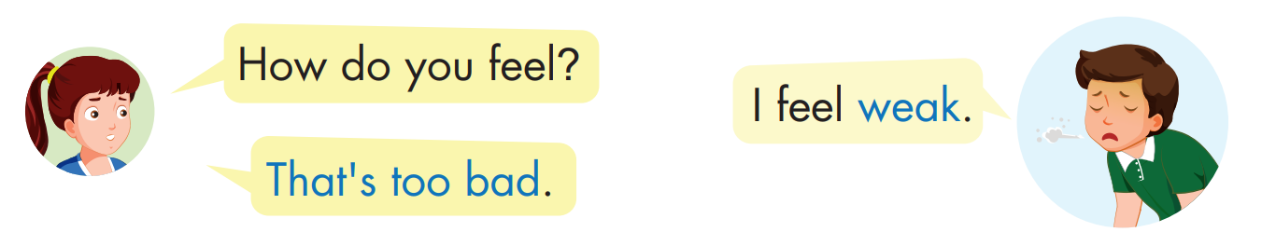
Structure

Slide 16

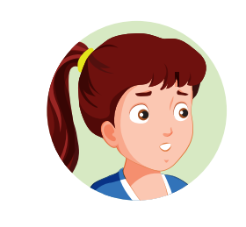

Slide 17

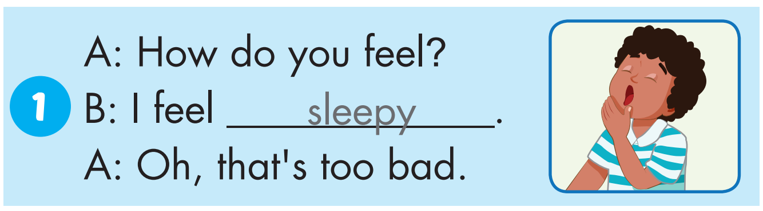

Slide 18
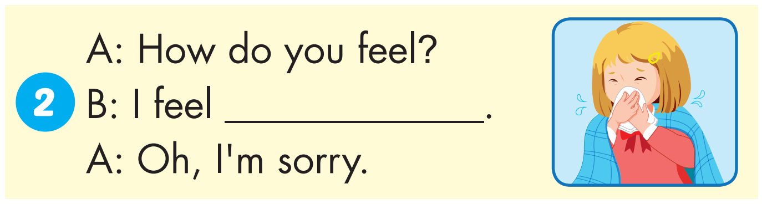
stuffed up

Slide 19
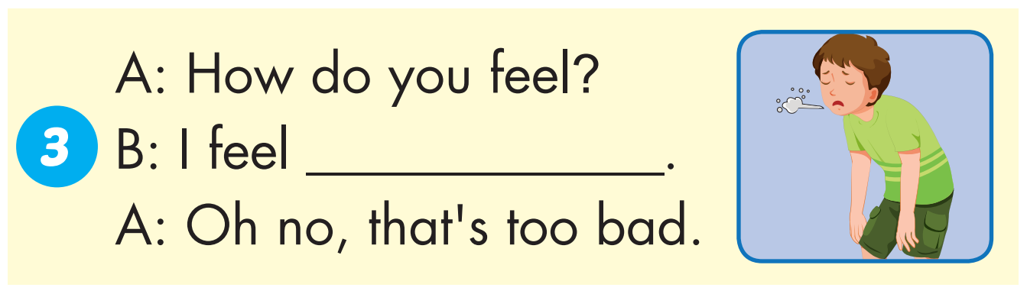
weak

Slide 20
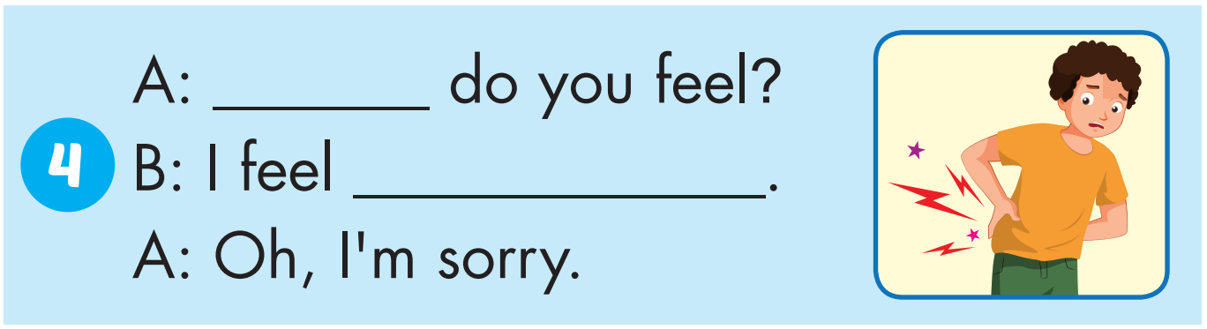
How
sore

Slide 21
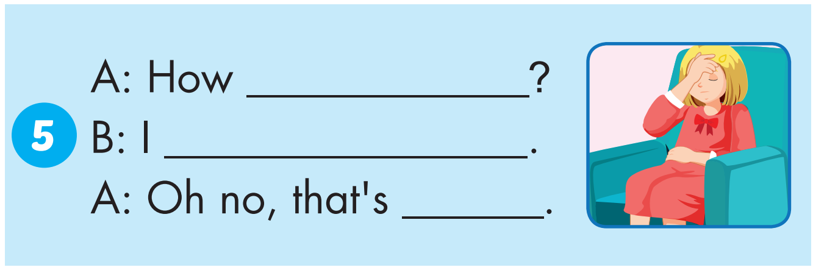
do you feel
feel terrible
too bad

Slide 22
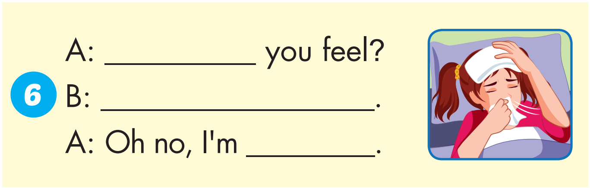
How do
I feel sick
sorry

Slide 23
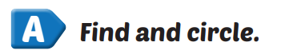
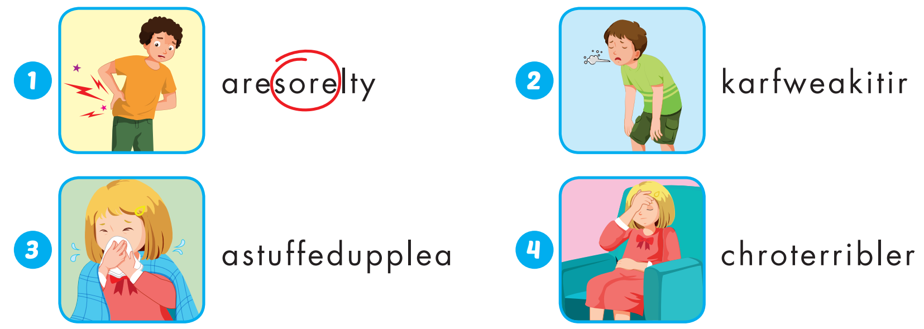
Extra Practice
WB, page 44

Slide 24
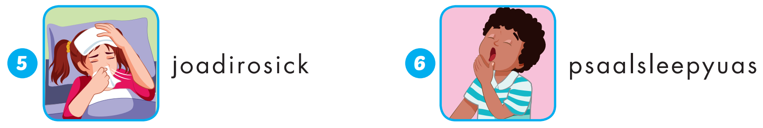
Extra Practice
WB, page 44

Slide 25
sore |  | sick
 | terrible
weak |  | sleepy
 | stuffed up
1
2
3
4
5
6
7
8
9
10
11
12

Slide 26
Today’s lesson
Vocabularies
terrible, sleepy, weak, sick, sore, stuffed up.
Structures/ Sentence patterns
How do you feel?
I feel weak.
That's too bad.

