Slide 1

Unit 5: HEALTH
Lesson 1.2
Page 65

Slide 2
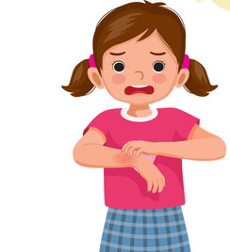
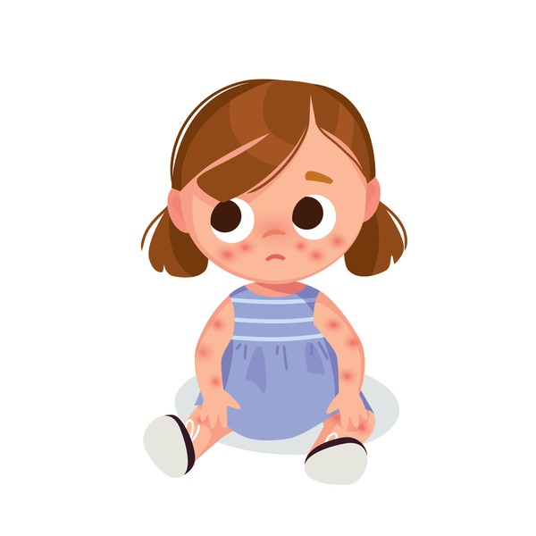
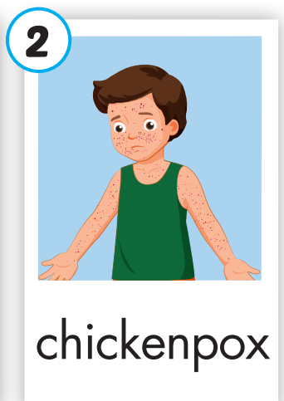
What’s wrong?
itchy
red rash
chickenpox

Slide 3
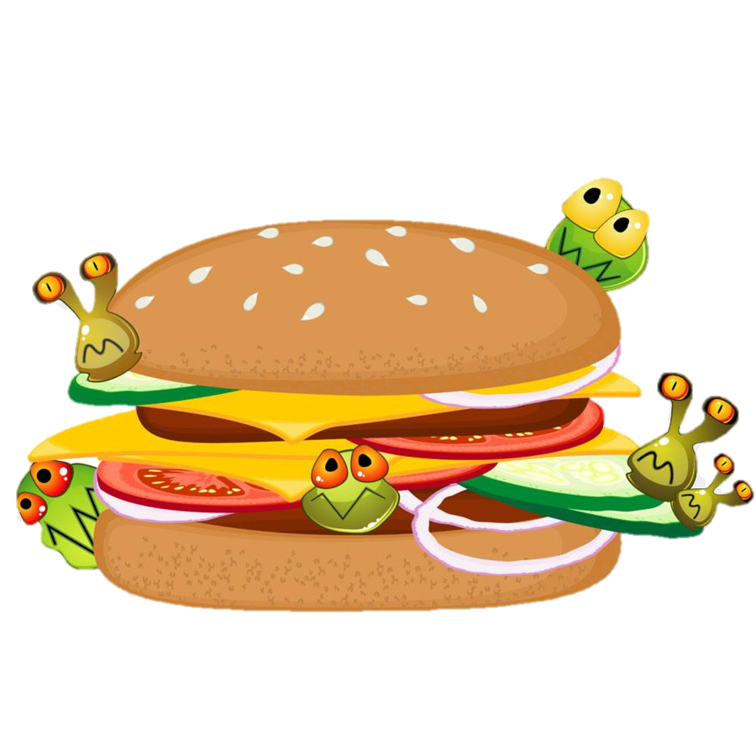
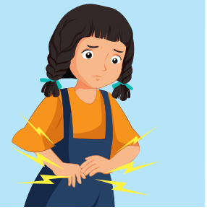
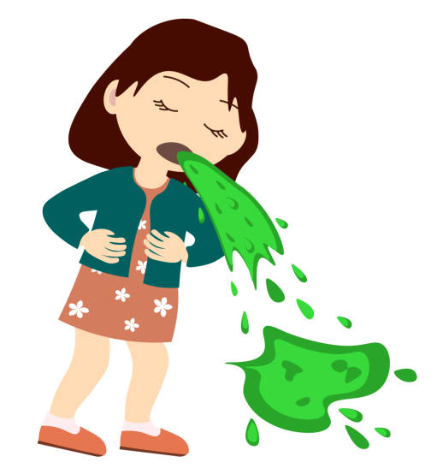
What’s wrong?
stomachache
vomit
food poison

Slide 4
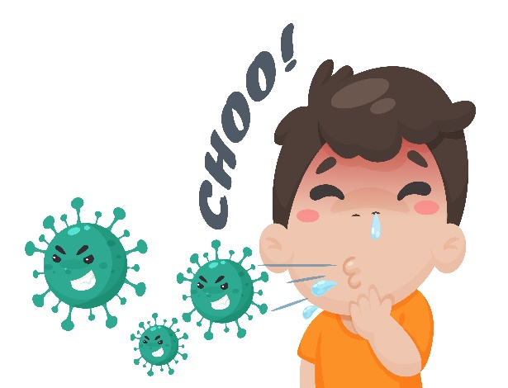
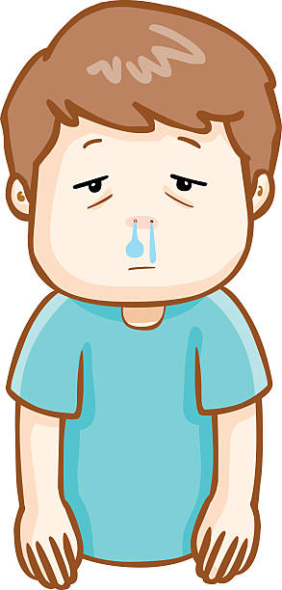
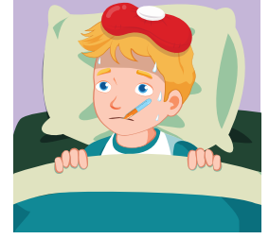
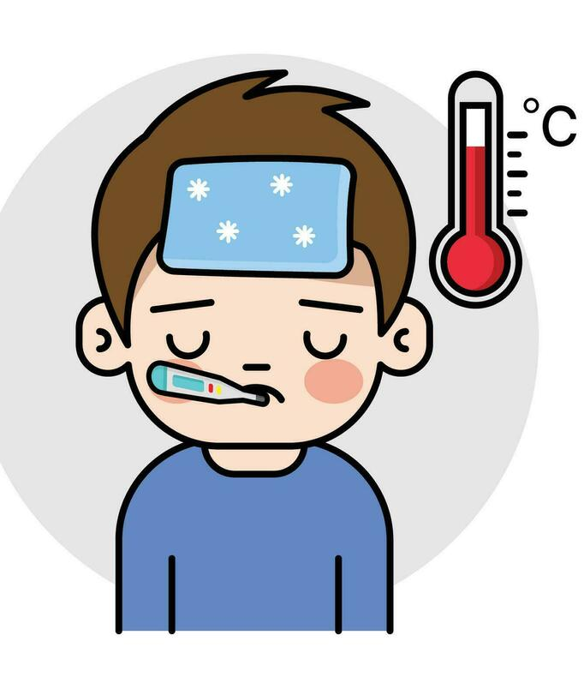
What’s wrong?
the flu
sneezing
runny nose
fever

Slide 5
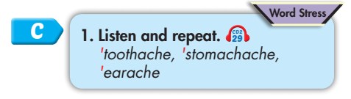


Click on C to hear the sound.
earache
toothache
stomachache
headache
chickenpox

Slide 6
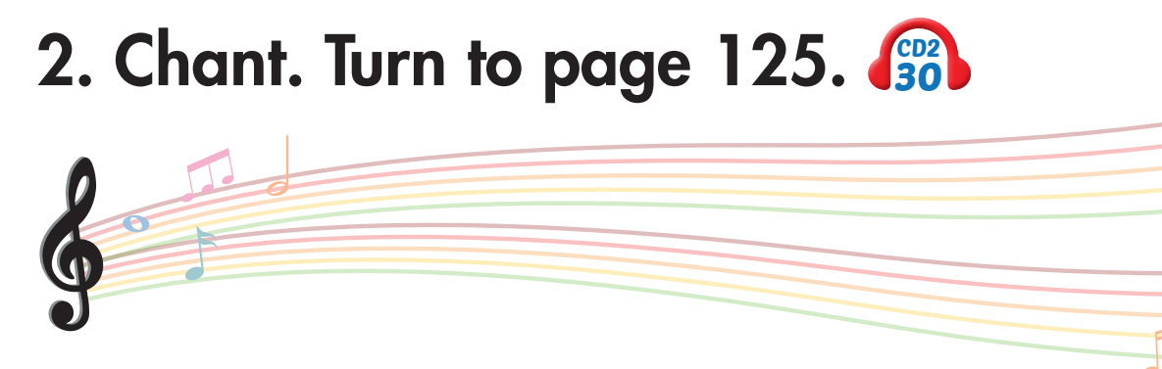

Slide 7

Listening

Slide 8

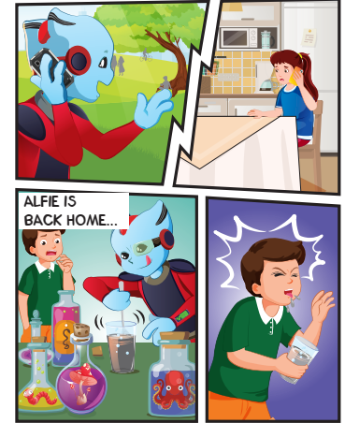
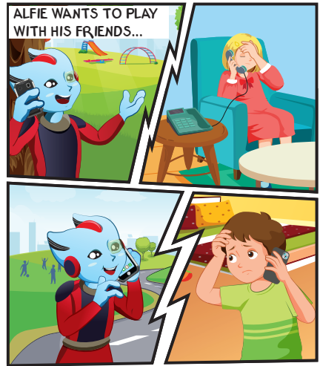

Slide 9
Lucy
3
Sue
Ben
Tom
4
2

Slide 10
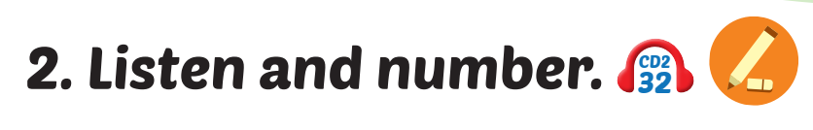
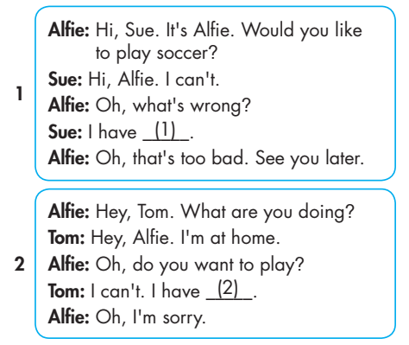
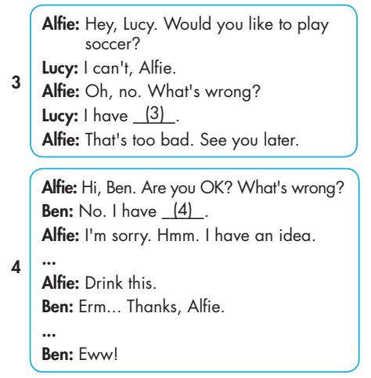
Click on 2 to hear the sound.
3
2
4

Slide 11

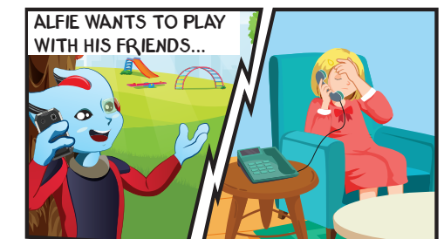
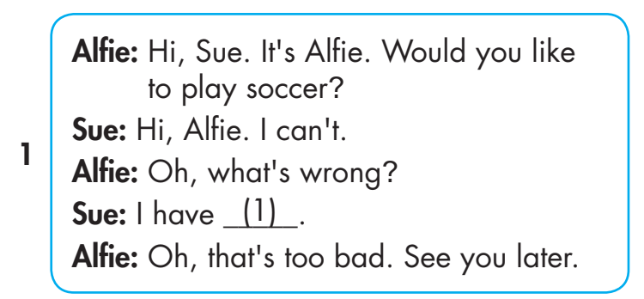
a stomachache.

Slide 12
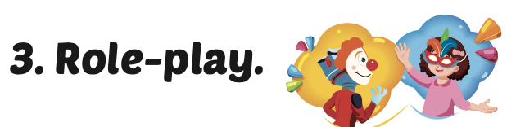


Slide 13
chickenpox.
a stomachache.
the flu.
a toothache.

Slide 14
MAKE YOUR OWN STORY

Slide 15
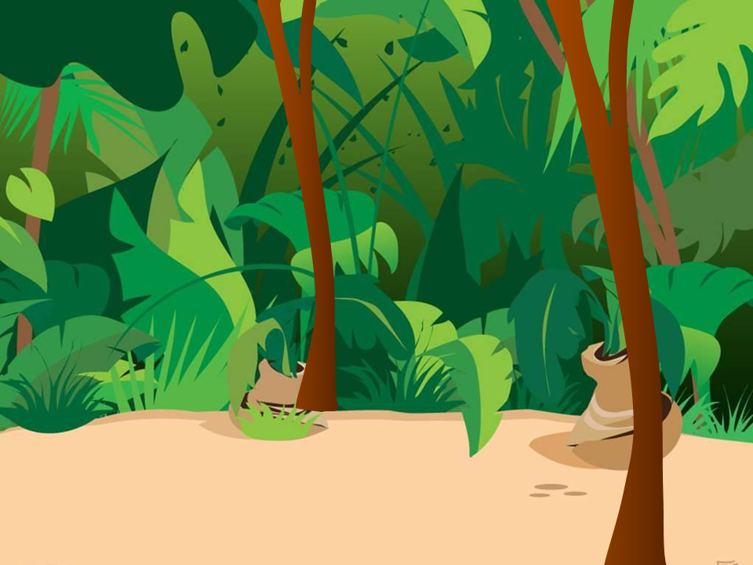





Slide 16

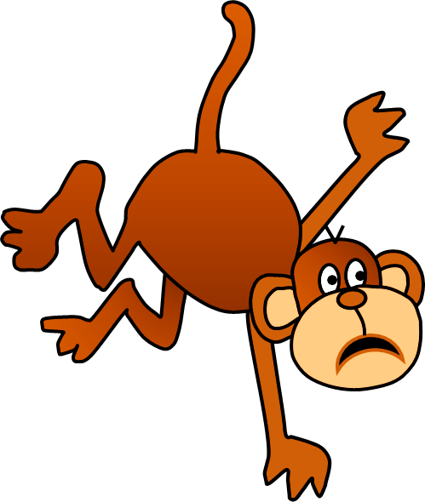
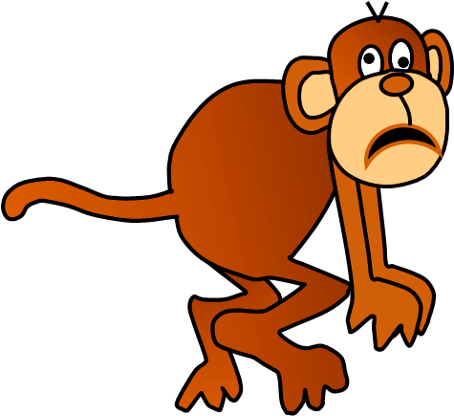
Click on the right option
He has the flu.
He has a headache.
THANK YOU!
NEXT

Slide 17
Click on the right option
She has a stomachache.
She has a toothache.
THANK YOU!
NEXT

Slide 18
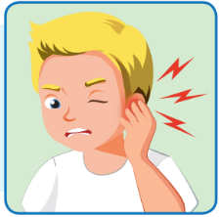
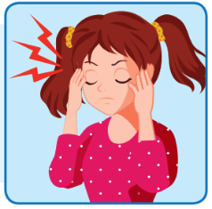
Click on the right option
.
.
THANK YOU!
What’s wrong?
I have a headache.
NEXT

Slide 19
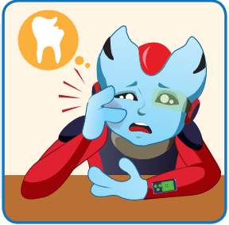
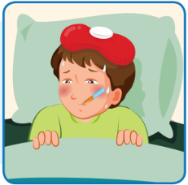
Click on the right option
.
.
THANK YOU!
What’s wrong?
He has a toothache.
NEXT

Slide 20
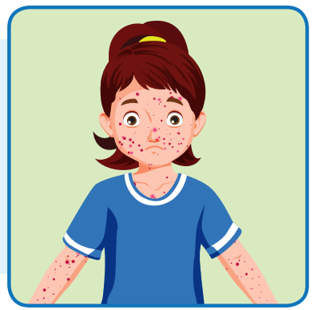
Click on the right option
.
THANK YOU!
.
What’s wrong?
I have chickenpox.
NEXT

Slide 21
Today’s lesson
Pronunciation
Word Stress
headache, earache, stomachache, toothache, chickenpox.
Structures/ Sentence patterns
What’s wrong?
- I have a toothache.
What’s wrong?
- He has chickenpox.

