Slide 1

Unit 1: HEALTH
Lesson 1.1
Page 64

Slide 2






Guessing pictures
Click on pictures to check the answer.
No smoking
Dental clinic
Hospital
Ambulance
Wash hands

Slide 3
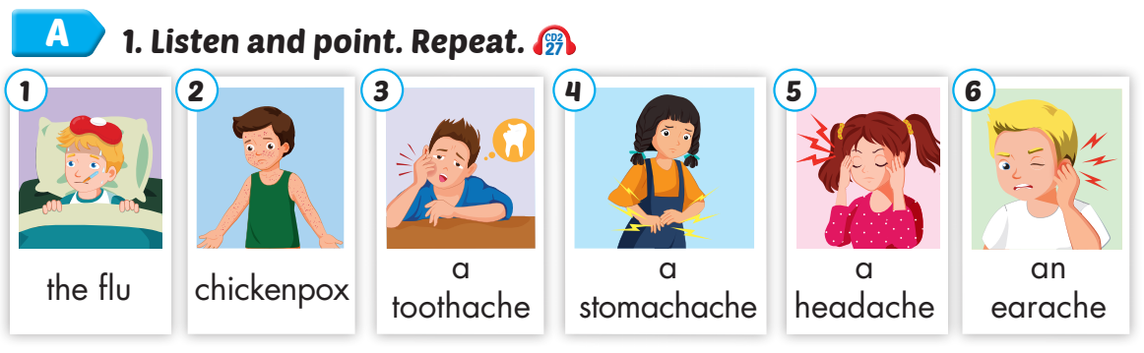
Click on A to hear the sound.
/fluː/
bệnh cúm
/ˈtʃɪkɪnpɑːks/
bệnh thuỷ đậu
/ˈtuːθeɪk/ sự đau răng
/ˈstʌməkeɪk/
sự đau bụng
/ˈhedeɪk/ sự đau đầu
/ˈɪreɪk/ sự đau tai
Notes:
Click vào hình A. 1. Listen and point. Repeat để cho cả audio full chạy

Slide 4
Listen and choose. Then say.

Slide 5
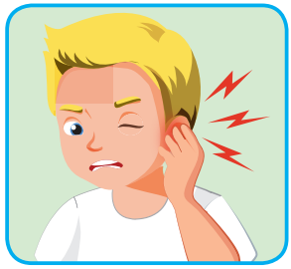
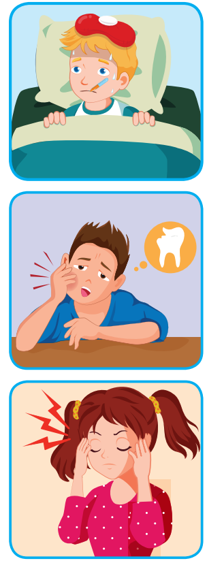

Listen and choose
A
B
C

Slide 6
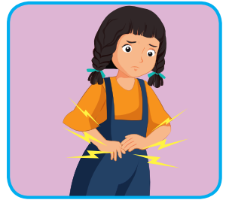
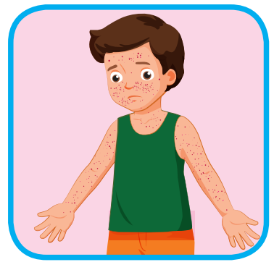
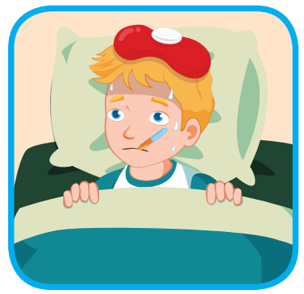
Listen and choose
A
B
C

Slide 7
Listen and choose
A
B
C

Slide 8
Listen and choose
A
B
C

Slide 9
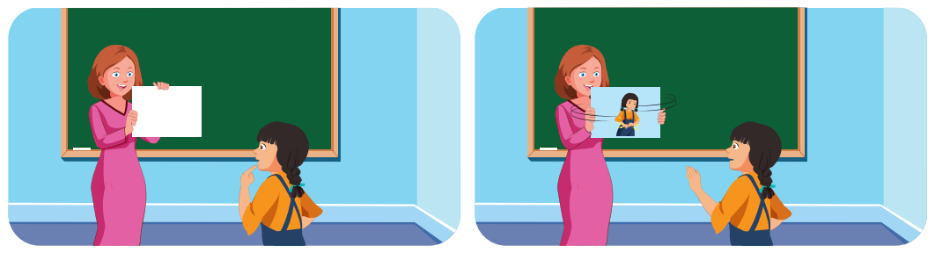
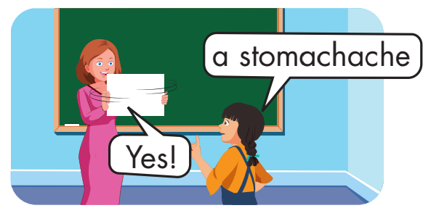

Slide 10
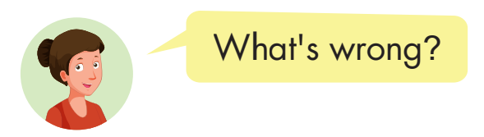
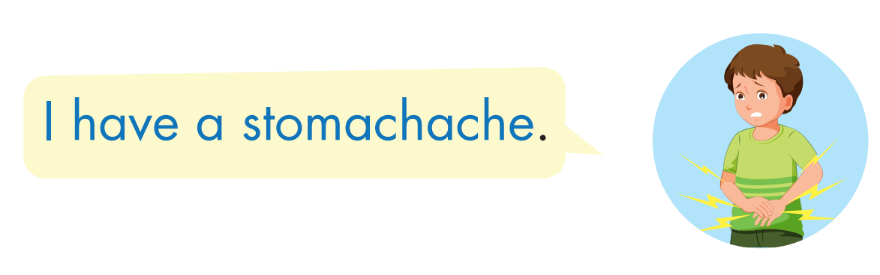
Structure

Slide 11


Structure
Click on B to hear the sound.
Click on the picture to hear the sound.

Slide 12

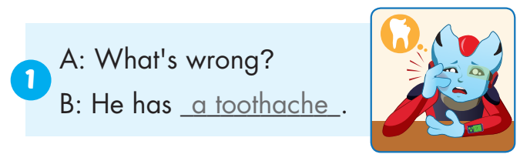
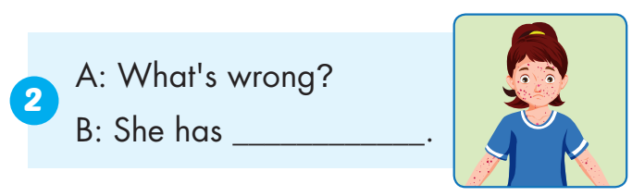
chickenpox

Slide 13
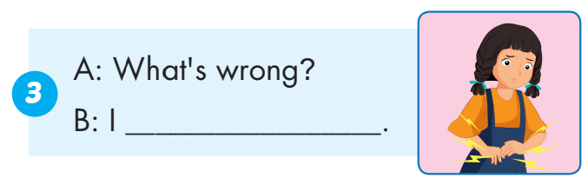
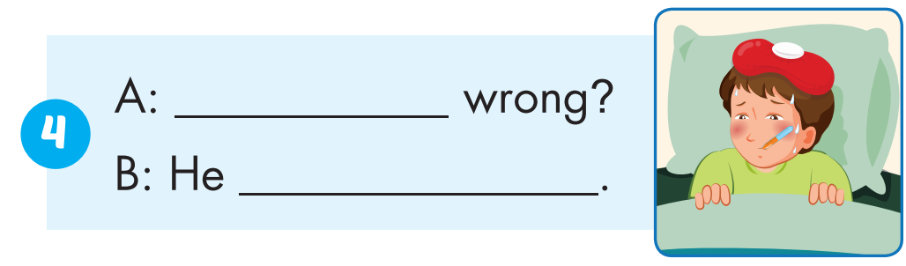
have a stomachache
What’s
has the flu

Slide 14
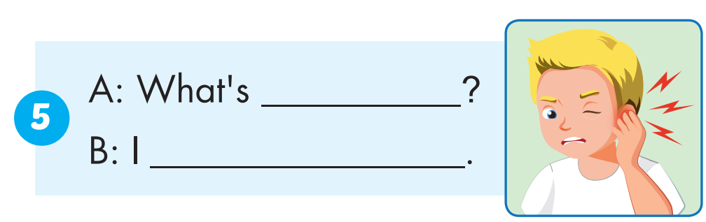
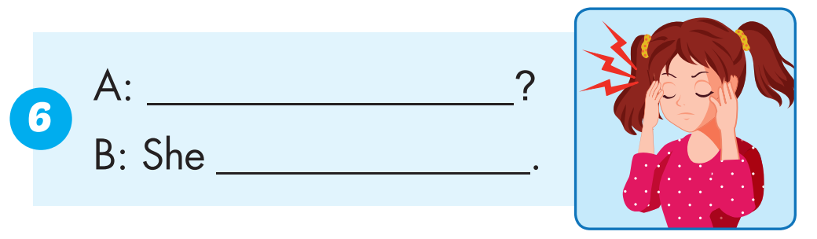
wrong
have an earache
What’s wrong
has a headache

Slide 15
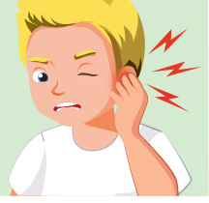
an earache
SHOW

Slide 16
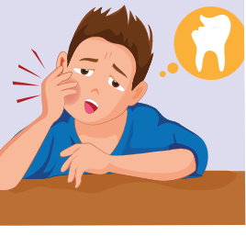
a toothache
SHOW

Slide 17

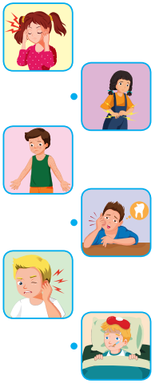
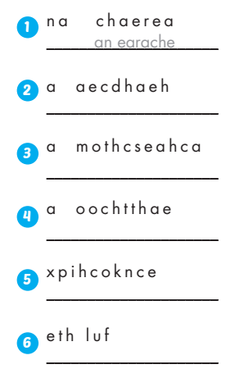
Extra Practice
WB, page 42
a headache
a stomachache
a toothache
chickenpox
the flu

Slide 18
Today’s lesson
Vocabularies
the flu, chickenpox,
a toothache,
a stomachache, a headache,
an earache.
Structures/ Sentence patterns
What’s wrong?
- I have a toothache.
- She has a headache.

