Slide 1


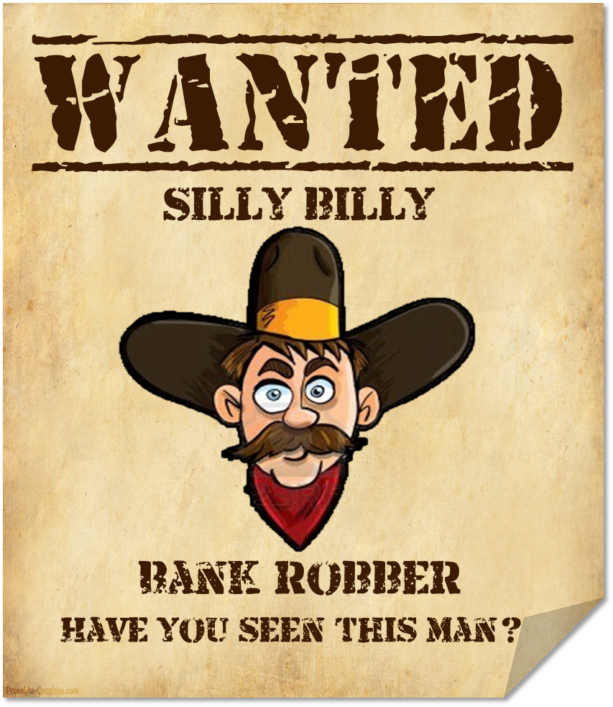
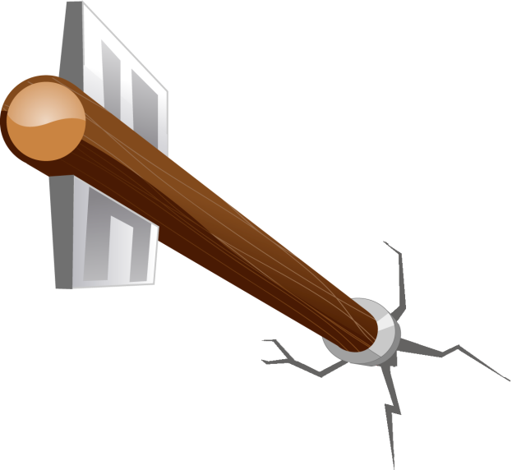

by HERBER

Slide 2
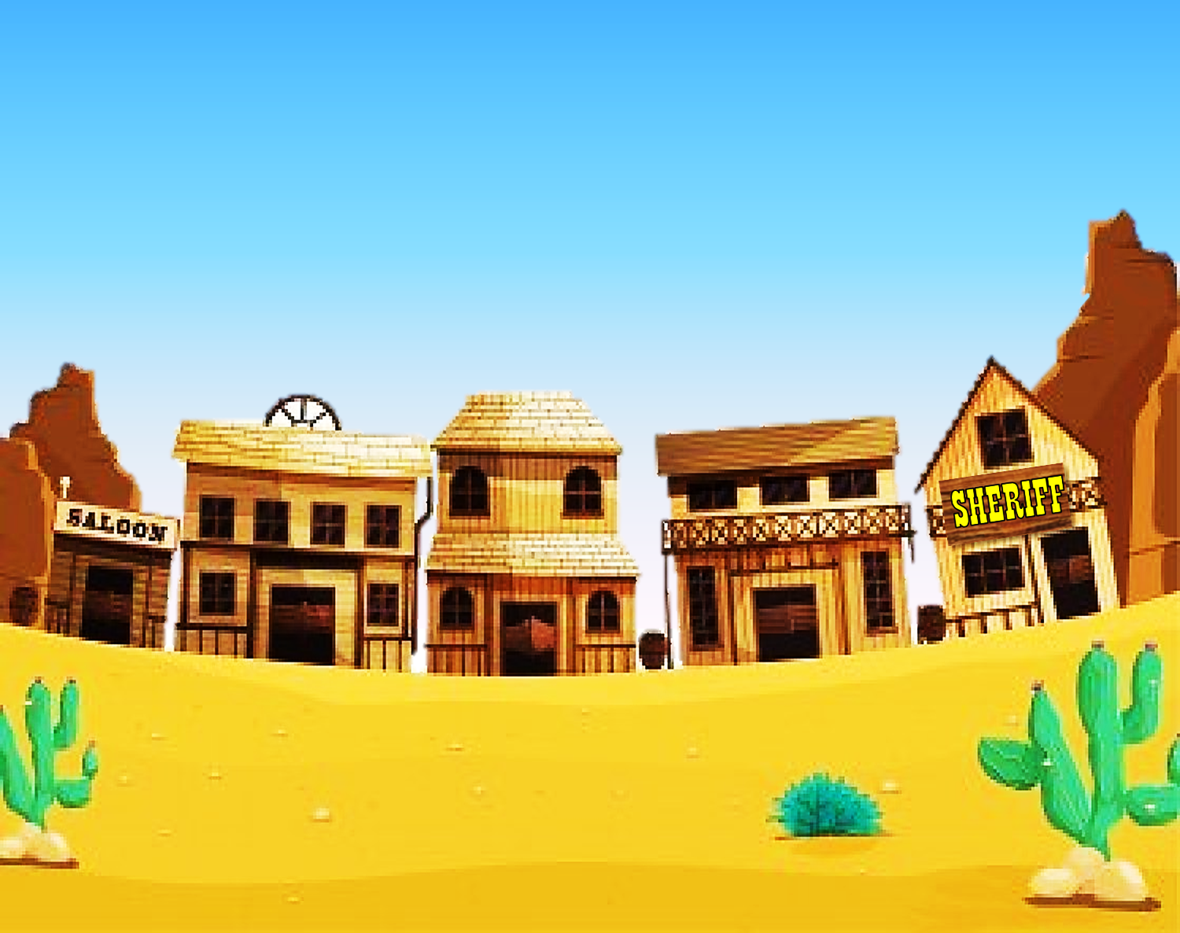
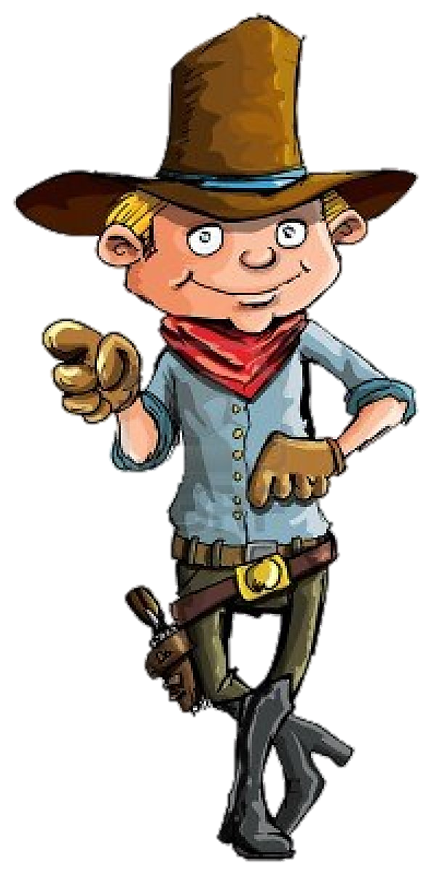

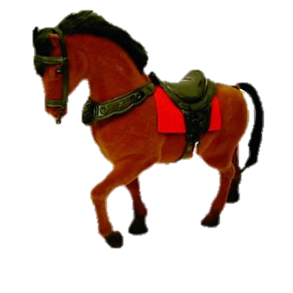
Read the descriptions and click on the right name to catch the bank robbers

Slide 3
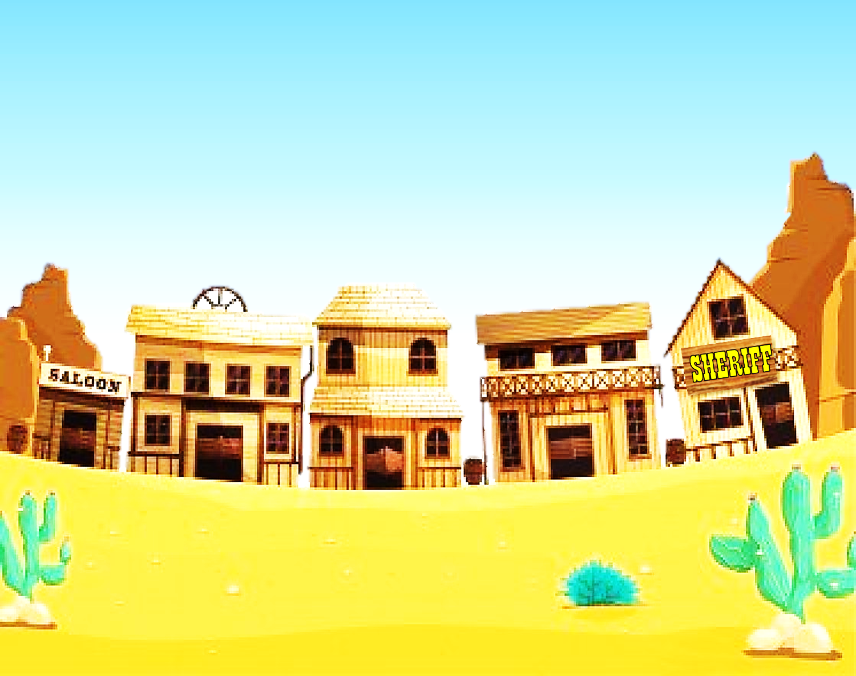

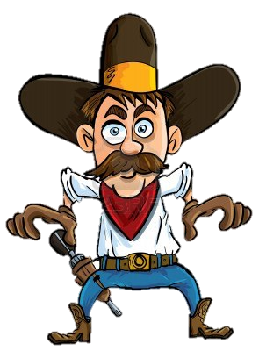
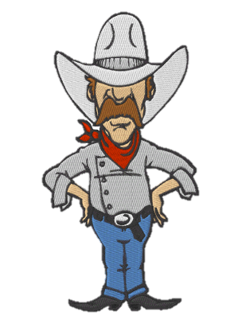
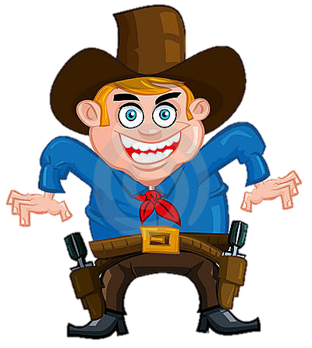

Silly billy
Smiley kid
cocky joe

Slide 4
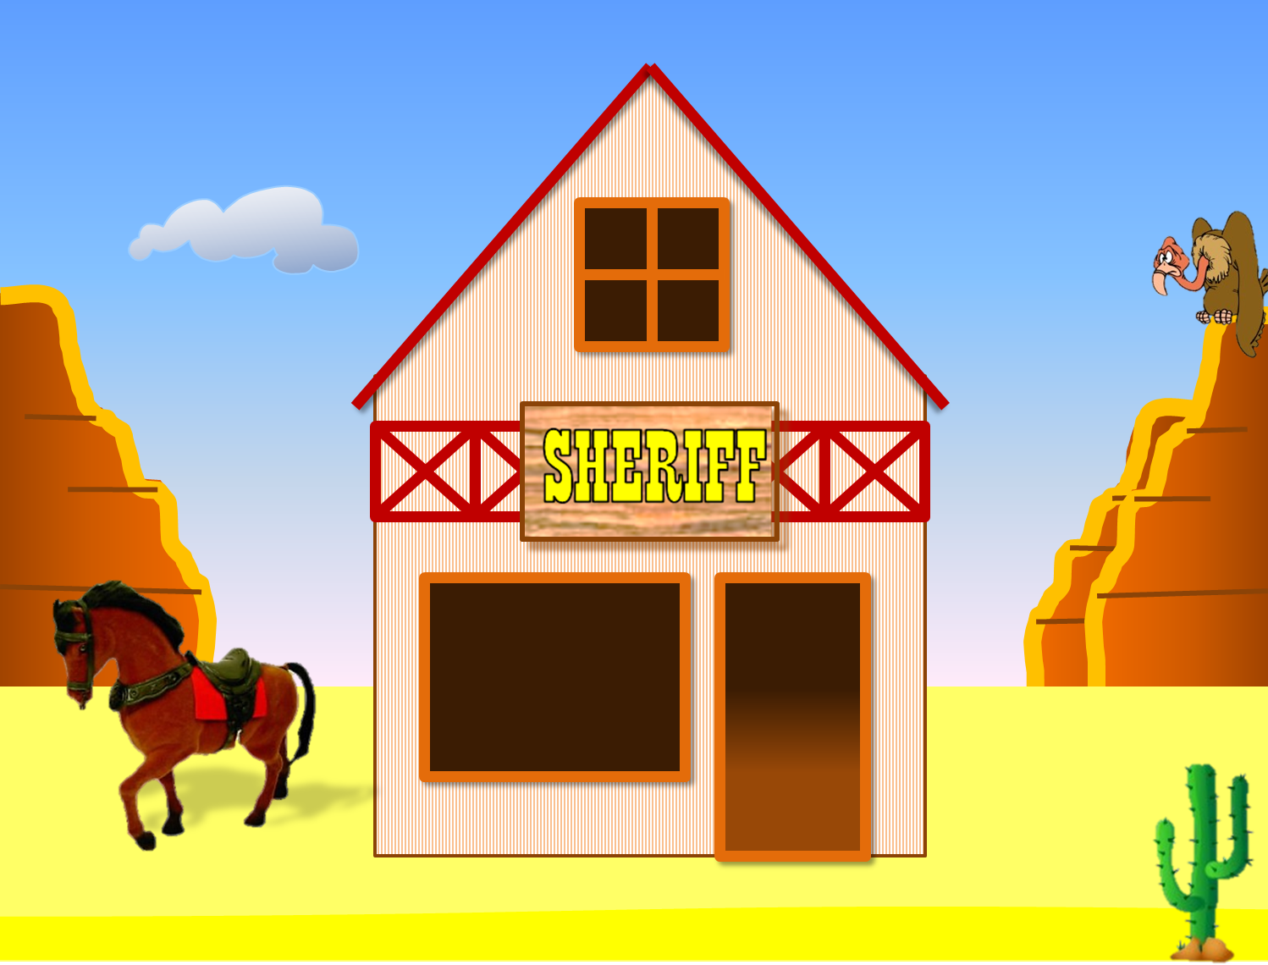
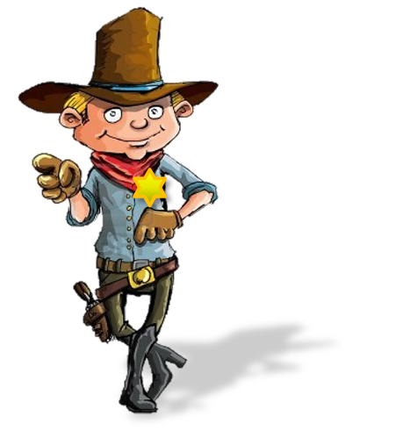
Thank you!
Oh, no!

Slide 5

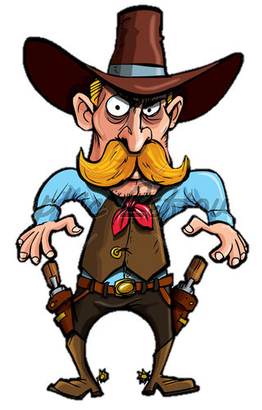
Skinny jim
Silly billy
cocky joe

Slide 6
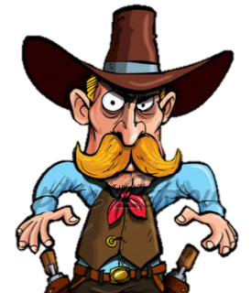
Thank you!
Oh, no!

Slide 7

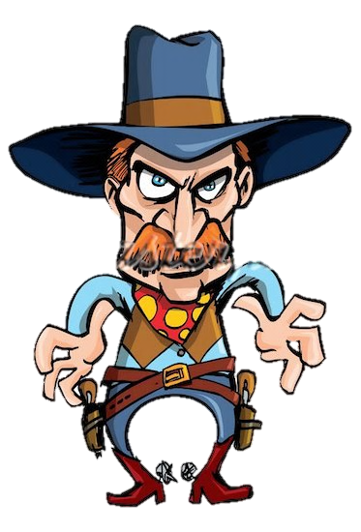
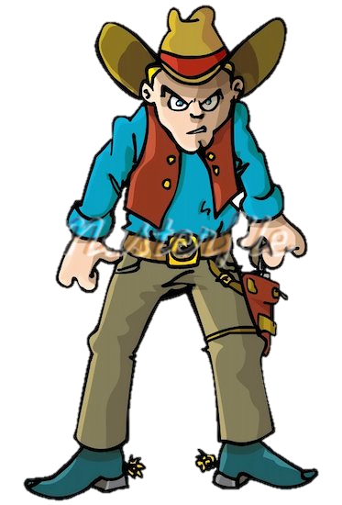
angry Tim
Silly billy
naughty jack

Slide 8
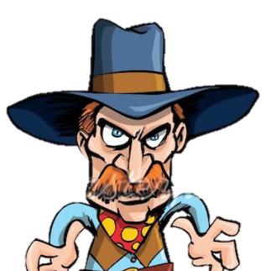
Thank you!
Oh, no!

Slide 9

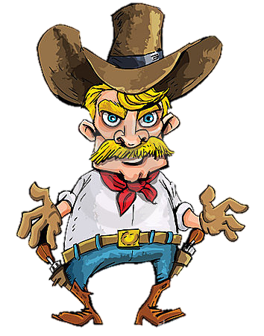
angry Tim
Silly billy
Little johnny

Slide 10
Thank you!
Oh, no!

Slide 11

angry Tim
cocky joe
Little johnny

Slide 12
Thank you!
Oh, no!

Slide 13

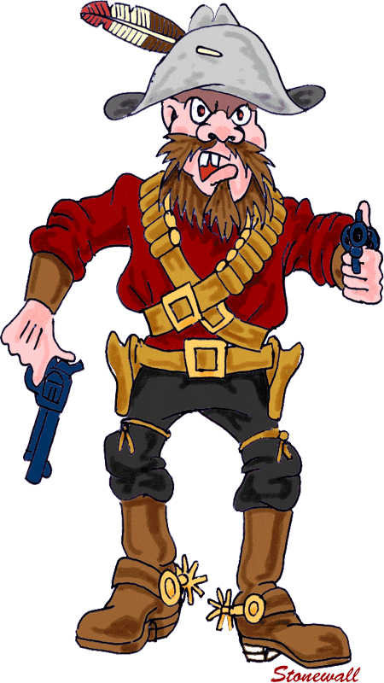
angry Tim
Baddy paddy
Little johnny

Slide 14
Thank you!
Oh, no!

Slide 15

Smailey kid
Baddy paddy
Little johnny

Slide 16
Thank you!
Oh, no!

Slide 17

Smailey kid
skinny jim
Little johnny

Slide 18
Thank you!
Oh, no!

Slide 19
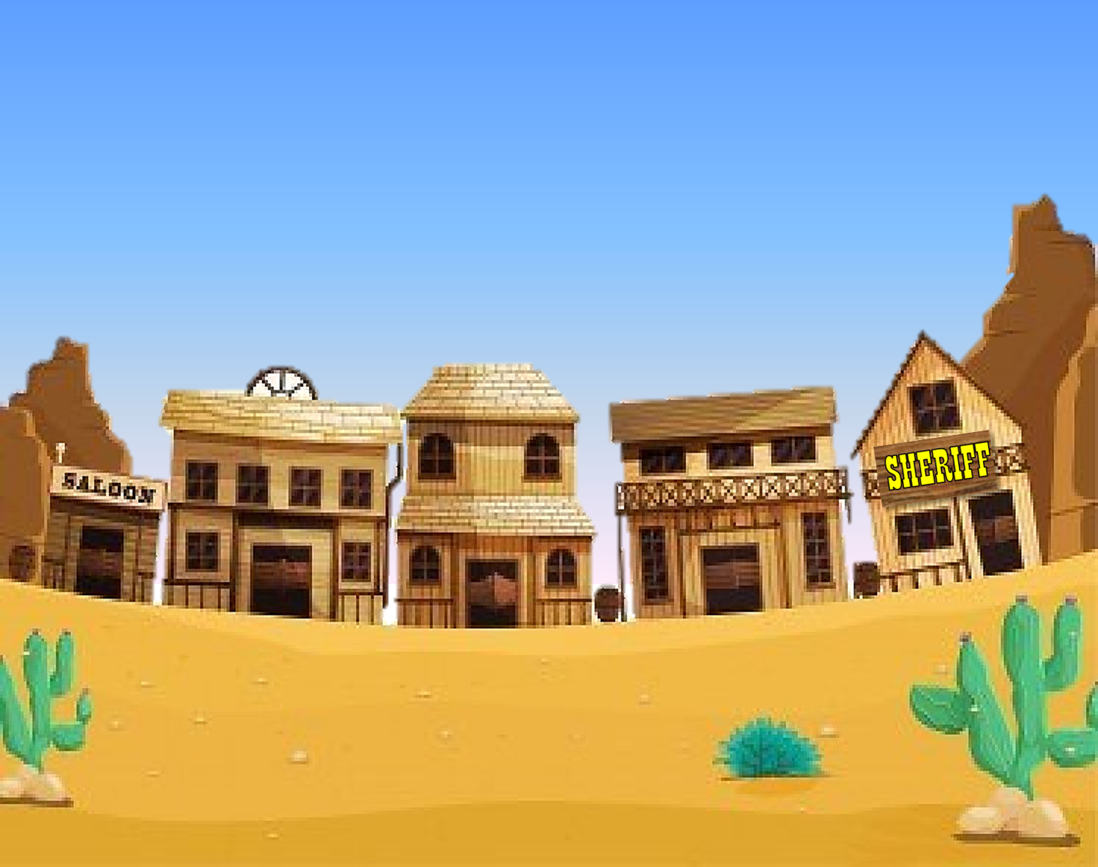
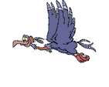
Thank you for making this town a safer place

Slide 20


