Slide 1
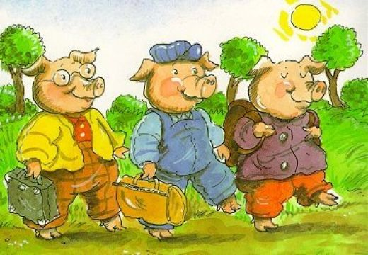
The Three Little Pigs
And the Big Bad Wolf

Slide 2
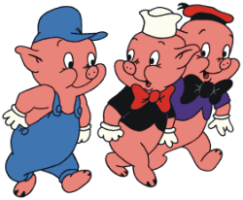
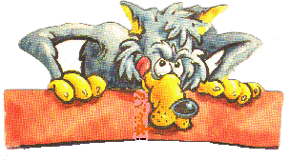
Characters
Second little pig
Third little pig
The big bad wolf
First little pig

Slide 3
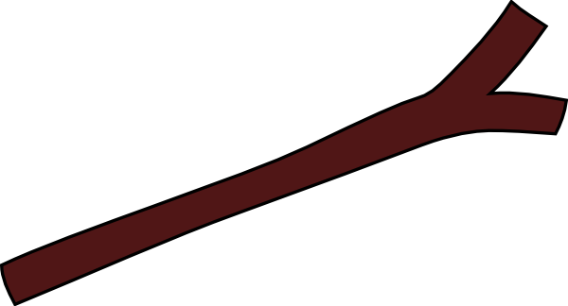
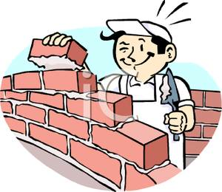
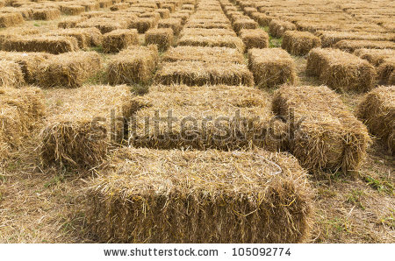
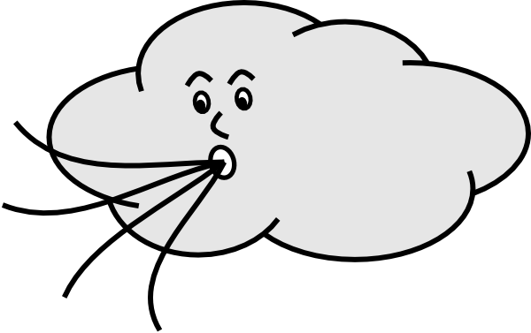

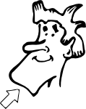

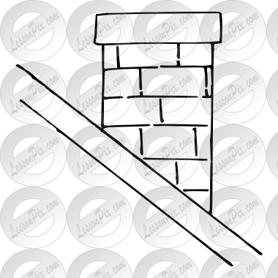
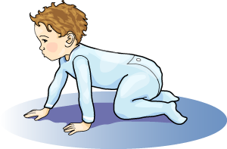
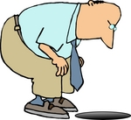
Straw
Stick
Bricks
Blow
Hair
Chin
Kettle
Chimney
Crawl
Hole

Slide 4
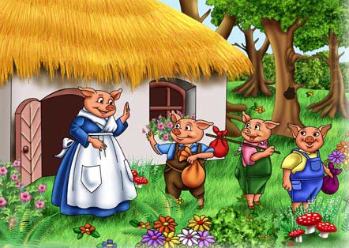
Once upon a time there were three little pigs, but the time had come for them to leave home and seek their fortunes.
Before they left, their mother told them, “Whatever you do, do it the best that you can. Because that’s they way to get along in the world”.

Slide 5
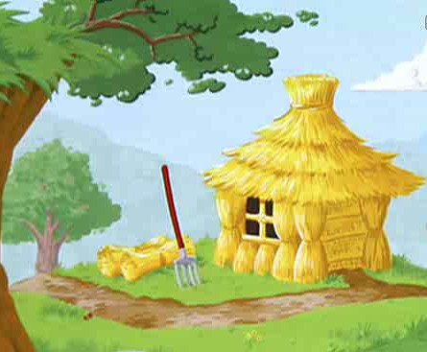
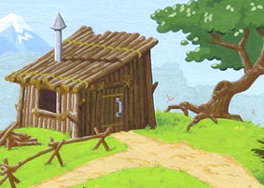
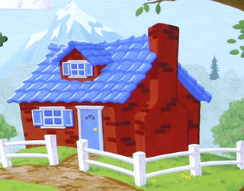
The first little pig built his house out of straw because it was the easiest thing to do.
The second little pig built his house of sticks. It was a little stronger than the house of straw.
The Third little pig built his house out of bricks. It was stronger than the house of straw and the house of sticks.
Notes:
Straw, sticks, bricks,

Slide 6
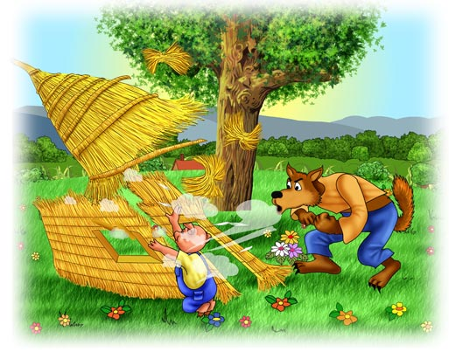
One night the big bad wolf, who dearly loved to eat fat little piggies, came along and saw the first little pig in his house of straw.
He said, “Let me in, let me in, little pig or I’ll huff and I’ll puff and I’ll blow your house in!”
“Not by the hair of my chinny chin chin”, said the little pig.
But of course, the wolf did blow the house in and ate the first little pig.
Notes:
Blow, hair, chin

Slide 7
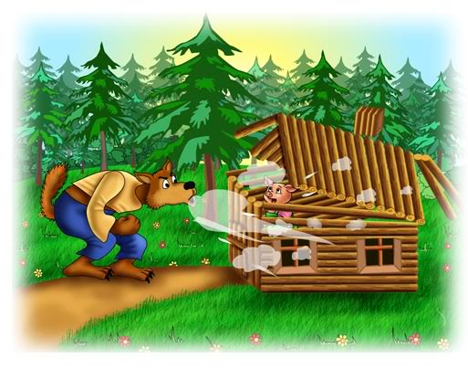
The wolf then came to the house of sticks, of the second little pig.
“Let me in, let me in, little pig, or I’ll huff and I’ll puff and I’ll blow your house in”.
“Not by the hair on my chinny chin chin”, said the little pig.
But the wolf blew that house in too, and ate the little pig.

Slide 8
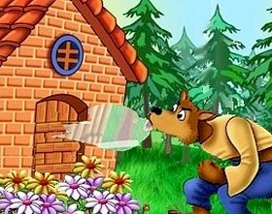
The wolf then came to the house of bricks.
“Let me in, let me in, little pig or I’ll huff and I’ll puff and I’ll blow your house in”
“Not by the hair of my chinny chin chin”, said the little pig.
Well, the wolf huffed and puffed but he could not blow down that brick house.

Slide 9
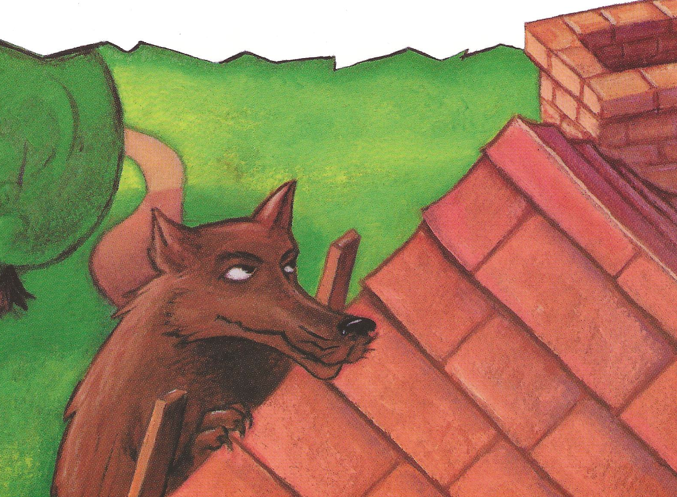

But the wolf was a sly old wolf and he climbed up on the roof to look for a way into the brick house.
The little pig saw the wolf climb up on the roof and let a roaring fire in the fireplace and placed on it a large kettle of water.
Notes:
Kettle

Slide 10
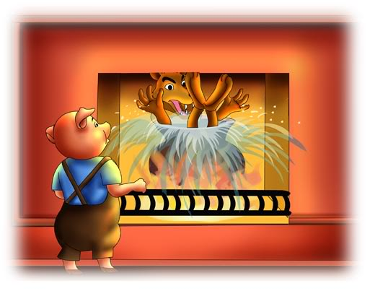
When the wolf finally found the hole in the chimney he crawled down and fell with a splash, right into the kettle of water.
That was the end of his troubles with the big bad wolf.
The end
Notes:
Chimney, crawl, hole

Slide 11
________
_______
________
________
_______
_______
______
_______
________
________

