Slide 1




DESCRIBING PLACES

Slide 2
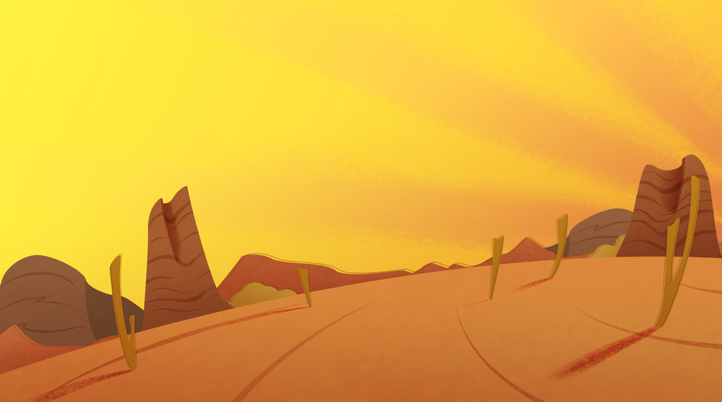
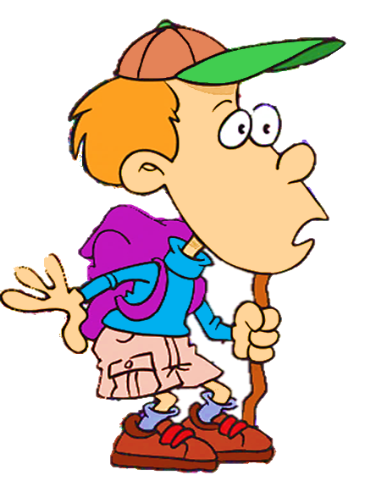

Answer the question
You are in a desert
Where am I?
CHECK

Slide 3


Click on the right adjective to complete the sentence:
dry
Deserts are _______ places.
dry
wet

Slide 4
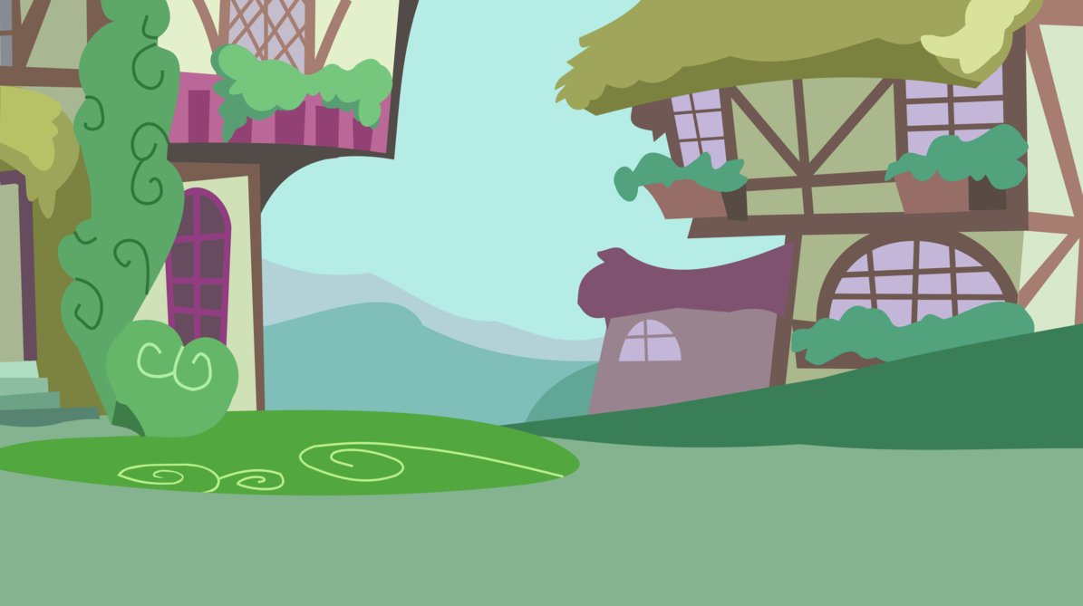
You are in a village
Where am I?
CHECK

Slide 5
peaceful
Villages are __________ places.
noisy
peaceful

Slide 6
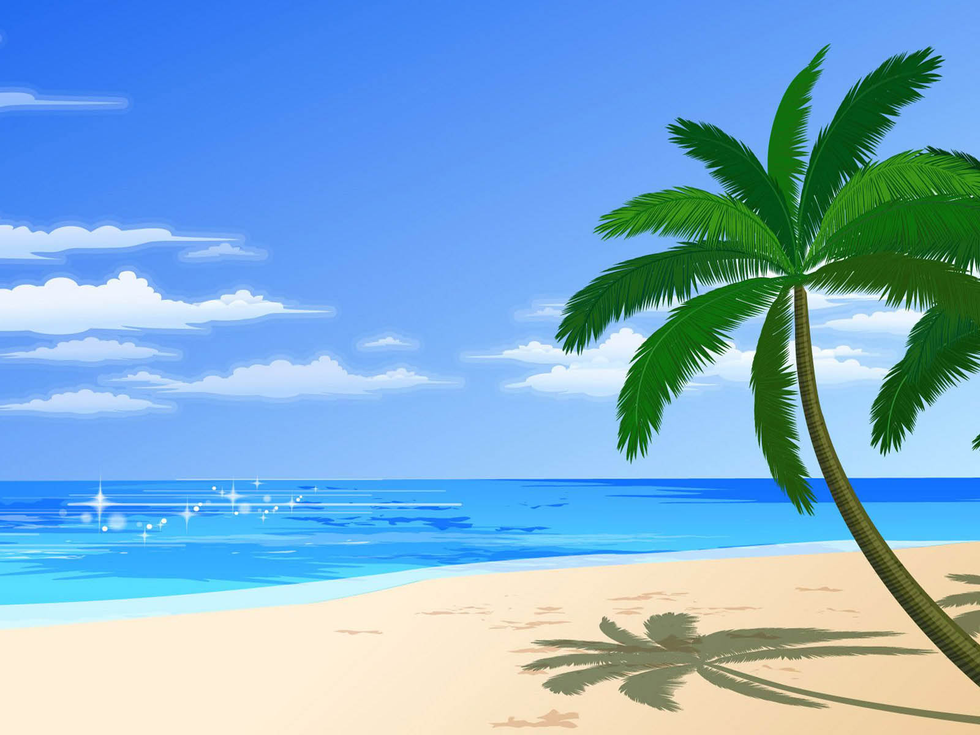
You are in a beach
Where am I?
CHECK

Slide 7
sandy
Beaches are usually _________ places.
sandy
rocky

Slide 8
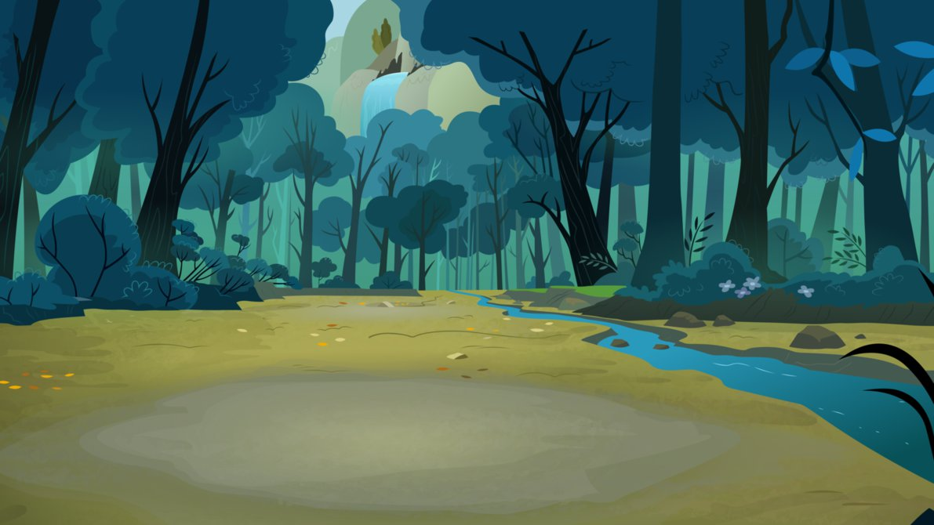
You are in a forest
Where am I?
CHECK

Slide 9
wet
Forests are _______ places.
dry
wet

Slide 10
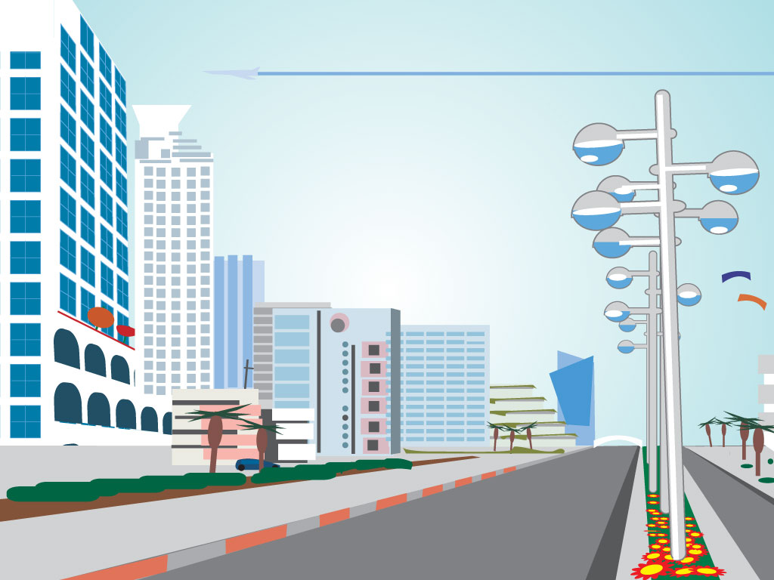
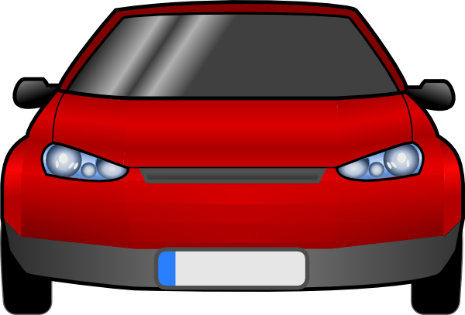
You are in a
big city
Where am I?
CHECK

Slide 11
noisy
Big cities are _______ places.
noisy
peaceful

Slide 12
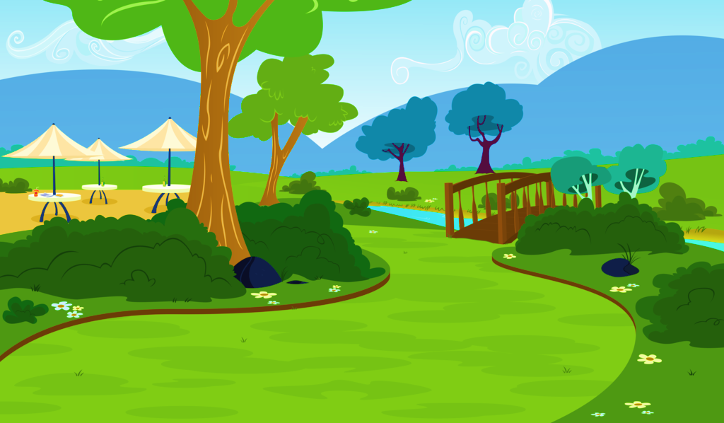
You are in a park
Where am I?
CHECK

Slide 13
beautiful
Parks are ___________ places.
beautiful
ugly

Slide 14
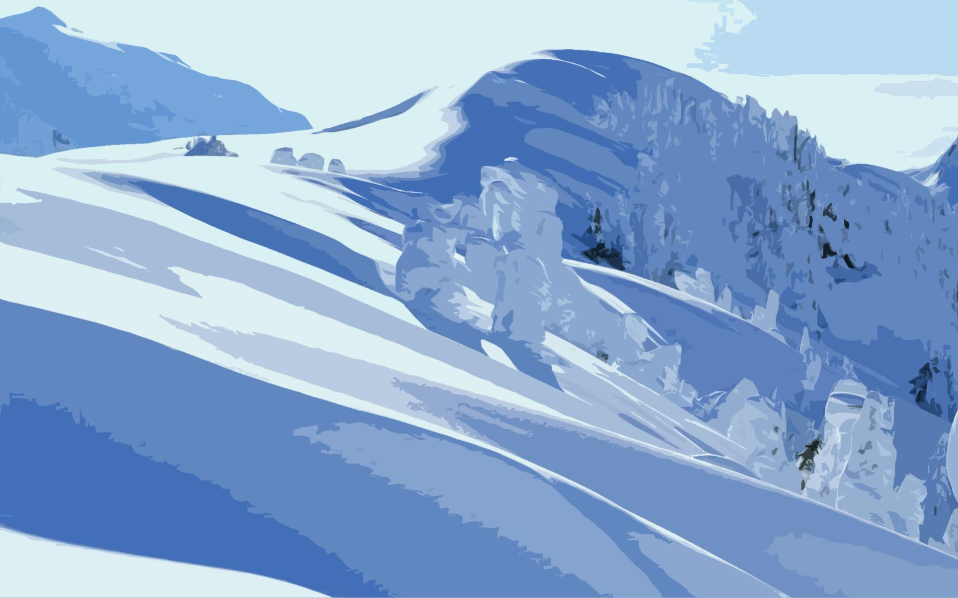
You are in a mountain
Where am I?
CHECK

Slide 15
cold
Mountains are _______ places.
hot
cold

Slide 16
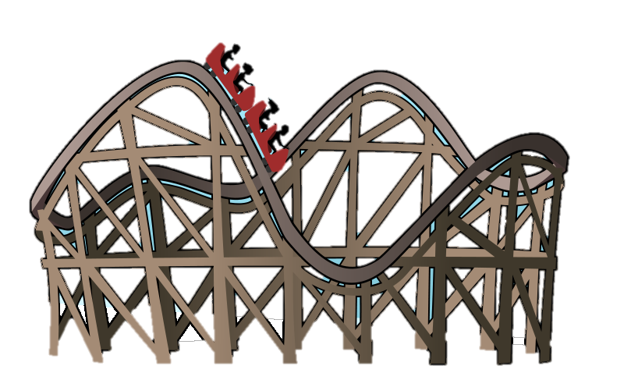
You are in a theme park
Where am I?
CHECK

Slide 17
amazing
Theme paks are _________ places.
amazing
boring

Slide 18
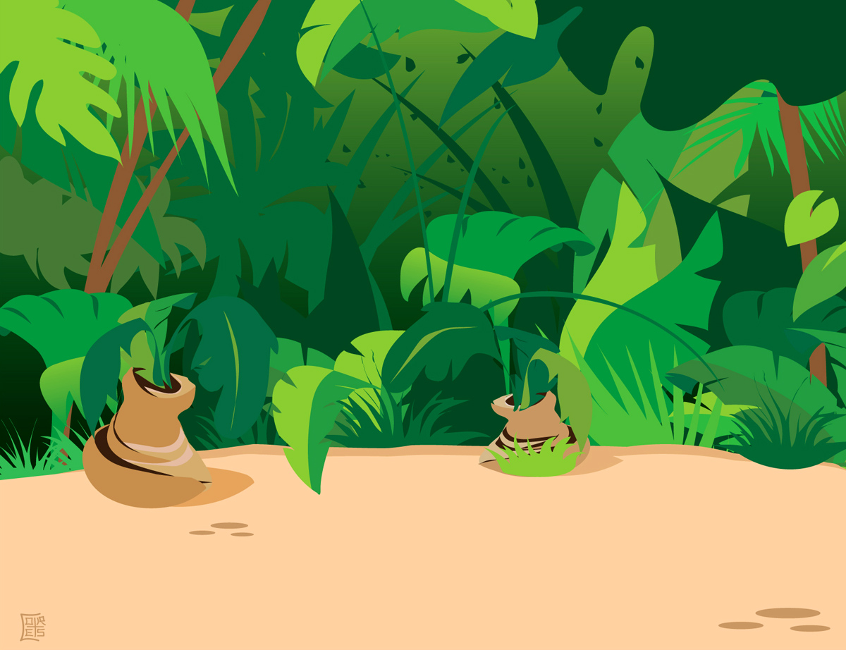
You are in a jungle
Where am I?
CHECK

Slide 19
shady
Jungles are _______ places.
sunny
shady

Slide 20
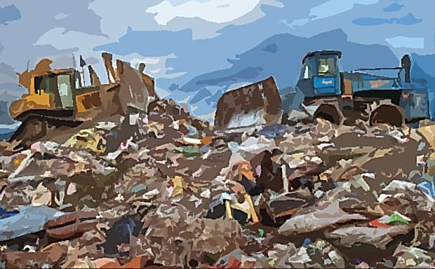
You are in a dump
Where am I?
CHECK

Slide 21
dirty
Dumps are _________ places.
dirty
clean

Slide 22
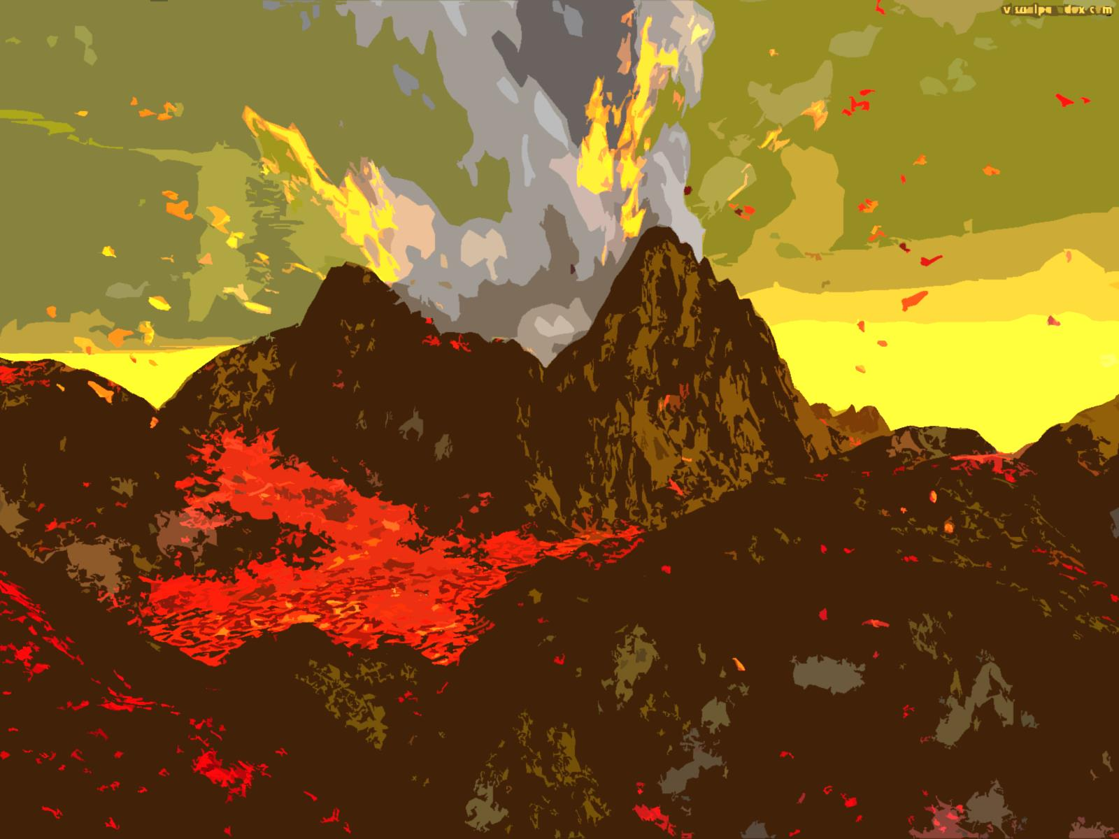
You are in a volcano
Where am I?
CHECK

Slide 23
hot
Volcanos are _______ places.
hot
cold
EXIT

