Slide 1



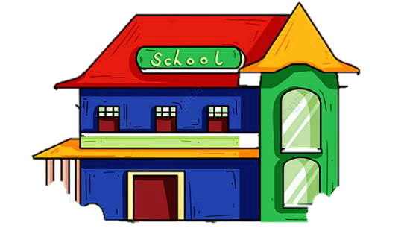
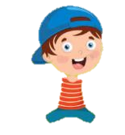
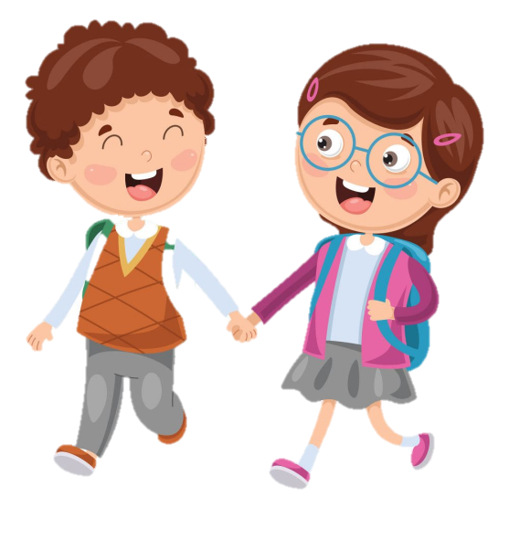



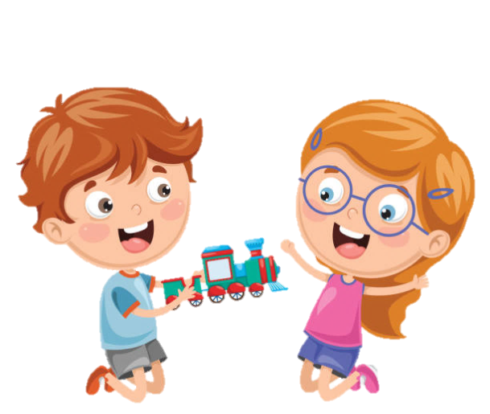





SCHOOL

Slide 2




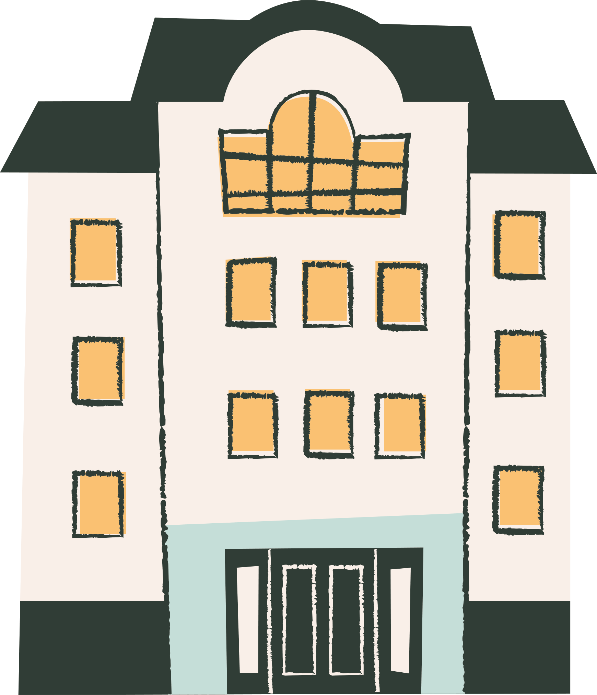
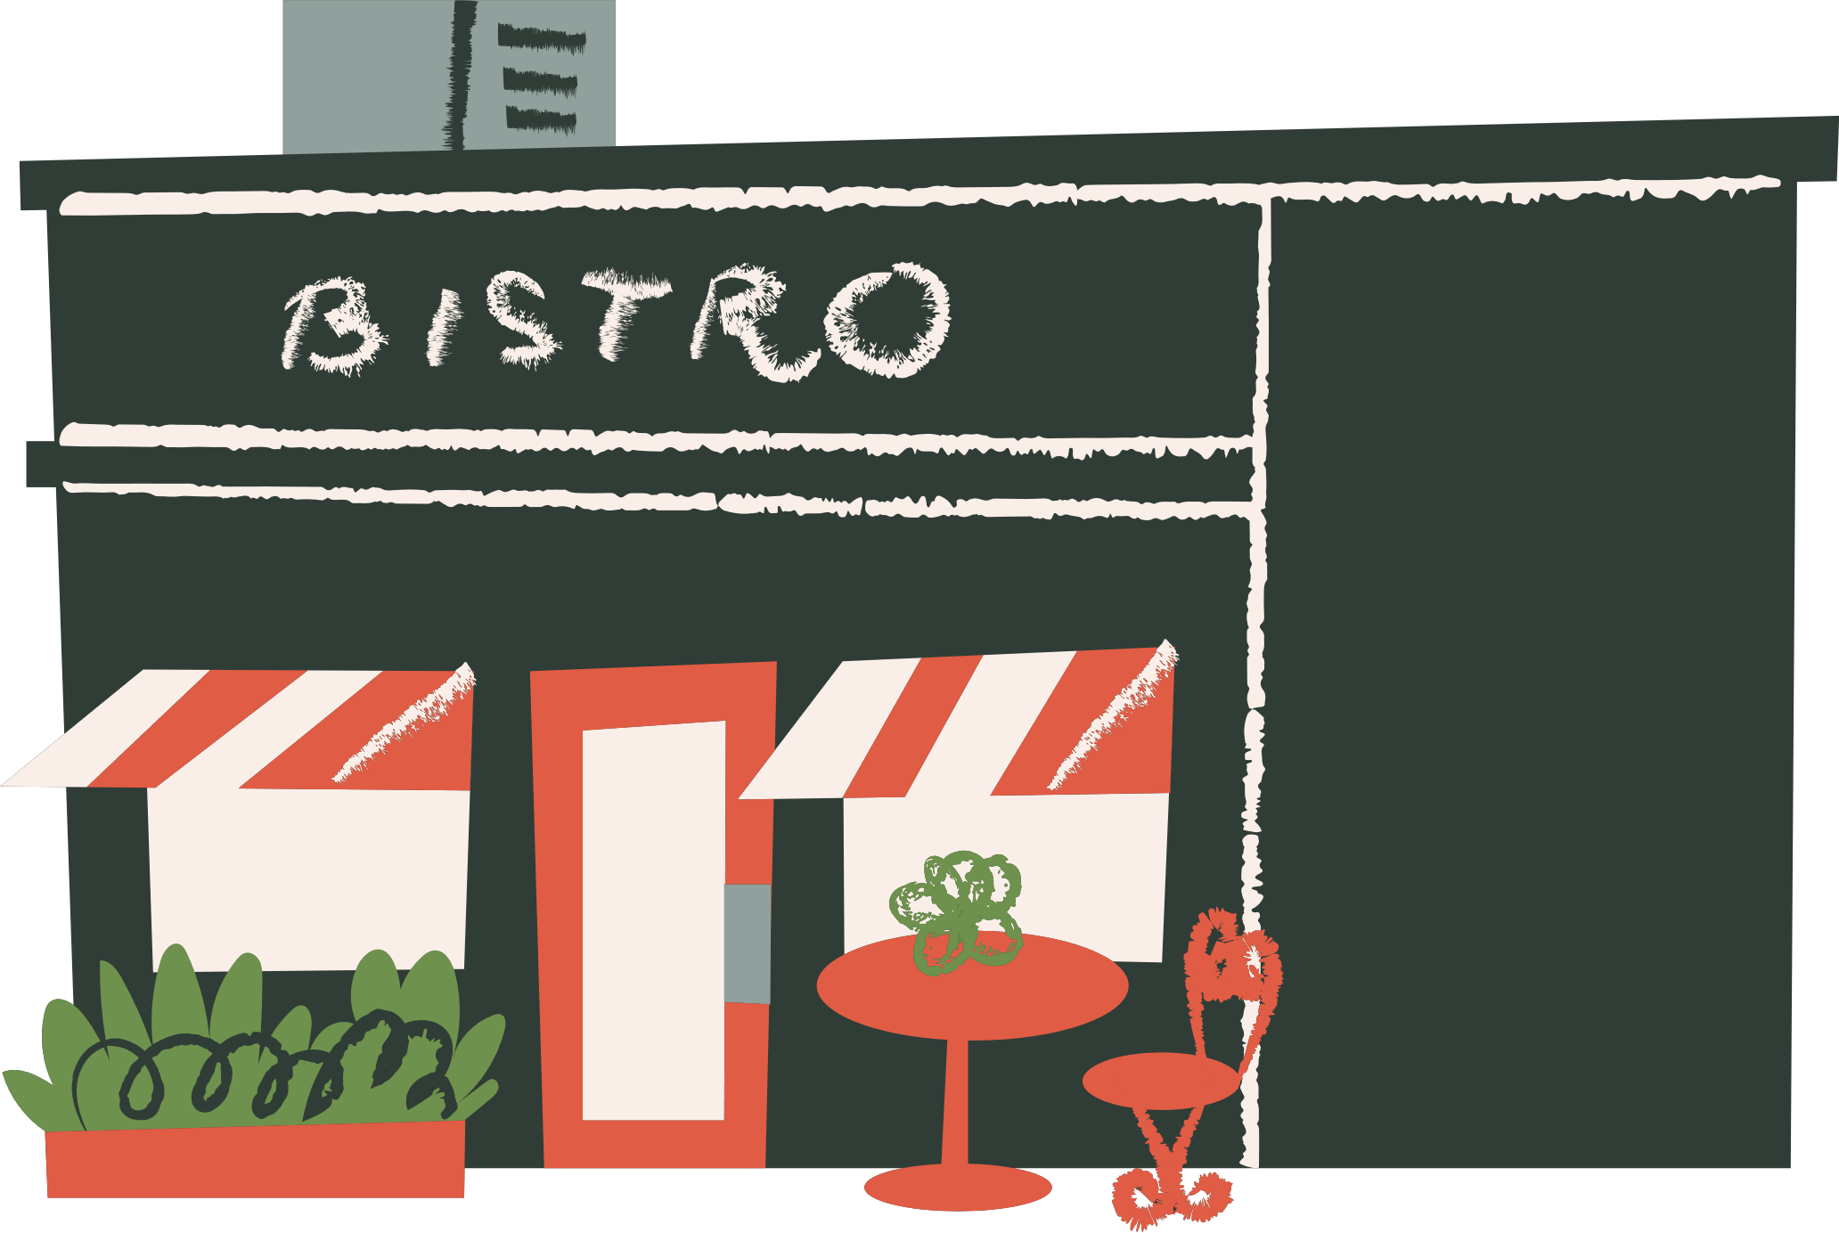

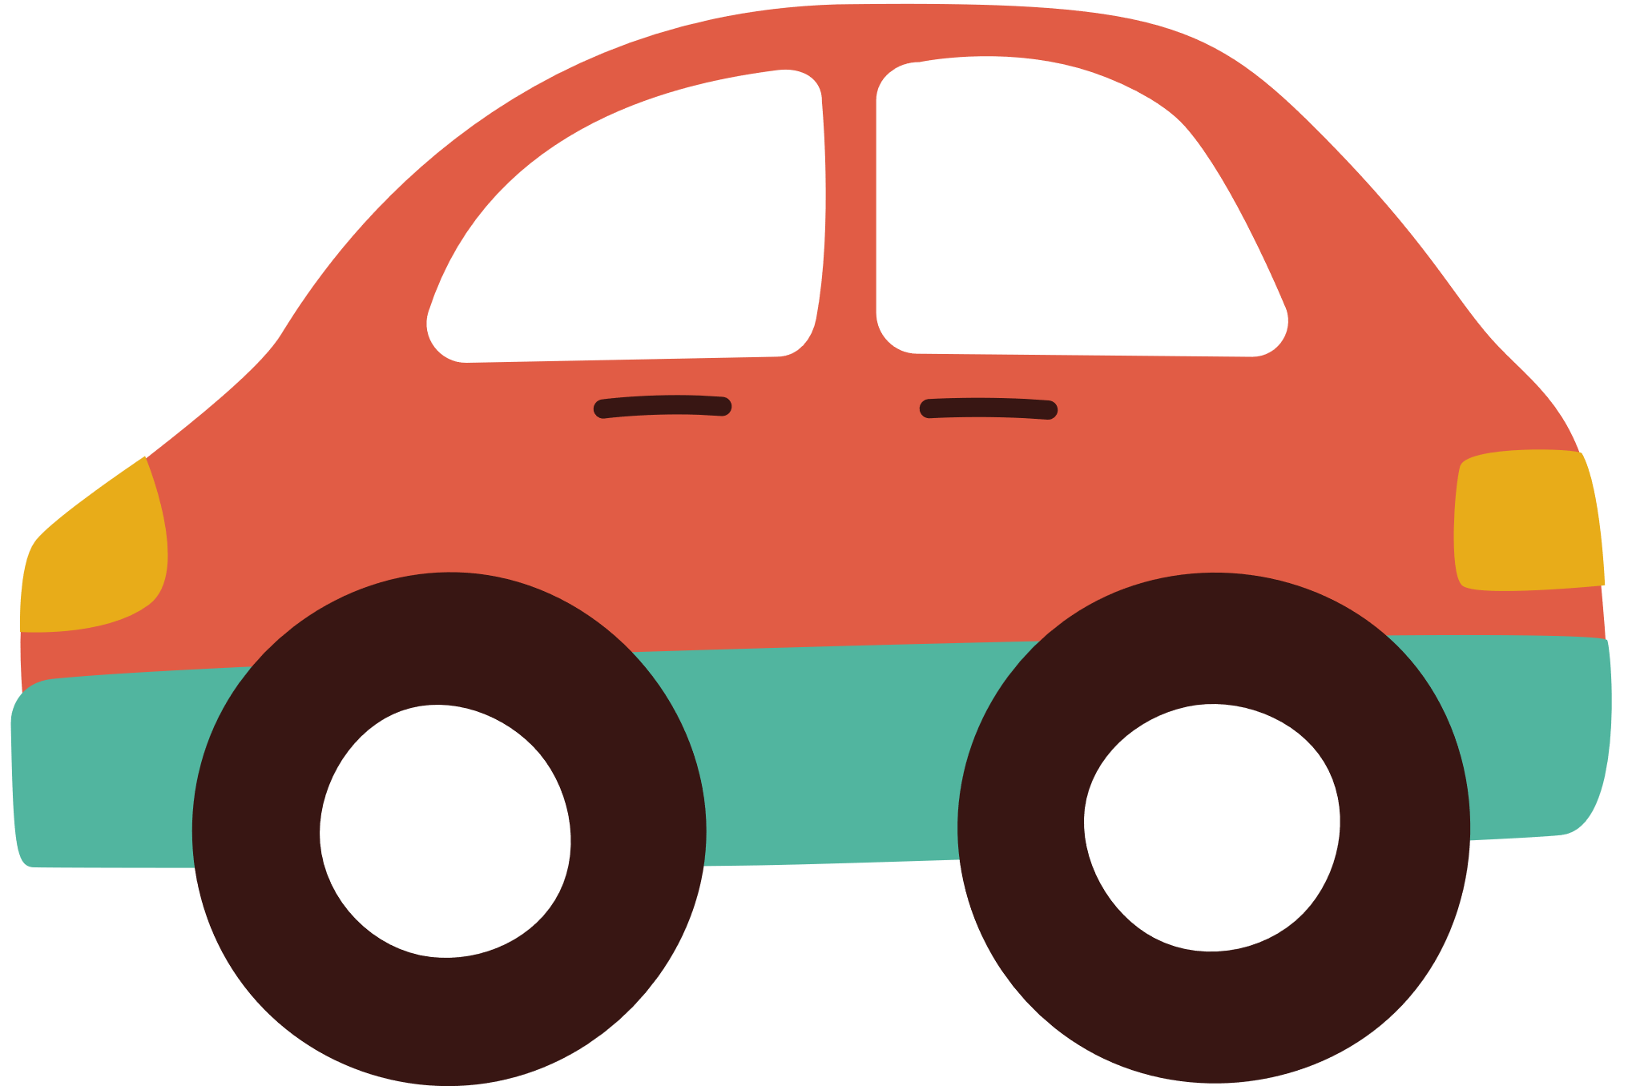
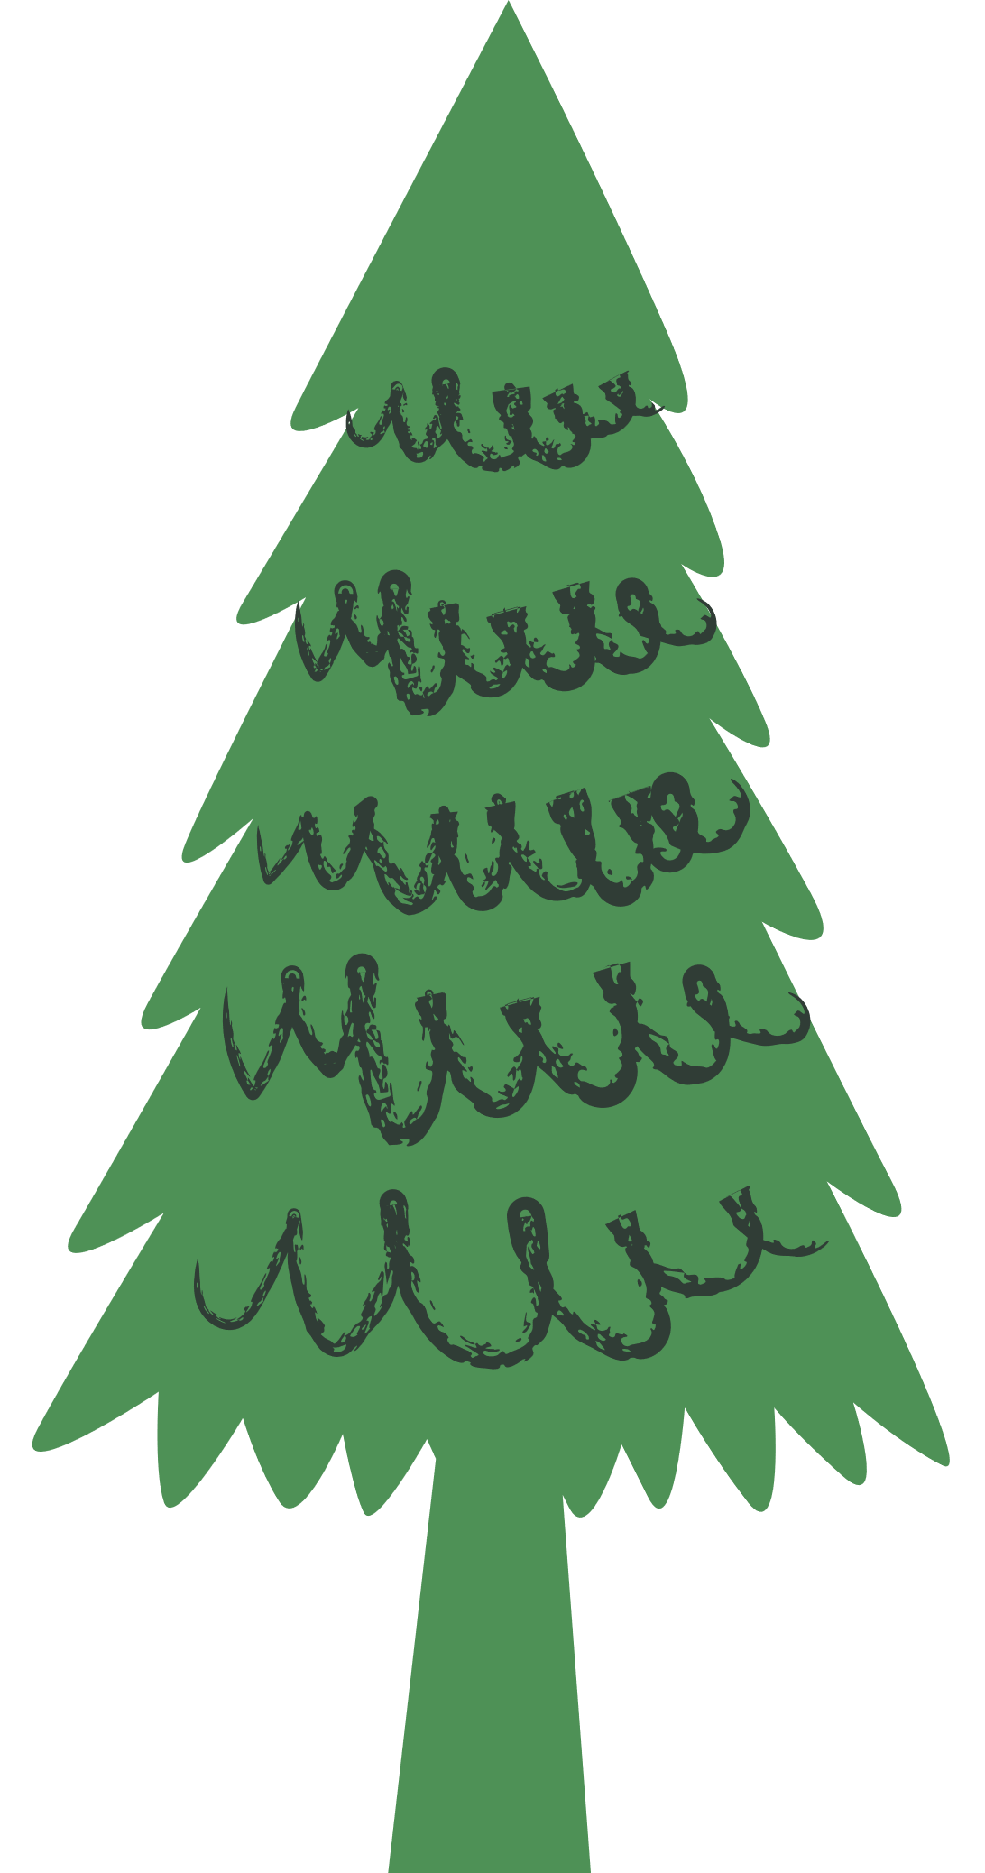

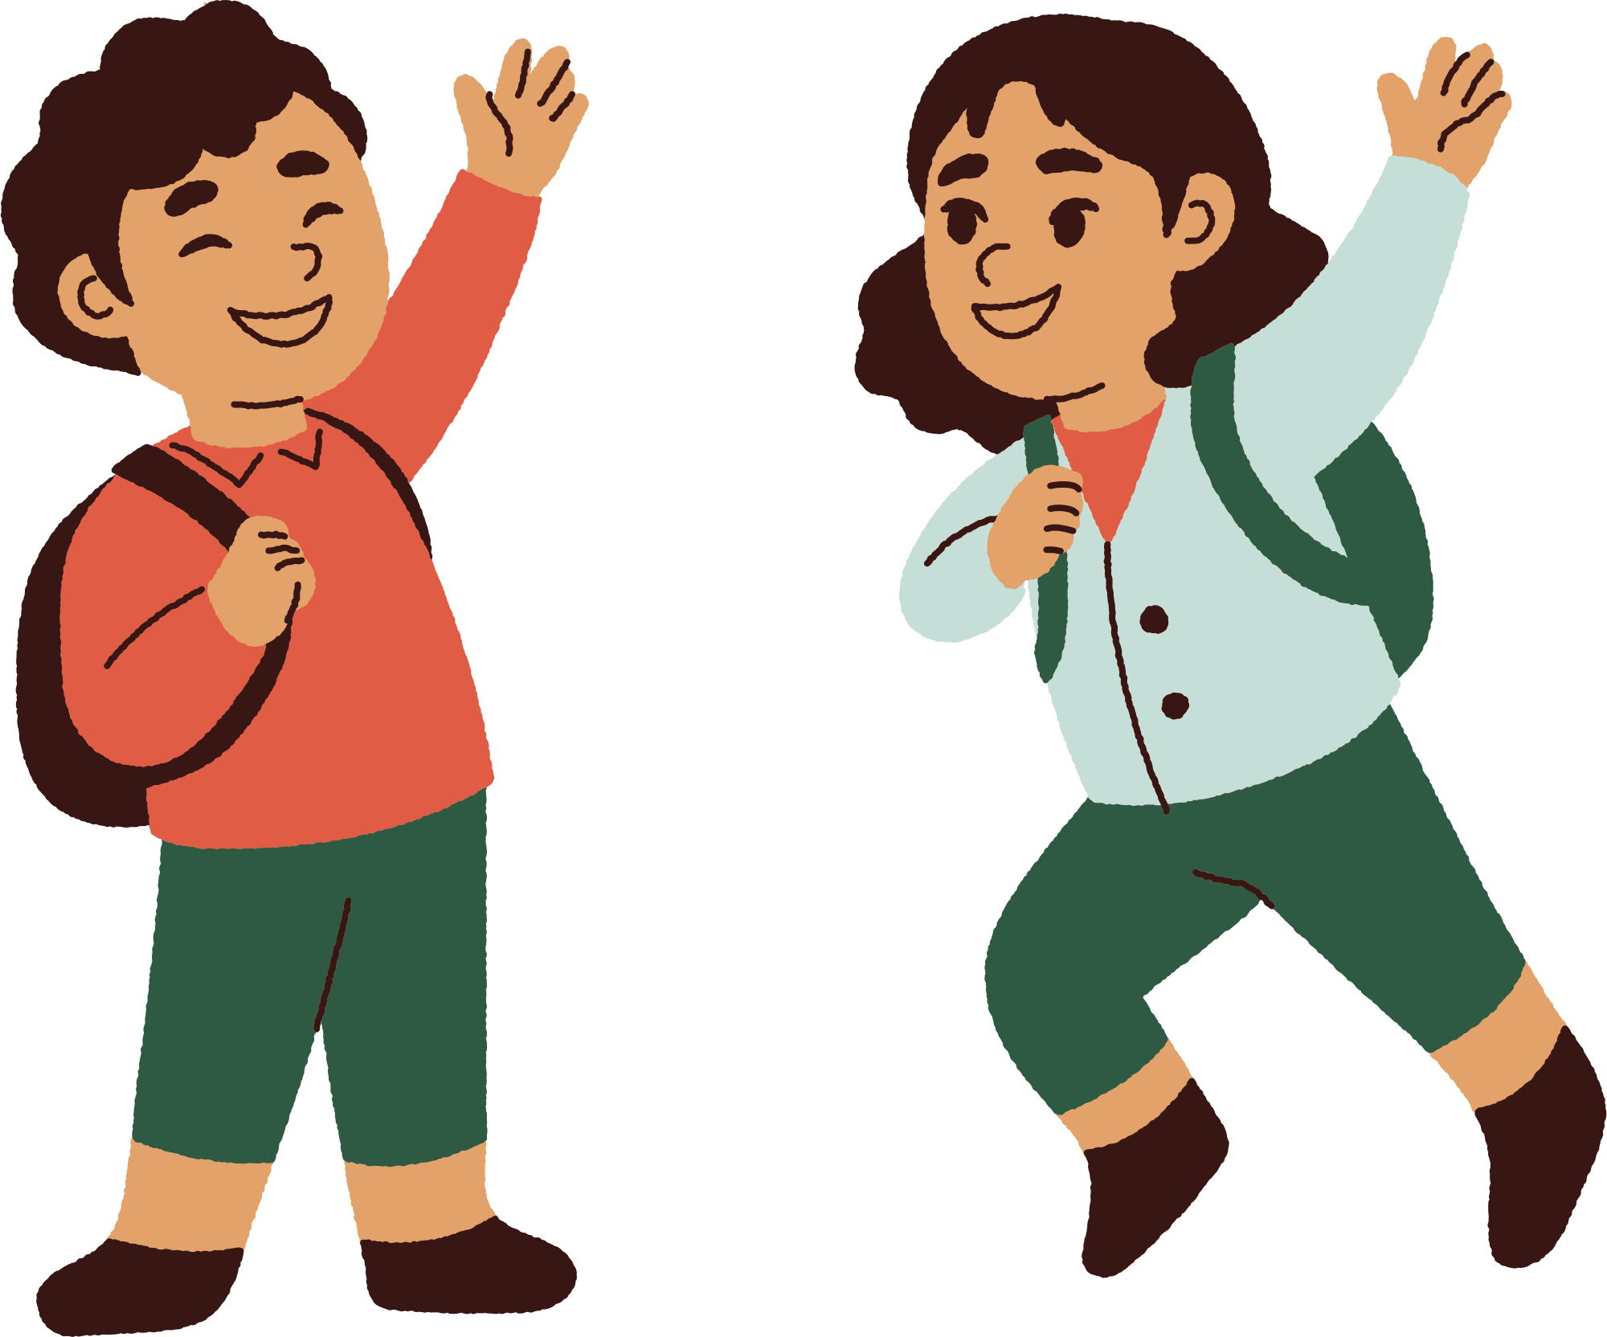



Unit 8
People and Places
LESSON 2
Part 4, 5, 6

Slide 3




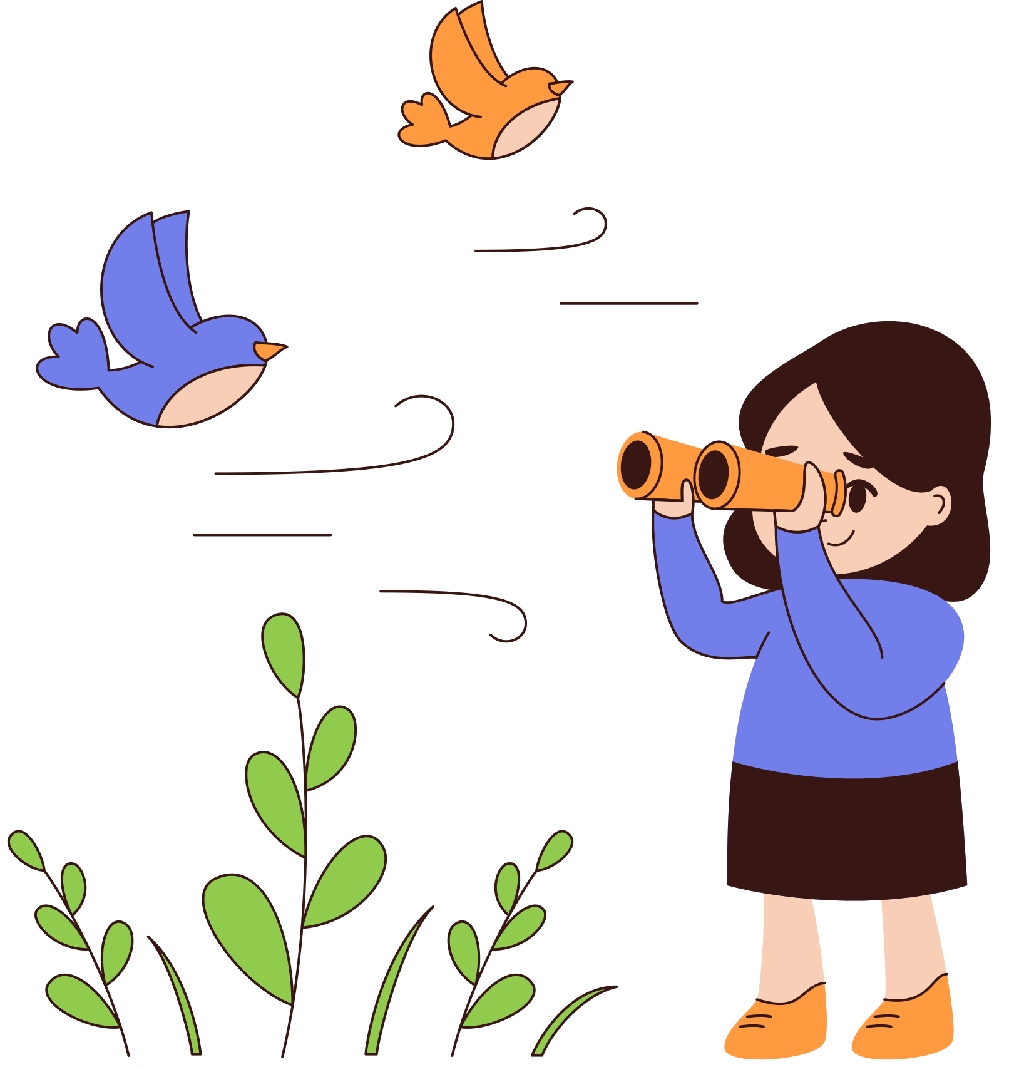

01
Warm-up

Slide 4
Can you guess?

Slide 5
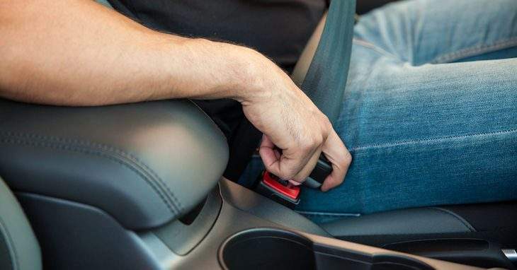


Click here
What is he doing?
He is fastening their seat bell.

Slide 6
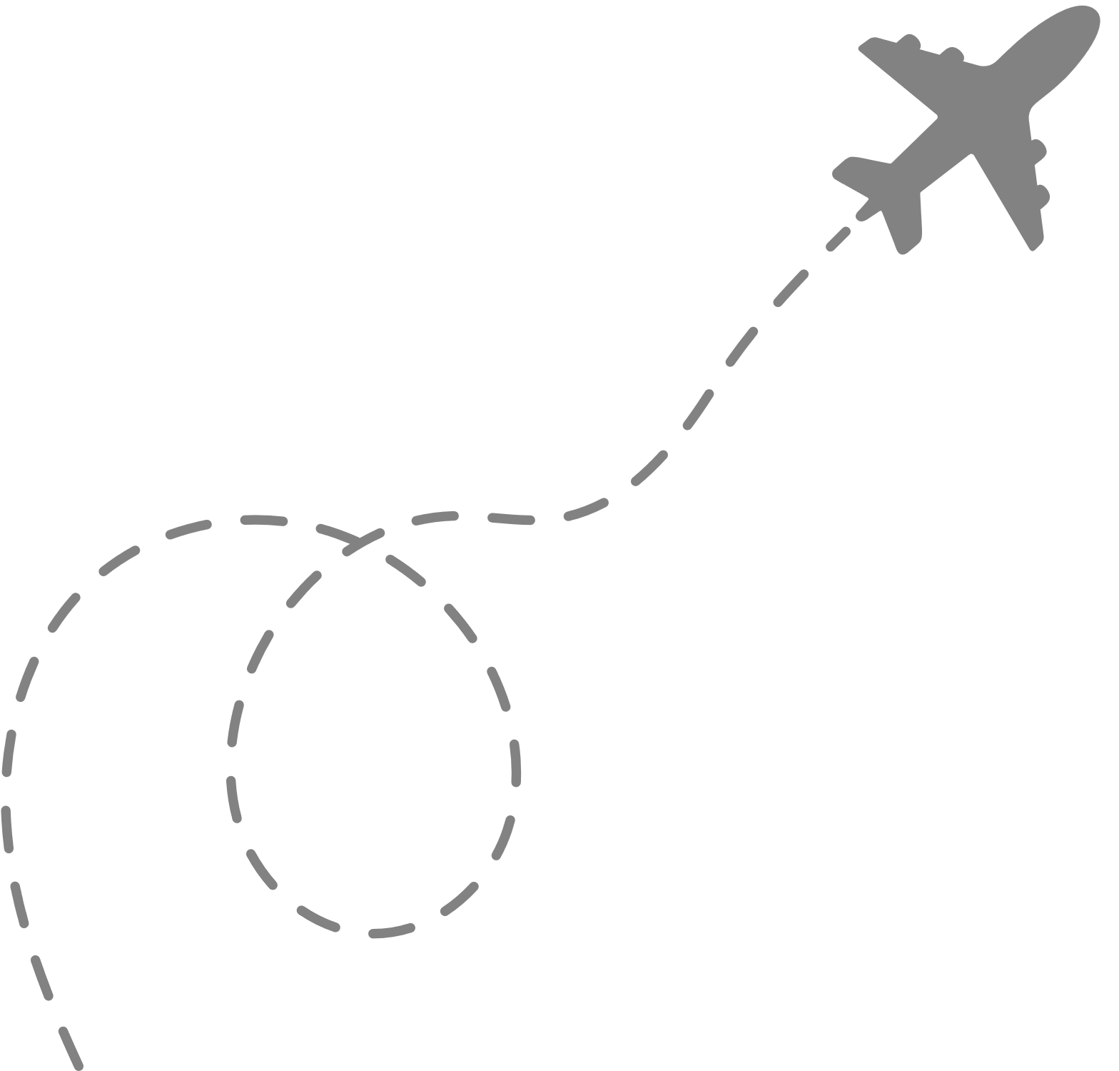

02
Presentation

Slide 7
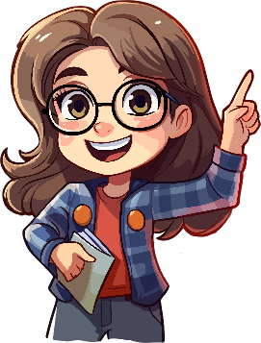
MUST (modal verb)
/mʌst/
Definition | used to say that something is necessary or very important (sometimes involving a rule or a law) https://www.oxfordlearnersdictionaries.com/
Negative form | must not / mustn’t
Structure | must / mustn’t + infinitive Verb
Example | 1. Food doesn’t stay on plates, so scientists must eat food from packages. 2. There isn’t a fridge on the ISS, so they mustn’t keep fruit and vegetables for long.

Slide 8

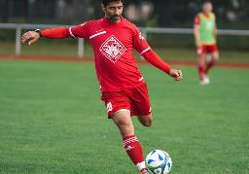

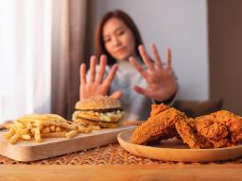

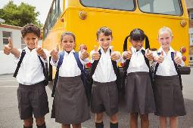
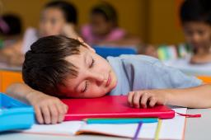
4. Look at the picture and complete the sentences with must or mustn’t.
1. You ______ kick the ball.
You ______ touch the ball with your hands.
must
mustn’t
2. You ______ eat a lot of junk food.
You ______ eat more fruit.
mustn’t
must
3. They ______ wear white shirts to school.
Girls ______ wear grey skirts.
must
must
4. He ______ pay attention.
He ______ fall asleep at school.
must
mustn’t

Slide 9
03
Practice

Slide 10
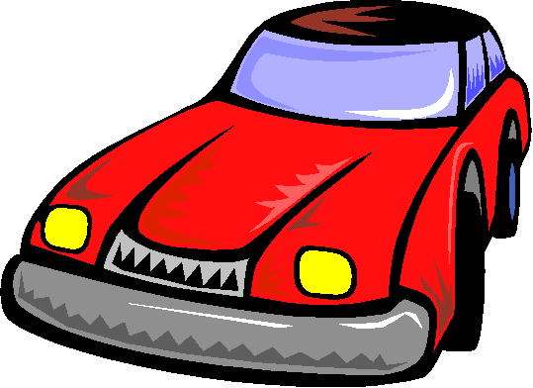
DRIVING TEST
must or mustn’t ?

Slide 11

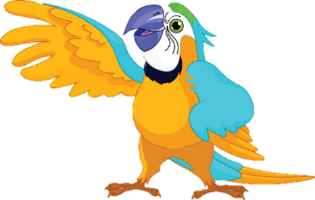
If you see this traffic sight, you _________ turn right.
must
mustn’t

Slide 12

If you see this traffic sight, you _________ turn left.
must
mustn’t

Slide 13
04
Production

Slide 14

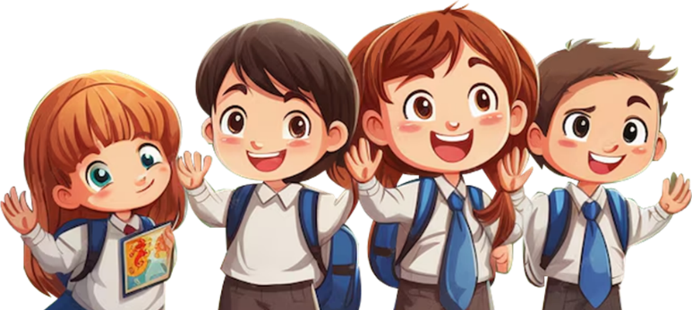
6. Write and say. What must or mustn’t we do at school?
Use the verb in the box to help you.
eat run play clean sleep write climb do use
must
mustn’t
We must clean the board.
We must ____
We mustn’t climb the trees.
We mustn’t ___

Slide 15
05
Wrap-up &
Assessment

Slide 16





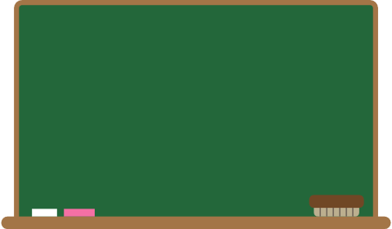
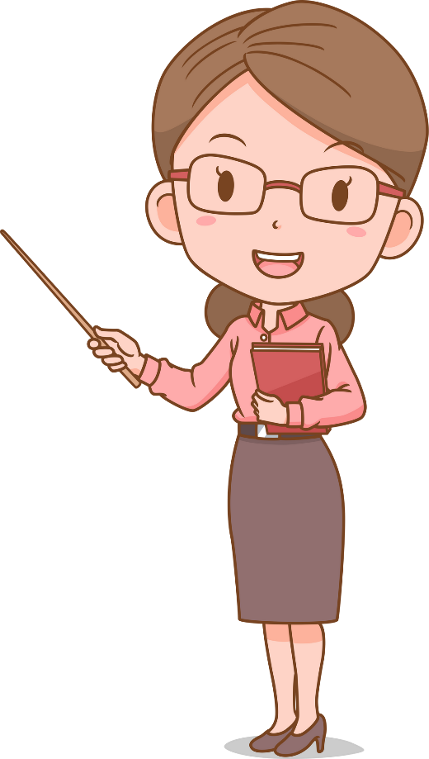
WRAP-UP
What have we learnt today ?
Modal verb: must, mustn’t
Structure: must / mustn’t + infinitive Verb
Examples:
- Food doesn’t stay on plates, so scientists must eat food from packages.
- There isn’t a fridge on the ISS, so they mustn’t keep fruit and vegetables for long.

