Slide 1



















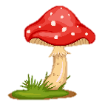
Unit 11
My day
Funtime & project

Slide 2







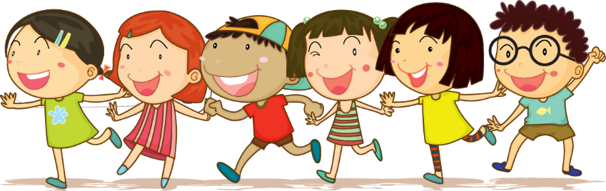



1 Warm up
Cross the river

Slide 3

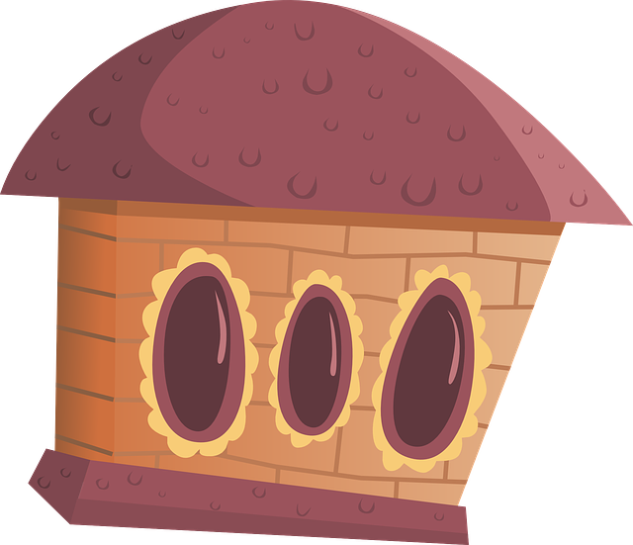
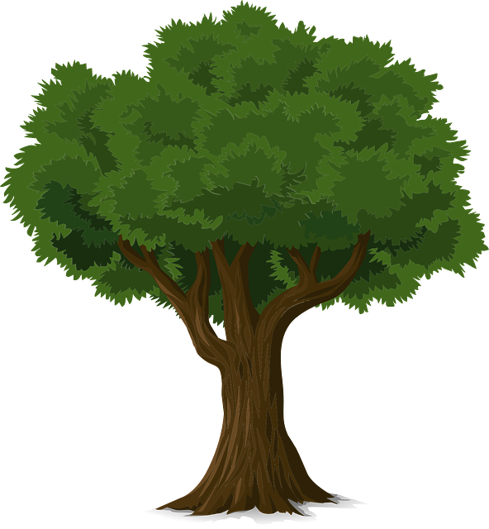
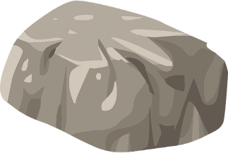
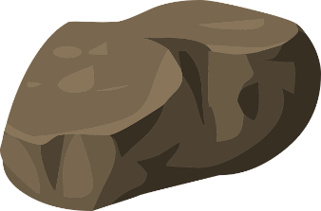
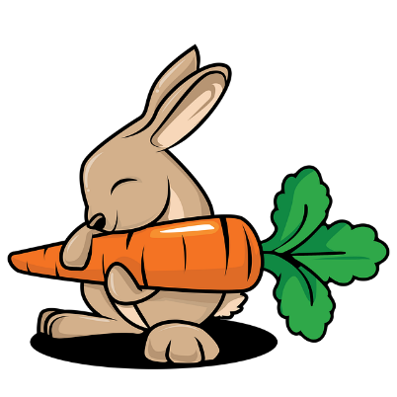

1
2
3
4
5
6
7
8
Practice
Notes:
T clicks numbers to show the questions, click the rabbit to make it move.
Giáo viên click vào các số để mở câu hỏi. Khi trả lời xong thì click “back” để quay lại, sau đó click vào chú thỏ để bước thêm 1 bước. Lặp lại đến khi hết câu hỏi và chú thỏ bước sang bờ song bên kia. Click vào Practice để chuyển sang phần tiếp theo.

Slide 4
What day is it?
WDENESDYA
=> It’s Wednesday.
Back

Slide 5
Fill in the blanks
S_T_RDAY
A
U
Back

Slide 6
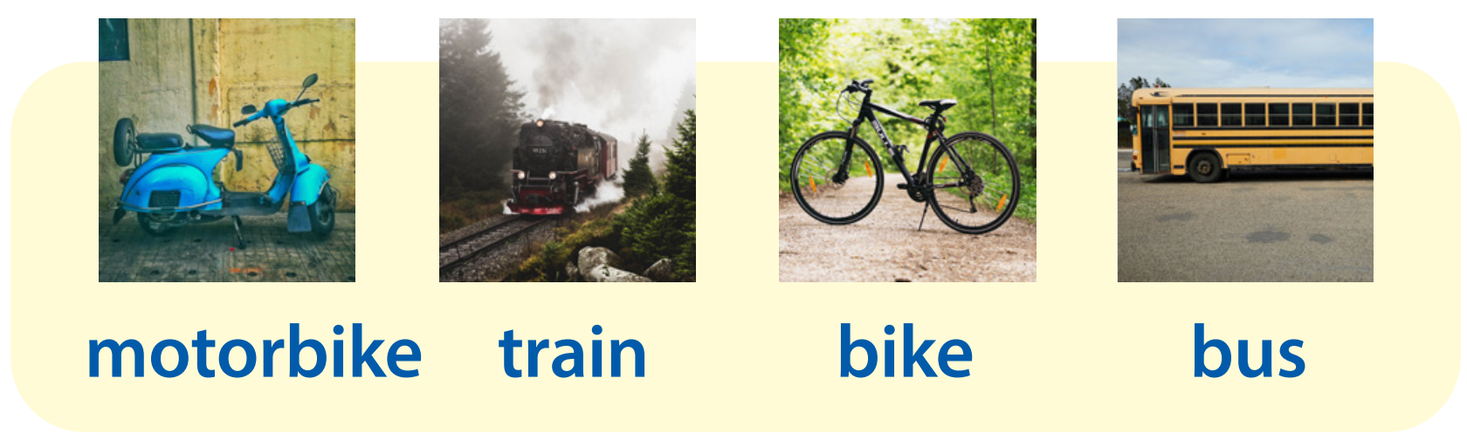
What is it?
=> It’s a motorbike.
Back

Slide 7
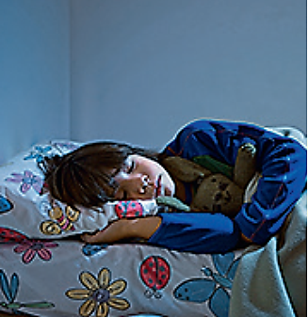
What activity is it?
=> It’s “go to bed”.
Back

Slide 8
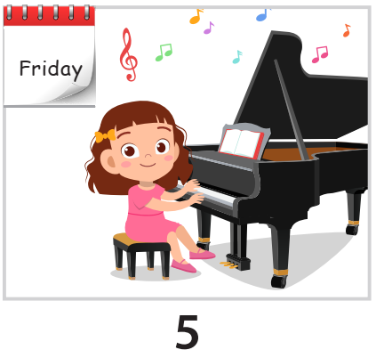
What do you do on Fridays?
=> I play the piano on Fridays.
Back

Slide 9
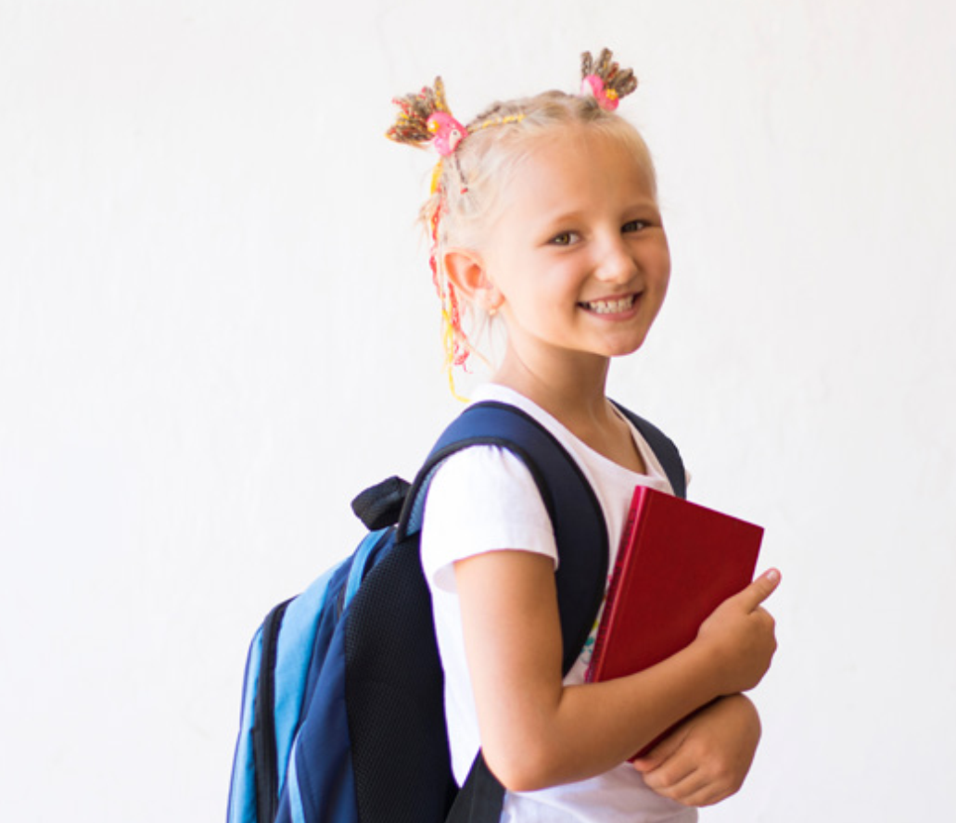

Fill in the blank
___________________?
By bus.
How do you go to school
Back

Slide 10
Rearrange the words to make a sentence.
with/go/my sister/swimming/I
=> I go swimming with my sister.
Back

Slide 11
Fill in the blank.
- ____________________?
- I go to the park with my family.
=> Who do you go to the park with?
Back

Slide 12
2 Practice writing

Slide 13

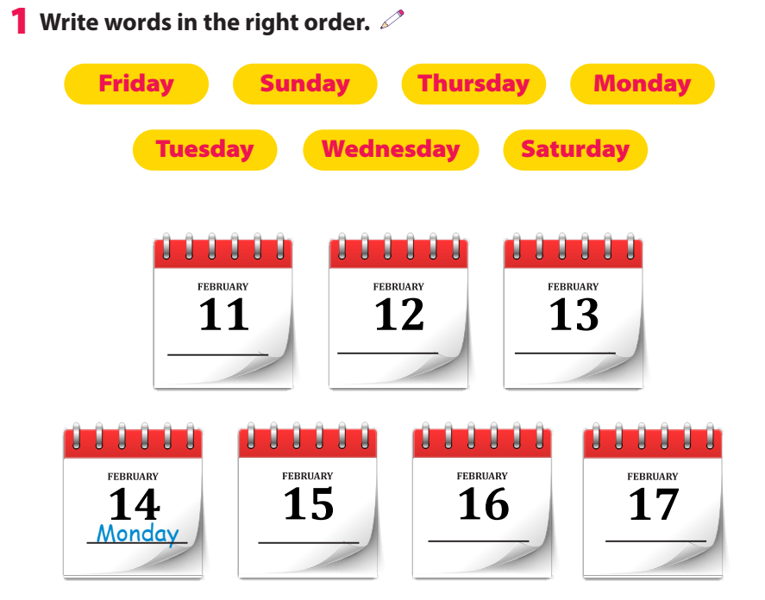
Friday
Saturday
Sunday
Tuesday
Wednesday
Thursday

Slide 14
3 Project
My week

Slide 15
Game
What word is missing?
Monday
Tuesday
Wednesday
Thursday
Friday
Sunday
Saturday
=> It’s Tuesday.
Notes:
Click màn hình để chuyển sang câu tiếp theo. Cho học sinh nhìn các từ trong khoảng 5-10s. Click 1 lần nữa để cho từ đó ẩn đi và cho 1 học sinh đoán từ đã mất. Click 1 lần nữa để hiển thị đáp án.

Slide 16
Game
What word is missing?
Tuesday
Saturday
Wednesday
Friday
Thursday
Sunday
Monday
=> It’s Sunday.

Slide 17
Game
What word is missing?
Sunday
Saturday
Thursday
Friday
Wednesday
Tuesday
Monday
=> It’s Thursday.

Slide 18
Game
What words are missing?
Tuesday
Saturday
Wednesday
Friday
Thursday
Sunday
Monday
=> They’re Wednesday and Friday.

Slide 19
Game
What words are missing?
Tuesday
Saturday
Wednesday
Friday
Thursday
Sunday
Monday
=> They’re Saturday and Monday.

Slide 20

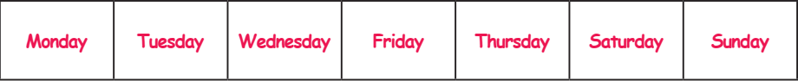
Write.
What do you do on ______?

Slide 21
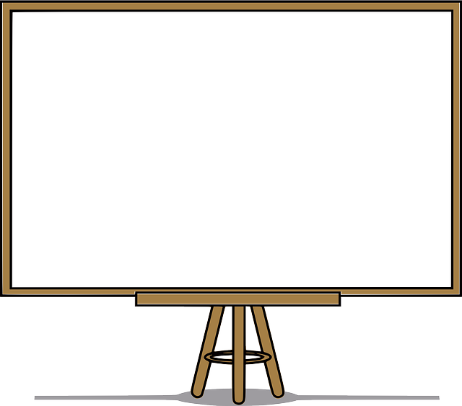
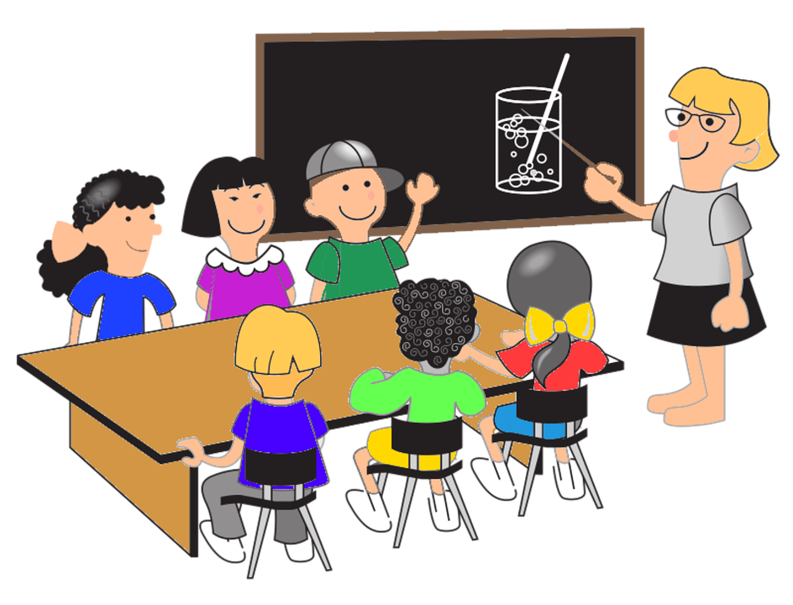
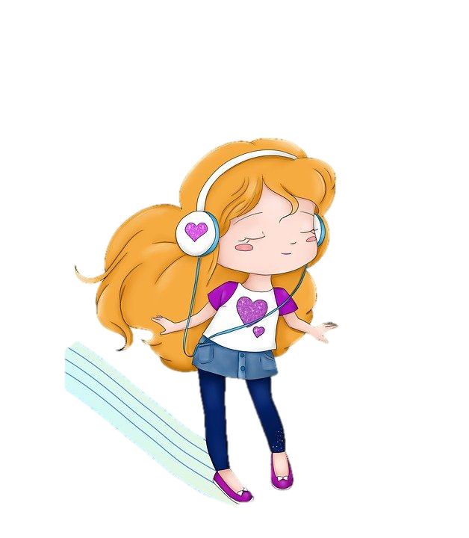
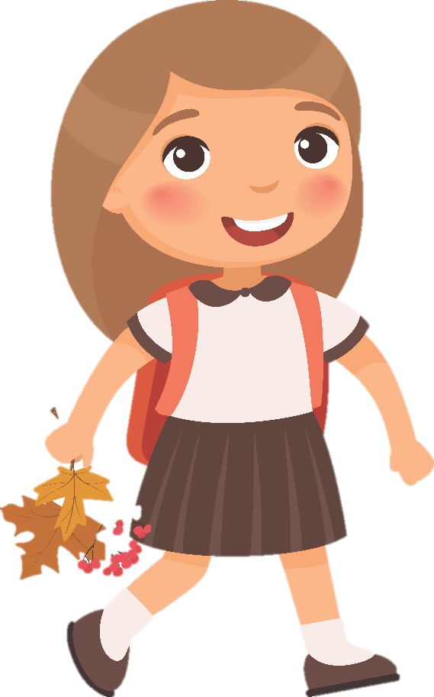
Draw. Then say!
I go to school with my friends on Mondays. I sing and dance on Sundays.
Monday
Sunday

Slide 22
4 Assessment

Slide 23
Write
What do you do on ______?
1 I ____________ on Sundays.
2 I ____________ with my family on Fridays.
3 I ____________ on Saturdays.
4 I _____________ on Tuesdays and Wednesdays.
5 I _____________ on Monday mornings.
Notes:
It’s a free-answer question. Ss can show they opinions in their own words.

