Slide 1





Super Hero Team
Task 5. Look and Say
Let’s go
Please, help the Police catch the thief

Slide 2




You win !
1
2
3
4
Next
Notes:
Click vào từng số để mở tranh.
Click vào hình siêu nhân để di chuyển nếu hs trả lời đúng .
Bấm next part để tới phần production.

Slide 3
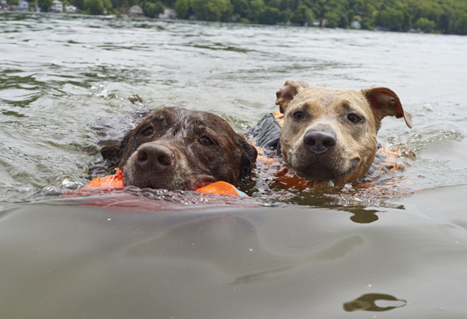
HOME
1. They / the river
1. They swim in the river.

Slide 4
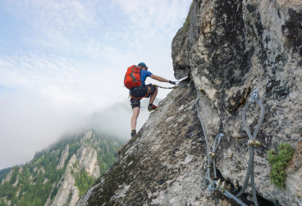
HOME
2. I/ climb the rock
2. I climb the rock.

Slide 5
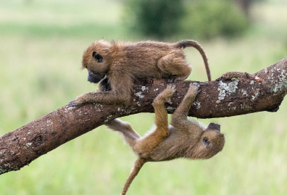
HOME
3. They/ trees
3. They climb the trees.

Slide 6
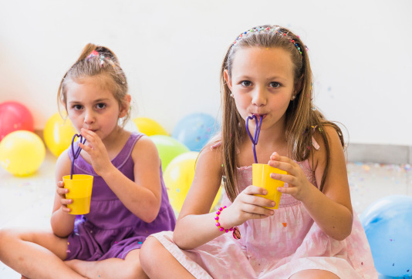
HOME
4. We/ water
4. We drink water.

