Slide 1


Unit 11: Before our time
Lesson 2: Task 1, 2, 3

Slide 2


1
Warm up
Guess what?
Notes:
Warm-up: Play a small game “ Guess what”
T divides the class into 2 teams.
The teacher asks SS to look at the picture and time in the past to make a sentence where someone was. If he/she can answer, he/she can get the points for his/her team.
T asks Ss to repeat full sentences after each picture.

Slide 3

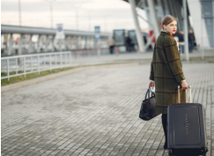
last week
+4
+4
She was at the airport last week.

Slide 4

last year
+3
+3
My family was at the shopping center last year.

Slide 5
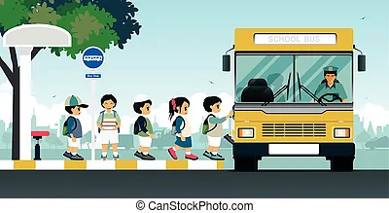
last month
+3
+3
The students were at the bus stop last month.

Slide 6
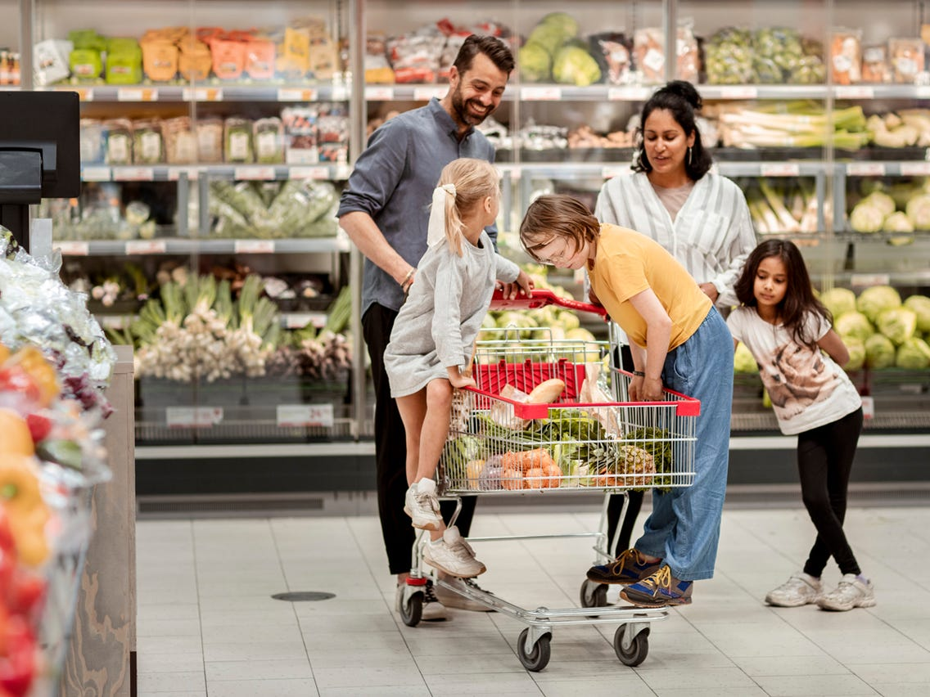
yesterday
+4
+4
They were at the supermaket yesterday.

Slide 7
2
Presentation

Slide 8
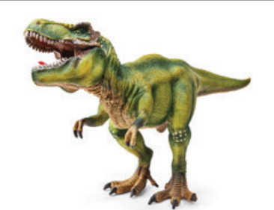


dinosaur
Notes:
Task 1: Listen and point. Repeat. (Track 11.4)
- Use flashcards to introduce the vocabulary of the lesson.
- Say the words for students to listen and repeat in the chorus.
- Say a word for students to repeat then point.

Slide 9
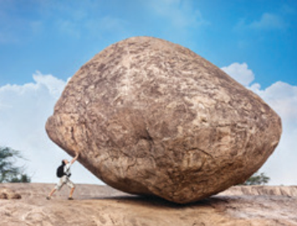
huge

Slide 10
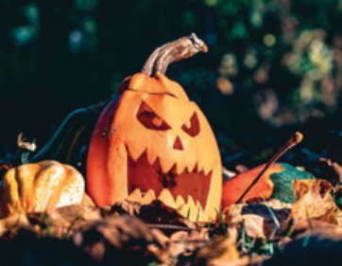
scary

Slide 11
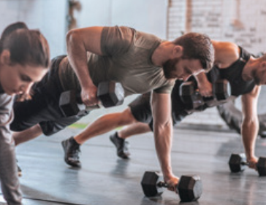
strong

Slide 12

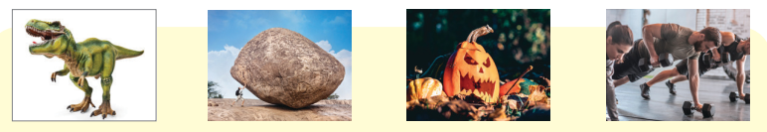

1. Listen and point. Repeat. Tr.11.4.
dinosaur
huge
scary
strong
Notes:
- Play track 11.4 for the students to listen to, point to, and repeat the words in chorus and groups.

Slide 13
3
Practice

Slide 14


2. Listen αnd reαd. Tick. Tr.11.5.
Ann: Look at the photo. I was at the museum last week. There were scary dinosaurs.
Ann: They’re the bones of a T.rex. T.rex was a strong dinosaur. Its favourite food was meat.
Harry: Wow! These bones are so big!
Harry: It looks scary.
Ann: Yes, it does.
T.rex was a scary dinosaur. Yes No
Its favourite food was meat. Yes No

Slide 15
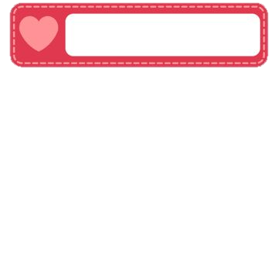
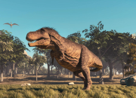
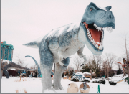
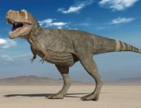
3. Look and say.
Sth was/were + adj.
1 T. rex / scαry
2 T. rex / strong
3 T. rex / huge
T. rex was scαry.
T. rex was strong.
T. rex was huge.

Slide 16
4
Production

Slide 17
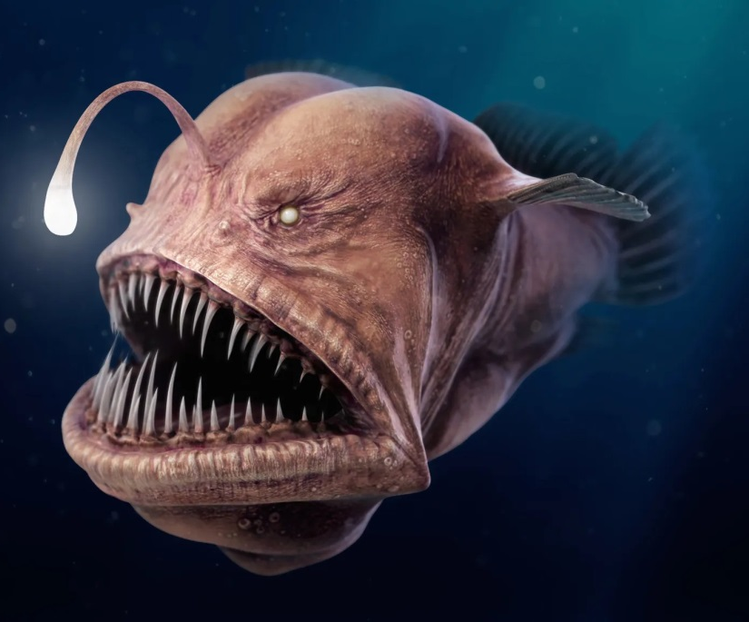

scary
Anglerfish was scary.
Anglerfish

Slide 18
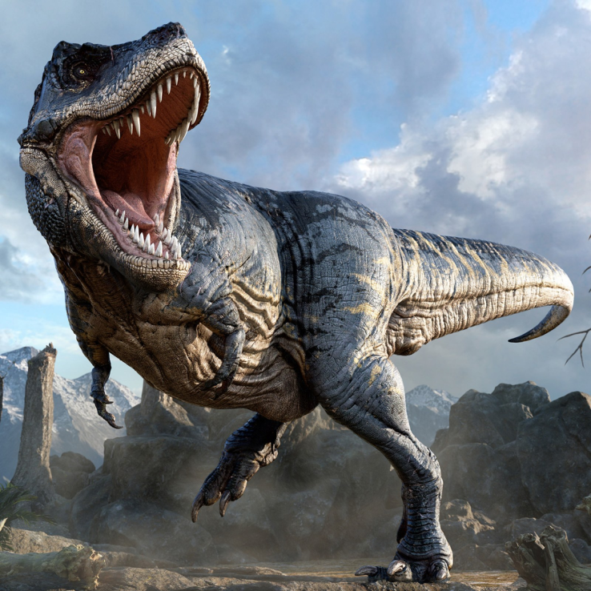
dinosaur
The dinosaur was scary.

Slide 19
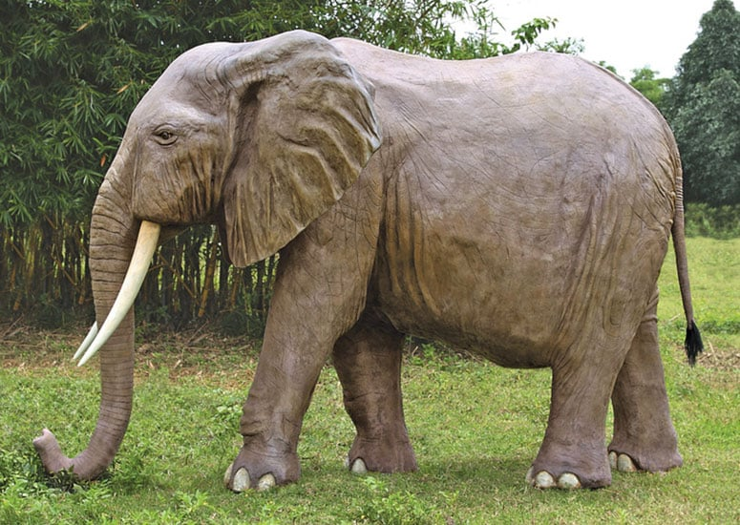
huge
The elephant was huge.

Slide 20
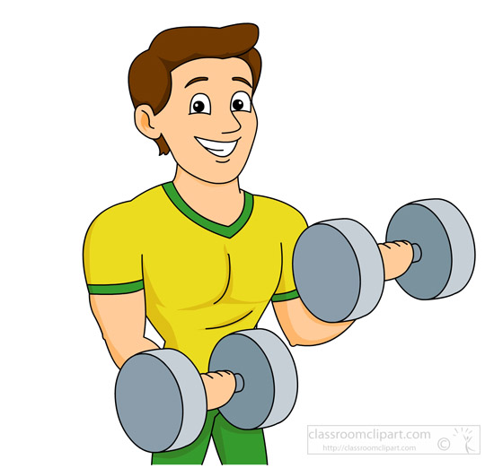
strong - was
He was a strong man.

Slide 21
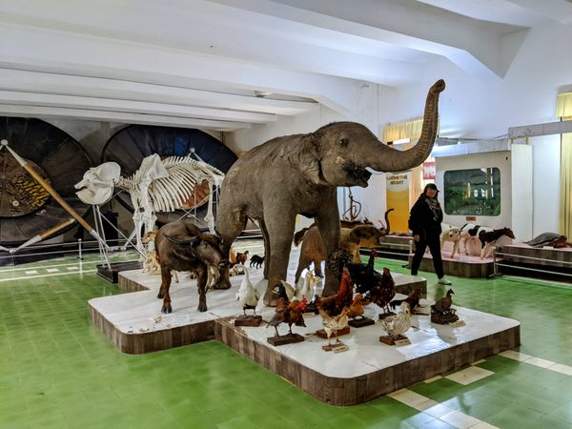
museum
He was at the museum.

Slide 22
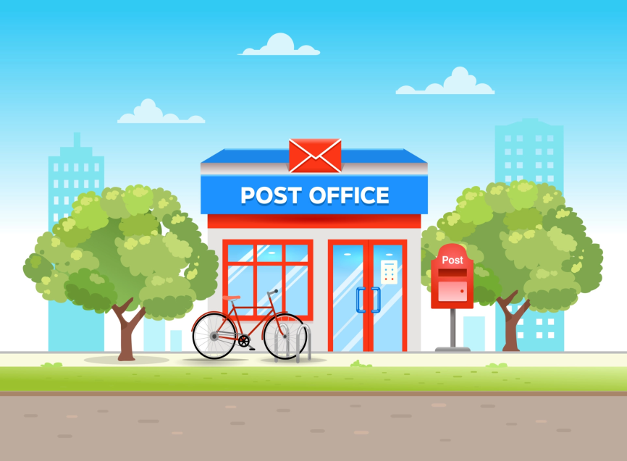
last month
I was at the post office last month.

Slide 23
5
Assessment

Slide 24
UNIT 11: BEFORE OUR TIME
LESSON 2 – PERIOD 1
What we learnt today
dinosaur
huge
Vocabulary
scary
strong

