Slide 1





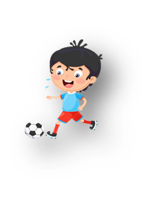



Unit 11: Before our time
Lesson 1: Task 4, 5, 6

Slide 2

1
Warm up
Flashcard duck
Notes:
Warm-up: Play a small game “Flashcard duck”
The teacher asks SS to play a small game.
T introduces the rule of the game.
(Game: There are 4 students, and each student has a flashcard. T calls a flashcard, and who has this has to raise it over his head. Who is slow or incorrect will be a loser. Who can do the best will be a winner.)
T asks Ss to repeat time in the past.

Slide 3
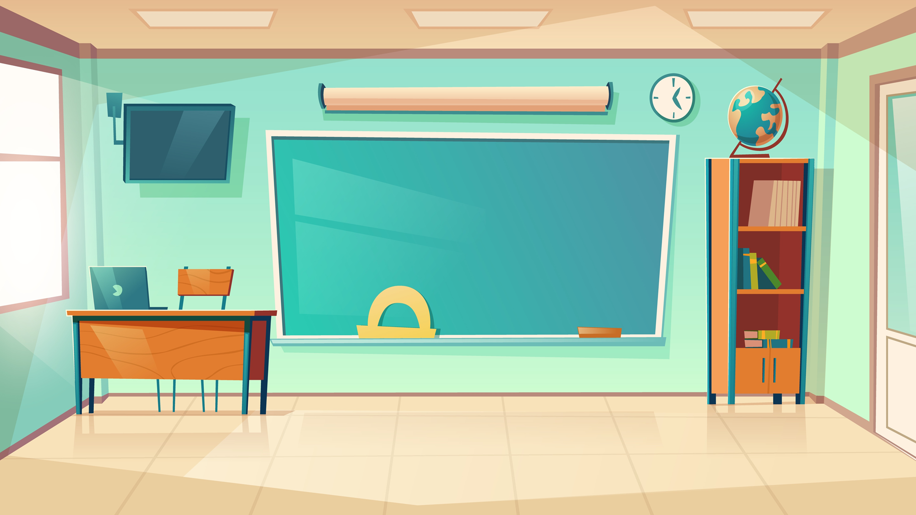

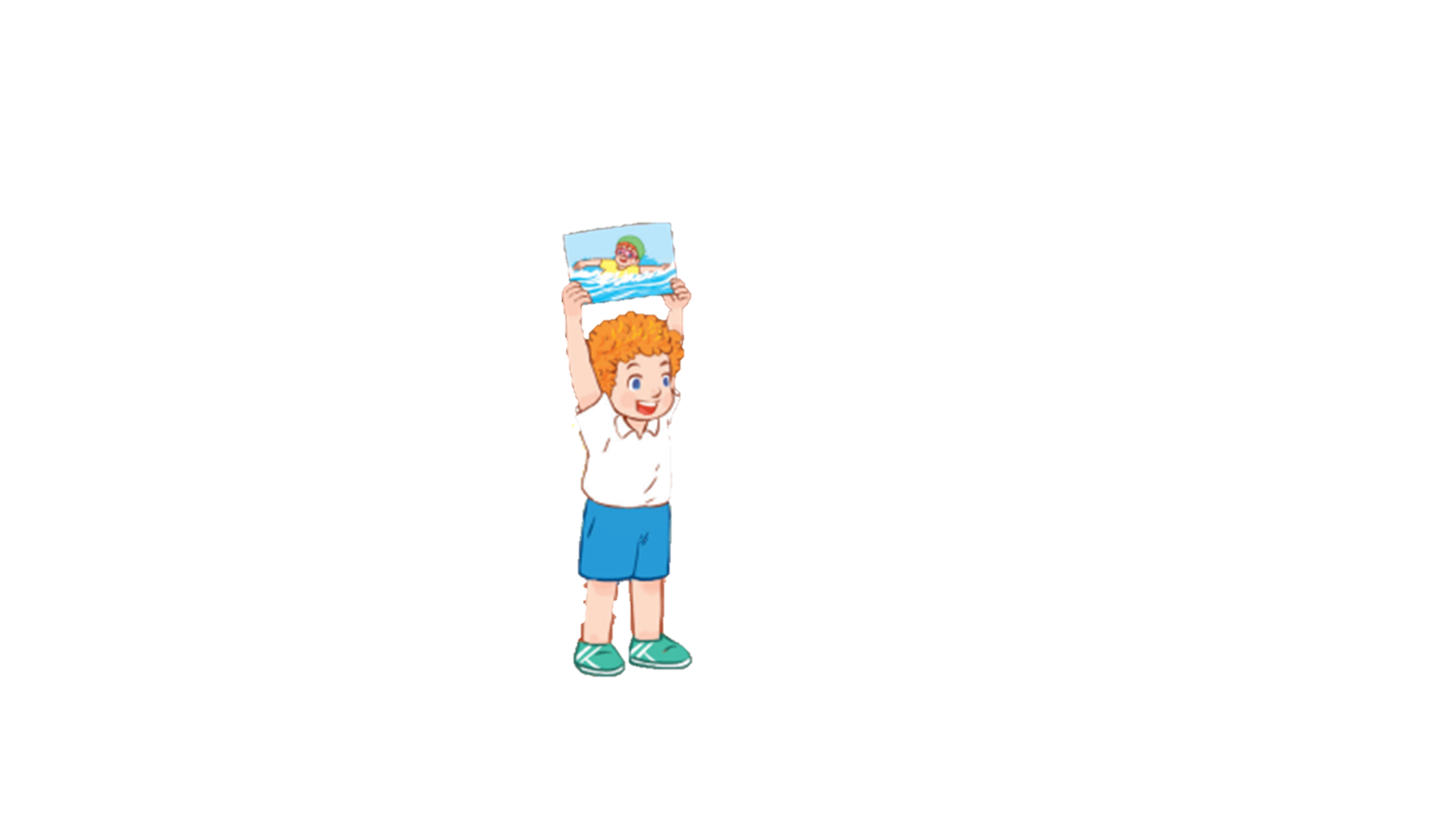
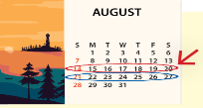
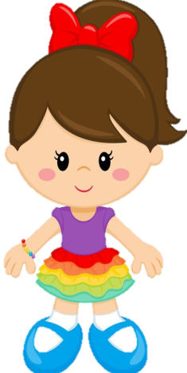
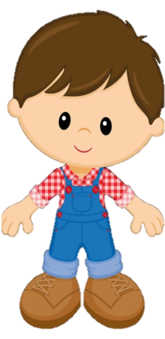
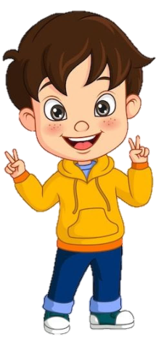
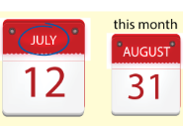
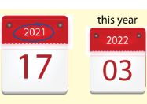
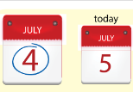
last week

Slide 4
2
Presentation

Slide 5


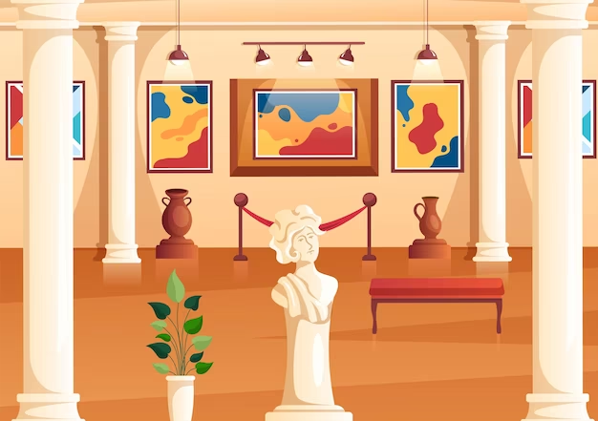

museum
Notes:
Task 1: Listen and point. Repeat. (Track 11.3)
- Use flashcards to introduce the vocabulary and structure of the lesson.
- Say the words for students to repeat in the chorus.
- Say a word for students to repeat then point.
- Use flashcard “museum” to introduce the structure of the lesson. T helps SS to distinguish how to use “was” and “were” with singular subjects or plural subjects.
- Say the structure for SS to repeat in the chorus.
- Use different flashcards to ask Ss to make sentences.
- Play track 11.3 for the students to listen to, point to, and repeat the words in chorus and groups.

Slide 6

shopping center

Slide 7
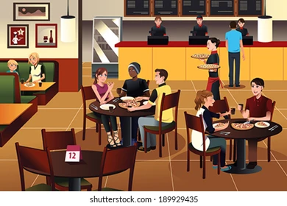
restaurant

Slide 8


I/ he/she/ Julia was at the ____.
They/ we/ you/ Julia and Josh were at the ____.

Slide 9

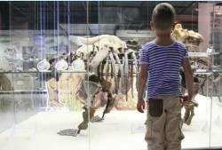
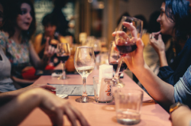
4. Listen and repeat. Tr.11.3.
1. I wαs αt the museum
lαst week.
2. He wαs αt the
shopping centre
yesterdαy.
3. They were αt the
restαurαnt lαst month.

Slide 10
3
Practice

Slide 11
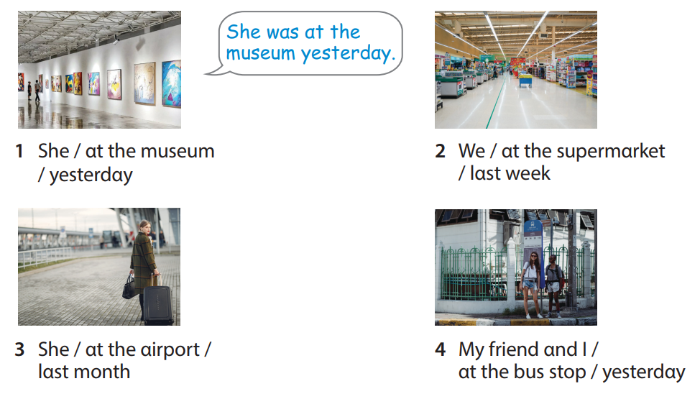
5. Look and say.
Notes:
Task 5: Look and say.
- Ask SS to identify names of pictures and words under them.
- Ask SS to look at the board and make a sentence with the words under the picture, then ask SS to work in pairs in 3 min.
- Ask SS to play “Board game”:
(T divides the class into 2 teams. Each team chooses a number and makes a sentence. Then role the dice to move to the goal “Finish”. If they move to the head of snake, they have to move to the tail of snake. Each picture can be used many times.)
- Call some students to read again after the game and give them comments.

Slide 12
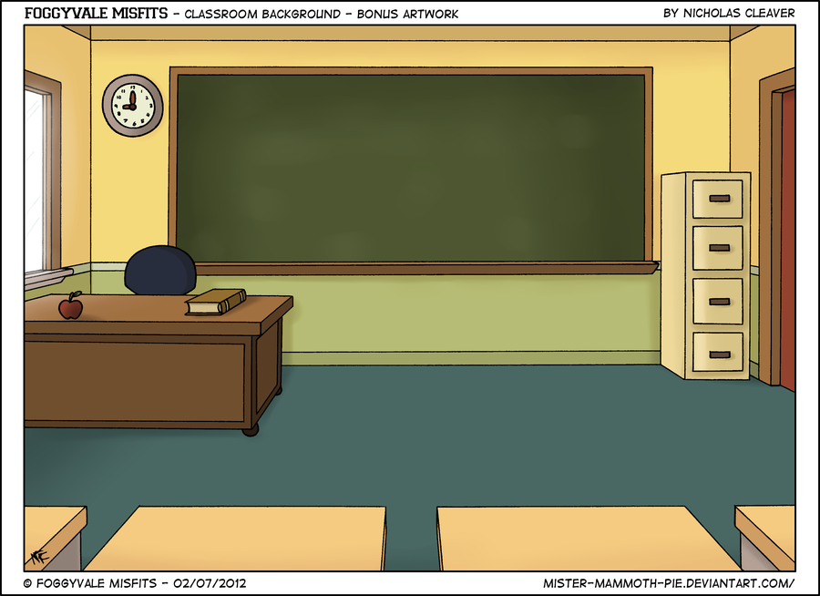
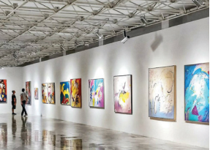

1. She / αt the museum/ yesterdαy
She was αt the museum yesterdαy.
MENU

Slide 13
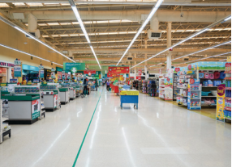
2. We / αt the supermαrket
/ lαst week
We were αt the supermαrket lαst week.
MENU

Slide 14
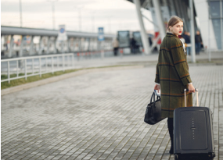
3. She / αt the αirport /
lαst month
She was αt the αirport lαst month.
MENU

Slide 15
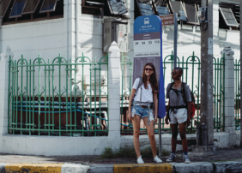
4. My friend αnd I /
αt the bus stop / yesterdαy
My friend αnd I were
αt the bus stop yesterdαy.
MENU

Slide 16
4
Production

Slide 17


6. Let’s play.
Tαlk αbout where you were yesterdαy, lαst week, lαst month αnd lαst yeαr.
I wαs αt the pαrk
with my fαmily
yesterdαy.
I wαs αt the post office
yesterdαy. How αbout you?
Cool!
Notes:
6. Let’s play.
- Work in pairs.
- Ask SS to look at the board and call a student to make a converstion.
- Ask SS to prepare a pen and paper to draw 2 places where they were in 3 min. Then ask them to work in pairs to ask and answer.
- Call pairs to present in front of the class.
- Check and give feedback.

Slide 18

5
Assessment

Slide 19
UNIT 11: BEFORE OUR TIME
LESSON 1 – PERIOD 2
What we learnt today
Review vocabulary
yesterday, last week, last month, last year
- I was at the museum last week.
- He was at the shopping centre yesterday.
- They were at the restaurant last month.
Structure

