Slide 1







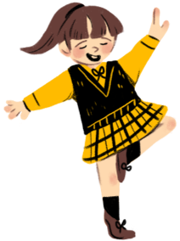



Unit 10
PERFORMING ARTS
Fun time & project
Period 1

Slide 2












Table of contents
01
03
Warm-up
Production
02
04
Review &
Practice
Wrap–up & Assessment

Slide 3

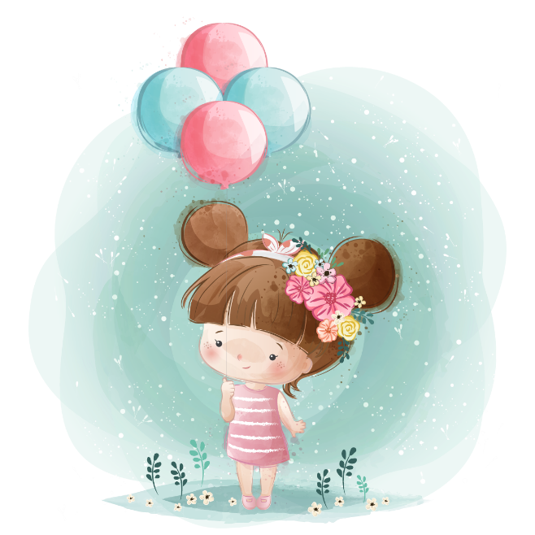
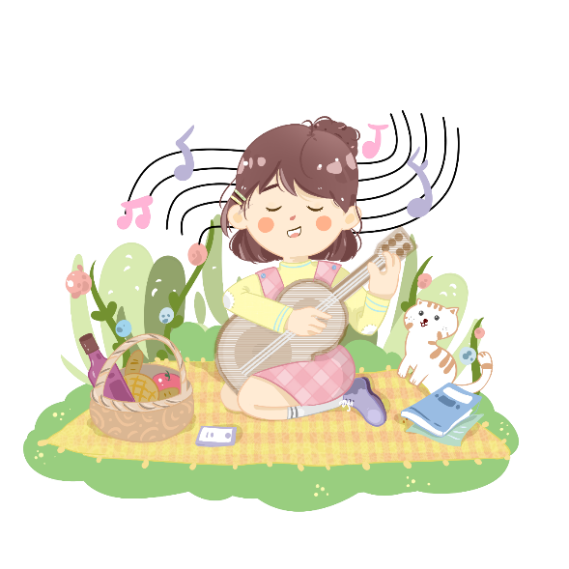

01
WARM-UP
Greeting
My Pets

Slide 4




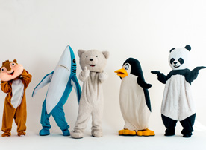

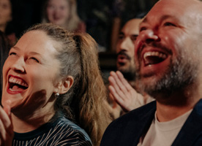

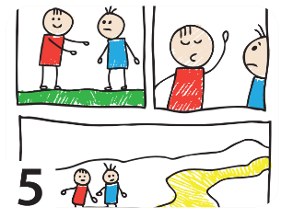


1 Unscramble the words.
1
2
3
1 ratacresch _________
2 tedirroc _________
3 yemcod _________
4 macrea _________
5 notorac __________
characters
director
comedy
camera
cartoon
4
5

Slide 5
03
PRODUCTION
Greeting
My Pets

Slide 6

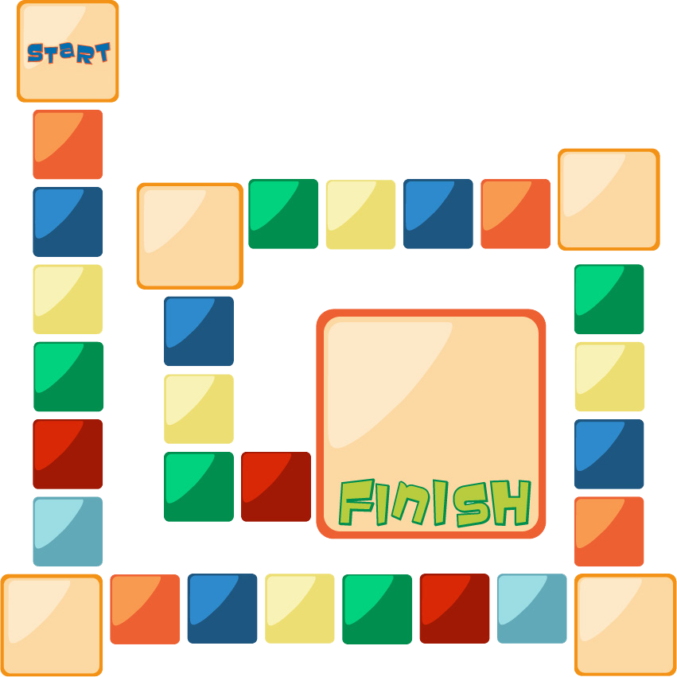







2. Board game
PAST SIMPLE
PLAY
STOP
have
Miss a turn
write
Oh no! Go back!
swim
leave
get
fly
ride
teach
catch
speak
run
eat
build
sleep
do
dream
go
make
Move ahead 2 spaces
drink
win
lie
pay
read
Go back 3 spaces
sit

Slide 7
04
WRAP-UP & ASSESSMENT
Greeting
My Pets

Slide 8

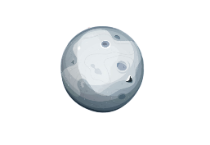
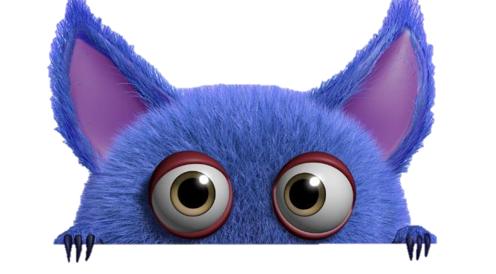


Let’s play a game !
secret Gift box game

Slide 9



















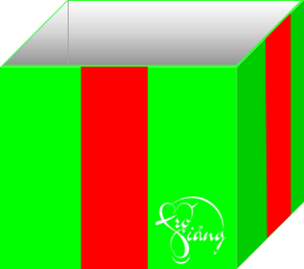



Notes:
Bấm vào sọc đỏ ở giữa hộp quà để nó có hiệu ứng ra câu hỏi và mất đi khi trl hoàn thành

Slide 10











I _____ at home all weekend.
A. stay
B. stayed
You are given 5 stars
C. stays
D. staying
GO HOME

Slide 11


Mike ______ to the cinema last night.
A. went
B. go
You are given 10 stars
C. going
D. going
GO HOME

Slide 12



This type of film makes you laugh.
A. adventure
B. science fiction
C. musical
D. comedy
You are given 5 stars
GO HOME

Slide 13


The story was about a___________.
beautiful princess
princess beautiful
You are given 10 stars
princess beautifully
beautifully princess
GO HOME

Slide 14
________ action film did you prefer?
- I preferred Transformers.
Where
Which
You are given 5 stars
What
Who
GO HOME

Slide 15
This is where films are planned and made.
film studio
playground
You are given 3 stars
cinema
stage
GO HOME

Slide 16
Did you ______ any movie yesterday?
- Yes, I did.
watched
watching
watches
You are given 8 stars
watch
GO HOME

Slide 17

_____did you get to the cinema?
- I got there at nine o’clock.
When
Where
You are given 2 stars
How
What
GO HOME

Slide 18

John looks ________.
very happily
happy very
You are given 10 stars
very happy
happily very
GO HOME

Slide 19
This type of film is stories about supernatural events, magic and unreal things.
adventure
fantasy
comedy
musical
You are given 20 stars
GO HOME

Slide 20




Wrap-up
Review:
advert, autograph, director, film studio, make-up, set…
Unit 10: Performing arts
Fun time & Project –Period 1
What have we learnt today?
Grammar:
Positive form:
S + V (past form) + … .
Negative form:
S + didn’t + infinitive V + … .
Question form:
Did + S + infinitive Verb + …?
- Yes, S + did. / No, S + didn’t.

