Slide 1
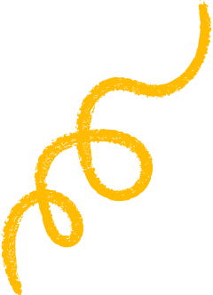

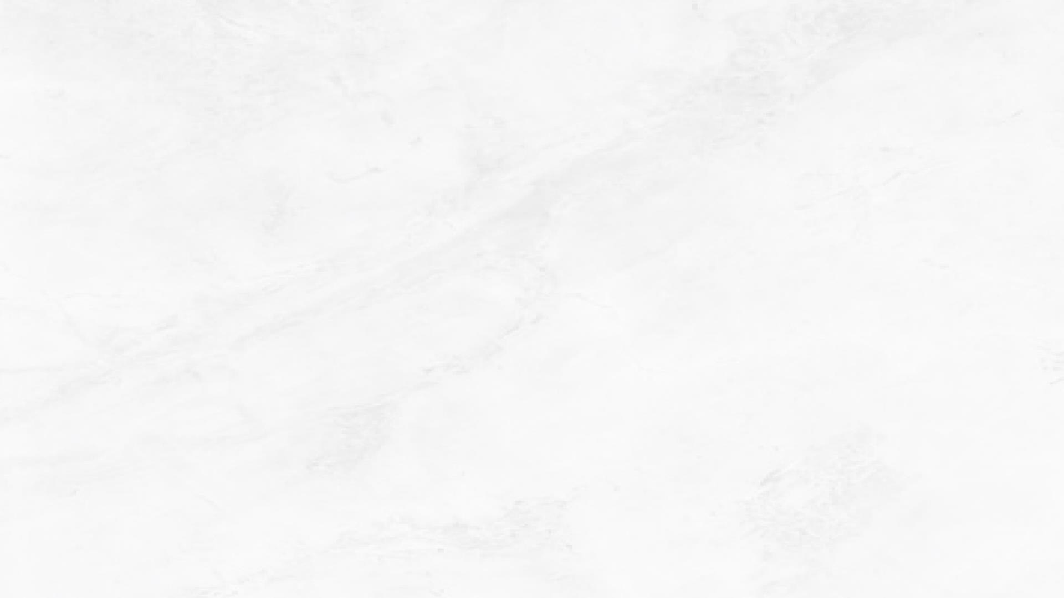

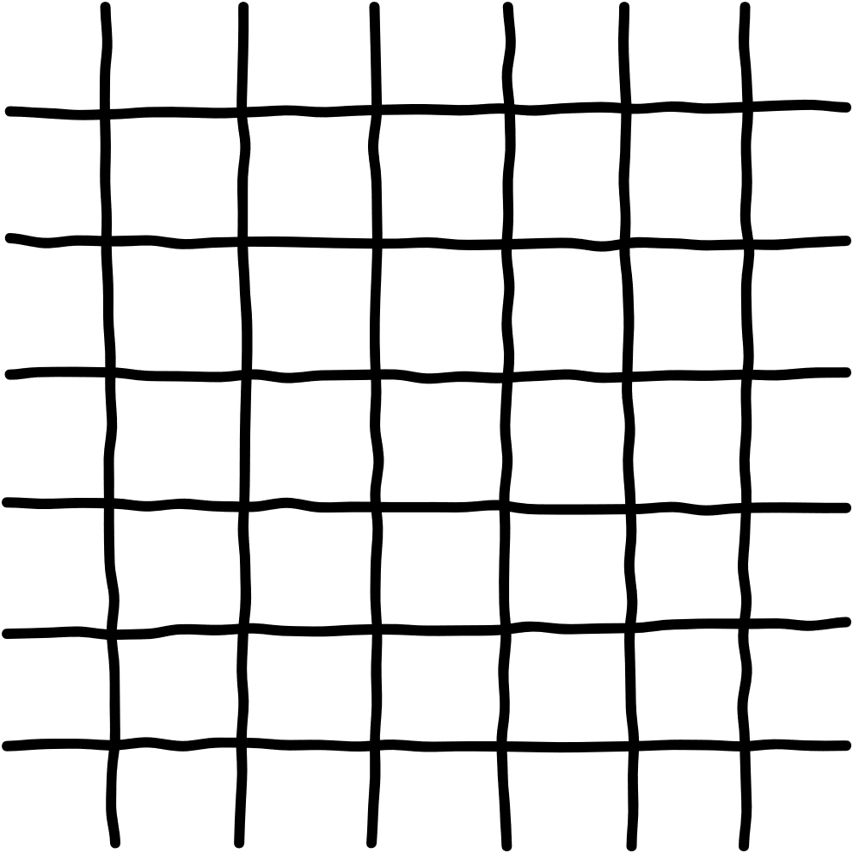


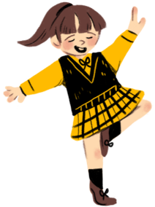



Unit 4
PERFORMING ARTS
Lesson 1: Part 4-5-6

Slide 2




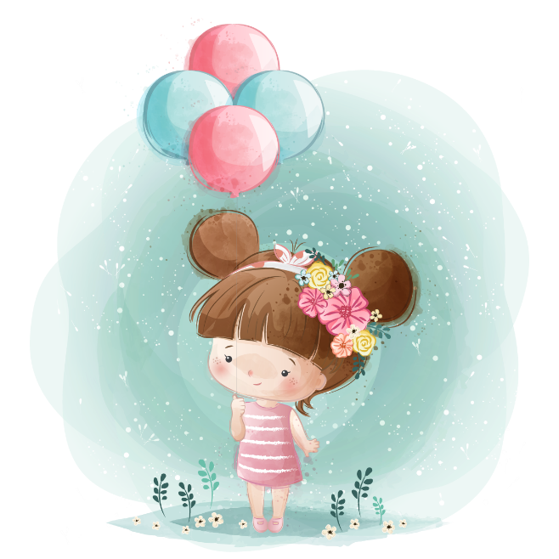
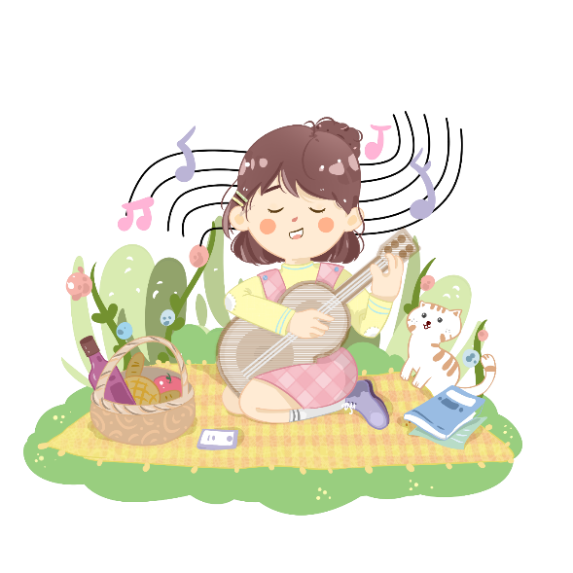


02
Presentation
Greeting
My Pets

Slide 3



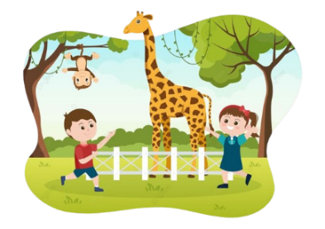

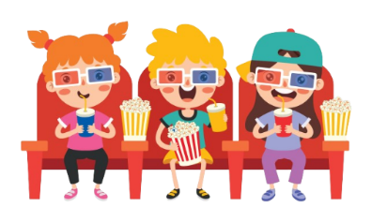

Positive form:
Grammar
Review:
Eg:
_______
I visited the zoo yesterday.
They went to cinema last weekend.
_____
regular verb
Simple Past
Tense
___
__________
irregular verb
Positive form:
S + V (past form) + ….
Note: pay attention to the regular and irregular verbs.
Eg:
Regular Verbs
liked
played
needed
Irregular Verbs
went
slept
spoke

Slide 4

Grammar
Review:
When do we use past simple tense?
Simple Past
Tense
We use past simple tense to talk about actions or events that:
+ happened at a specific time in the past
+ are already finished.
Past Simple Tense
Present Simple Tense

Slide 5
05
Wrap-up & Assessment
Greeting
My Pets

