Slide 1





Where’s the thief?
Notes:
Explain the thief ( giải thích từ) -→ steal : ăn trộm

Slide 2
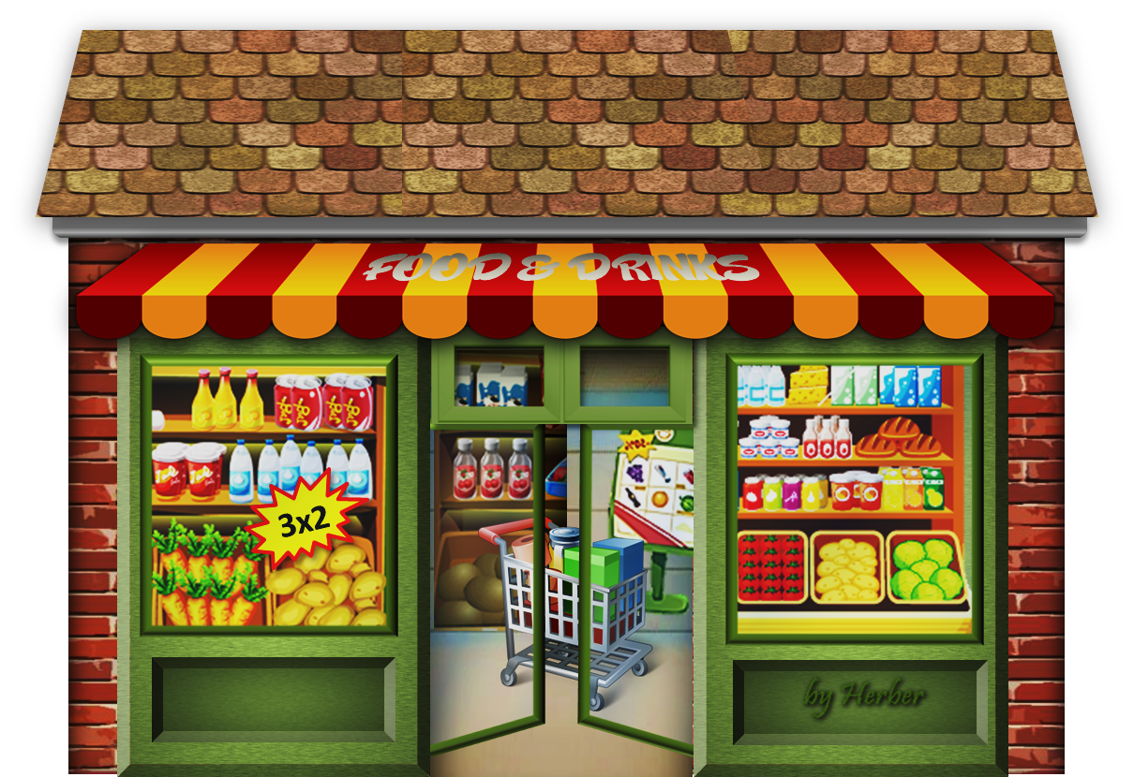


Where do we steal some foods and drinks ?

Slide 3


AT THE SUPERMARKET

Slide 4

Where do we steal letters and parcels ?

Slide 5

AT THE POST OFFICE

Slide 6

Where do you steal paintings ?

Slide 7


AT THE MUSEUM

Slide 8
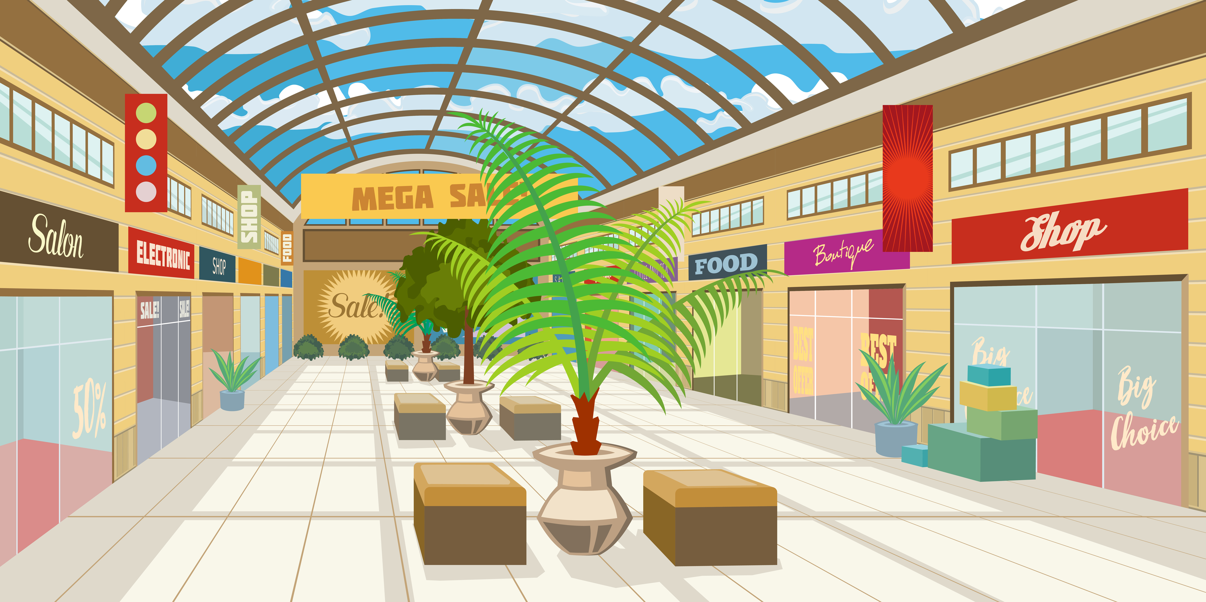
Where do we steal some clothes and shoes?

Slide 9

At the SHOPPING CENTRE

Slide 10

GOODBYE!

