Slide 1




TRÒ CHƠI
ĐÀO VÀNG
BẮT ĐẦU

Slide 2
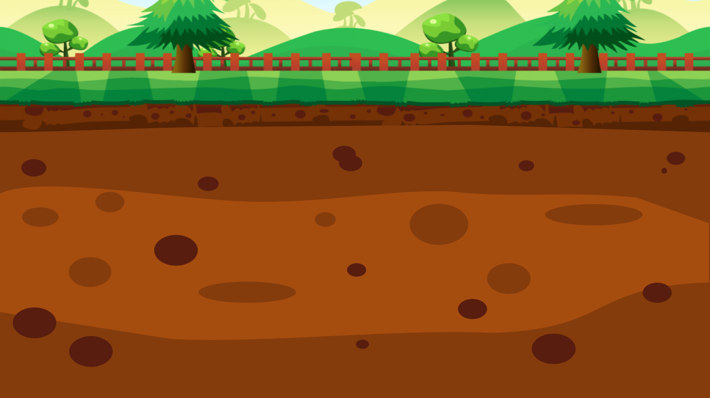




100$
150$
50$
20$
10$
100$
10$
20$
150$
50$

Slide 3


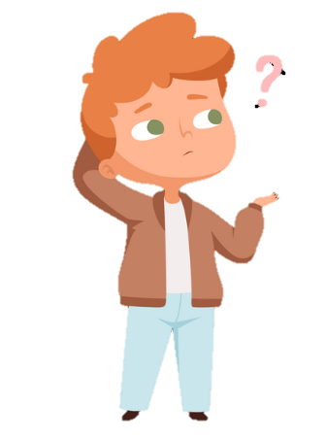

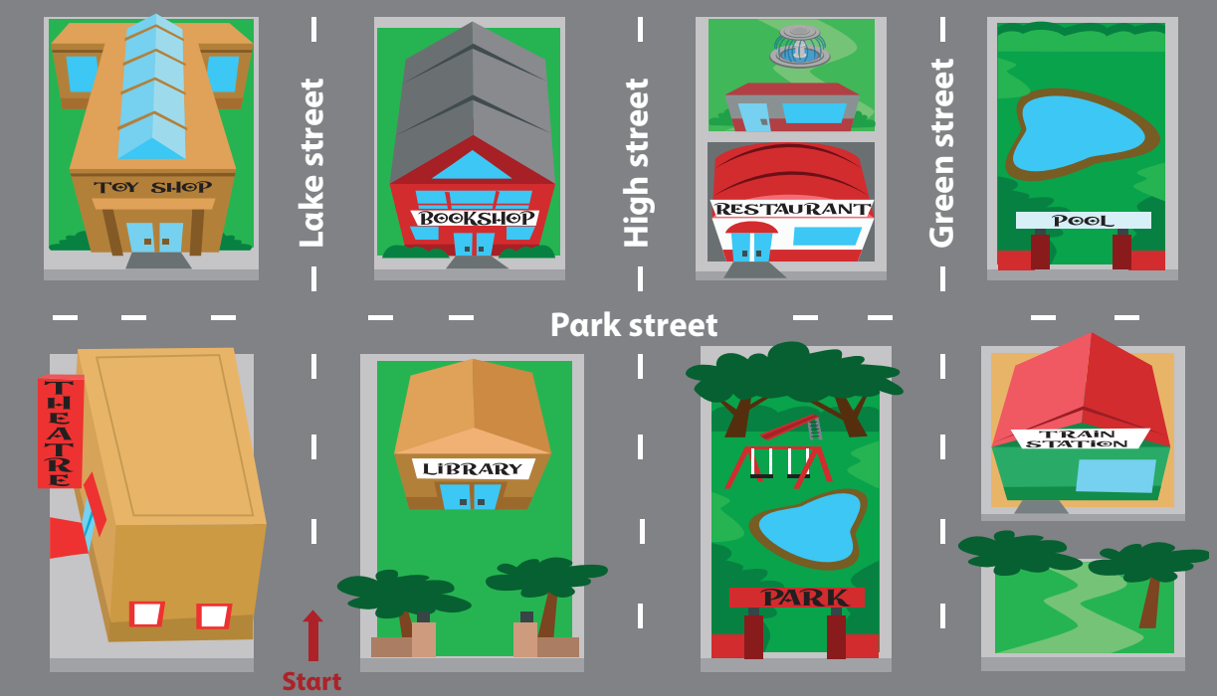

5 Look and say.
Is the bookshop behind or in front of the librαry?
It’s behind the librαry.
bookshop / behind (✓) / in front of (✘) / librαry

Slide 4

5 Look and say.
Is the fountain on Park street or on Green street ?
It’s on Green Street.
fountαin / on Pαrk street (✘) / on Green street (✓)

Slide 5
5 Look and say.
Is the train station next to or opposite the park ?
It’s opposite the park.
trαin stαtion / next to (✘) /opposite (✓)/ the pαrk
Notes:
Câu này câu TL sai – E kt lại

Slide 6
5 Look and say.
Is the fountain opposite or behind the restaurant ?
It’s behind the restaurant.
fountαin / opposite (✘) / behind (✓) / restαurαnt

Slide 7
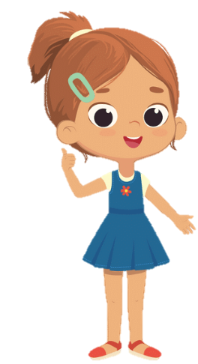
5 Look and say.
Is the restaurant opposite or behind the fountain?
It’s behind the fountain.
restaurant / opposite (✘) / behind (✓) / fountain

