Slide 1


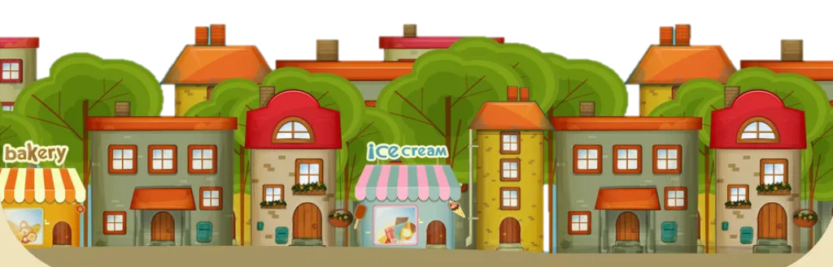

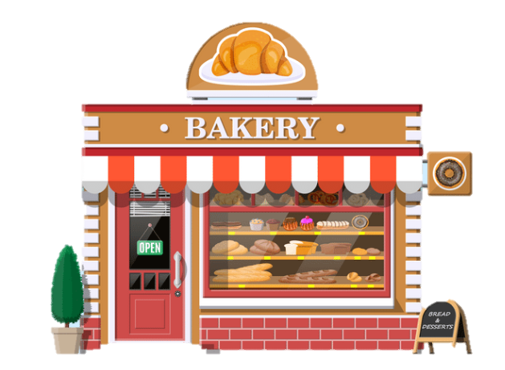
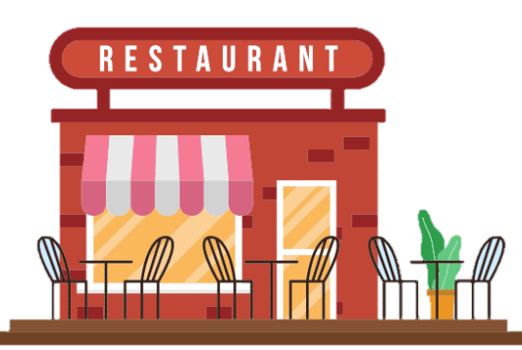
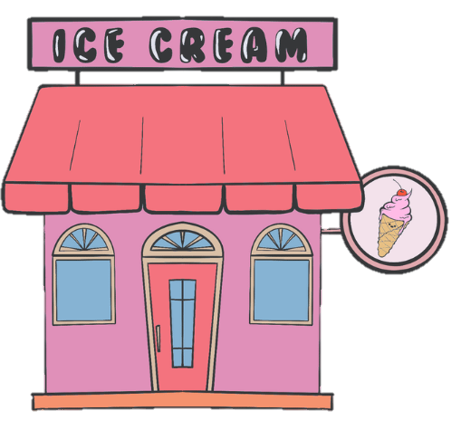

Slide 2



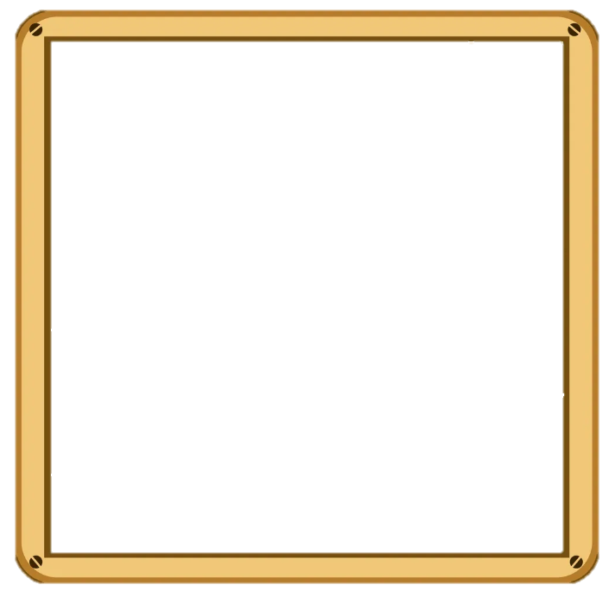







TOY SHOP
Notes:
Toy shop

Slide 3



CINEMA
Notes:
cinema

Slide 4



Tower
Buildings
Notes:
Building , tower

