Slide 1


Jigsaw puzzle
Notes:
+Revise 9 vocabulary (the zoo, the museum, a toy shop, a playground, a pool, a park , a market, the library, the theater)
+ Cut a picture into 4 parts and disorder them( the names of those small pieces are a,b,c,d)
+ Show a empty table and ask students to choose which parts will be appropriate those positions.
Click vào từng ô chữ nhật để các hình ghép về đúng chỗ. Click tiếp 1 lần nữa để hiện ra đáp án. Click màn hình để chuyển sang câu tiếp theo.

Slide 2


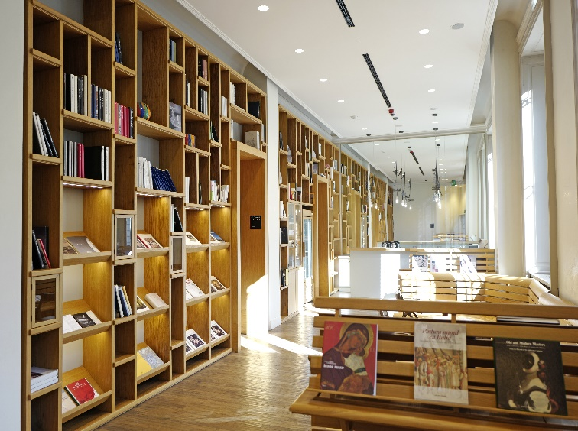
The library
1
2
3
4
a
b
c
d
Notes:
T clicks to the numbers to put the pieces of the picture to the right places, clicks the white callout box to show the word.

Slide 3
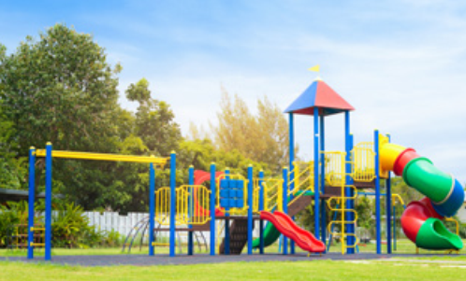
The playground
1
2
3
4
a
b
c
d

Slide 4
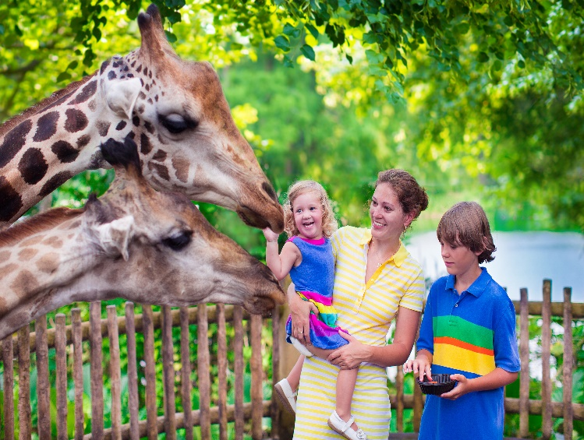
The zoo
1
2
3
4
a
b
c
d

