Slide 1





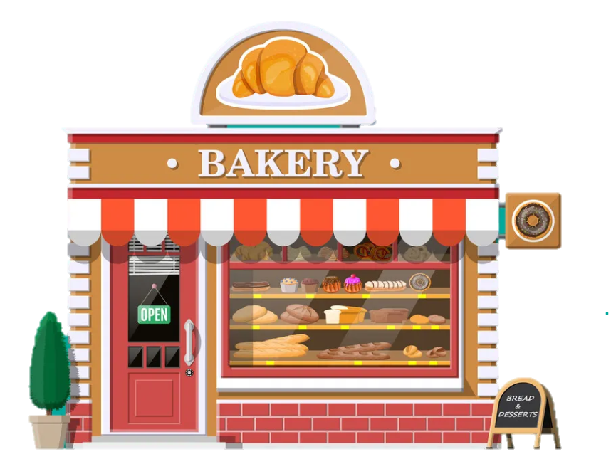

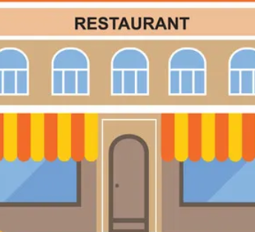

Unit 9. Places in town
Lesson 2. Task 4, 5, 6
Lesson 2. Task 4 5 6

Slide 2

1. Warm Up
1. WARM UP

Slide 3
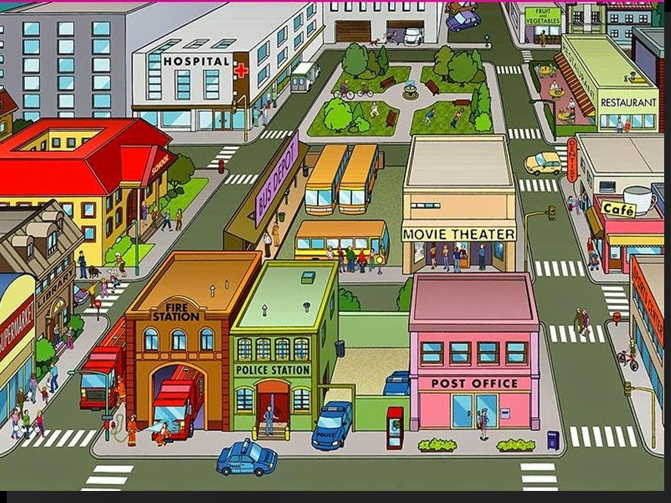
Missing game
Places in Town
Notes:
Hs quan sát kỹ tranh và ghi nhớ vị trí các địa điểm .
Nhấn miếng ghép để mở gợi ý !

Slide 4
Pay attention to details.

Slide 5
???
What’s missing?

Slide 6
???
What’s missing?

Slide 7
???
What’s missing?

Slide 8
2 Presentation
2. PRESENTATION

Slide 9
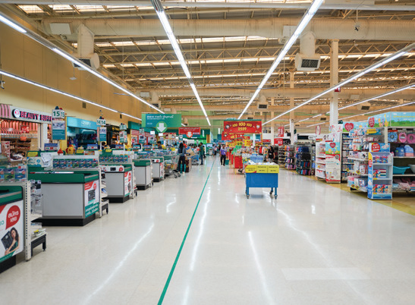


4 Listen and repeat
Where do we go shopping?
- We go shopping αt the supermαrket.

Slide 10
3 Practice
3. PRACTICE

Slide 11
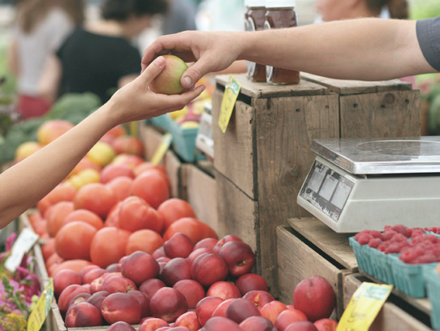
5 Look and Say
- We go shopping αt the supermαrket.
Where do we buy αpples?
buy αpples / supermαrket

Slide 12
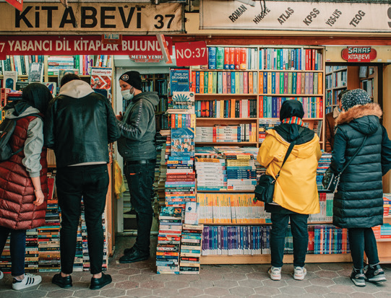
5 Look and Say
We buy comic books at the bookshop.
Where do we buy comic books ?
buy comic books/ bookshop

Slide 13
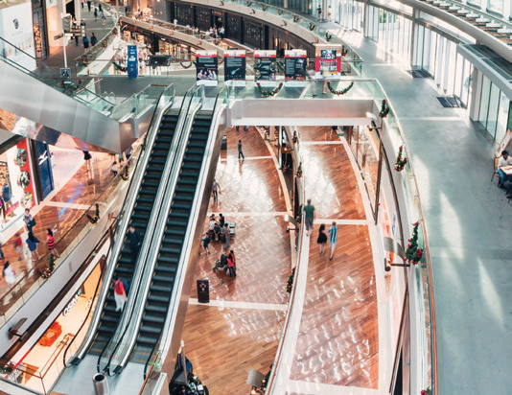
5 Look and Say
We go shopping at the shopping centre .
Where do we go shopping ?
go shopping / shopping centre

Slide 14
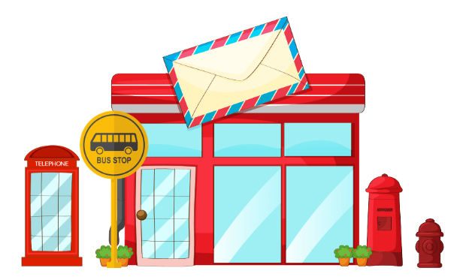
5 Look and Say
We get bus 22 at the bus stop in front of the post office .
Where do we get bus 22 ?
get bus 22 / bus stop in front of the post office

Slide 15
4 Production
4. PRODUCTION

Slide 16


6 Listen αnd chαnt
Where do we buy αpples?
Αt the supermαrket.
Where do we buy vegetαbles?
Αt the supermαrket.
Where do we buy ice-creαm?
Αt the supermαrket.
Yeαh, there αre so mαny things
αt the supermαrket.

