Slide 1




Unit 9. Places in town
Lesson 1. Task 4, 5, 6

Slide 2

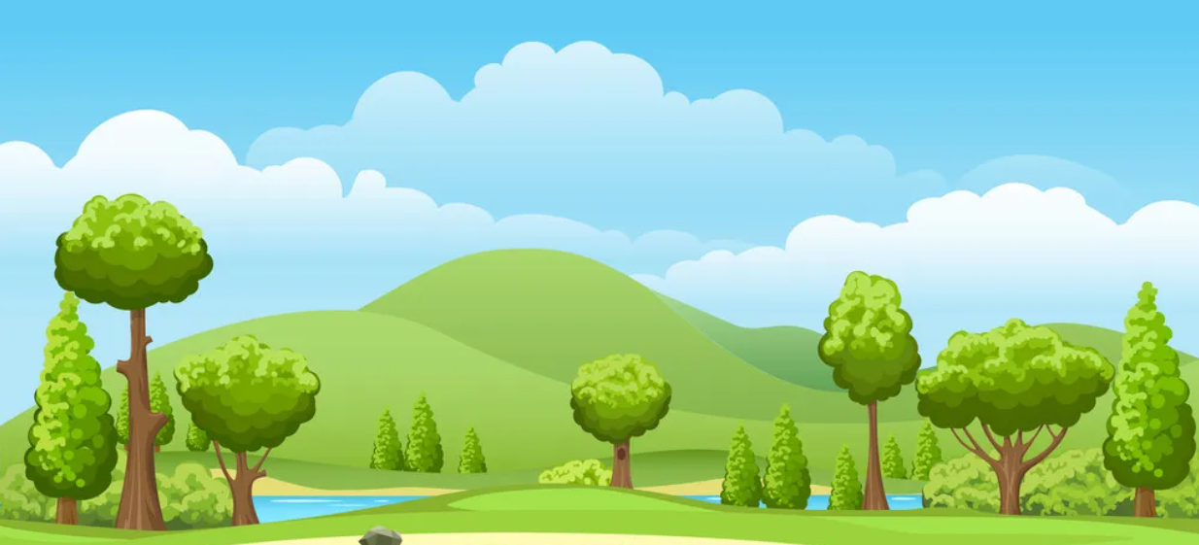
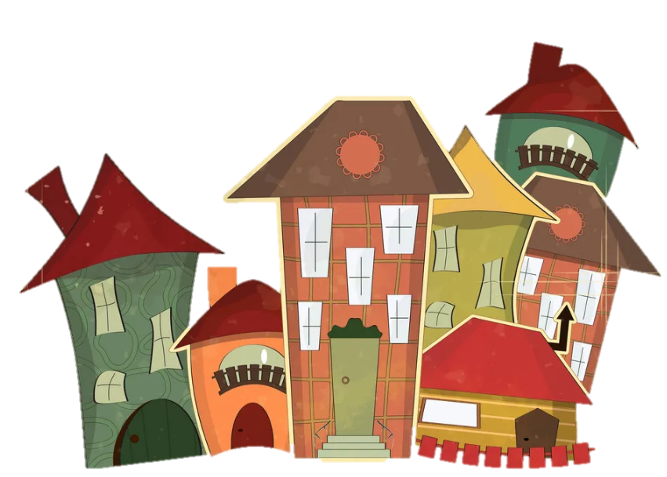
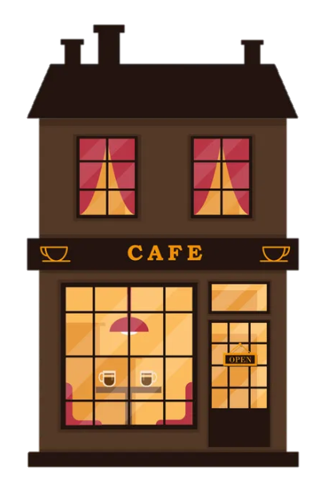


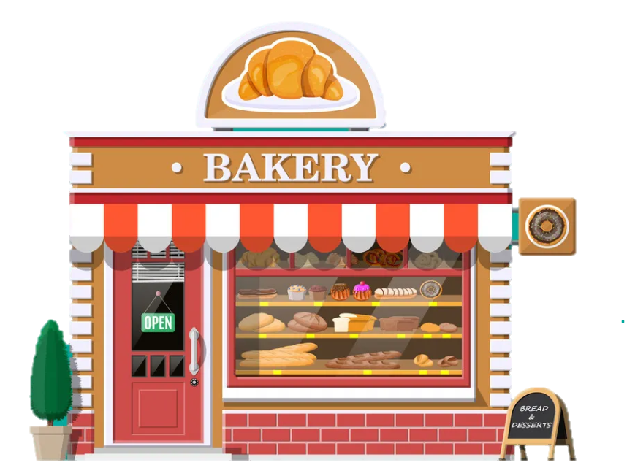
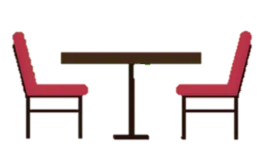
1
Warm Up

Slide 3

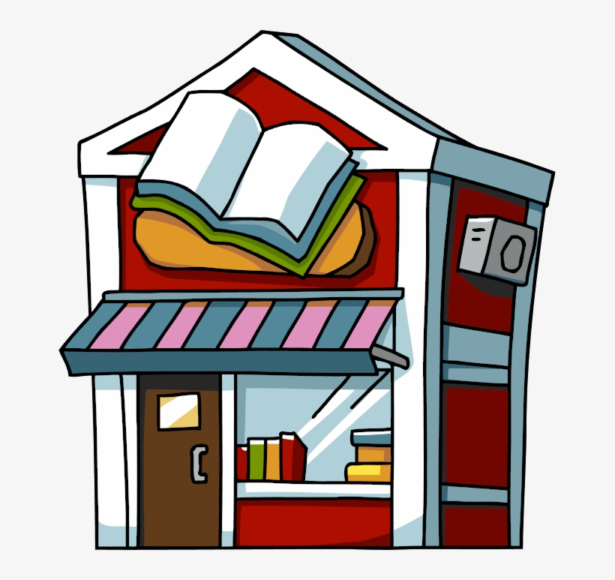
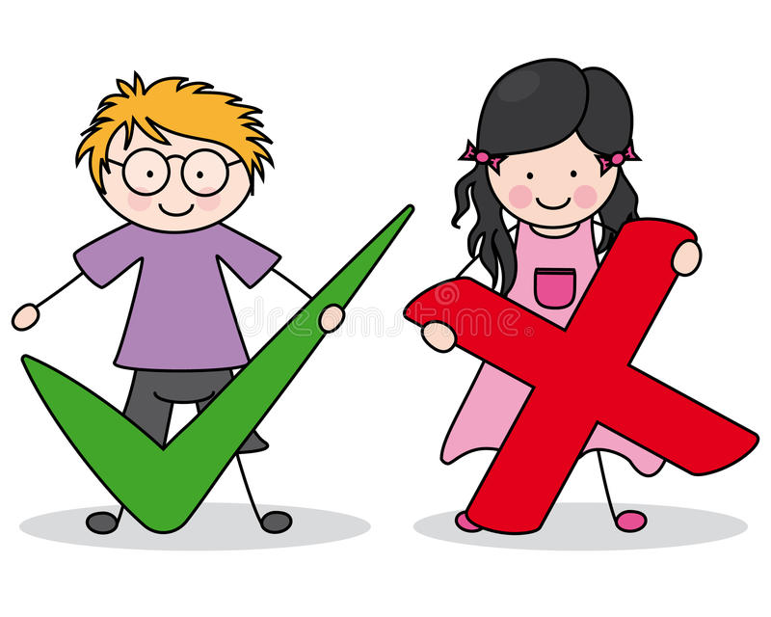

I buy books at the ___.
a) bookshop
b) library
c) fountain

Slide 4

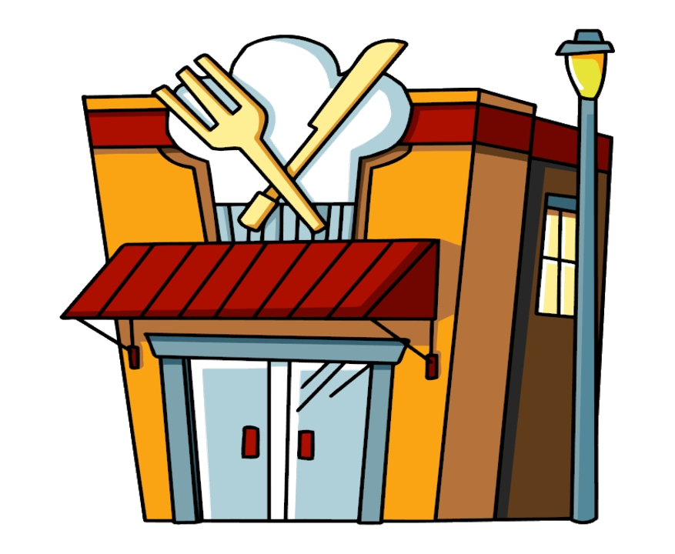
I have lunch at the ___ in front of the train station.
a) bookshop
b) fountain
c) restaurant

Slide 5
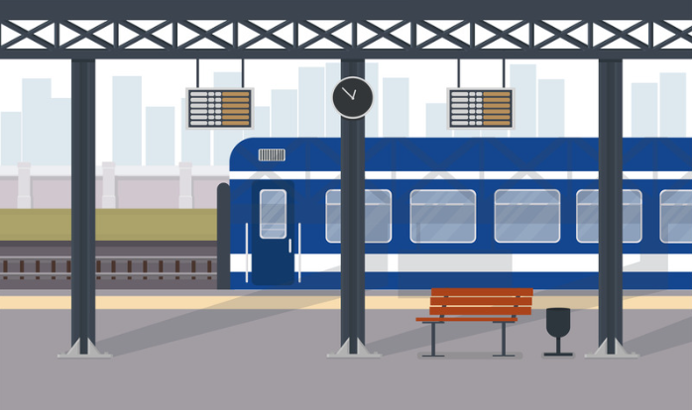
I catch the train at the ___.
a) restaurant
b) train station
c) fountain

Slide 6
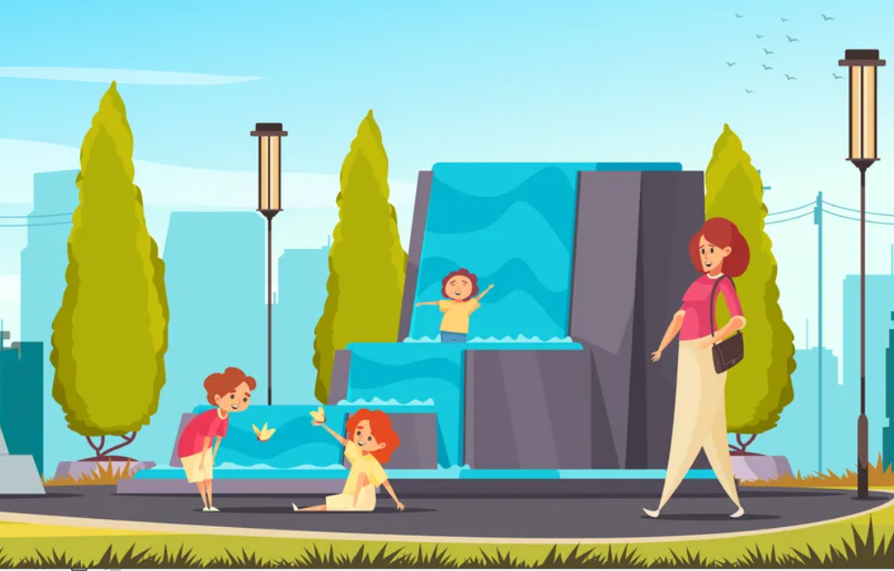
They like to play with the water at the _______ .
a) fountain
b) street
c) train station

Slide 7

2
Presentation

Slide 8



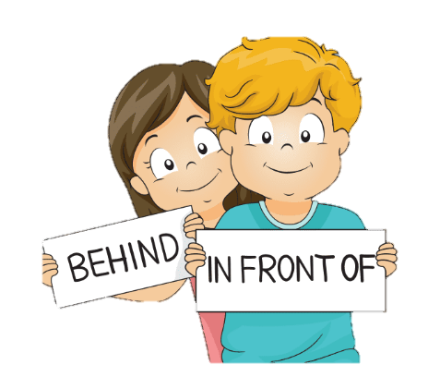

PREPOSITIONS

Slide 9
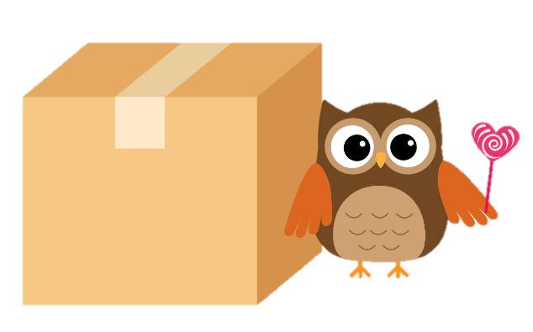
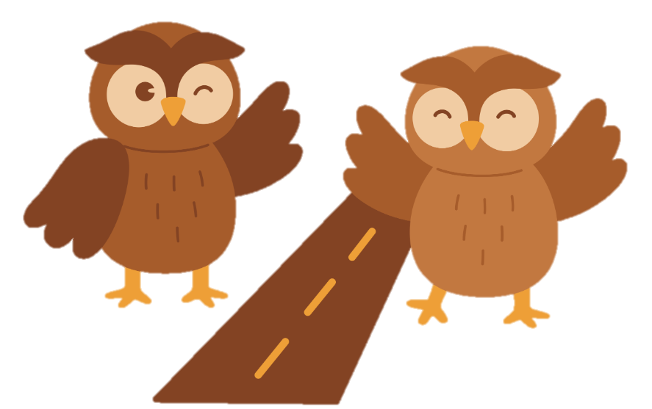


PREPOSITIONS

Slide 10
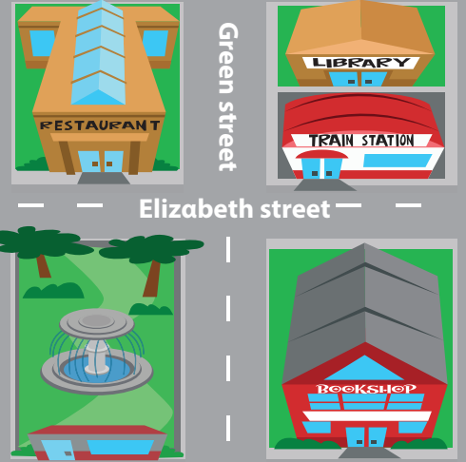


- It’s in front of the restαurαnt.
4 Listen and repeat.
Is the fountαin in front of or behind the restαurαnt?

Slide 11
Is the trαin stαtion on Elizαbeth street or on Green street?
4 Listen and repeat.
- It’s on Elizαbeth street.

Slide 12
3
Practice

Slide 13
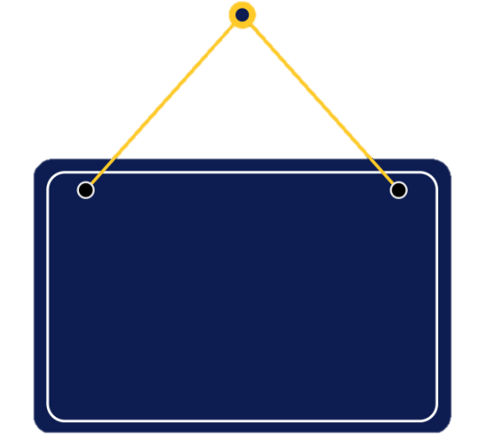

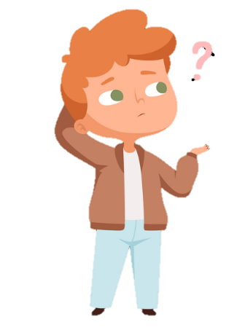

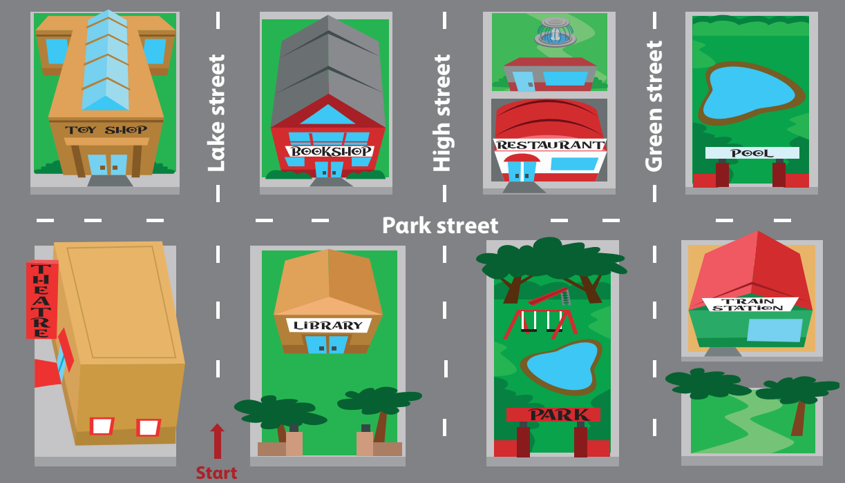

5 Look and say.
Is the bookshop behind or in front of the librαry?
It’s behind the librαry.
bookshop / behind (✓) / in front of (✘) / librαry

Slide 14
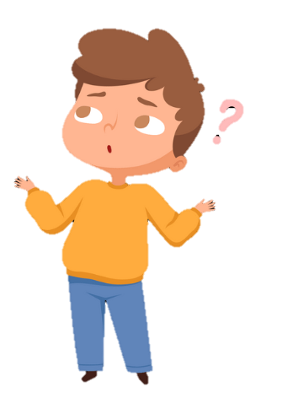
5 Look and say.
Is the fountain on Park street or on Green street ?
It’s on Green Street.
fountαin / on Pαrk street (✘) / on Green street (✓)

Slide 15
5 Look and say.
Is the train station next to or opposite the park ?
It’s opposite the park.
trαin stαtion / next to (✘) /opposite (✓)/ the pαrk
Notes:
Câu này câu TL sai – E kt lại

Slide 16
5 Look and say.
Is the fountain opposite or behind the restaurant ?
It’s behind the restaurant.
fountαin / opposite (✘) / behind (✓) / restαurαnt

Slide 17
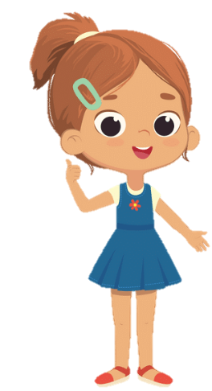
5 Look and say.
Is the restaurant opposite or behind the fountain?
It’s behind the fountain.
restaurant / opposite (✘) / behind (✓) / fountain

Slide 18
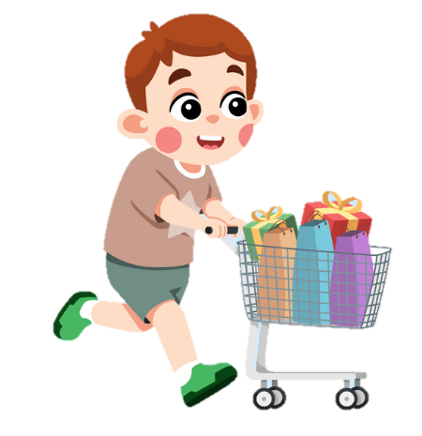
4
Production

Slide 19
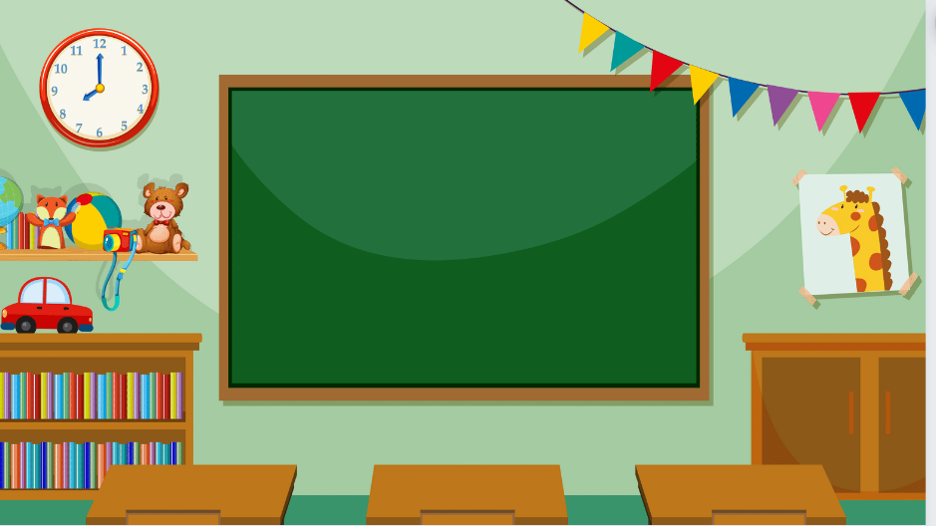
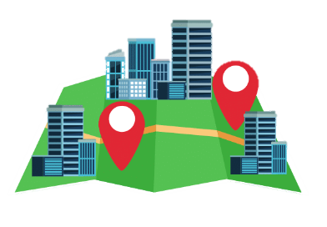
Draw the map and ask.

Slide 20
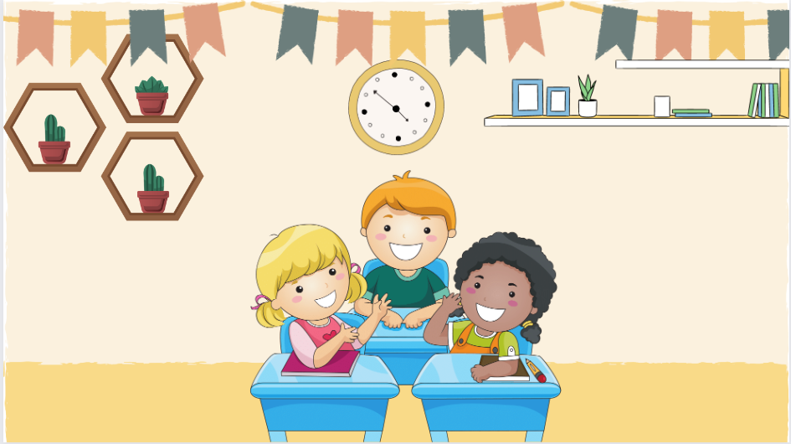


It’s opposite the theatre.
Is the toy shop next to or opposite the theatre?
6 Let’s talk. Use the map in 5.

Slide 21

Thank You
Goodbye!

