Slide 1








Unit 9:
Places In Town
Fun time & Projects

Slide 2

01
WARM-UP

Slide 3


BOARD RACE

Slide 4
02
REVIEW

Slide 5
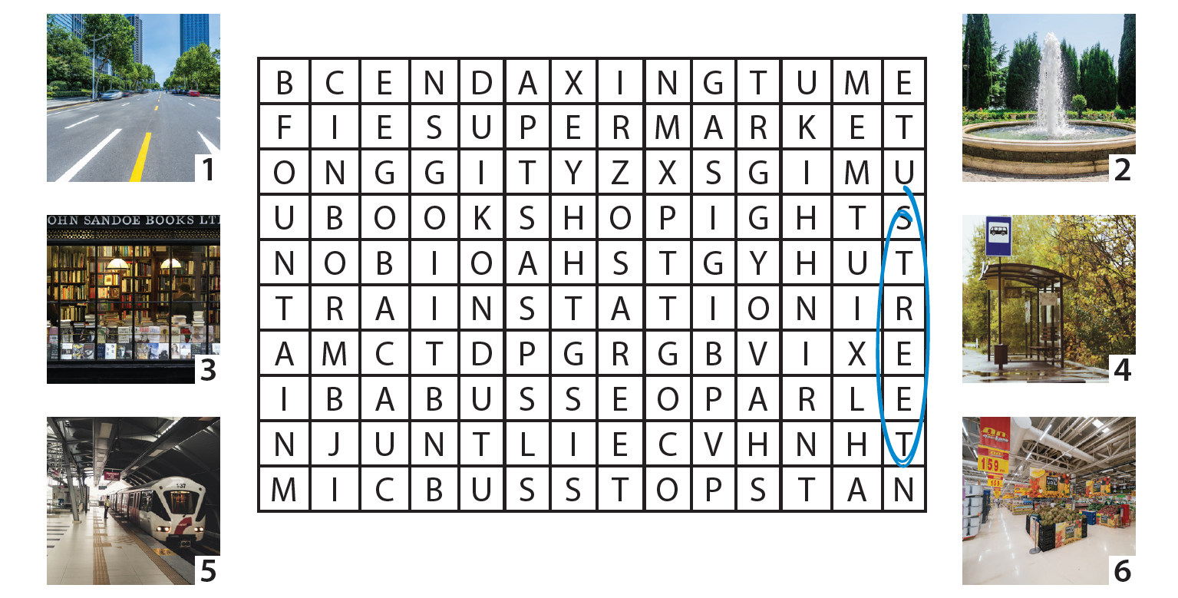
1. Find and Circle!
2
3
4
5
6

Slide 6
03
PROJECT

Slide 7
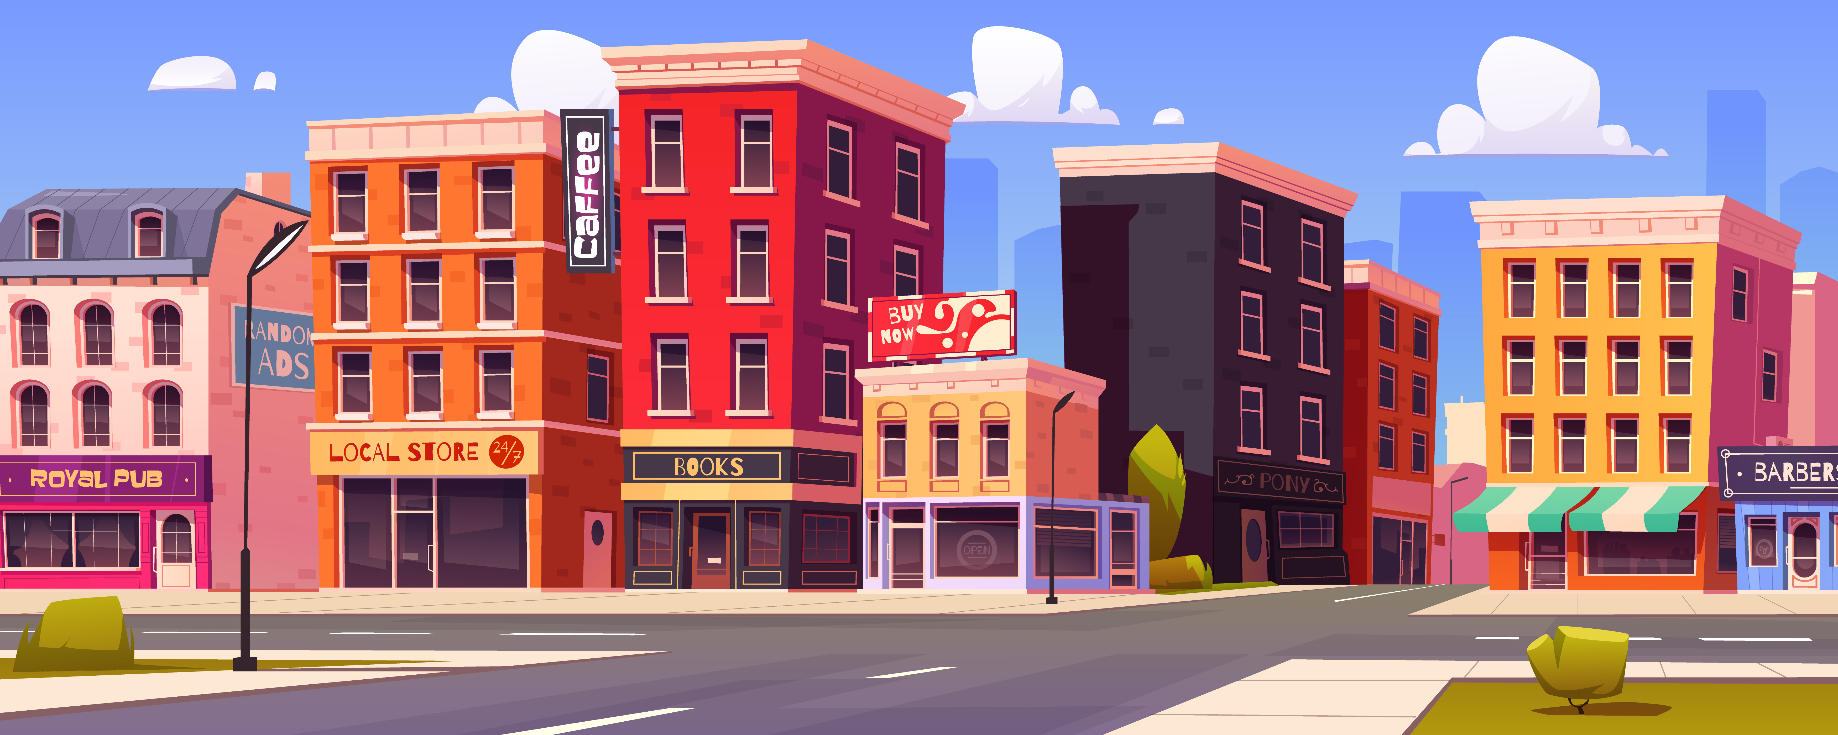
Let’s draw your home street!

Slide 8


It’s time to draw!

Slide 9
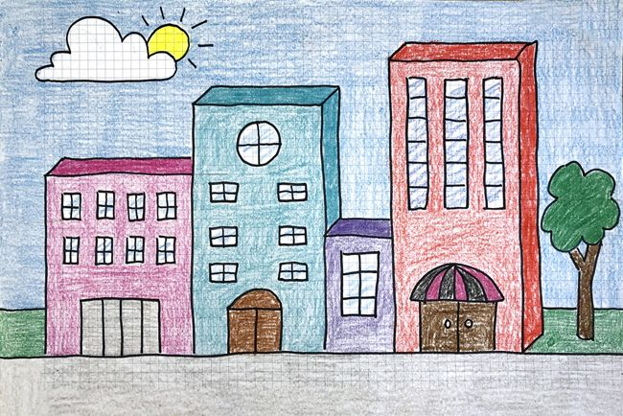
Describe your home!
We often go shopping in Chadstone Plαzα. It’s next to my house.

