Slide 1

Unit 6: My Hobby
FUN TIME & PROJECT

Slide 2
2 REVIEW
Task 1 Find and circle.

Slide 3








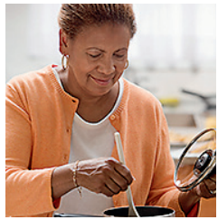
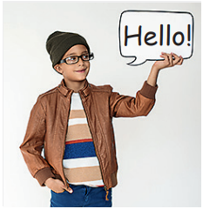
V
J
S
W
C
P
C
Q
P
R
O
A
O
Y
E
I
L
I
O
D
A
T
O
N
K
D
K
E
U
T
R
A
S
P
R
Y
R
N
W
S
I
N
G
C
I
Y
Y
L
M
E
M
B
N
T
Y
Notes:
Xem lại thiết kế vì không ra kết quả từng từ. Ngoài ra việc để viên kim cương k có hiệu ứng tìm kim cương sau khi chơi xong nên hơi hẫng cho hs
Bấm vào ảnh để khoanh tròn từ của ảnh đó
- Show the platform of the task
- Set context: You have to find 8 codes to open the treasure chest and get the big diamond.
- Ask students to work in groups
- Give game instruction: look at the picture, circle the equivalent words
- Give students time to play the game
- Have students do cross-check
- Check with whole class by saying words aloud
- Award the fastest team with most correct answer

Slide 4

3 PROJECT
What we can do

Slide 5

Let’s write.
play the drums
cook
paint
sing
play the guitar
write
What you can’t do?
What you can do?
Notes:
- Give students some green and red piece of papers.
- Ask students to write the actions they and their family members can do on green piece of papers, the actions they and their family members can’t do on red piece of papers

