Slide 1

Unit 6: My Hobby
Lesson 1 – Task 1, 2, 3

Slide 2
Children with musical instruments, Rio de Janeiro, Brazil
Look. Tick what you see.
hat
yellow
T-shirt
green

Slide 3

cook
read
swim
write
speak
English

Slide 4
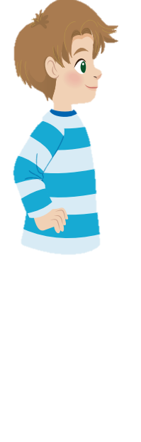
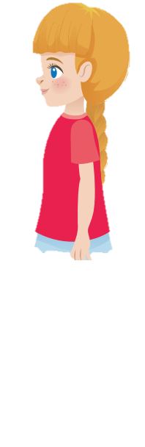
That’s my brother.
Is he in the kitchen?
Yes, he is.
And he can cook!
Oh! That’s great!
1 Is that her cousin?
Yes
No
2 Is he in the kitchen?
Yes
No
Alex
Sophie

Slide 5
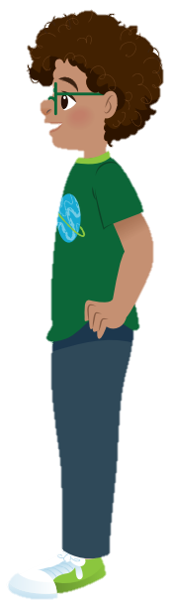
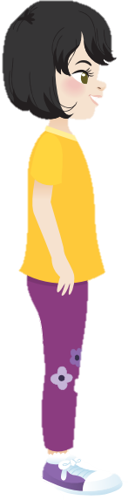
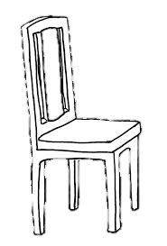
Where am I?
Cook!
Are you in the living room?
No!
Are you in the kitchen?
Yes!

