Slide 1














Unit 8 - Lesson 2 – Period 3

Slide 2



1 WARM UP
Choose correct answer

Slide 3
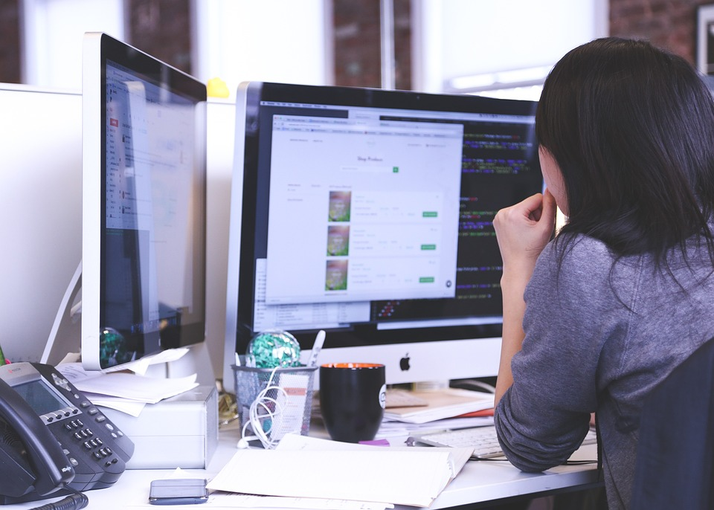
I ____ learn English on computer.
always
sometimes

Slide 4
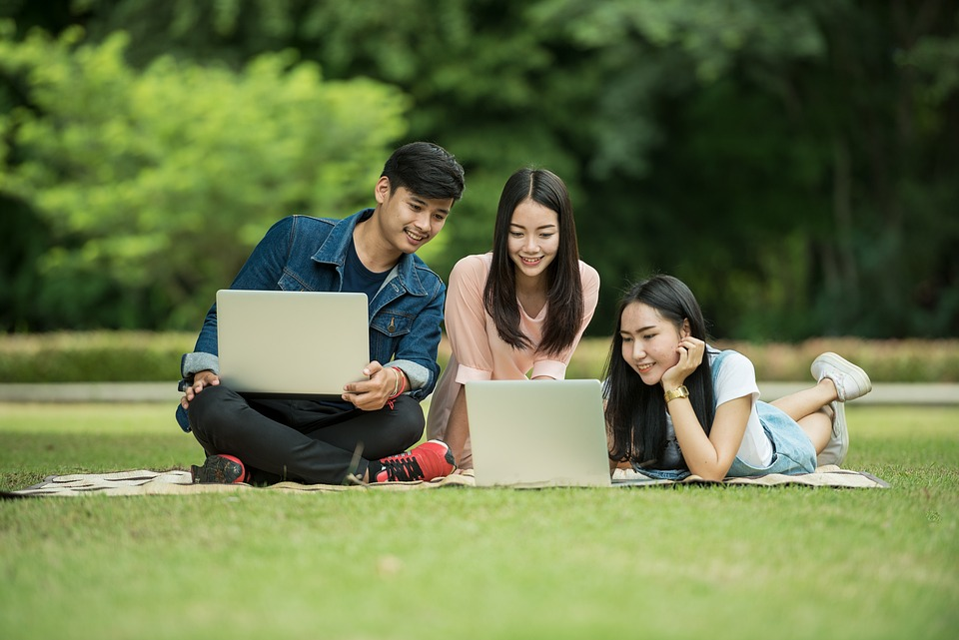
__ work in groups and do homework.
We
He

Slide 5
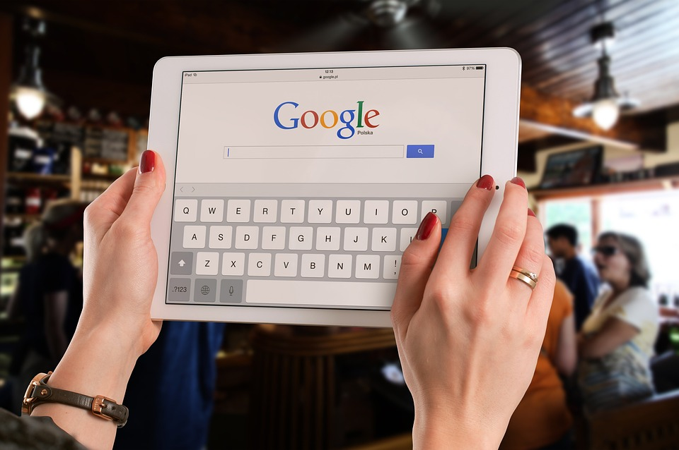
Teacher, can we use the ___ in class?
phone
tablet

Slide 6
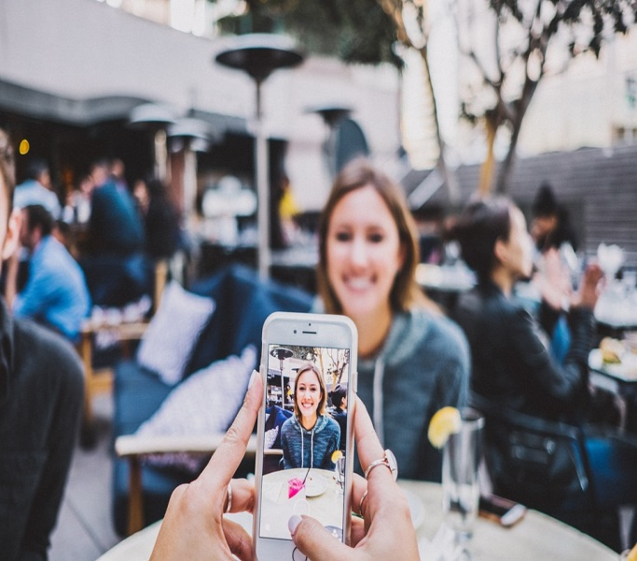
They ____ take photos on phones.
can
can’t

Slide 7
2 Presentation
Task 7 Listen and circle.

Slide 8



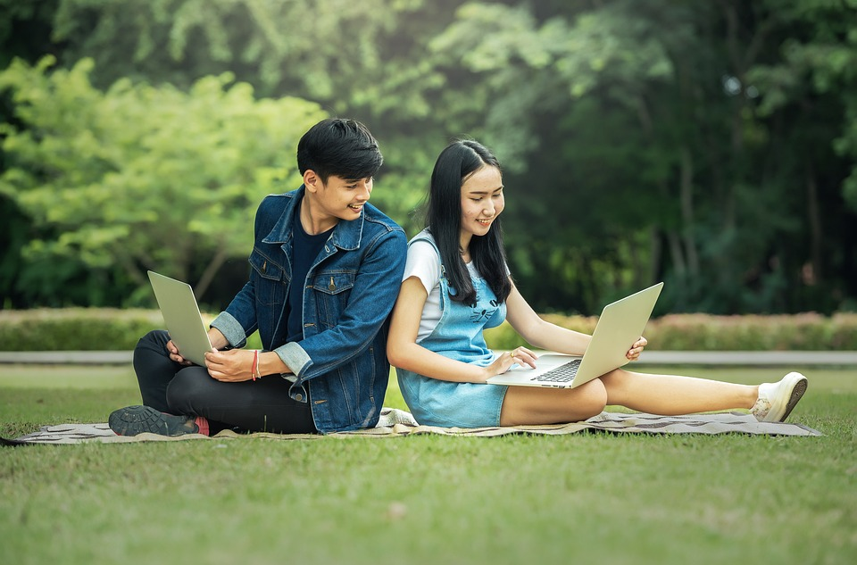
7. Listen and circle.
1. Laura and her friends ____ learn English together.
A. sometimes
B. always
C. don’t
Notes:
Nghe và khoanh đáp án đúng

Slide 9
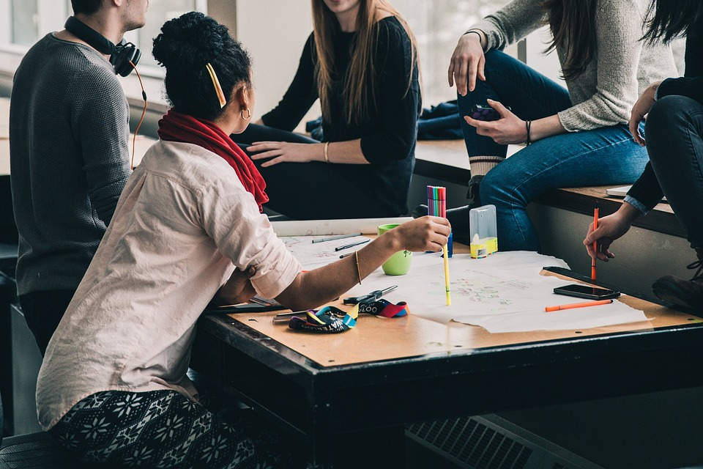
2. They work ______ and do their homework.
A. in class
B. in pairs
C. in groups

Slide 10

3. There are nice photos and ____ in the units.
A. lessons
B. colour
C. videos

Slide 11
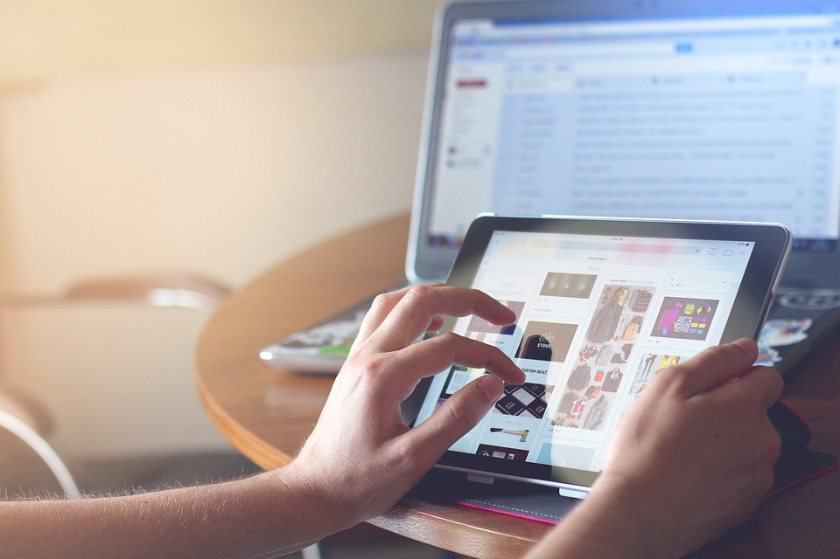
4. They sometimes use the computer or ____,too.
A. tablet
B. smartphone
C. book

Slide 12
3 Practice
Task 8 Point and say.
Notes:
Dấu câu

Slide 13






8. Point and say.
We can’t use
the tablet in class.
x
2. We can work in groups in class.
✔
Notes:
Nhìn hình và sử dụng cấuu trúc We can/ can’t

Slide 14

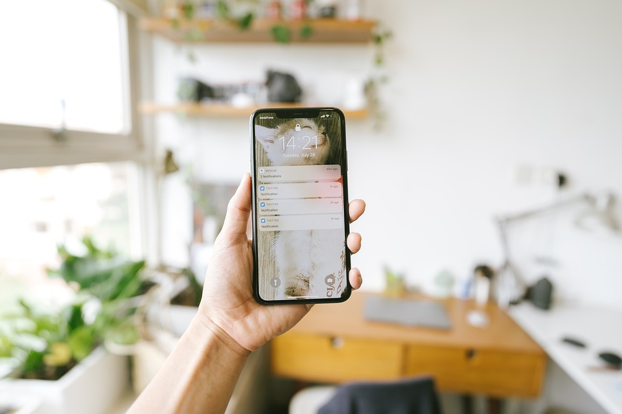

8. Look and say.
3. We can work in pairs.
✔
4. We can’t use the phone in class.
x

Slide 15

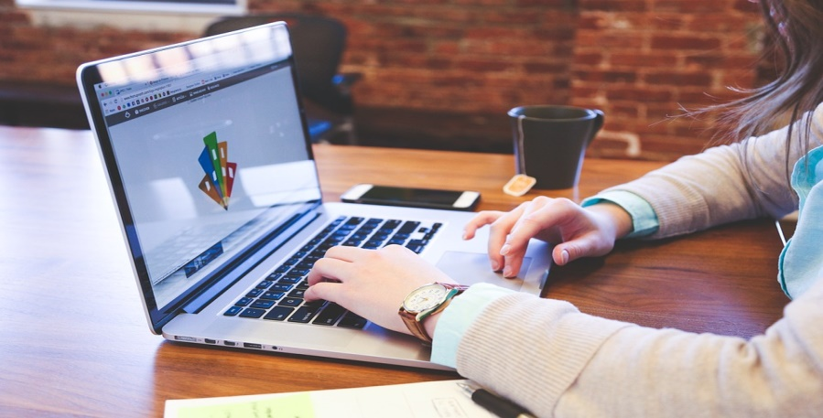
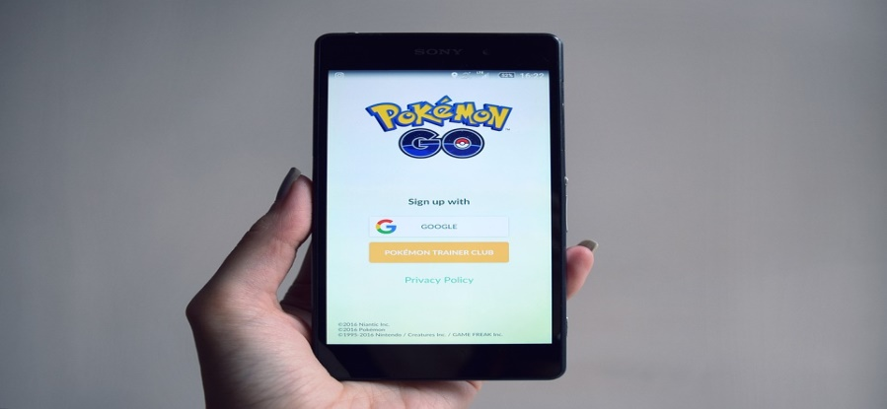
8. Point and say.
5. We can’t surf
the Internet.
x
6. We can’t play the video games on phone.
x
Notes:
Trình bày lại chữ

Slide 16
4 Production
Task 9 Let’s play.
Notes:
Dấu câu

Slide 17
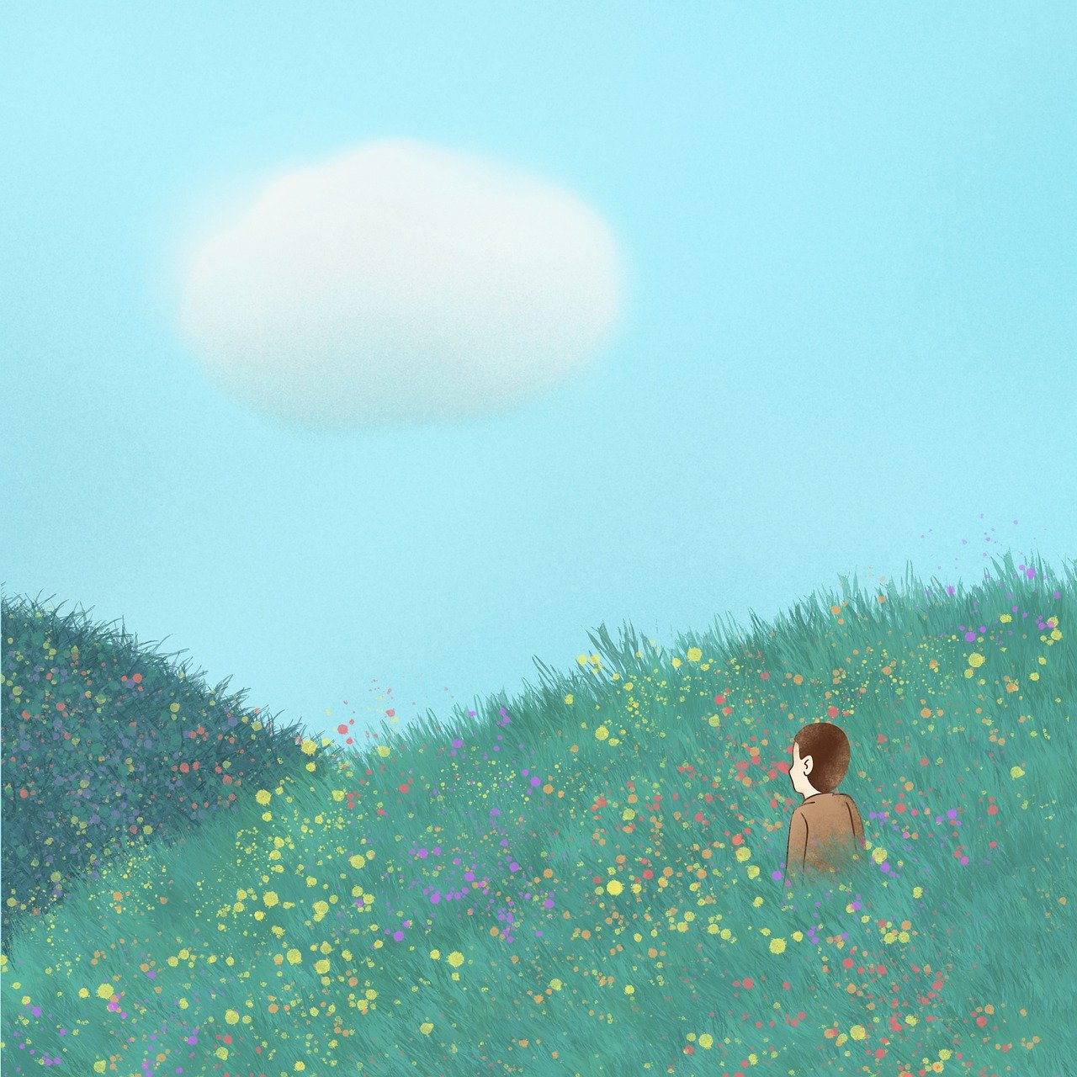


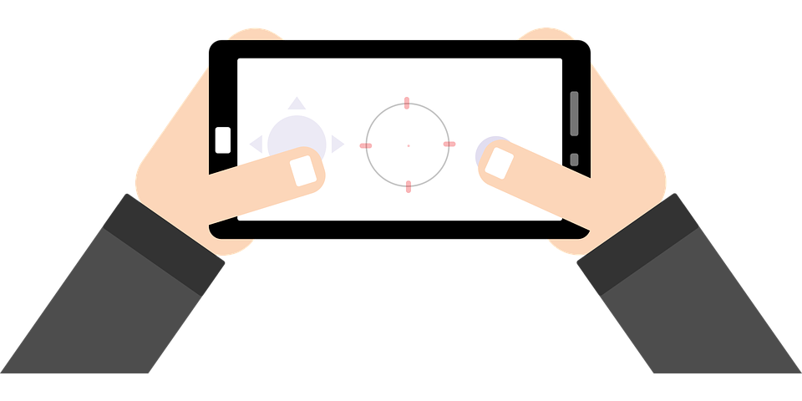

9
Let’s play.
Teacher, can
we work in
groups?
Yes, you can.
x
✔
No, you can’t.
Teacher, can
we play video
games in class?

Slide 18
5
Assessment
& Wrap up
Notes:
Đây k phải là extra, đây là hđ 3 của bài

Slide 19
Matching Game
1.We can surf
a.the Internet.
2.He can’t take
b.the tablet?
3.Can we use
c.English with Lan.
4.I always learn
d.photos on phone.
1
A
2
D
3
B
4
C

Slide 20
REMEMBER
STRUCTURE:
Teacher, can we use the tablet?
-Yes, you can.
-No, you can’t.
20

