Slide 1












Unit 8 - Lesson 1– Period 2

Slide 2



1. Warm up

Slide 3

Do a crossword in red?
7
7
M
A
K
E
1
E
N
G
L
I
S
H
2
W
R
I
T
E
3
S
M
A
R
T
P
H
O
N
E
4
P
L
A
Y
G
A
M
E
S
5
6
R
O
B
O
T
S
Notes:
Hs chọn số để nhìn hình, trả lời từ còn thiếu và điền vào chỗ trống
Click số 7 để hiện key của crossword

Slide 4

We can _____ videos on a smart phone.
HOME

Slide 5

I can learn _________.
HOME

Slide 6

We can ______
emails on the
smart phone.
HOME

Slide 7
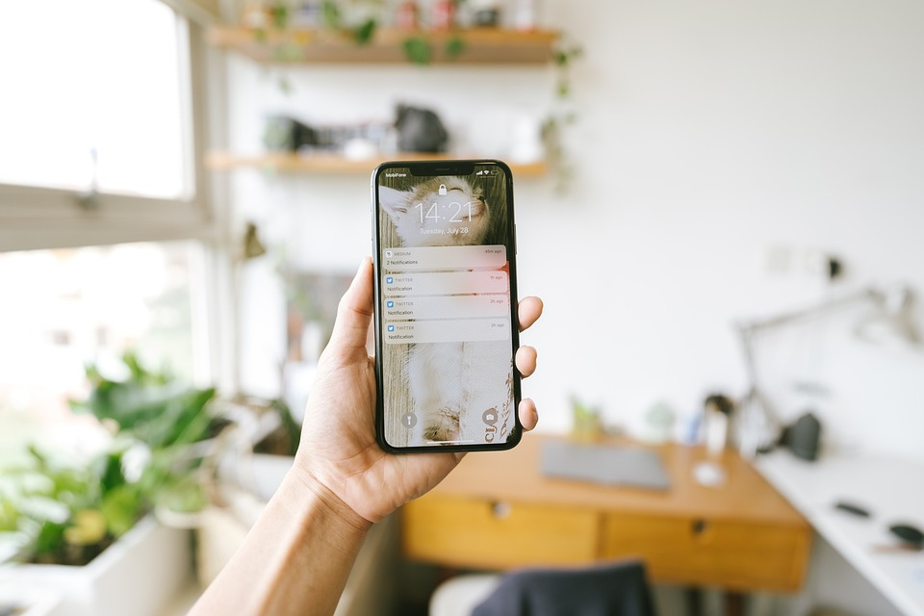
It’s a __________.
HOME

Slide 8

He can ___________.
HOME

Slide 9



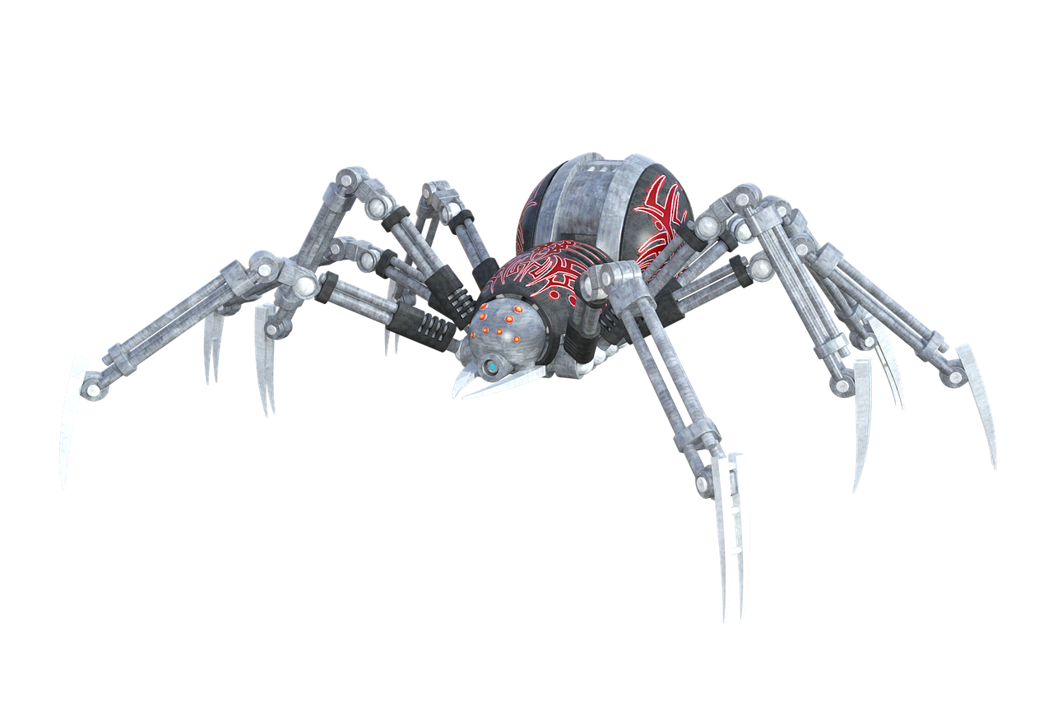
They are ______.
HOME

Slide 10

Presentation
4
Listen and repeat.

Slide 11

Frequency Adverbs
Always
Sometimes

Slide 12


Choose correct answer
1
What can she do?
2
He ____ learns English.
A. She can make videos.
A. sometimes
B. She can write emails.
B. never
C. She can learn English.
C. always

Slide 13




4
Listen and repeat.
1
She sometimes makes videos on her smartphone.

Slide 14

2
He always learns English on his computer.

Slide 15

Practice
5
Look and say.

Slide 16




5
Look and say.
Linda/write emails
Linda sometimes writes emails on her computer.

Slide 17

My brother/ make videos
My brother always makes videos on his computer.

Slide 18

Richard/ play games
Richard sometimes plays games on his smartphone.

Slide 19

Uncle Mark/
make phone calls
Uncle Mark sometimes makes phone calls on his smartphone.

Slide 20
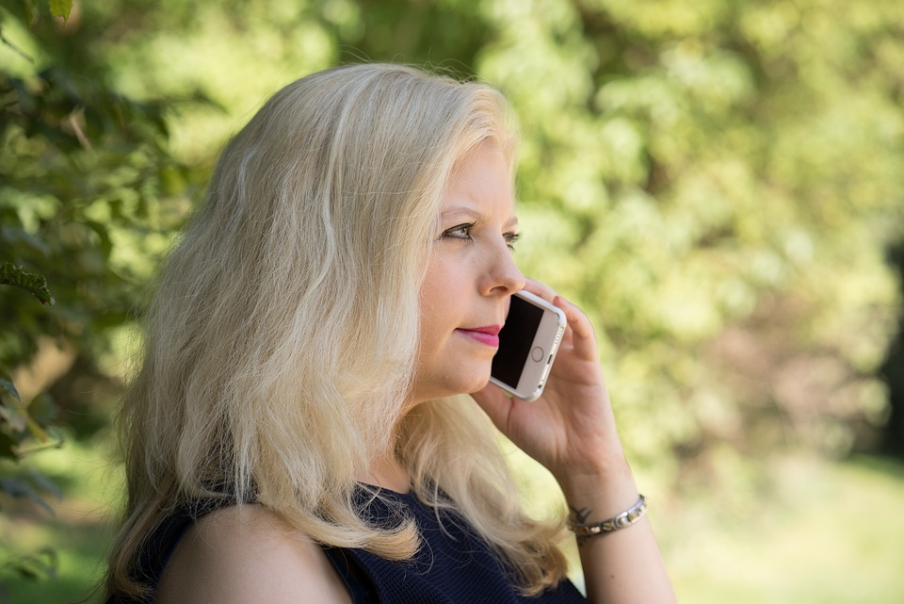

Frequency adverbs practice
always
usually
often
sometimes
never

Slide 21

Production
6
Let’s talk.

Slide 22

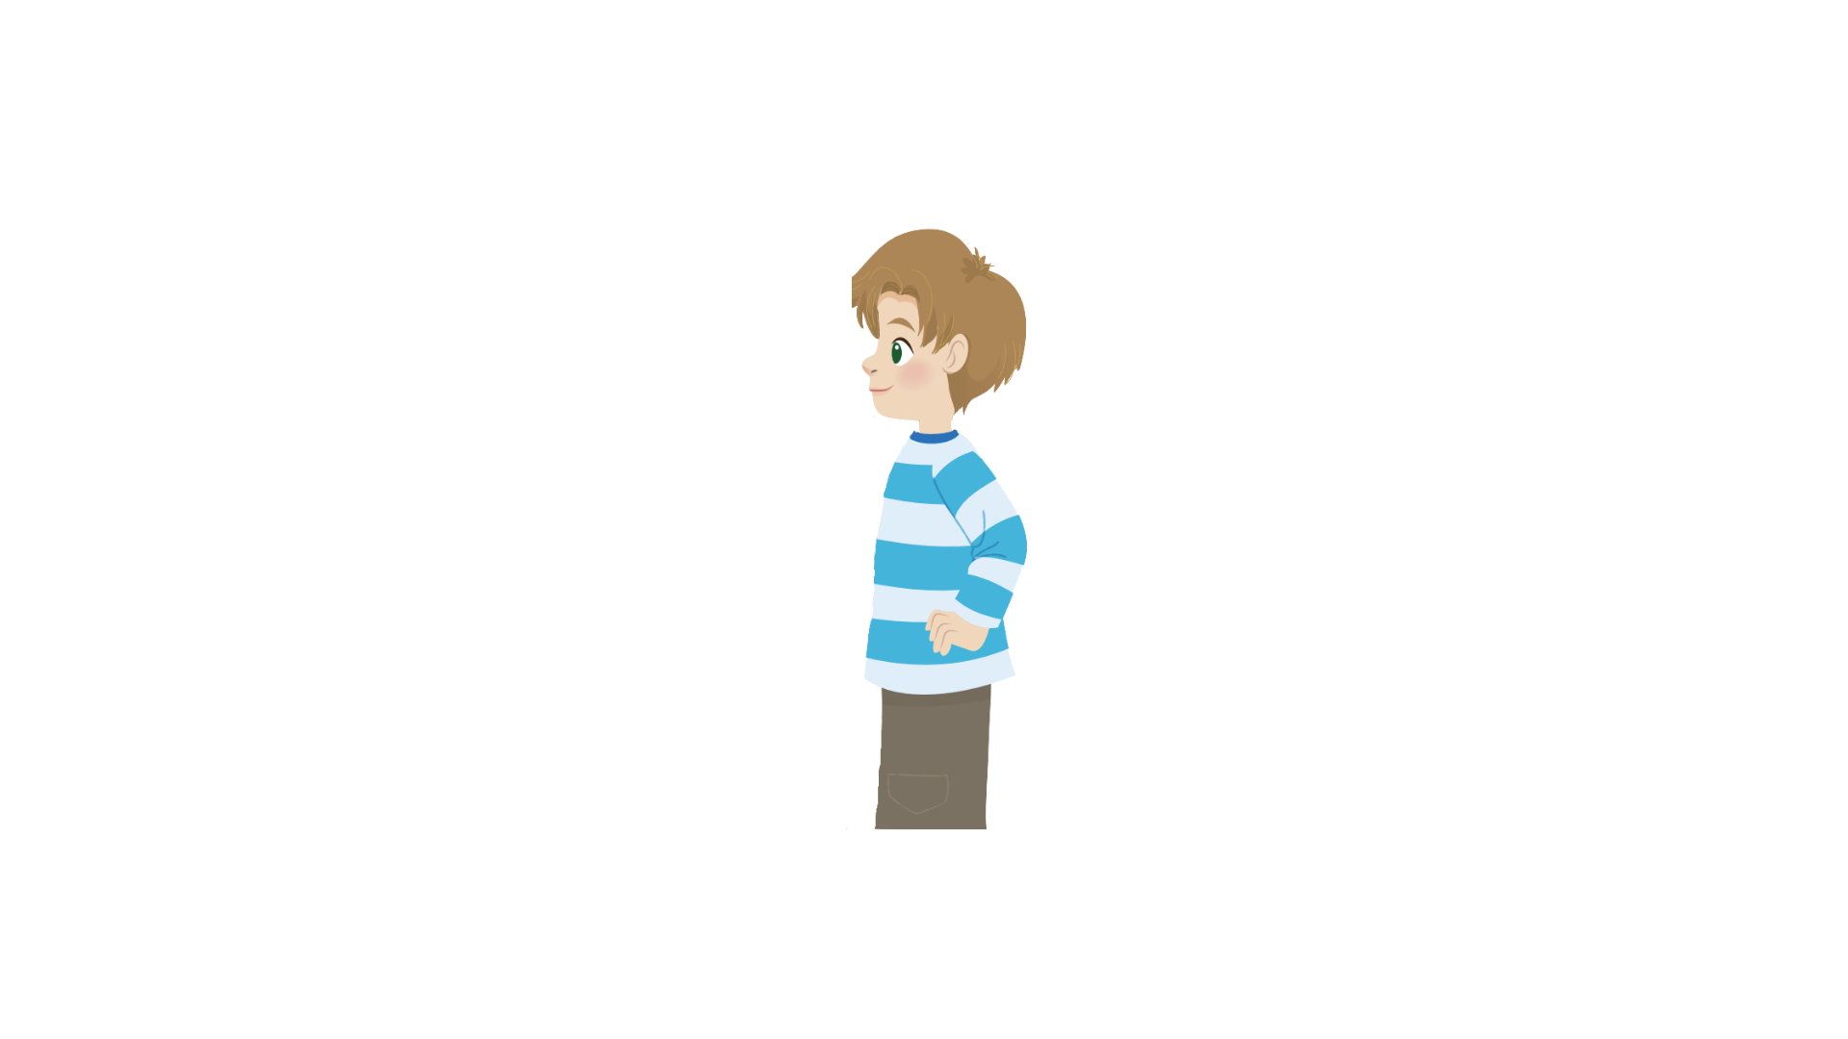
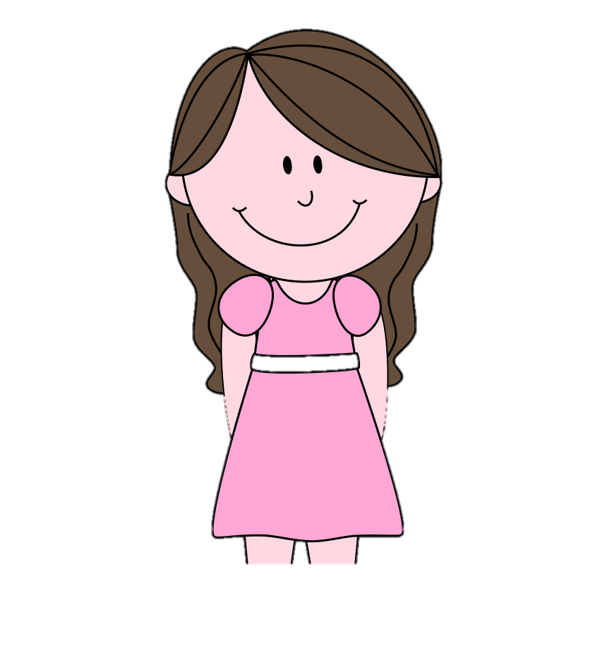
6
Let’s talk
I always learn English on my smartphone.
That’s cool! I sometimes play video games on my smart phone.
Sam
Andy

Slide 23

Assessment

Slide 24


Choose the correct answers.
1. I ______ learn English on my smartphone.
A. always
B. alway
C. allways
D. awway
2. They can ________emails on their computer.
A. eat
B. hit
C. leave
D. write
3. What can you do on your _______?
A. I
B. we
C. phone
D. he
4. Aunt Trang sometimes ____ phone calls.
A. made
B. makes
C. make
D. makees
Notes:
HOẠT ĐỘNG TƯƠNG TÁC

Slide 25

Wrap up

Slide 26


REMEMBER
VOCABULARY:
Sometimes: đôi khi
Always: luôn luôn
STRUCTURE:
I/We/ They sometimes/always + V
He/She sometimes/always + Vs/es

Slide 27




Thank you & goodbye!

