Slide 1



















Unit 8
My Town
Funtime & Project

Slide 2








1 Warm up

Slide 3

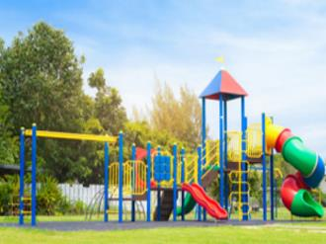
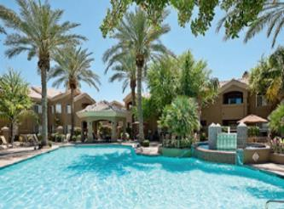
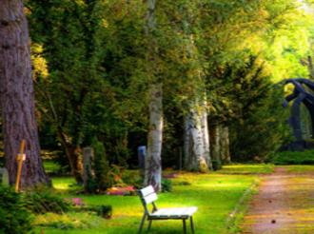
Quick look
playground
pool
park

Slide 4
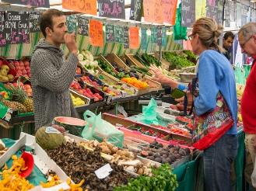
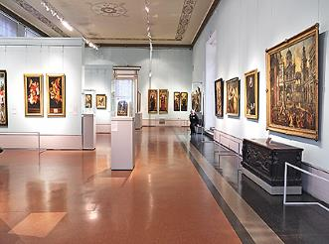
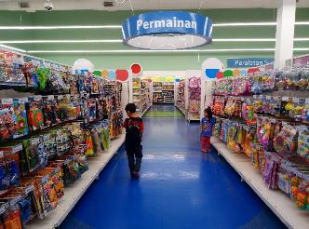
Quick look
market
museum
toy shop

Slide 5
2 Practice

Slide 6


Jigsaw puzzle
Notes:
+Revise 9 vocabulary (the zoo, the museum, a toy shop, a playground, a pool, a park , a market, the library, the theater)
+ Cut a picture into 4 parts and disorder them( the names of those small pieces are a,b,c,d)
+ Show a empty table and ask students to choose which parts will be appropriate those positions.

Slide 7



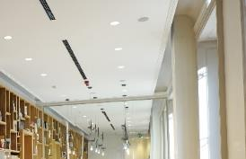
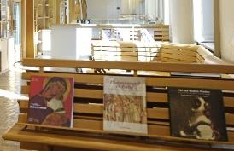
The library
1
2
3
4
a
b
c
d
Notes:
T clicks to the numbers to put the pieces of the picture to the right places, clicks the white callout box to show the word.

Slide 8


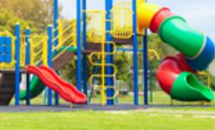
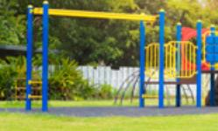
The playground
1
2
3
4
a
b
c
d

Slide 9
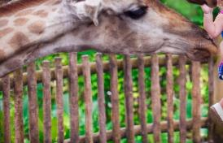

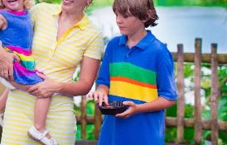
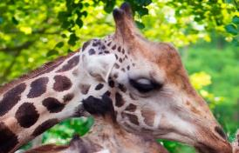
The zoo
1
2
3
4
a
b
c
d

Slide 10

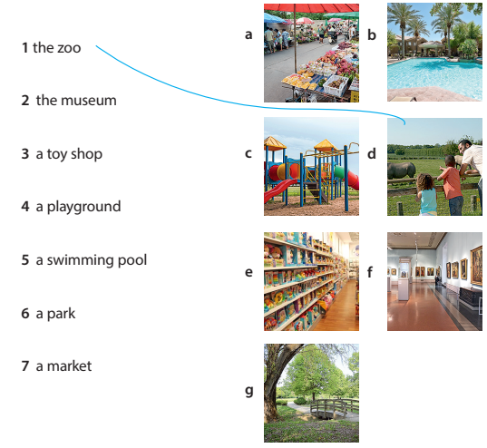

Task 1. Look and match

Slide 11
3 Project

Slide 12

Look and fill.
Let’s go to the ______ and swim.
pool

Slide 13
Look and fill.
Let’s go to the ______ and read books.
library

Slide 14
Look and choose.
Let’s go to the market and _____________.
buy some apples
1 buy some apples
2 dance
3 read books

Slide 15
Look and choose.
Let’s go to the theater and ___________.
listen to music
1 listen to music
2 jump
3 run

Slide 16
Look and choose.
Let’s go to the museum and ___________.
watch pictures
1 eat ice cream
2 sing
3 watch pictures

Slide 17
Task 2. Project
our dream place
Draw a place you like. Tell your class about it.

Slide 18
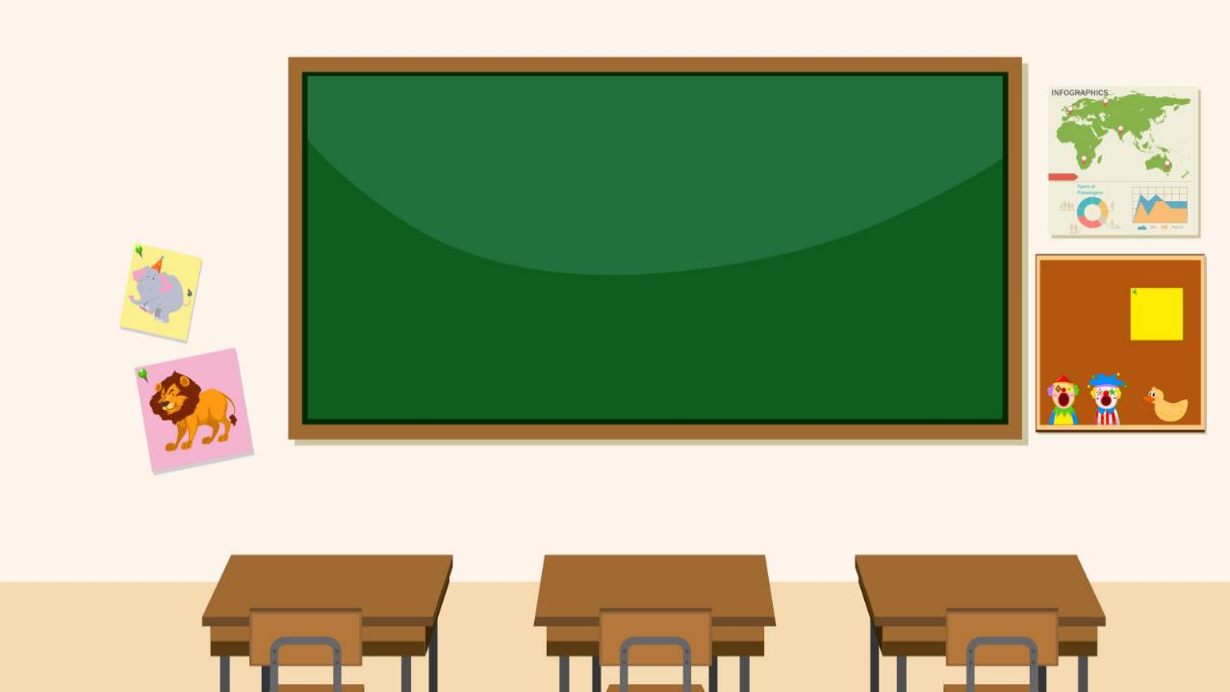



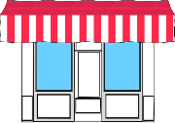



This is my dream city. There’s a toy shop. Let’s go to the toy shop and buy a teddy bear there.

Slide 19



4 Assessment

Slide 20

Example: Write the full sentence with “ let’s”:
playground/have fun
Let’s go to the playground and have fun there.

Slide 21
1. Write the full sentence with “ let’s” :
park/ride a bike
Let’s go to the park and ride a bike there.

Slide 22
2. Write the full sentence with “ let’s” :
theater/listen opera
Let’s go to the theater and listen to the opera there.

Slide 23
3. Write the full sentence with “ let’s”:
toy shop/buy robots
Let’s go to the toy shop and buy robots there.

Slide 24
4. Write the full sentence with “ let’s” :
zoo/watch the lions
Let’s go to the zoo and watch the lions there.

Slide 25
5. Write the full sentence with “ let’s” : market/buy foods
Let’s go to the market and buy foods there.

Slide 26


Thank you & goodbye!

