Slide 1
















Notes:
Để nguyên trang bìa như này, chỉ thay đổi tên bài trong quá trình làm. Logo của sách Wonderful World

Slide 2




Review 3:
Part 4

Slide 3
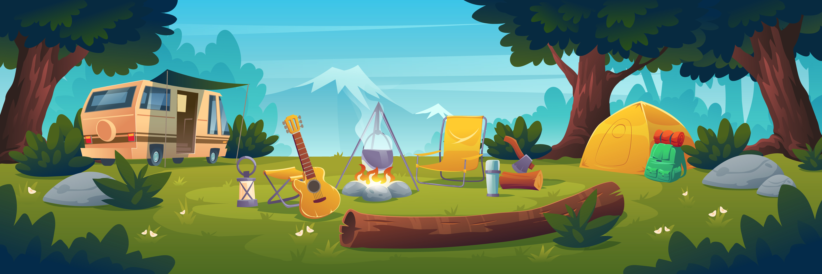
01
WARM-UP

Slide 4
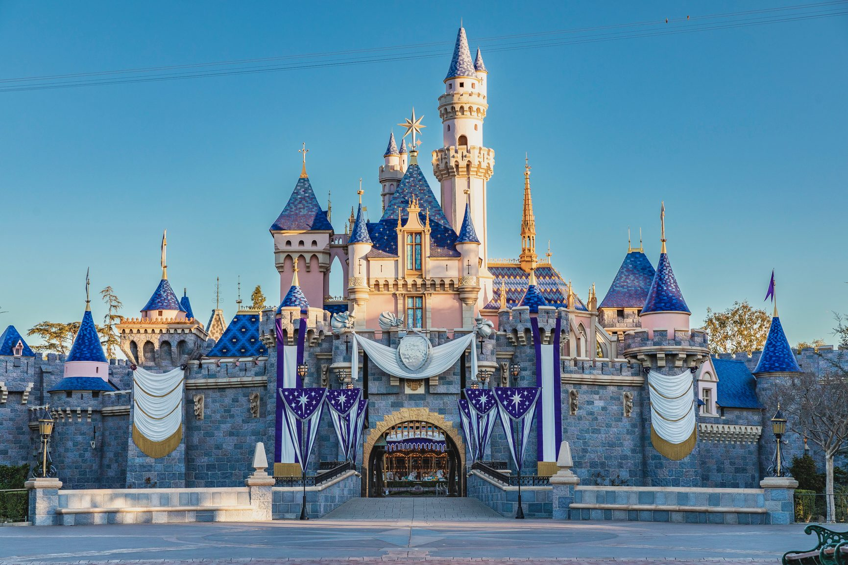
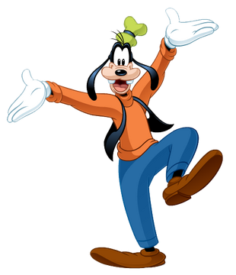
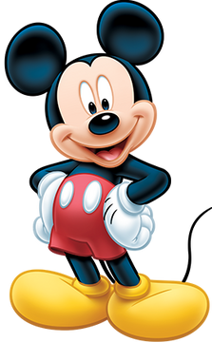
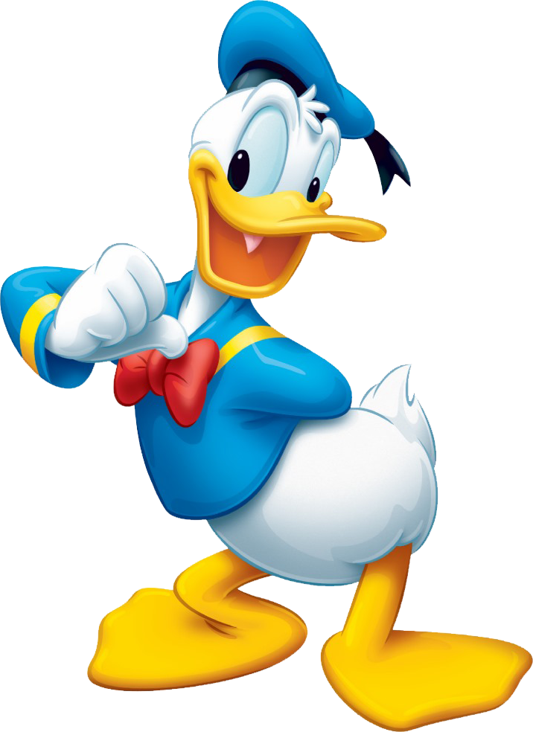
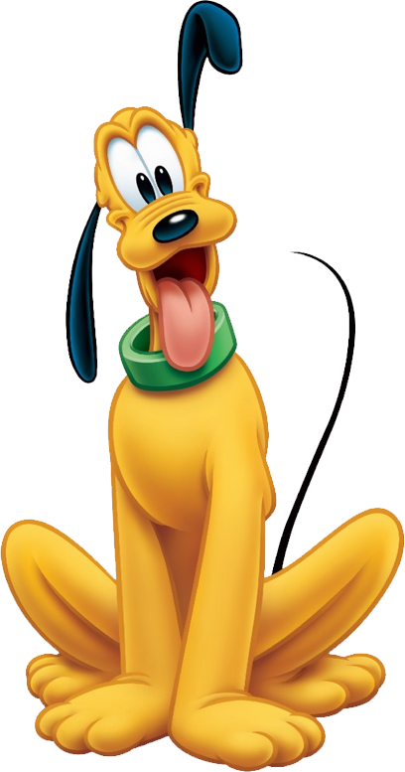
The Mickey Quiz!

Slide 5
mountain
back

Slide 6
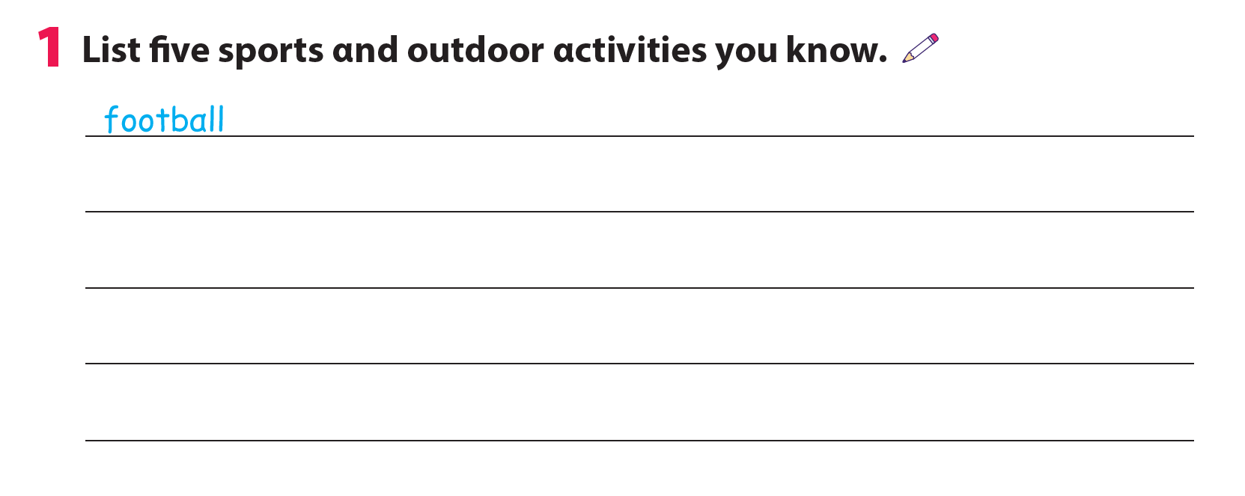
ice hockey
ride a bike
baseball
tennis
skiing

Slide 7
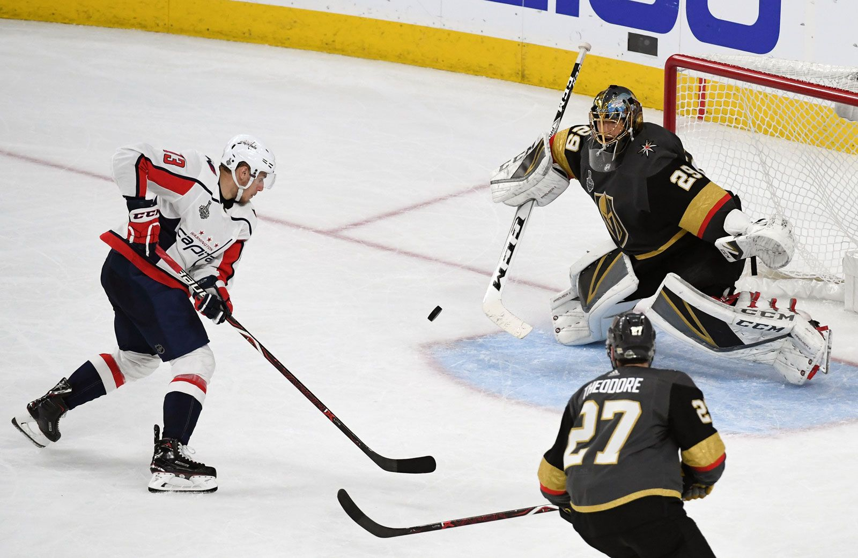
Ice hockey

Slide 8
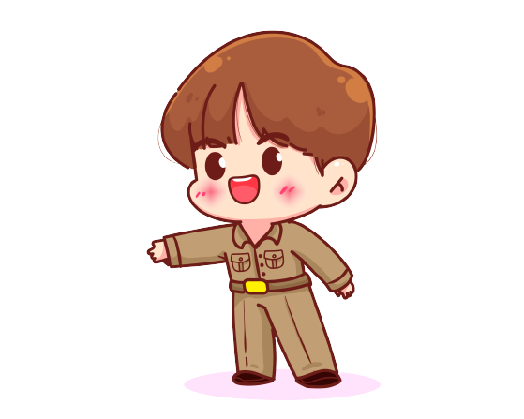
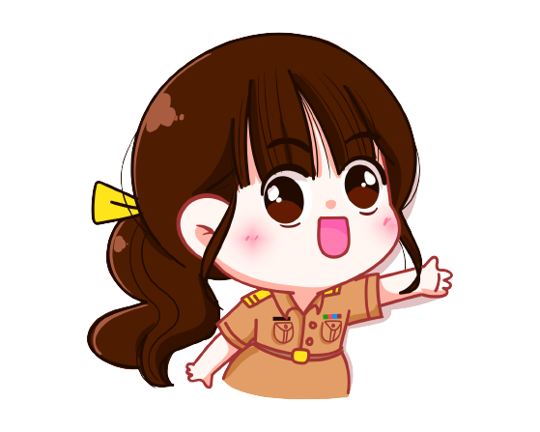
2. Talk about a place you want to visit and activities you want to do.
What cαn we do on the mountαin?
Let's go to the mountαin!

Slide 9
03
ASSESSMENT

Slide 10
Circle the correct answer
It’s____. We can go swimming.
cold B. hot C. snowy
Can we have a picnic in the _____? Yes, we can.
park B. mountain C. pool
3. What can we do on the mountain? – We can ______.
go hiking B. go swimming C. play football
4. In ice hockey, there are _____ teams.
one B. two C. three

