Slide 1


















Slide 2






Review 3
Part 1

Slide 3
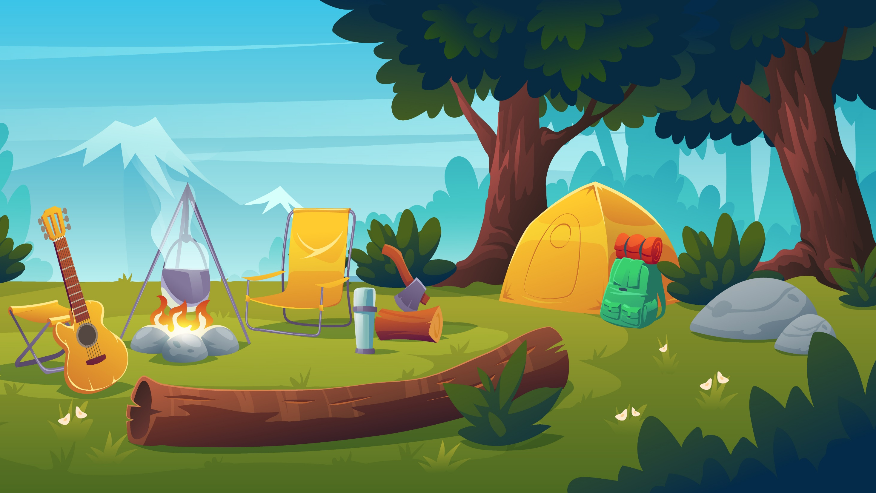
01
WARM-UP
Notes:
Bổ sung thêm bài hát sau slide warm up này

Slide 4

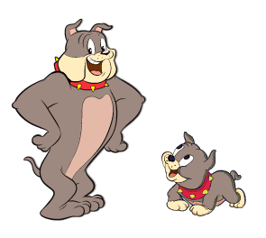
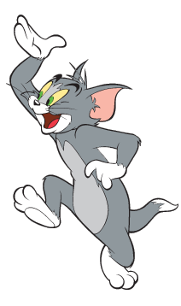
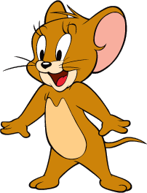
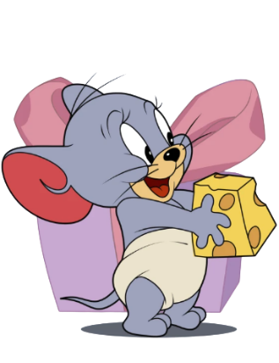
Tom and Jerry Puzzle!

Slide 5
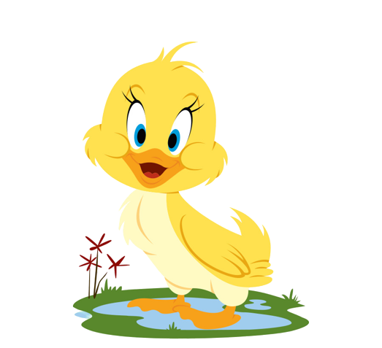
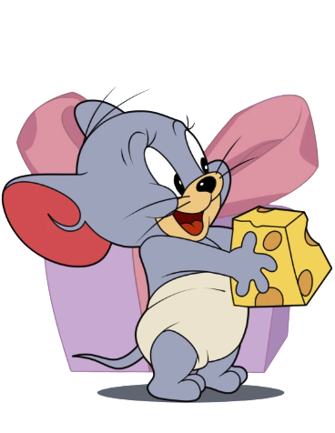
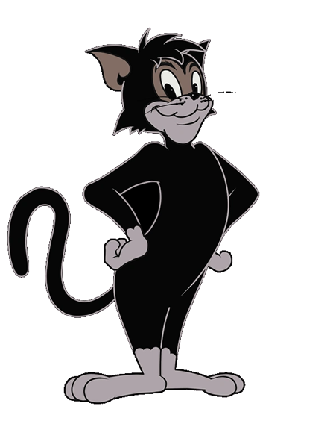
Pick A Character!
Next

Slide 6
What are they doing?
They are going fishing.
BACK

Slide 7
What are they doing?
They are making a campfire.
BACK

Slide 8
What is he doing?
He is playing ice hockey.
BACK

Slide 9
02
PRACTICE

Slide 10

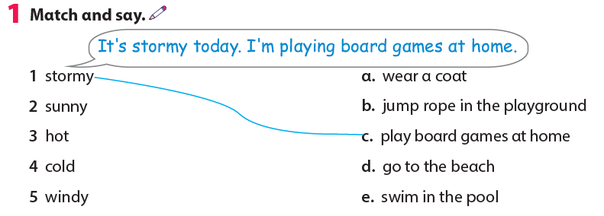

Slide 11
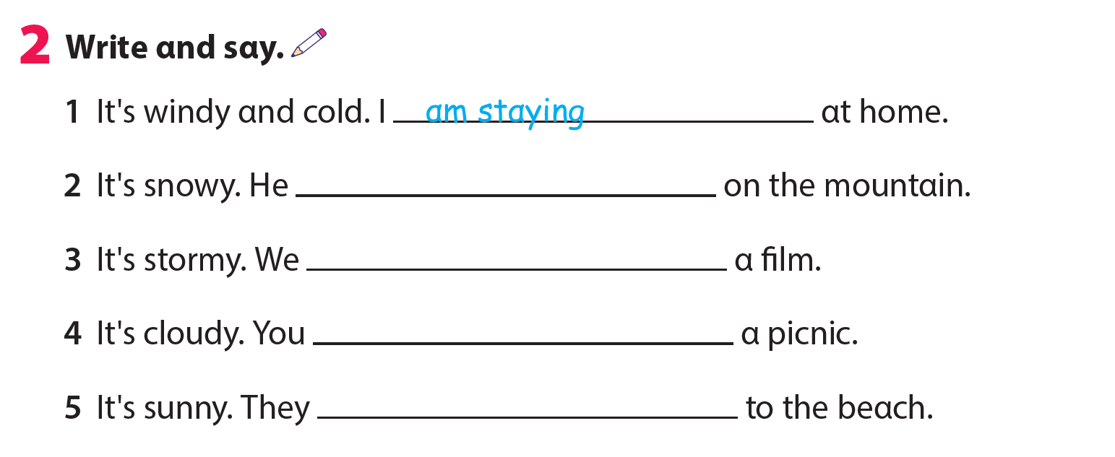
is skiing
are watching
are having
are going

Slide 12




Thank you & goodbye!

